Slide 1
ECE 8527 Final Project
Arpita das
May 08, 2023

Slide 2
Outline
Approach
Algorithms
Results

Slide 3
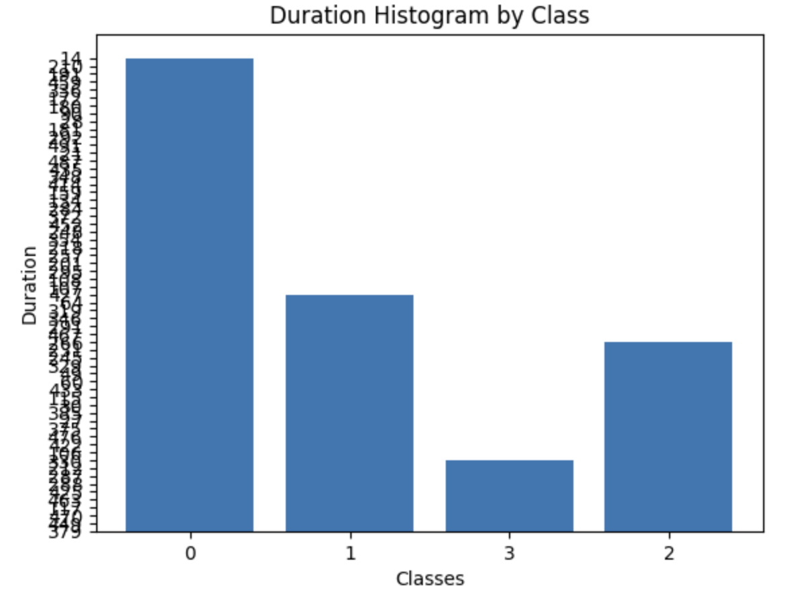
Problem Formulation and Observations
Given raw data and a series of time stamps with event classifications, build a machine learning model to segment the signal at the events and classify these events
Event data is encoded in rectangular pulses
The duration of these pulses follow a uniform distribution
Fourier spectrums are similar
Amplitude encodes information and is less obvious
Amplitude is dependent on number of pulses
The more time a particular class occurs, the more likely the data will take a higher amplitude value for that class

Slide 4
Feature: Duration?
Covariance of duration and mean for event sequences (Class 1):
[[1.00241546 0.01853951]
[0.01853951 1.00241546]]
Covariance of duration and mean for event sequences (Class 2):
[[1.00232558 0.09172686]
[0.09172686 1.00232558]]
Covariance of duration and mean for event sequences (Class 3):
[[1.00264550e+00 6.88504379e-05]
[6.88504379e-05 1.00264550e+00]]
Covariance of duration and mean for event sequences (Class 4):
[[ 1.00238095 -0.03181031]
[-0.03181031 1.00238095]]

Slide 5
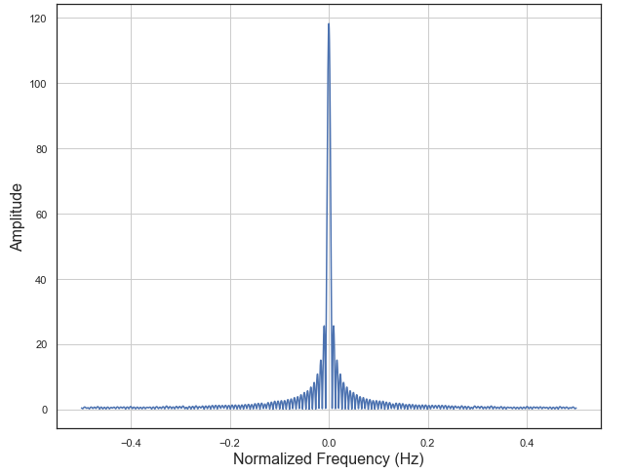
Feature: Frequency?

Slide 6
General Architecture (k-means + LSTM)
Normalized features
Binary Signal
Preprocess Data
K-means
1st order derivation (start and stop times)
Quantized features
Amplitude sequence extraction
Timestamp extraction
LSTM
Decoded Sequence
True sequence
Baum-Welsh algorithm
Results Analysis

Slide 7
General Architecture (Autoencoder + LSTM)
Normalized features
Binary Signal
Preprocess Data
Autoencoder
1st order derivation (start and stop times)
Quantized features
Amplitude sequence extraction
Timestamp extraction
Training Procedure:
Discretize labels
LSTM
Decoded Sequence
True sequence
Baum-Welsh algorithm
Results Analysis

Slide 8
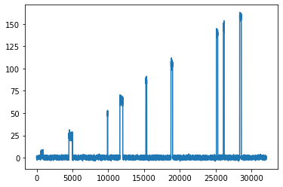
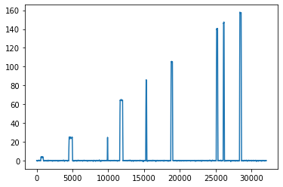
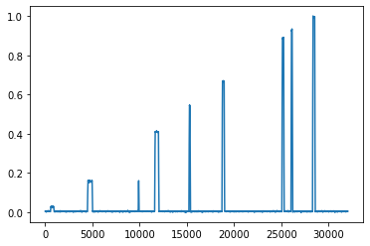
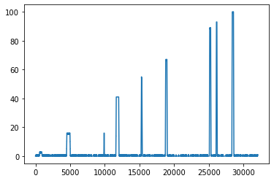
Preprocessing
Read Raw
Smoothing filter
Normalize
Quantized

Slide 9
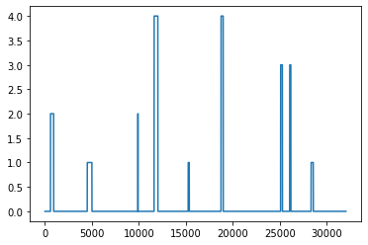
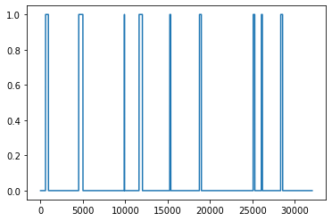
Preprocessing
Labeled Signal
Discretize

Slide 10
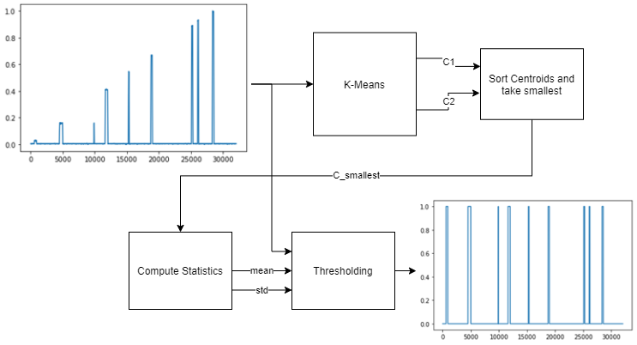
Segmentation (K-Means)

Slide 11
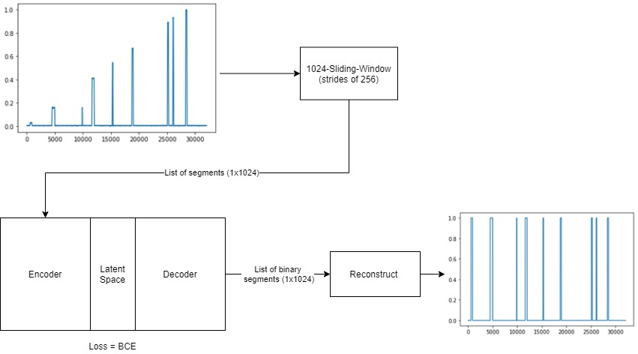
Segmentation (Autoencoder)

Slide 12
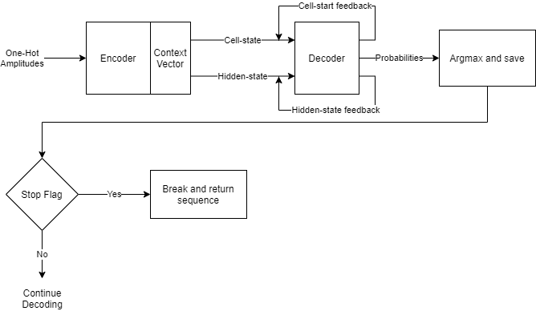
Sequential Decoding (LSTM)

Slide 13
Optimization
Optimize the LSTM first using the annotated data provided in training
amount of quantization (equivalent to varied vocabulary size )
Varied number of internal nodes
LSTM
Quantization | # of Nodes | Error (in %)
100 | 32 | 7.38
100 | 16 | 8.92
50 | 32 | 8.97
25 | 32 | 8.10

Slide 14
Optimization
Optimize the autoencoder + LSTM by changing autoencoder parameters
Only optimize autoencoder once LSTM is already optimized
Varied loss function
Autoencoder
Parameter | Error (in %)
MSE | 16.46
BCE | 14.66

Slide 15
Results

Slide 16
Conclusions
Both segmentation algorithms used the same LSTM
Autoencoder received higher false positives on the dev set (18.33%)
K-Means received lower false positives on the dev set (11.22%)
Based on statistical significance, the K-Means approach has statistical significance using a confidence of >80%
Given that K-Means is much less expensive with lower false positives, the hybrid approach is more viable.
A testament to Occam’s Razor!

