Slide 1
Final Project
James Brodovsky | ECE 8527 | Spring 2023

Slide 2
Approach
How to relate a feature vector of (time, amplitude) to event label (start, stop, class)?
Previous approaches in class have been geared towards single-point labeling
Break out into two sub-problems: point by point classification and clustering.

Slide 3
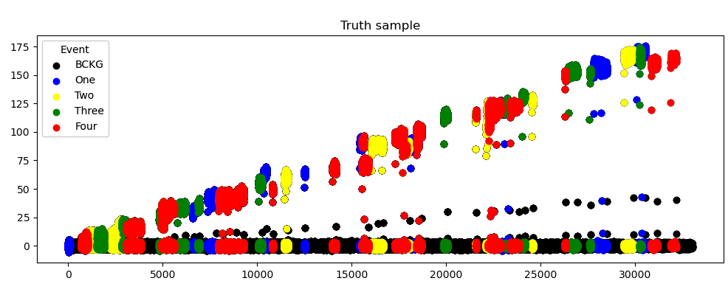
Data examination
Are there any obvious trends in the truth data that lend itself towards a classifier?
Amplitudes and class?
Duration and class?
Start time and class?
Sequence?
Any trends in the data that should be normalized or filtered?
250,000 samples plotted
Clear linear trend
No class label trend
Substantially more background noise points than events

Slide 4
Preprocessing
At a bare minimum, “normalize” the class content of the dataset
Normalize the amplitude to be between -1 and 1 by dividing by maximum value in the data (~204)

Slide 5
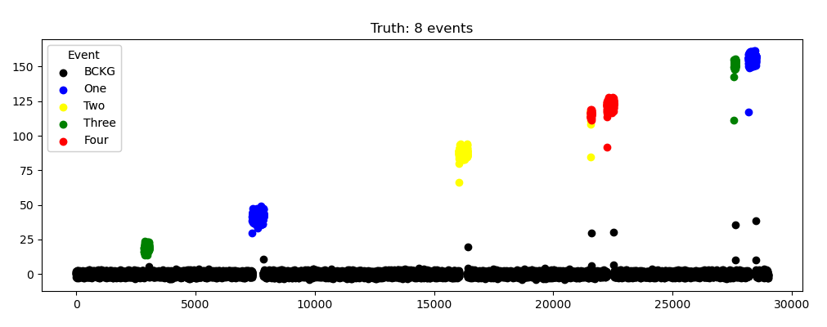
Clustering method: DBSCAN
Notes:
Plotted data with associated class colorations. Lots of background noise, but events specifically tend to be at higher amplitudes over 10. I can visually see 7 clusters so it appears that events so a simple clustering mechanism should be sufficient to segment the data.

Slide 6
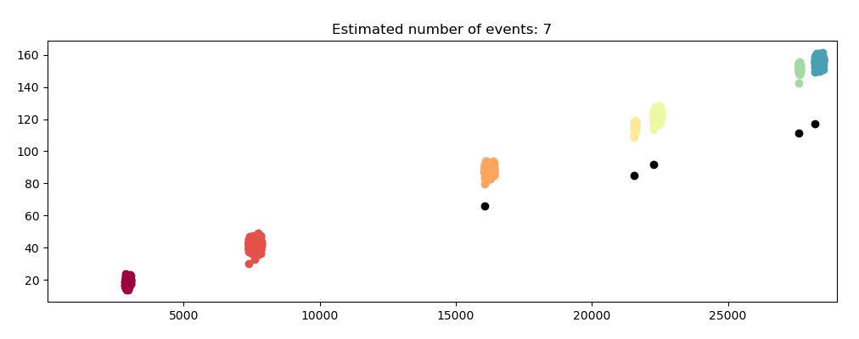
Clustering method: DBSCAN
Notes:
I chose DBSCAN as my clustering method. DBSCAN is a density-based clustering algorithm that works on the assumption that clusters are dense regions in space separated by regions of lower density. DBSCAN successfully got 7/8 of the classes from this sample.
Clusters now come in the form of a list of points all with a time, amplitude, and classification. Start and stop times are easily resolved by finding the minimum and maximum time value. I took overall cluster classification by taking the mode of the point-by-point class.

Slide 7
Classification methods
No obvious trend or segmentation that yields a good decision surface.
Classifier One: Random Forest
Classifier Two: Convolutional Neural Network

Slide 8
Random Forest
Used SciKit Learn implementation
Initially trained on un-normalized and default parameters: memorized training set
Class-normalization and min_samples_split=2, min_samples_leaf=5
Training score (normalized): 0.7337
Whole set: 0.9689

Slide 9
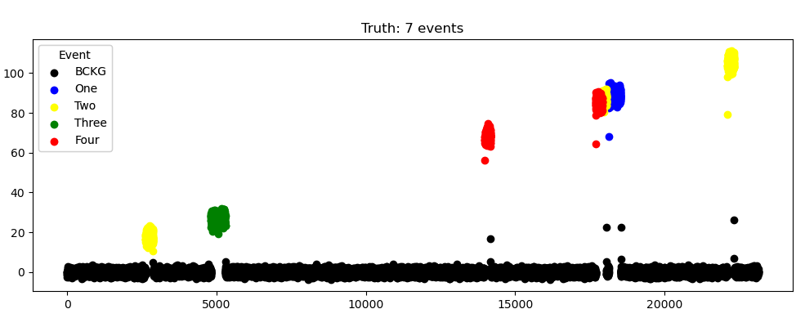
Random Forest

Slide 10
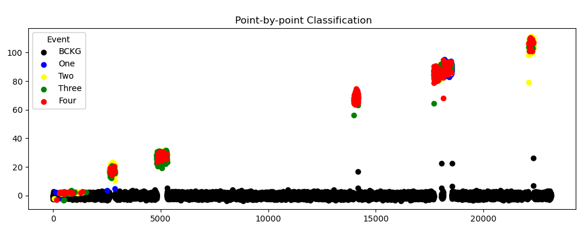
Random Forest

Slide 11
Random Forest
Predicted Events
Actual Events
2626, 2879, 2
4814, 5291, 3
13984, 14179, 4
17695, 18057, 4 ***
missing
18128, 18532, 2
22110, 22332, 2
2626, 2879, 2
4814, 5291, 3
13984, 14179, 4
17694, 17910, 4
17911, 18057, 2
18127, 18532, 1
22109, 22332, 2

Slide 12
Convolutional Neural Network
Simple architecture: two convolutional layers followed by four hidden layers and an output layer
ReLU activation with 25% dropout on the hidden layers.
Softmax output

Slide 13
Convolutional Neural Network
Some additional data pre-processing:
Normalized all the input amplitudes to be from (-1,1)
Read in raw files to a (N, 2, max_length) array
Converted array to data loader which read in 100, 2 by 25 data samples.

Slide 14
Convolutional Neural Network
Trained with Cross Entropy loss due to class-based labeling and Adam optimization
Pipeline successfully executed but failed to train
Likely causes
Focusing on chunks of data rather than events
Not supplying enough data to the CNN

Slide 15
Results
 | Train | Dev | Test
Random Forests + DBSCAN | 77.04 | 82.77 | TBD
CNN + DBSCAN | N/A | N/A | N/A

