Slide 1
ML Approach for EEG Signal Classification
using CNN and Random Forest models
Anway Bose 05/08/2023

Slide 2
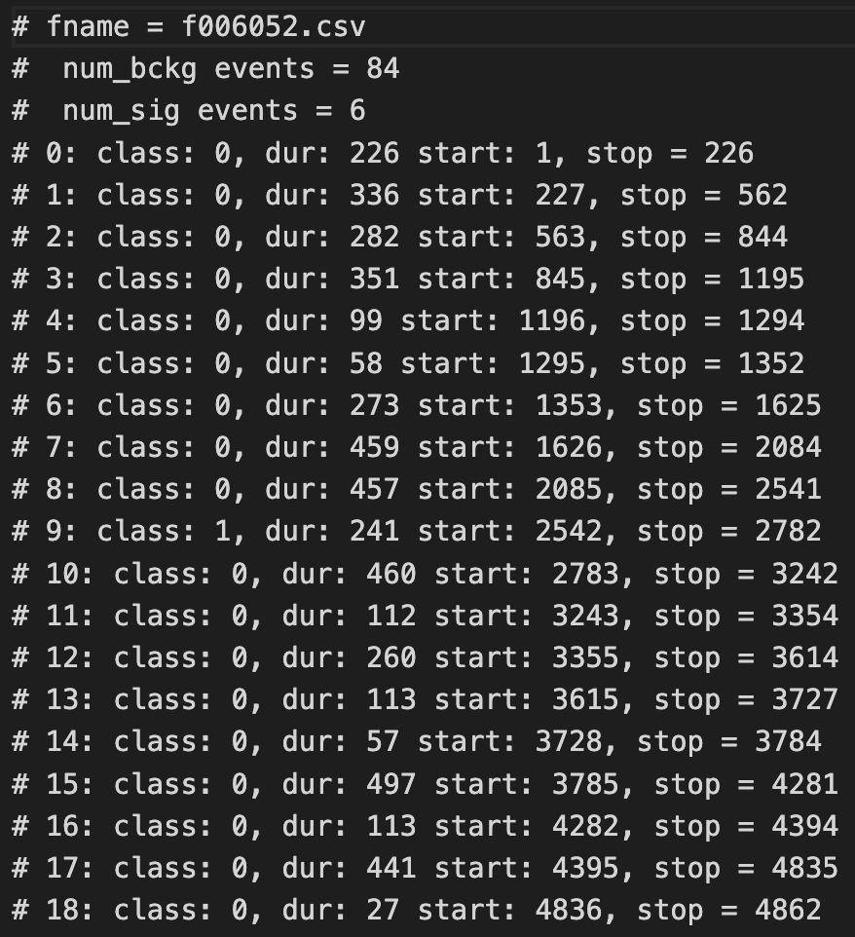
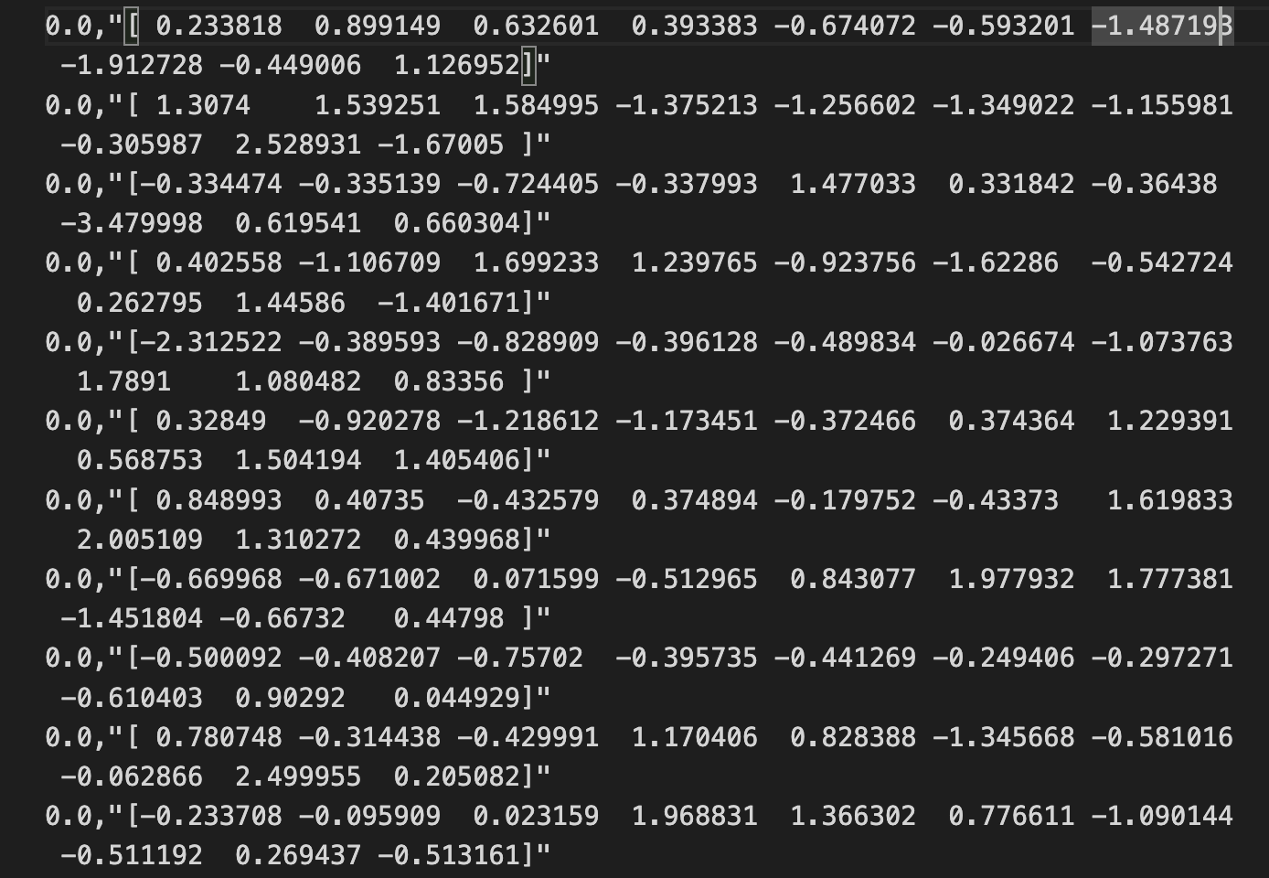
Data resampling and redefining

Slide 3
Algorithm 1: CNN
Motivation

Slide 4
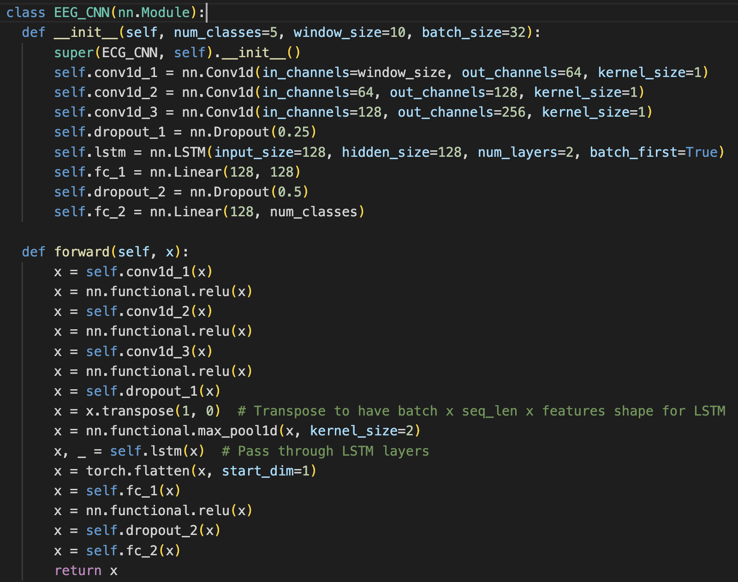
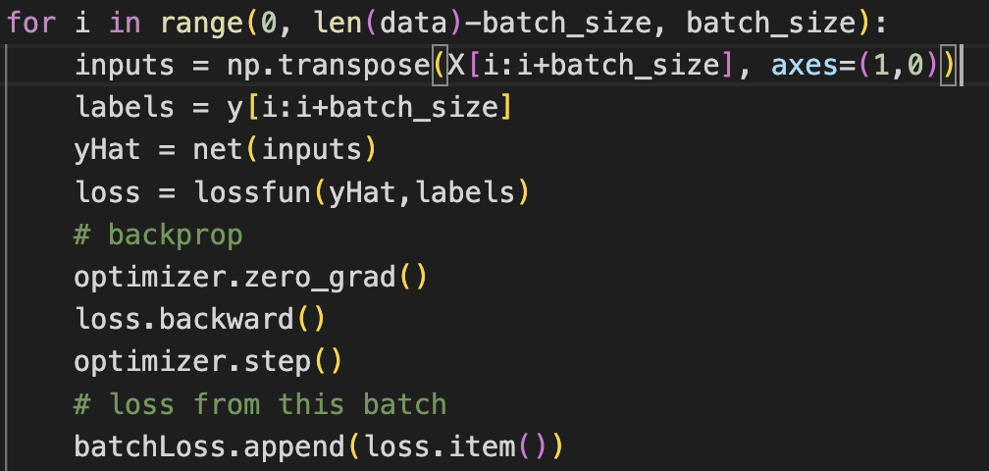
Algorithm 1: CNN

Slide 5
Algorithm 2: Random Forest

Slide 6
Results

Slide 7
THANK YOU

