Slide 1
ECE 8527 Final Project: SVM, RNF, and LSTM Approach
John Bannan, May 8th, 2023

Slide 2
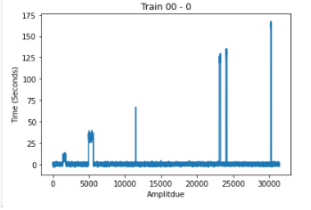
Data Set Introduction and Preprocessing
Data set contained sample amplitudes and time as well as class labels (0-4) and durations
Labeled all samples with appropriate class from label data with start and end times, loading each file
Used sliding window approach with size 11 across all the data sets and normalized data between 0 and 1 for uniformity and assigned class label based on the middle point.

Slide 3
Approach
Classify sample data points using start time, end time and class
Window Data and normalize
Classify Window using labelled middle point
Apply Window and Class Label to training using SkLearn or Keras (SVM, RNF or LSTM) - Encoder
Save model and apply to data sets - Decoder
Report class labels, start and end times for each window

Slide 4
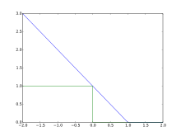
Support Vector Machine with Stochastic Gradient Descent
-SVM uses support vectors to create hyper planes, and then maximize the margin of the classifier for the optimal hyperplane
- Used SGD Sklearn library, allowed updates to hinge loss function as more data was presented, issue with .fit for other sklearn libraries, problem with updating with new data

Slide 5
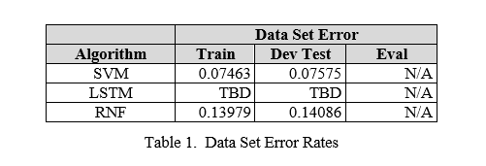
Results SVM
Most values classified were zero, low error rate, but mainly attributed to unbalanced label data of zero or error in code
Loss function is also typically used for binary data, although there is multiclass hinge functions
Parameters were constantly updated to optimize the SGD, so no other parameters were optimized

Slide 6
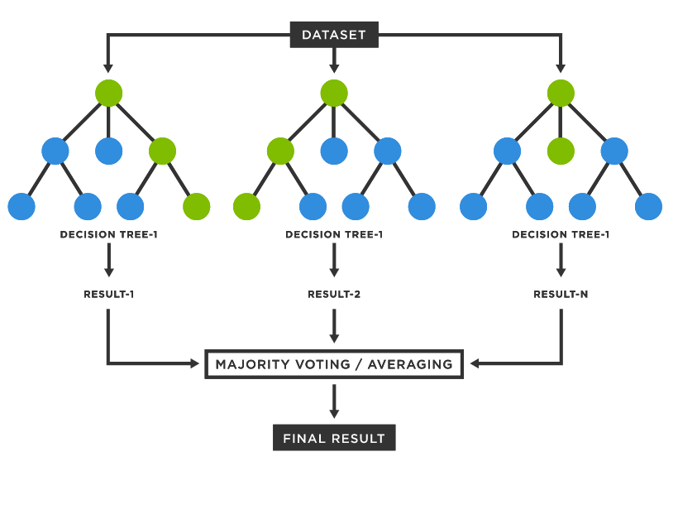
Random Forest
Uses a varied of decision trees and then uses a majority vote for classification
Applied RNF from Sklearn library, used warm_start and updated number of estimators for each iteration of fit

Slide 7
Results - Random Forest
Error rate seems double that of SVM
However output csv files seem to agree with expected output rather than all zeros as in SVM
Value for number of estimators was not optimized because it was updated each iteration

Slide 8
Long Short Term Memory Network
A type of Recurrent Neural Network (RNN) which contains memory cells that each contain an input gate, forget gate, and output gate.
Used the Keras library to build the LSTM network, used categorical cross entropy for multiclass and softmax activation function, dropout to prevent overfitting
Model fitted with 1 epoch, due to time constraints and 1 batch size, due to varying lengths of data

Slide 9
Results - LTSM
Likely would have been better with more computational power to train more epochs per data file
Parameters or structure could have been changed for more optimal performance

Slide 10
Thank you!

