Slide 1
ECE8527 Final Project
Fall 2023
Mahdi BAbaei

Slide 2
EEG Signal Segmentation
Problem: The aim of this task is to utilize machine learning methods to analyze raw time-series data by segmenting it to identify events, and then classify each event into one of five classes, consisting of a background class and four event classes.
Data: The provided training dataset consists of 10,000 signals, each containing significant information. Each training file comprises two parts. The first section includes the start and end times of events along with their corresponding class values. The second section is a 1D feature represented by a series of floating-point numbers, which highlights the pulses in the signal.
The signals recorded in the files are primarily sparse, indicating that the majority of the data in each file is noise in the background, and the events are not frequent.

Slide 3
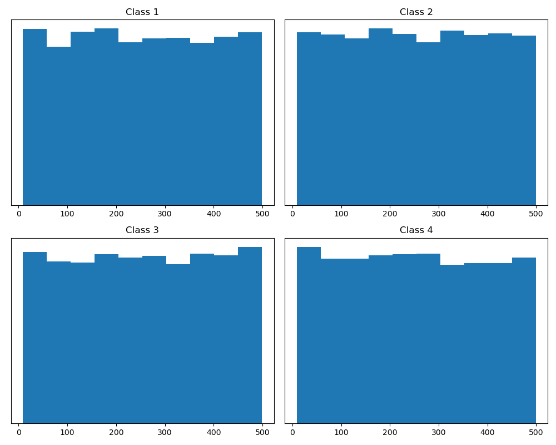
Observations
Amplitude of events durations is uniform distribution
This makes it challenging to draw any assumptions about pulse duration

Slide 4
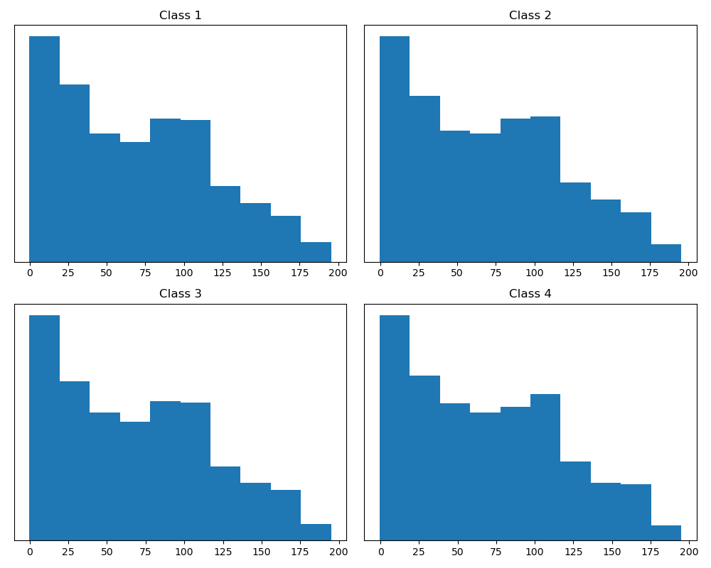
Observations
Amplitude of events pulse strength
relying solely on pulse strength (feature values) will not yield useful information

Slide 5
The Basic Approach
splitting the task into two parts:
developing a model capable of distinguishing between background noise and the event classes
developing a model to classify the events into their respective classes.

Slide 6
First Approach: RNF + LSTM

Slide 7
RNF + LSTM
First Step: Training the RNF
Reading the data:
Using window size of 40 and stride of 20
Considering all non-zero labels as 1
Reading the data using window and stride
Set the labels based on major class inside each window
Train the RNF with the produced data
Use less complex model (lower number of trees and depth)

Slide 8
RNF + LSTM
Second Step: Training the LSTM
Reading the data:
Using window size of 40 and stride of 20
Reading the data using window and stride on each event
Set the labels based on event class
Use zero-padding if needed
Train the LSTM with the produced data
Employ class weight technique (over-sampling and under-sampling)
Fine tuning the parameters based on dev set results

Slide 9
RNF + LSTM
Third Step: Evaluation
Reading the data:
Using window size of 40 and stride of 20
Use zero-padding if needed at the end of signal
Feed the data to RNF
Postprocessing the output considering the overlapping

Slide 10
RNF + LSTM
Third Step: Evaluation
Reading the data (only event parts):
Using window size of 40 and stride of 20
Use zero-padding if needed at the end of events
Feed the data to the LSTM
Postprocessing and Smoothing the output considering the overlapping

Slide 11
Second Approach: MLP + LSTM

Slide 12
MLP + LSTM
First Step: Training the MLP
Reading the data:
Using window size of 40 and stride of 20
Considering all non-zero labels as 1
Reading the data using window and stride
Set the labels based on major class inside each window
Train the MLP with the produced data
Fine tuning the parameters based on dev set results

Slide 13
MLP + LSTM
Second Step: Training the LSTM
Reading the data:
Using window size of 40 and stride of 20
Reading the data using window and stride on each event
Set the labels based on event class
Use zero-padding if needed
Train the LSTM with the produced data
Employ class weight technique (over-sampling and under-sampling)
Fine tuning the parameters based on dev set results

Slide 14
MLP + LSTM
Third Step: Evaluation
Reading the data:
Using window size of 40 and stride of 20
Use zero-padding if needed at the end of events
Feed the data to MLP
Postprocessing the output considering the overlapping

Slide 15
MLP + LSTM
Third Step: Evaluation
Reading the data (only event parts):
Using window size of 40 and stride of 20
Use zero-padding if needed at the end of signal
Feed the data to the LSTM
Postprocessing and Smoothing the output considering the overlapping

Slide 16
Thank You

