Slide 1
Signal Classification
Final project
ECE 8527
Keren Zhao

Slide 2
Content
Introduction
Algorithm
Data Treatment
Result
Further develop the system
Acknowledgement

Slide 3
Introduction
 | #Sample | Class 0 | Class 1 | Class 2 | Class 3 | Class 4
Full train data | 105,052 | 49,544 | 13,536 | 14,094 | 13,983 | 13,895
Selected train data | 20,000 | 9,433 | 2,638 | 2,740 | 2,589 | 2,600
To classify the univariate time series data
Convolutional neural network (CNN)
&
Image processing
Ideal:
Least computing resource, high accuracy
Avoid unnecessary reading, learning … …
Least pre processing, low effort in developing functionalities;
When the computer breakdown, the data can be used in the new round

Slide 4
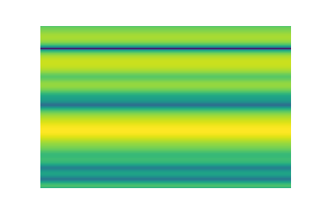
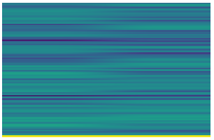
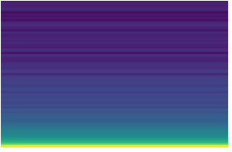
Data Treatment
Data clean
The univariate time series data
3-dimentional data (spectrogram)
Class 0
Class 1
Class 2
Class 3
Class 4

Slide 5
Algorithm
Convolutional layers (2D,32)
Activation function: ReLU
MaxPooling layer
Detecting peaks
Convolutional layers (2D, 64)
MaxPooling layer
Convolutional layers (2D, 64)
Activation function: ReLU
Activation function: ReLU
Convolutional neural network (CNN)
ReLU as activation function
MaxPooling layer was used
Background as a class
Flatten layer
Dense layer (ReLU)
Dense layer (5)
Optimizer (adam)

Slide 6
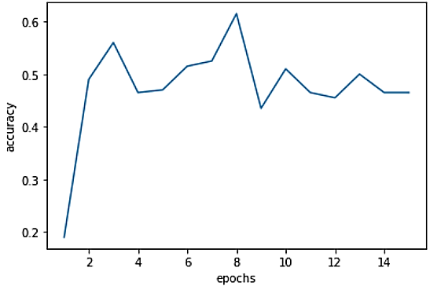
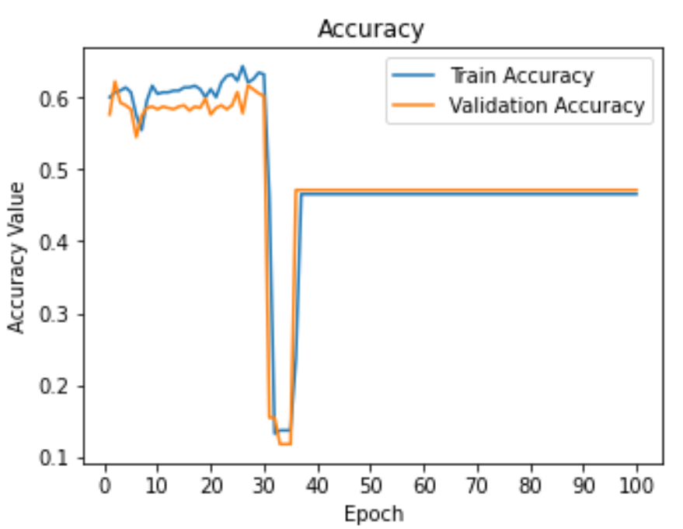
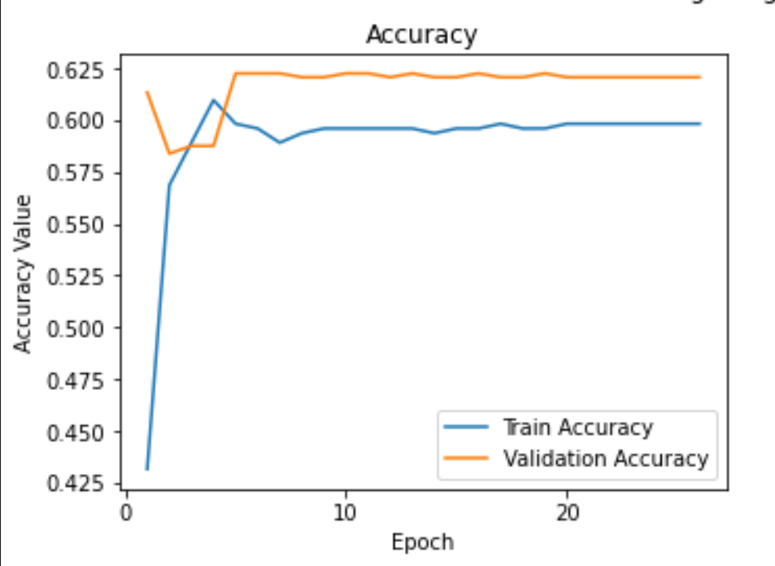
Result
15 epochs
200 train(
Sadly, there are still something I can not understand;
The train and validation accuracy are similar, which means the model is not over trained;
I am doing good
100 epochs
438 train
543 dev
26 epochs
438 train
543 dev

Slide 7
Further develop the system
Get a better computer
Time window, for both training and prediction
Find the segment first instead of a moving window
Ratio of classes (for the evaluation, is there going to be 0 class?)

Slide 8
Acknowledgement
Dr. Joseph Picone
Mohammand Najjartabar Bisheh
Labmates
Classmates

