Slide 1
ECE-8527 Final Exam
Spring 2022
Richard Sand
Department of Electrical and Computer Engineering, Temple University
richard.sand0001@temple.edu
April 29, 2022

Slide 2
Project Overview
Objectives:
  Project Overview
  Challenges
  Approach
  Initial Results
  Current State
  Next Steps
Resources:
  Development Tools
  Helpful Articles

Slide 3
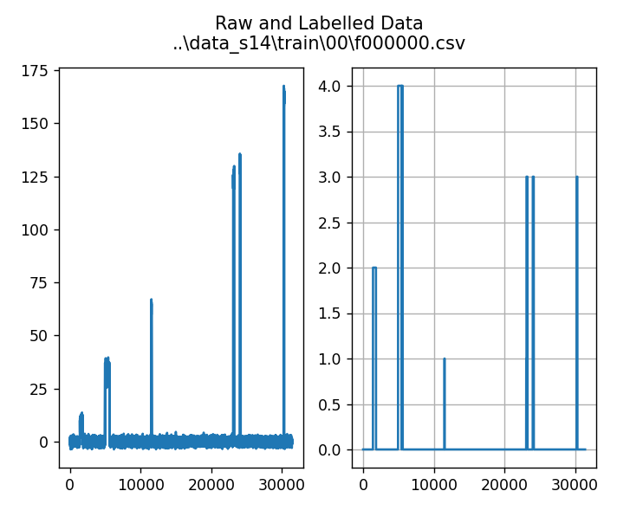
Project Overview
Time sequence data
5 classes, 0-5
  Class 0 is background noise
Visual inspection - What is this data?
  Low grade noisy data
  Noticeable spikes
  Spikes have varying amplitude, durations

Slide 4
What could it be?
SETI?
Underwater whale sounds?
Solar radiation?
Something evil that Dr. Picone dreamed up at 25 or 6 to 4?

Slide 5
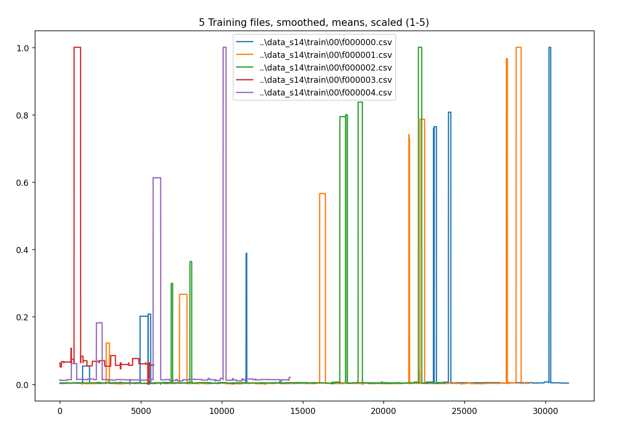
Understanding the data
Square waveforms
Little overlap
Cleans up nicely!

Slide 6
Training Process
Identify the start and end of each event
Take event duration and amplitude as 2D, classified data
Preprocess data
Apply learning algorithm to TRAIN
Calculate error rate
Minimize error
Adjust parameters to optimize DEV

Slide 7
Approach
Iterate over training data to find likely events
  Normalized the data using the Zach method (patent pending)
  Using a window of 1, i.e. comparing the current sample to the previous, detected upward deltas over a certain % threshold (0.1)
  Then detected the corresponding drop to complete the event
  Danger Will Robinson! This approach did NOT work well on the evaluation data
Train on the training dataset, tune for the dev dataset, then evaluate
Two traditional (i.e. non-neural network) algorithms
  K-Nearest Neighbor (KNN)
  Random Forest (RNF)
One NN approach
  Multilayer Perceptron (MLP)

Slide 8
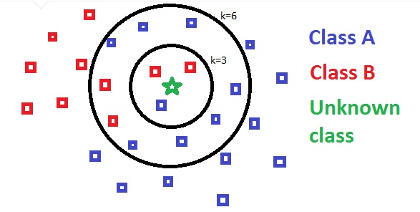
Algorithms - KNN
KNN (K-Nearest Neighbor)
Supervised classification
  distance from new data point to identify N nearest samples
  typically Euclidian distance
  majority vote determines classification of new data
from sklearn.neighbors import KNeighborsClassifier

Slide 9
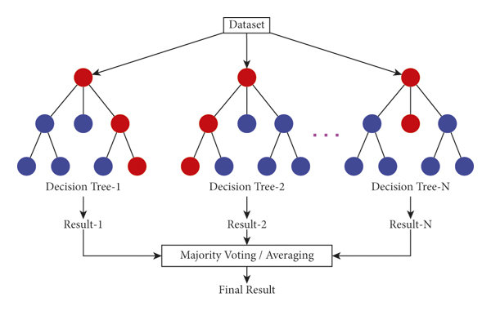
Algorithms - RNF
RNF (Random Natural Forest)
  “Ensemble” learning method
  Multiple decision trees
  Majority vote
  Varied number of estimators
from sklearn.ensemble import RandomForestClassifier

Slide 10
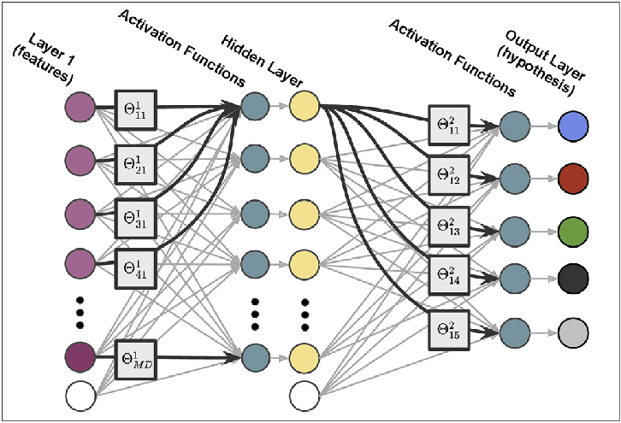
Algorithms - MLP
MLP (Multilayer Perceptrons)
  ISIP / PyTorch / the Nabila method (patent also pending)
  Network with 3 layers of linear transformation (torch.nn.Linear)
  Dropout function between each transformation (torch.nn.Dropout).
  Rectified linear unit activation function (torch.nn.ReLU)
    y = x for x > 0 and y=0 for x ≤ 0
  Cross entropy loss function (torch.nn.CrossEntropyLoss).
Notes:
Dropout: When a large feedforward neural network is trained on a small training set, it typically performs poorly on held-out test data. This "overfitting" is greatly reduced by randomly omitting half of the feature detectors on each training case. This prevents complex co-adaptations in which a feature detector is only helpful in the context of several other specific feature detectors. Instead, each neuron learns to detect a feature that is generally helpful for producing the correct answer given the combinatorially large variety of internal contexts in which it must operate. Random "dropout" gives big improvements on many benchmark tasks and sets new records for speech and object recognition. (Geoffrey E. Hinton, 2012)
Loss functions: measure the error between a given output and a target value. It tells how close the algorithm model is from the expected outcome.
Other loss functions, like the squared loss, punish incorrect predictions. Cross-Entropy penalizes greatly for being very confident and wrong. (Opidi, PyTorch Loss Functions: The Ultimate Guide, 2021)

Slide 11
Initial Results
 | KNN | RNF | MLP
/train | 0.2366 | 0.0546
/dev | 0.3557 | 0.3572
notes | Best training result at n= 3 Best dev result at n= 11 | Best training result at n= 49 Best dev result at n= 11
The KNN method was fractionally better than the RNF, and RNF has a randomness factor. But RNF was significantly better than the KNN on the training data. Therefore, I chose to use the RNF algorithm on the evaluation data.

Slide 12
Current Status
The event detection method I used for training does not work well on the eval data
  To correct, I applied a low-pass filter
  Tested several increments to the activation threshold
  These improved the results somewhat, but not enough
  Most files would be missing an event or two, and a few files would have multiple times more
  Basically, I need to widen the window as instructed
MLP not run yet
Need to save results in specified HYP format

Slide 13

A Very Important Lesson

Slide 14

Because if you DON’T…

Slide 15
Next Steps
Parameterize and widen the event detection window
Wire in the MLP implementation from HW 13
Save results in specified HYP format
Run scoring app on evaluation results
Turn in document
Sleep until at least June

