Slide 1
ECE8527 Final Project
Spring 2022
Michael Samarco

Slide 2
Outline
Approach
Algorithms
Performance Summary

Slide 3
Initial Approach: Conduct a Feature Search
Do analysis on data and see if anything stands out (any patterns?)
Are there any additional measurement, other than the raw samples, that could be leveraged in classification?

Slide 4
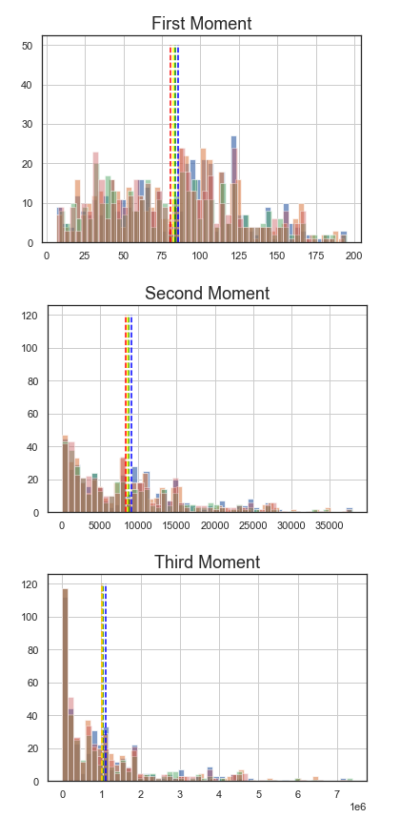
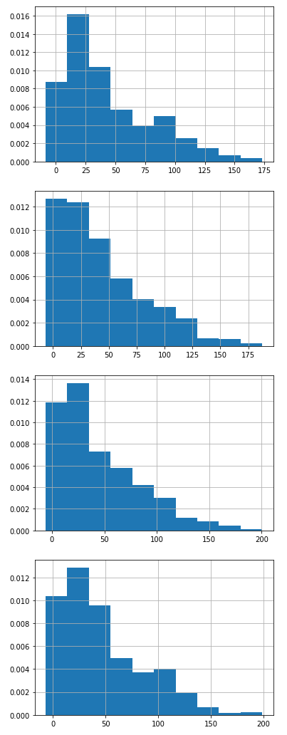
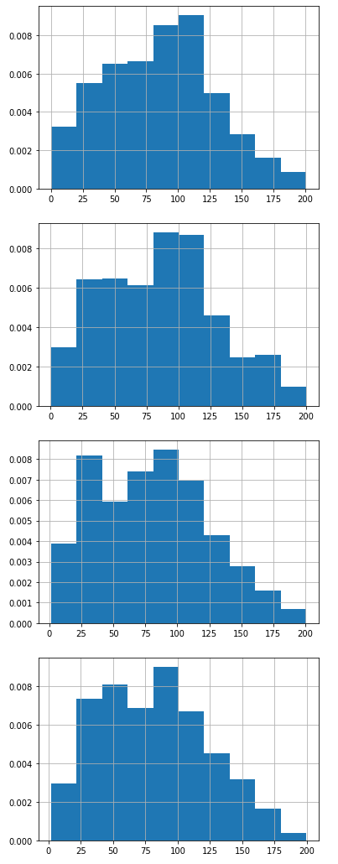
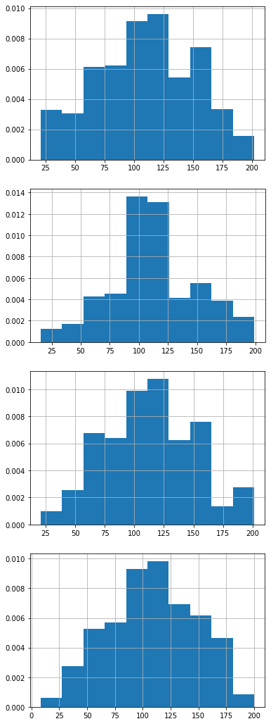
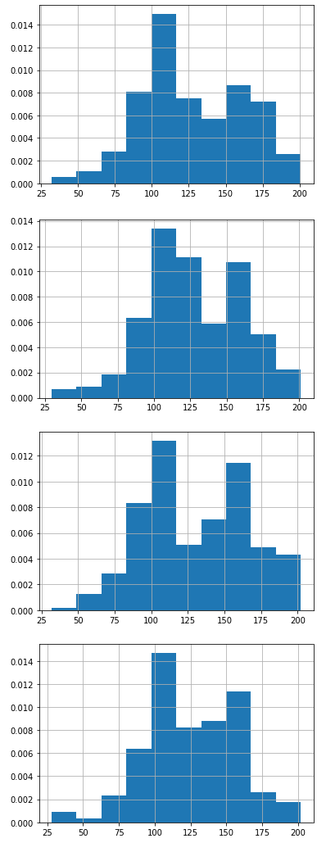
Feature: Amplitudes?
1st Occurrence
2nd Occurrence
3rd Occurrence
4th Occurrence

Slide 5
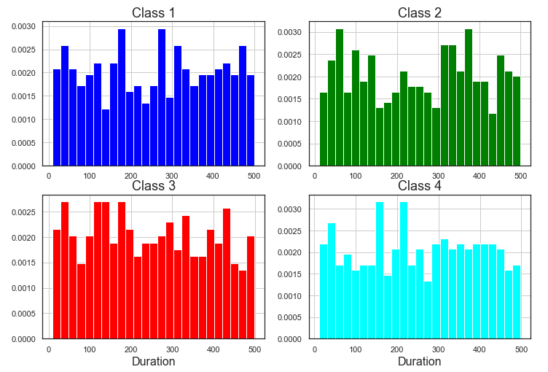
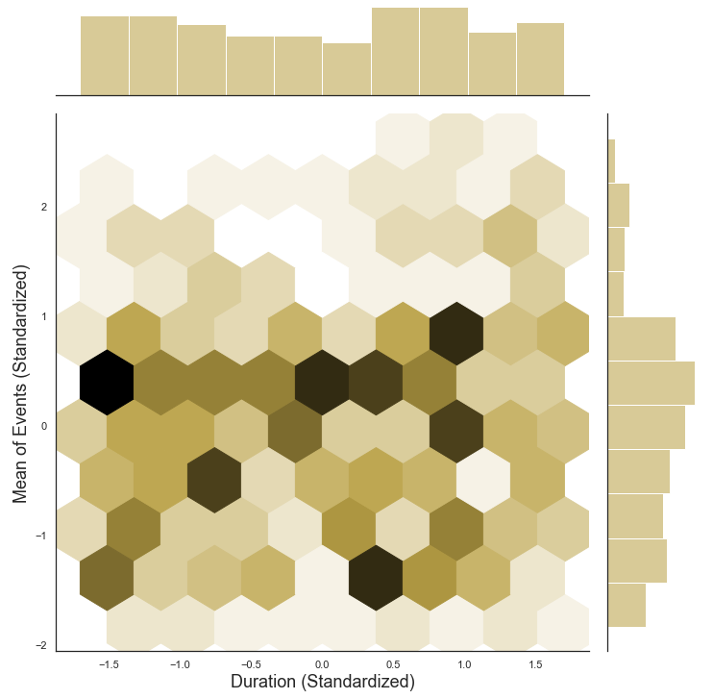
Feature: Duration?
Covariance of duration and mean for event sequences (Class 1):
[[1.00241546 0.01853951]
[0.01853951 1.00241546]]
Covariance of duration and mean for event sequences (Class 2):
[[1.00232558 0.09172686]
[0.09172686 1.00232558]]
Covariance of duration and mean for event sequences (Class 3):
[[1.00264550e+00 6.88504379e-05]
[6.88504379e-05 1.00264550e+00]]
Covariance of duration and mean for event sequences (Class 4):
[[ 1.00238095 -0.03181031]
[-0.03181031 1.00238095]]

Slide 6
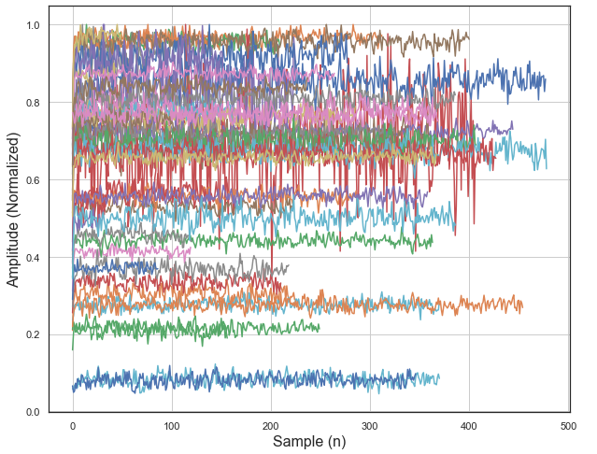
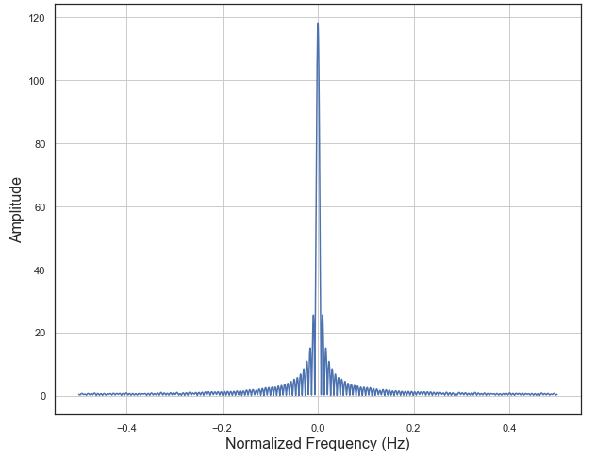
Feature: Frequency?

Slide 7
Algorithm/Classifier Choice
Conclusion: it appears to be a challenge to manually find distinguishable features and a time consuming process for these dataset
Any Algorithms that do well in feature discovery?
Random Forests Classifier (decision trees)
Neural Networks
Particularly, Convolutional Neural Networks (CNN) seem to do well with sequential data

Slide 8
Classifier 1: Random Forests

Slide 9
Classifier 1: Random Forests
Steps to train and classify Random Forests:
Get and group events samples and pair them with labels. In my case, I got events from 100 random files and for every background event (0), I only retained 10 of those samples (limit mem usage):
def getDat(fpaths, numFiles, bNorm=True, randFiles=False):
...
...
for i in range(len(eventList)):
if (eventList[i][1] == 0):
outDat.extend(eventList[i][1]*np.ones(10))
inDat.extend(np.array(frame.loc[(frame["n"] >= eventList[i][3]) &\
(frame["n"] < (eventList[i][3]+10))]))
else:
outDat.extend(eventList[i][1]*np.ones(eventList[i][2])) # input/raw data inDat.extend(np.array(frame.loc[(frame["n"] >= eventList[i][3]) &\
(frame["n"] <= eventList[i][4])]))
xTrain, yTrain = getDat(trainFiles, 100, bNorm=True, randFiles=True)
xDev, yDev = getDat(devFiles, 100, bNorm=True, randFiles=True)

Slide 10
Classifier 1: Random Forests
To try and get best performance out of Random Forests, optimize it. Do this by first randomly searching grid of params:
Test fitting on the random params:
# Create the random grid
random_grid = {'n_estimators': n_estimators,
'max_features': max_features,
'max_depth': max_depth,
'min_samples_split': min_samples_split, 'min_samples_leaf': min_samples_leaf,
'bootstrap': bootstrap}
rnf_model = RandomForestClassifier()
# Random search of parameters, using 3 fold cross validation,
# search across 30 different combinations, and use all available cores
rf_random = RandomizedSearchCV(estimator = rnf_model, param_distributions = random_grid,\
n_iter = 30, cv = 3, verbose=2, random_state = 42, n_jobs = -1)
# Fit the random search model
rf_random.fit(xTrain, yTrain)

Slide 11
Classifier 1: Random Forests
Based on best params from random grid search, search a more narrow set of params:
print(rf_random.best_params_)
from sklearn.model_selection import GridSearchCV
# Create the parameter grid based on the results of random search
param_grid = { 'bootstrap': [False],
'max_depth': np.arange(100,116,3),
'max_features': ['auto’],
'min_samples_leaf': [1],
'min_samples_split': [5],
'n_estimators': np.arange(25,40,3) }
# Create a base model
rf = RandomForestClassifier()
# Instantiate the grid search model
grid_search = GridSearchCV(estimator = rf, param_grid = param_grid,\ cv = 3, n_jobs = -1, verbose = 2)
# Fit the grid search to the data
grid_search.fit(xTrain, yTrain)
grid_search.best_params_

Slide 12
Classifier 1: Random Forests
Checking Accuracy of Model:
best_grid = grid_search.best_estimator_
# evaluate performance on 'optimized' param model
yPredBest = best_grid.predict(xDev)
best_acc = metrics.accuracy_score(yDev, yPredBest)
print(f"Accuracy (Optimized Model)={best_acc*100:.2f}")
Accuracy (Optimized Model)=46.18

Slide 13
Classifier 2: Convolutional Neural Networks

Slide 14
Classifier 2: Convolutional Neural Networks
Steps to train and classify CNN:
Resample events that occur in the files into fixed time step windows with dimensions: [num samples, num time steps, num features]
Read in Train and Dev data in the resampled format:
# collection of 10 event samples (eventList contains header info in file; the [3] defines event start index
inDat.append(np.array(frame["X"].loc[(frame["n"] >= eventList[i][3]) & (frame["n"] < eventList[i][3]+10)]))
trainX, trainY = packageFileDat(trainFiles, len(trainFiles)) devX, devY = packageFileDat(devFiles, len(devFiles))
n_timesteps, n_features, n_outputs = trainX.shape[1], trainX.shape[2], trainY.shape[1]

Slide 15
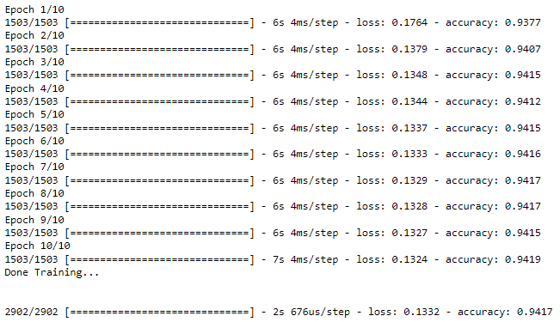
Classifier 2: Convolutional Neural Networks
Specify all of the layers in the CNN:
Fit Training Data to Model:
# specify CNN Layers
model = Sequential()
model.add(Conv1D(filters=64, kernel_size=5, activation='relu', input_shape=(n_timesteps,n_features))) model.add(Conv1D(filters=64, kernel_size=5, activation='relu’))
model.add(Dropout(0.4)) model.add(MaxPooling1D(pool_size=2))
model.add(Flatten()) model.add(Dense(100, activation='relu’))
model.add(Dense(n_outputs, activation='softmax’))
model.compile(loss='categorical_crossentropy', optimizer='adam', metrics=['accuracy'])
# fit network
model.fit(trainX, trainY, epochs=10, batch_size=500, verbose=1)
print("Done Training...\n\n")
# evaluate model
_, accuracy = model.evaluate(devX, devY, batch_size=50, verbose=1)

Slide 16
Classifier 2: Convolutional Neural Networks
For each file in the dataset, window in samples, 10 at a time (10 is my chosen time step size per sample) and predict on those windows. Classify and slide window by half window size at a time.
# predict the data in the windows
predP = model.predict(windowSamps)
predY = np.max(predP, axis=1) # max prediction/confidence
predY = np.repeat(predY,p)
predY = np.append(predY, np.repeat(predY[-1],p))
predC = np.argmax(predP, axis=1) # classification
predC = np.repeat(predC,p)
predC = np.append(predC, np.repeat(predC[-1],p))

Slide 17
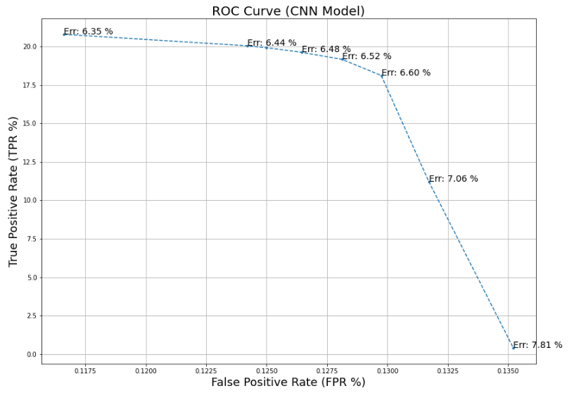
Performance Summary
Best Performance for my CNN classifier:
Error Rate: 6.35 %
True Positive Rate: 20.80 %
False Positive Rate: 0.12 %
Classifier | Error Rate
CNN | 6.35 %
RNF | 53.82 %

