Slide 1
KNN And MLP Approach for multiclass Sequence to Sequence Decoder Nazia Rahman
Rahman.nazia@temple.edu

Slide 2
Dataset Introduction:
1D signal (Amplitude vs time)
 | Training | Dev | Eval
Sample files | 10,000 | 2000 | 2000
Class | 0 (bckg) 1-4 (non-bckg) | 5

Slide 3
Data Preprocessing:
Sliding Window Approach
10000 Training data files, each of them are a sequence.
Create a Dataset for each data sequence:
Use a sliding window of length 10.
Assign a single label for each window. Dataset will have multiple rows ( which can be treated as multiple observations) , 10 columns (treated as features) and a single label for each observations.

Slide 4
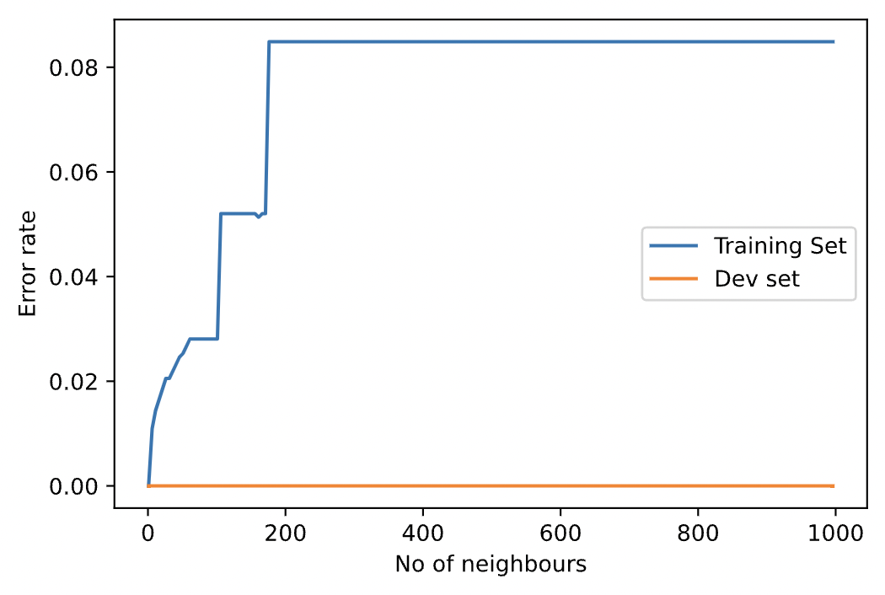
K-Nearest-Neighbors (KNN) Approach:
Choose the number of K neighbors
Based on distance measure approach take K nearest points as neighbors for the new data point
Assign the new data point to the category which is counted most in the neighbor
Selected value of K=3

Slide 5
Multilayer Perceptron Approach (MLP):
MLP is used to learn the relationship between the amplitudes within an window and its corresponding label.
Since we have 10 features of a dataset, so the input node of the network is set to 10.
And because we have 5 classes, number of output node is 5.
One hot encoder is used to categorize the labels.
Number of hidden layers and the nodes in each hidden layers are experientially set to 3 and 64 respectively.

Slide 6
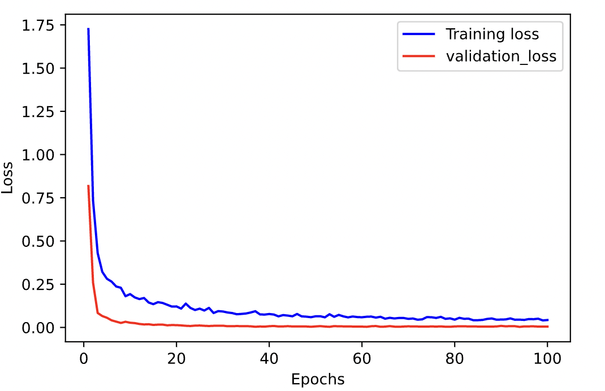
Multilayer Perceptron Approach (MLP):
For nonlinear activation function, ReLU is used in hidden layers, and softmax activation function in the output layer.
Categorical cross entropy loss function is used to train the network
Adam optimizer with a learning rate of 0.001 is used for minimizing the cost function.

Slide 7
Result
 | Dataset Error(%)
Algorithm | Train | Dev | Eval
MLP | 5.60 | 5.65
KNN | 0.68 | 0

Slide 8
Data Postprocessing:
Determination of start and stop time
Output of both of the algorithms are predicted labels.
Initially, start time is set to 0
Then two consecutive labels are checked.
If tow consecutive labels are different, the previous sequence stopped. So, we get a stop time.
The start time will be updated for next sequence.
Repeat

Slide 9
Conclusions
In between MLP and KNN, better performance is observed for MLP
Still there is some issue in training the model in KNN approach which is based on batched training. Performance evaluation will be better if the debugging was completed.

