Slide 1
ECE 8527 Final Project
Zachary Kane
April 29, 2022

Slide 2
Problem + Observations
Given raw data and a series of time stamps with event classifications, build a machine learning model to segment the signal at the events and classify these events
Event data is encoded in rectangular pulses
The duration of these pulses follow a uniform distribution
Fourier spectrums are similar
Amplitude encodes information and is less obvious
Amplitude is dependent on number of pulses
The more time a particular class occurs, the more likely the data will take a higher amplitude value for that class

Slide 3
Data Observations
This makes it very easy to confuse pulses
Image we get pulses of 10,20,20 with labels of 1,2,1
Assume that class1 usually has a starting amplitude of 9, and class2 has starting amplitude of 22
At t=0, it is most likely that the pulse takes class1
Next time we get class1, we expect an increase to its amplitude
At t=1, we get an amplitude of 20 but cannot distinguish its class since it could be class1’s second pulse or class2’s initial pulse (both are equally probable)
Decision at t=2 will depend on the amplitude as well as the previous classification
If t=1 was class1, then t=2 will be class2
If t=1 was class2, then t=2 will be class1

Slide 4
General Architecture (Hybrid)
Training Procedure
Evaluation Procedure

Slide 5
General Architecture (DNN)
Evaluation Procedure
Training Procedure

Slide 6
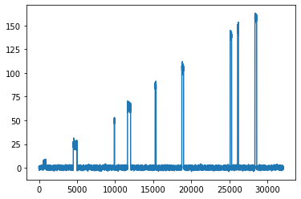
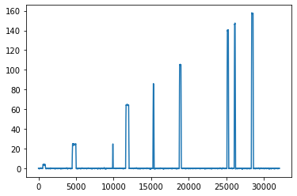
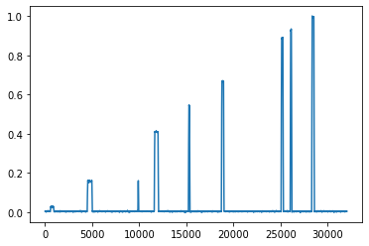
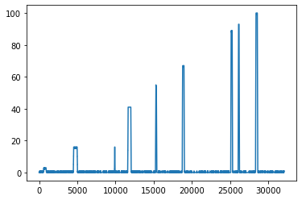
Preprocessing
Read Raw
Smoothing filter
Normalize
Quantized

Slide 7
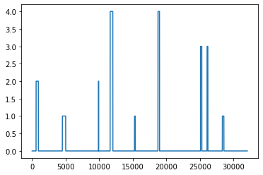
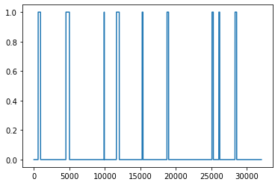
Preprocessing
Class | Start | Stop
0 | 0 | 1000
2 | 1000 | 1250
0 | 1250 | 4500
1 | 4500 | 5050
… | …. | ….
Labeled Signal
Discretize

Slide 8
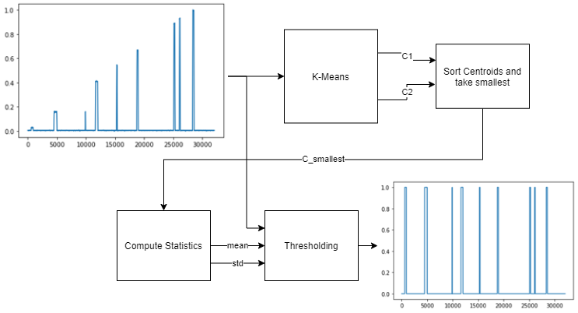
Segmentation (K-Means)

Slide 9
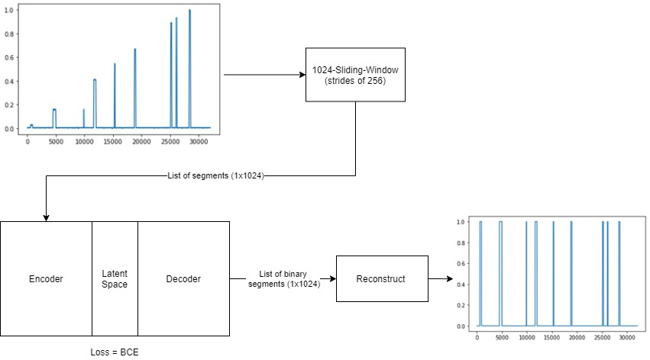
Segmentation (Autoencoder)

Slide 10
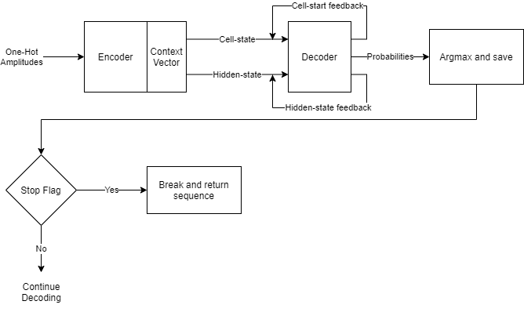
Seq2Seq (LSTM)

Slide 11
Optimization
Optimize the LSTM first using the annotated data provided in training
Varied vocabulary size (amount of quantization)
Varied number of internal nodes

Slide 12
Optimization
Optimize the autoencoder + LSTM by changing autoencoder parameters
Only optimize autoencoder once LSTM is complete
Varied loss function and compression

Slide 13
Results-Metrics

Slide 14
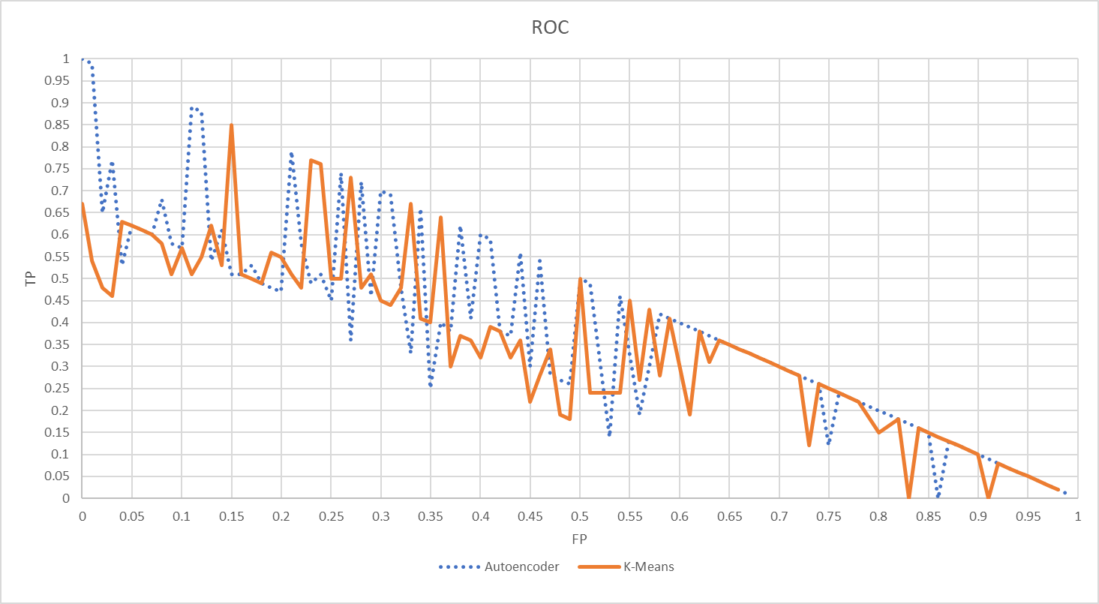
Results-ROC

Slide 15
Conclusions
Both segmentation algorithms used the same LSTM
Autoencoder received higher false positives on the dev set (17.16%)
K-Means received lower false positives on the dev set (10.64%)
Based on statistical significance, the K-Means approach has statistical significance using a confidence of >80%
Other metrics (accuracy, sensitivity, and F1) are not statistically significant, so we cannot rule one method being better than the other with respect to these metrics
Given that K-Means is much less expensive with lower false positives, the hybrid approach is more desirable
A testament to Occam’s Razor!

