Slide 1
Final Presentation:
CNN vs Simple Thresholding
Daniel Bici
Spring 2022

Slide 2
Introduction
Convolutional Neural Network: A simple application where the ability to learn a large number of filters in parallel that are specific to a training dataset under the constraints of a specific predictive modeling problem. It is designed to automatically and adaptively learn spatial hierarchies of features through a backpropagation algorithm. Great for time-series data.
Simple Thresholding: A type of evaluation method that determines a threshold for an evaluation score and treats the predictions differently depending on whether or not they score above the threshold.
Notes:
CNNs can also learn patterns within the time window

Slide 3
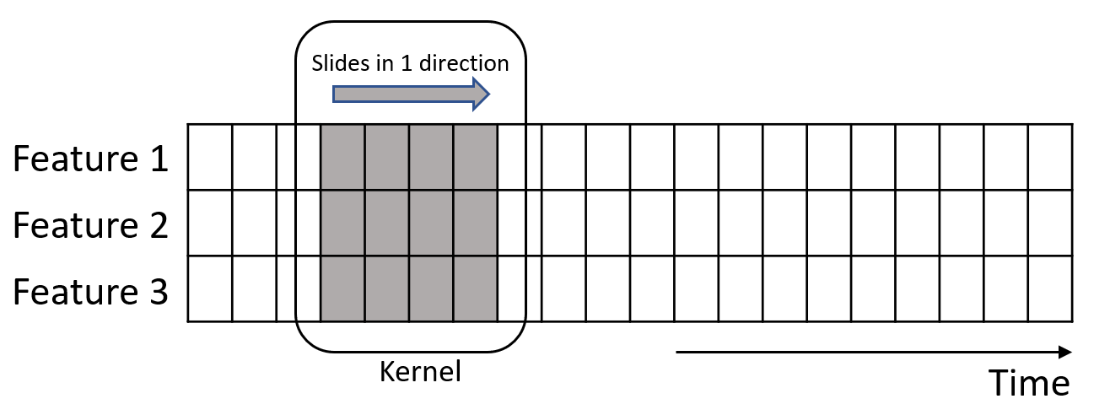
Convolutional Neural Network
Selected a frame duration roughly around the minimum expected duration of the event
Define, fit and evaluate a 1D CNN model
Adam version of stochastic gradient descent was used to optimize the network and calculate the cross entropy function of the class since it was built into PyTorch and appeared to have promising results
I calculated loss functions for the class, start, and stop by using Cross Entropy and MSE respectively
The learning rate was set to 0.002 with 200 epochs and a batch size of 128 to converge within a reasonable amount of time
Loss function was large: 53%

Slide 4
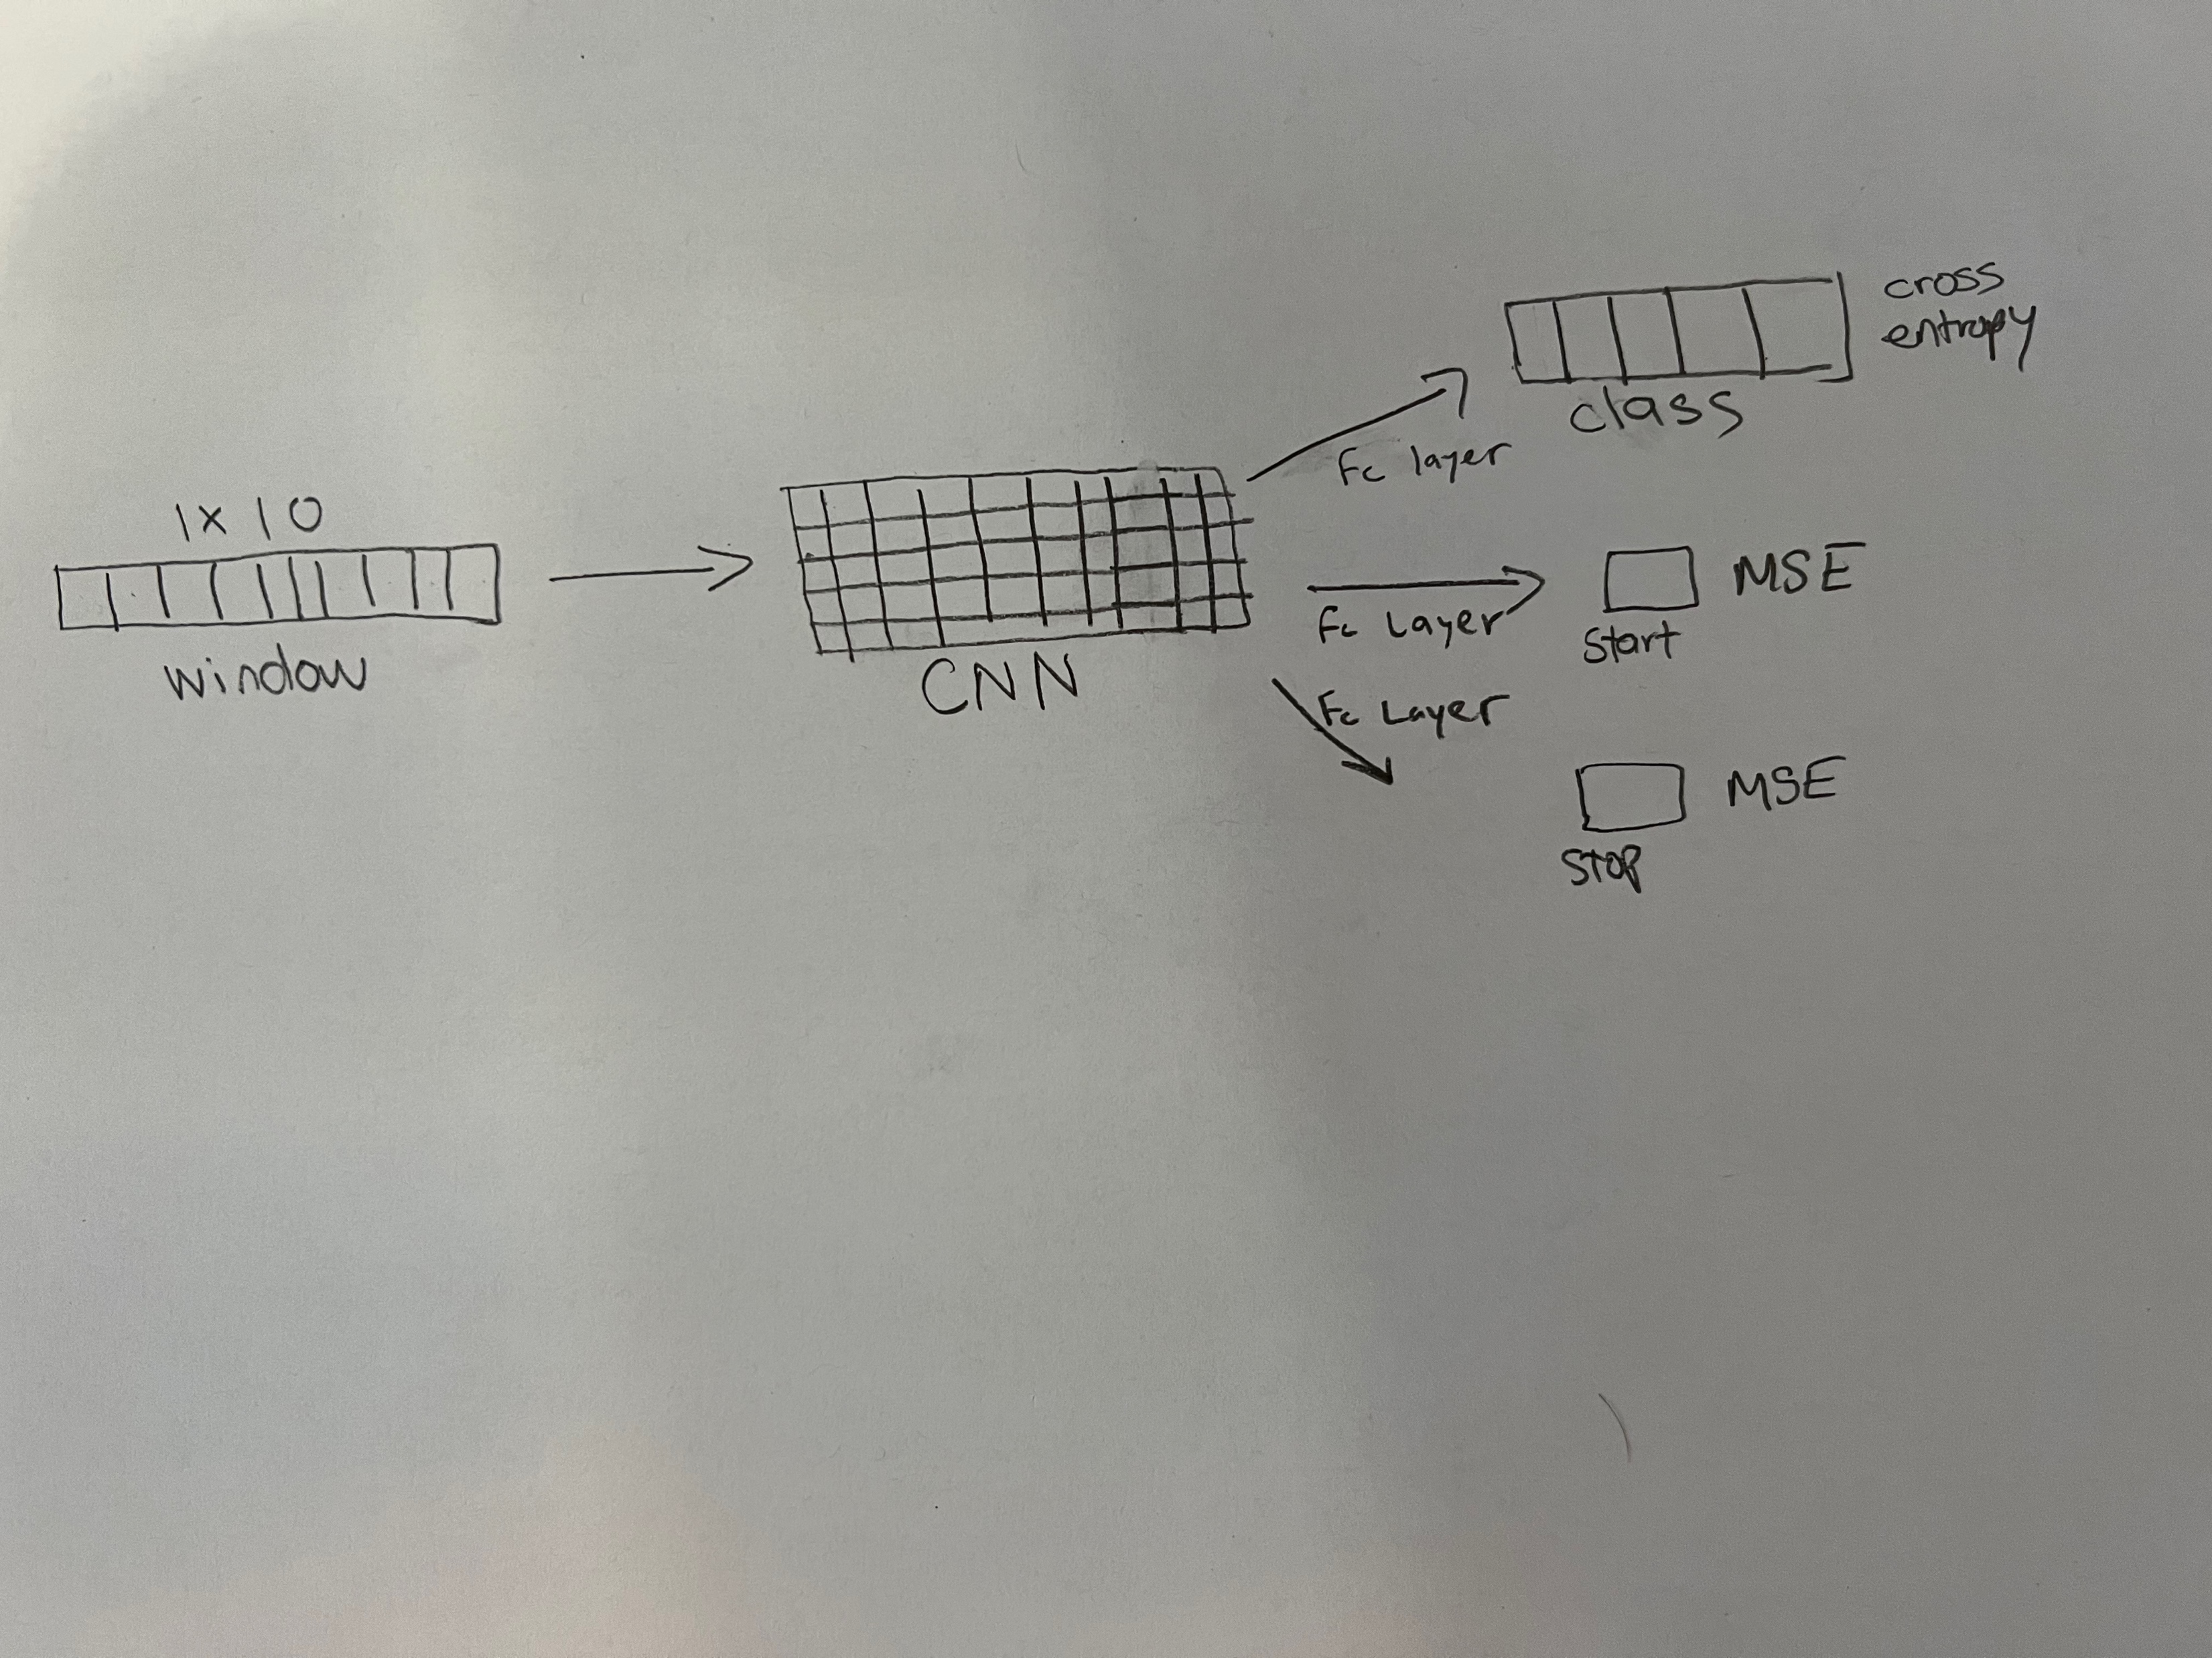
Convolutional Neural Network
Notes:
Even though this isn’t a large network with only a single convolution layer and a single fully connected layer for each output totaling in 3 separate fully connected layers, the network gradients were not able to accumulate in order to reach a minima because of my limited training time.

Slide 5
Simple Thresholding
For the first step in implementing this algorithm, I would look at the difference between two points
Then, I compared the difference in amplitude between them.
If the threshold is >6, it isn’t background noise.
An important part of choosing a threshold is determining how much you’ll suffer for making a mistake
The classes are then defined by taking a modulo 5 of the second amplitude and setting anything that’s negative as background noise.

Slide 6
Post-Processing
Began to look at sparsity of the dataset, and noticed that the data needed to be oversampled
Oversampled the positive classes
Formatted similarly: class, start, stop
Class output ranges from 0 to 4.
Start tracks the starting index within a sequence of inputs
If the sequence isn’t predicted to have a starting index, it will be -1
Similar idea for stop
We iterate over all values for each non overlapping sequence
Assign a start index variable on first seen positive start position
Identify a positive stop index which then becomes the indices of the event
Notes:
There is an extremely high signal to noise ratio as I was looking through the data.
The oversampling was necessary because without it, the model will eventually learn that the dataset is mainly of the zero class, identifying most occurrences as noise.
So both of the outputs of the models were formatted in the same manner, therefore we are able to use a single postprocessing function for both the NN and non NN models. The format of the output is class, start, stop . The class ranges from 0 to 4 for each class, including background; start is an integer that tracks the possible starting index within a sequence of inputs. IF the sequence is not predicted to have a starting index, then it will be assigned a value of -1. The stop output follows the same formatting scheme as start.
So then we iterate over all values for each non overlapping sequence. Here we assign a start index variable on our first seen positive start. We then wait for a positive stop index which then becomes the start and stop indices of our event. Class assignment is done by taking the first non-zero background class if one exists, otherwise the event will be background. This is done for all sequences of size 10 in order to asses larger event windows.

Slide 7
Comparison and Conclusion
Unfortunately, I was unable to run the train and eval scoring package in time due to PyTorch’s formatting of integers into scientific notation not playing nicely with
I presume that the simple thresholding will produce better results until a CNN is better trained, since 200 epochs is probably not enough

