Slide 1
Classification of Multiclass Overlapping Data via Random Forrest Classifier and Multi-layer Perceptron
ECE8527 – Introduction to Machine Learning and Pattern Recognition
Renato J. Rodriguez Nunez
Dynamical Systems Lab
Department of Mechanical engineering

Slide 2
Overview
Introduction
Data Visualization
Classifier Selection
Hyperparameter Tunning
Multilayer Perceptron
Random Forrest Classifier

Slide 3
INTRODUCTION

Slide 4
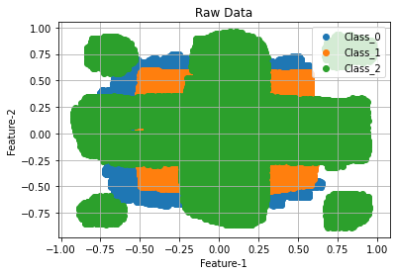
Data Visualization and Analysis
Instructions
The algorithm must be automatic
It cannot exploit knowledge of the data derived from a visualization of the data
Data visualization is needed to properly understand the scope of the problem
Get some intuition on what types of classifiers could adequately characterize this dataset
Identify which classifiers to eliminate from the design consideration
Training Data
Notes:
Dataset contains high level of overlap between the different classes (NOT LINEARLY SEPARABLE)

Slide 5
Classifier Selection
Design a generalized implementation that allows for training and testing of various classifications approaches
Based on sklearn’s Classifier Comparison approach
Train and score the selected classification methods on the training and testing data
Classifier set to default values
Select the best performing methods
Based on results, intuition, etc.
Best methods: MLP and RFC
Fine tune the relevant hyper parameters on the validation
 | Data Set
Algorithm | Train | Dev
AdaBoost | 36.92% | 37.08%
KNN | N/A | 30.75
MLP | 28.15% | 31.97%
RFC | 32.66% | 32.81%
SVM-RBF | 30.86% | 30.99%
Other Classifiers used, but not listed: SVM(Linear), Gaussian Naïve-Bayes, Quadratic-Discriminant-Analysis
Notes:
Allowing for an easy comparison of the classifiers score on train and dev sets.
Then using these initial scores, intuition form the data visualization step, and concepts such as computational complexity, I slected MLP and RFC

Slide 6
HYPERPARAMETER TUNNING

Slide 7
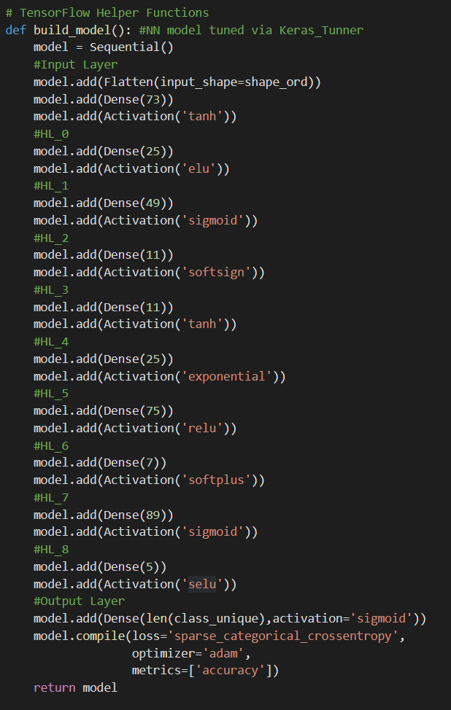
Multilayer Perceptron (TensorFlow)
MLP is a fully connected feedforward artificial neural network
Method has many hyperparameters (hp) that define its structure and performance
Hp are tuned based on validation results, while weights are tuned during training
HP Tunning
Automated tunning process
Dynamic Model
“Exhaustive” grid search of hp within defined range/list-of-options
Hyperparameters | Value
Number of HL | 9 (+2 in/out)
Number of Neurons | 5:90 (per HL)
Activation Function | ReLU, Tanh, etc. (9 diff)
Optimizer | Adam
Loss | Sparse Categorical Crossentropy
Number of Epochs | 50
Input
HL
Output
Notes:
Validation/development set

Slide 8
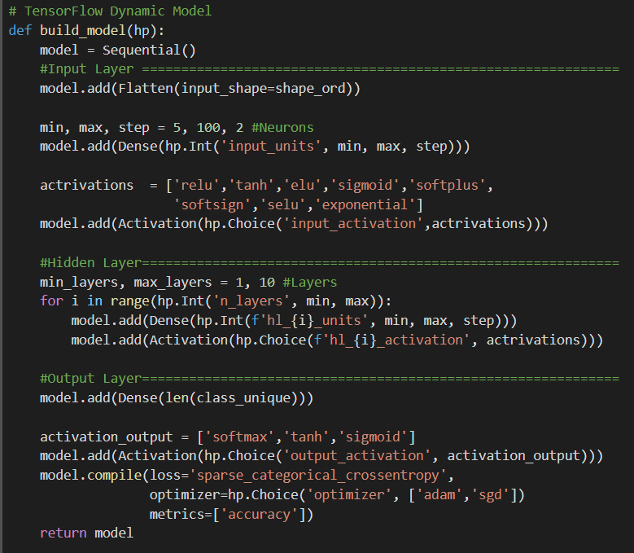
MLP HP Tunning
HP Tunning
Dynamic Model Design
Uses variables for the hp
“Exhaustive” grid search of hp within defined range/list-of-options
Implements variations of the hyperparameter sets (hp are varied together)
Automated tunning process
Once Dynamic Model is defined the method will seek for the best hp set within the defined hp range that maximizes the validation-accuracy
Input
HL
Output

Slide 9
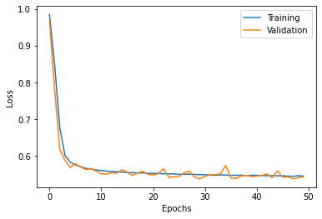
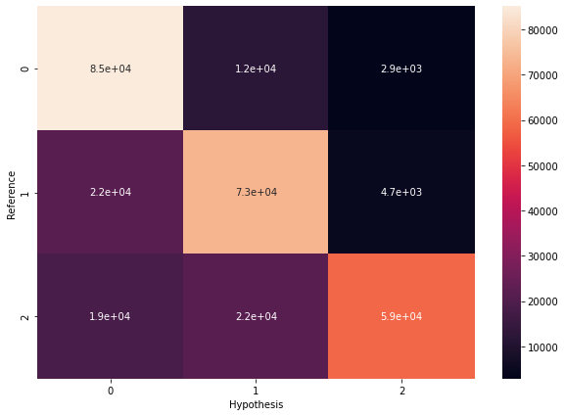
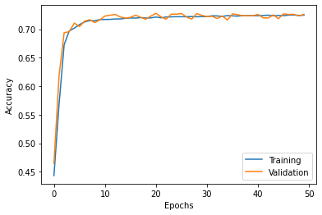
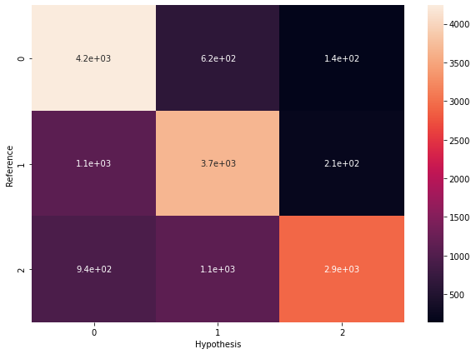
MLP Results
Loss plot shows the minimization of the crossentropy
Accuracy plot shows that the model performs equally well for both training and evaluation converging to an accuracy of ~73% (e.r. ~27%)
Same as the score form the scoring file
Shows that the model is generalizable
Confusion Matrix further reinforces the model's generalizability to unseen data
 | Data Set
Algorithm | Train | Dev Test | Eval
MLP | 27.44% | 27.40% | 61.59%
Notes:
Training
Development

Slide 10
Random Forrest Classifier (sklearn)
RFC is an ensemble-based method that fits decision trees on subsets of data
It uses averaging to improve the predictive accuracy and control over-fitting
HP Tunning
Tunning process consists of nested for loops that iterated over ranges of individual hp
MLP tunning iterates over combinations of hp
Hyperparameters | Value
Max Depth | None
Number of Estimators | 31
Max Samples | None
Number of estimators was the only parameter that provided a noticeable change in performance
Notes:
The maximum depth of the tree. If None, then nodes are expanded until all leaves are pure
or until all leaves contain less than min_samples_split samples.

Slide 11
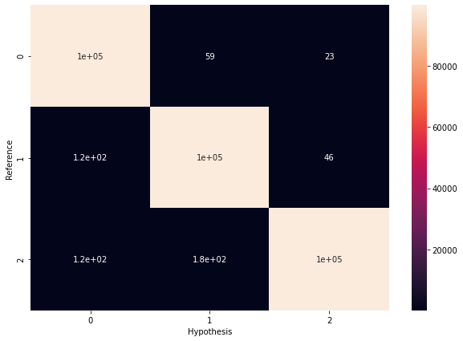
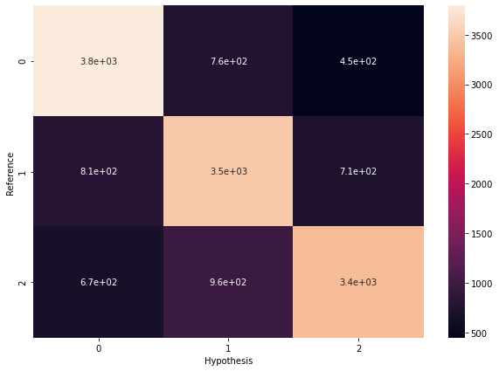
RFC Results
The Confusion Matrix and final scores show that the model does not generalize well to the development data
Likely due to overtraining
Reduces performance on unseen data
 | Data Set
Algorithm | Train | Dev Test | Eval
RBF | 00.18% | 29.03% | 63.36%

Slide 12
Summary and Conclusion
In this study two classifications methods were used, MLP and RFC
An automated hyperparameter tunning process was utilized to tunned the MLP
It works by implementing many variations of the hp sets and looks for the set within defined hp range that maximized validation-accuracy
This approach yielded a good performing and generalizable model
Performed well on the unseen data sets (dev/eval)
MLP model did not reach the expected classification performance
Performance should be equal to or greater than provided baseline
Further work is needed to improve this approach to ensure the optimal hp set is found
 | Data Set
Algorithm | Train | Dev Test | Eval
RFC | 00.18% | 29.03% | 63.36%
MLP | 27.44% | 27.40% | 61.59%
Notes:
Although the model achieved good levels of classification performance,
It did not reach the expected levels

Slide 13
Classification of Multiclass Overlapping Data via Random Forrest Classifier and Multi-layer Perceptron
ECE8527 – Introduction to Machine Learning and Pattern Recognition
Renato J. Rodriguez Nunez
Dynamical Systems Lab
Department of Mechanical engineering

