Slide 1
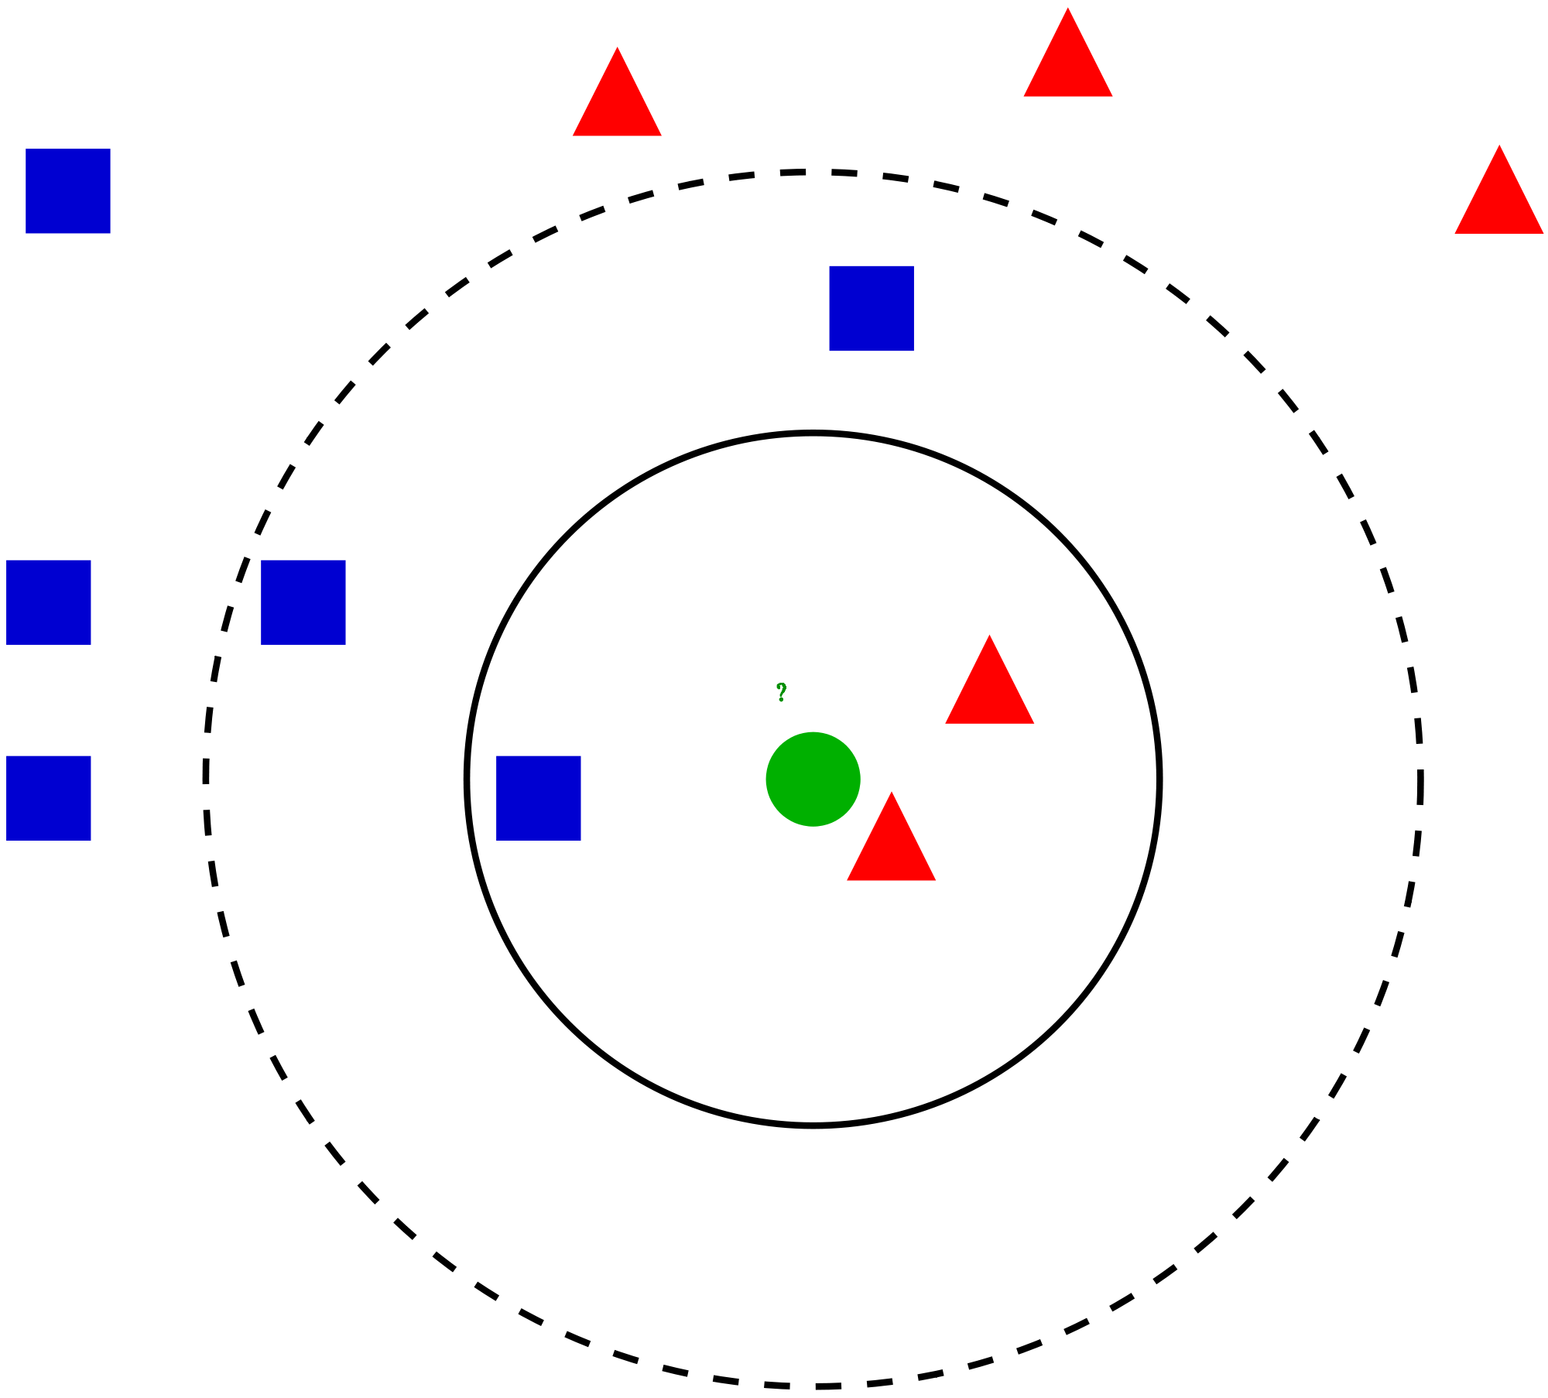
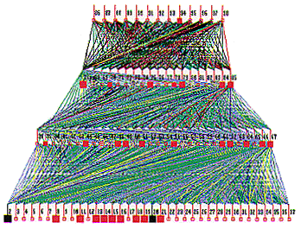
Final Presentation:
K-Nearest Neighbor vs Multilayer Perceptron
Jose Paz Amaya

Slide 2
Introduction
K-Nearest Neighbor: a non-parametric classification method used for classification and regression. The input consists of the k closest training examples in data set. When performing classification, the output is class membership. An point is classified by a majority vote of k neighbors so that it can be assigned to most common class among its neighbors.
Multilayer Perceptron: a type of feedforward artificial neural network (ANN). It will generally consists of multiple layers of perceptrons with defined activation functions. Learning occurs by changing connection weights based on the amount of error in the output compared to the expected outcome.

Slide 3
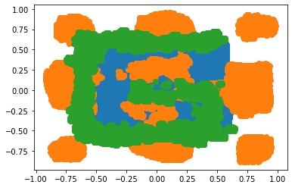
KNN
Performed GridSearchCV on a large scale and then narrowed down on a reasonable range for the KNN parameters
GridSearch was performed on the training and development data together in an attempt to generalize better.
The model was trained only on the training set and it was used to predict the labels.
The results were: Uniform Weight function, k=112, power parameter for the Minkowski metric = 1 (Manhattan distance).
Parameter | Value
Weight function | Uniform
N_neighbors | 112
P | 1 (Manhattan)
Algorithm | Auto

Slide 4
KNN
Data transformations were attempted to try and separate the data and increase performance.
LDA and PCA were both used separately to transform the data before computing the model and predicting the labels.
Gridsearch was performed on the transformed data to see of the optimal parameters would change.
The only change was that on after LDA, the k value changed from 112 to 111.
PCA resulted in no difference in performance while LDA showed a slight change.
However, this difference was not significant

Slide 5
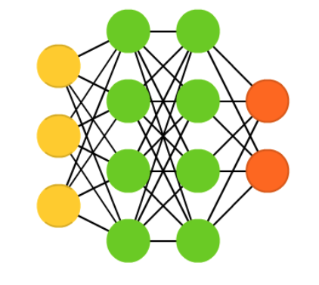
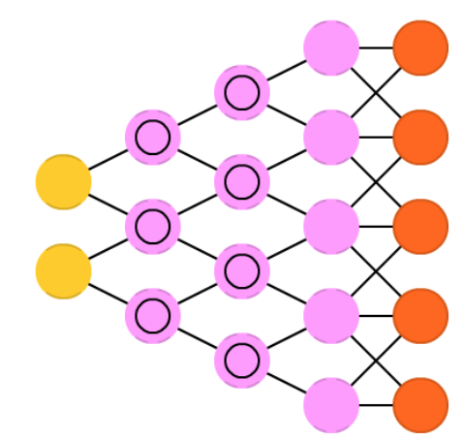
MLP
For the first step in building this network, different architectures were tested with default parameters.
The convergent architecture resulted in the best performance and was then chosen to start building the model.
The model consisted of 2 input neurons and then 300 neurons in the first layer, 30 in the second, and a final output layer of 3 neurons.
Every layer was set to rectified linear unit (ReLu) except the last one, where it was set to SoftMax since it gave better performance.

Slide 6
MLP
For the optimizer, I used Stochastic Gradient Descent (SGD) since it performed better than Adam.
The Sparse Categorical Cross Entropy was the best performing loss function out of the categorical loss functions available.
The learning rate was set to 0.01, the epoch was set to 60 and the batch size to 200 as this promoted convergence within a reasonable amount of time (~5 min.) while avoiding overfitting.
Algorithm | Train | Dev | Eval
MLP | 28.79% | 28.88% | 62.64%

Slide 7
Comparison
MLP generalized better and performed significantly better than KNN.
The difference in performance was significant at a 99% CL.
KNN may have been over fit during training, resulting in significantly better performance (again at 99% CL) than MLP in the training and development data sets.
MLP performed better than KNN when scored on the evaluation data set. The difference of almost 2% error in performance was significant at a 99% CL.

Slide 8
Conclusion
In conclusion, KNN has shown to be a great algorithm but performance on the evaluation set but MLP performed better due to its flexibility.
KNN does a great job at classifying data with non-linear decision surfaces and consequently, it was still a great fit for the data we had for the competition.
Gridsearch performed on the pooled data (training + development) may have over fit the model more than expected.
A higher K may have resulted in better performance since it would have smoothed out the decision surface and potentially generalized better.
In addition, the transformation of the data using LDA before training and testing the model did not result in a significant difference in performance at a reasonable confidence level.
MLP performed worse than KNN when scored on the training and development data set.
However, MLP was able to generalize better and achieved a better performance on the evaluation set when compared to KNN. had significant difference in performance when compared to KNN.
MLP achieved a 62.64% error whereas KNN got 64.30%.

