Slide 1
Data Classification Using KNN and Multilayer Perceptron

Slide 2
Dataset Description
Training Set
Samples = 300000
Class = 3
Development Set
Samples = 15000
Class =3

Slide 3
KNN Algorithm
Steps
Choose the Number K of neighbors.
Take the K nearest neighbors of the new data point, according to some distance measure.
Among these K neighbors, count the number of data points in each category.
Assign the new data point to the category which is counted most in the neighbor

Slide 4
Developed KNN Model
The KNN model is developed using python scikit learn tool.
Parameters
n_neighbors = 110
metric = ‘minkowski’
p = 6
Other Parameters = default

Slide 5
Results for KNN Model
Error Rate
Train | Dev Test | Eval
25.38% | 25.72% | 64.37%

Slide 6
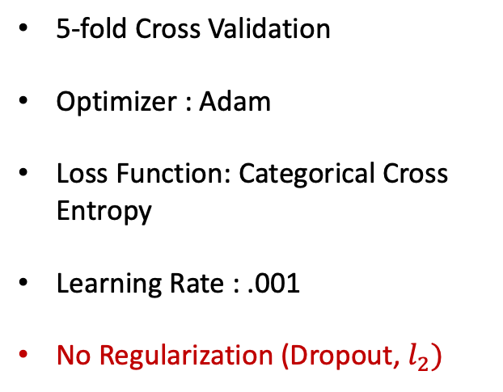
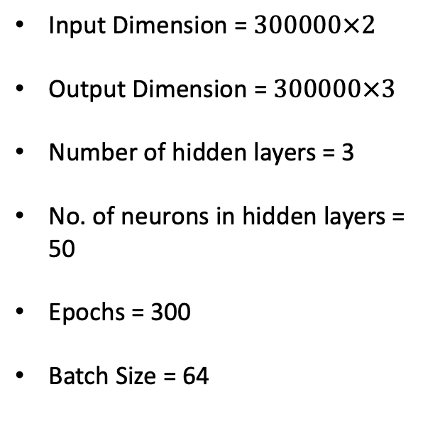
Multilayer Perceptron Model
Input Features
Input Dimension = $300000×2$
Output Dimension = $300000×3$
Number of hidden layers = 3
No. of neurons in hidden layers = 50
Epochs = 300
Batch Size = 64
5-fold Cross Validation
Optimizer : Adam
Loss Function: Categorical Cross Entropy
Learning Rate : .001
No Regularization (Dropout, $l_{2})$
Dense + ReLU
Dense + ReLU
Dense + ReLU
Softmax
Predicted Label

Slide 7
Results
Algorithm | Data
 | Train | Dev Test | Eval
KNN | 25.38% | 25.72% | 64.37%
MLP | 27.20% | 27.10% | 62.17%

Slide 8
Results
Algorithm |  | Accuracy | Sensitivity | Specificity | Precision | F1 Score
KNN | Class 0 | 0.84 | 0.81 | 0.85 | 0.73 | 0.77
 | Class 1 | 0.81 | 0.77 | 0.83 | 0.69 | 0.73
 | Class 2 | 0.85 | 0.65 | 0.94 | 0.85 | 0.73
MLP | Class 0 | 0.82 | 0.87 | 0.79 | 0.68 | 0.76
 | Class 1 | 0.83 | 0.78 | 0.81 | 0.68 | 0.73
 | Class 2 | 0.84 | 0.54 | 0.99 | 0.95 | 0.69

Slide 9
Conclusion
Performance on the evaluation data is bad. One possible reason for that might be the the evaluation data came from different distribution.
In this experiment, parameter tuning has been done manually. More Computationally Expensive Grid Search may find better set of parameters .

