Slide 1
Data Classification: k Nearest Neighbor and Multilayer Perceptron Classifiers
Objectives:
- Introduction
- K-Nearest Neighbor (non-neural network approach)
- Multilayer Perceptron (neural network approach)
- Results
- Conclusion
Thao cap

Slide 2
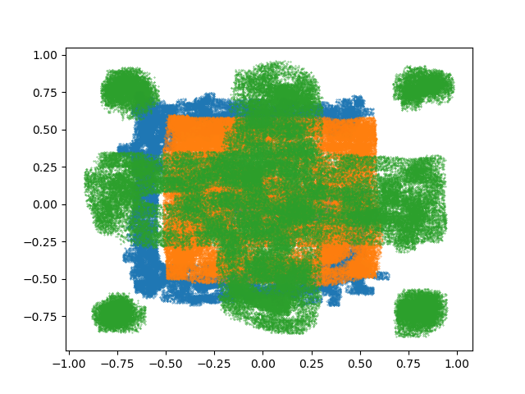
introduction
2-dimensional dataset including training data, development data, and evaluation data
Classify the data using 2 approaches: non-neural network approach and neural network approach
Since our training and development data is relatively small and provided with labels, we choose supervised models to classify our data.
Knn and MLP are chosen
Figure 1: training data plot

Slide 3
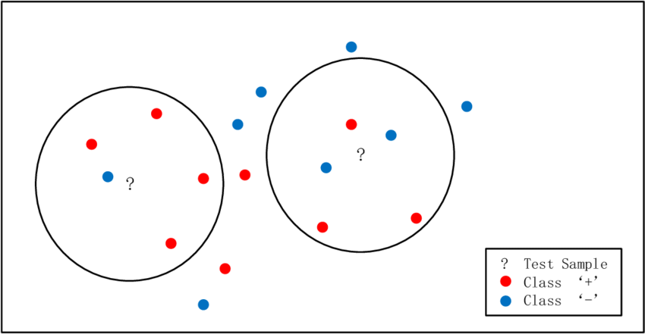
K-Nearest neighbor: Algorithm
A k-nearest-neighbor algorithm, often abbreviated k-nn, is an approach to data classification that estimates how likely a data point is to be a member of one group or the other depending on what group the data points nearest to it are in
A majority vote is used to assign which class.

Slide 4
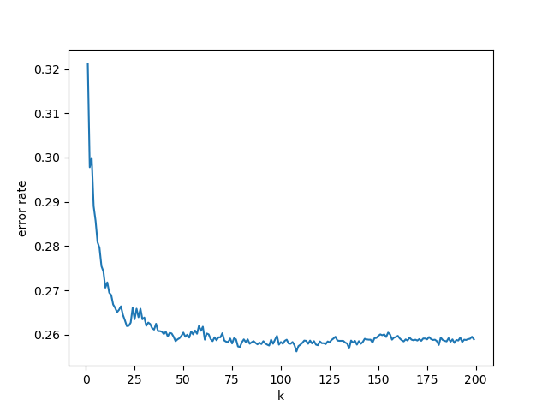
K-Nearest neighbor: TUNING
Parameters:
n_neighbors/k: Number of neighbors to use by default for kneighbors queries
Weights {uniform, distance}: weight function used in prediction
Algorithm {ball_tree, kd_tree, brute}: algorithm used to compute the nearest neighbors
p {Manhattan, Euclidean}: power parameter for the Minkowski metric
GridSearchCV is used to tune the model. It helps to loop through predefined hyperparameters and fit the estimator (model)
After finding error rate for k from range 1-200, we find k=108 has the smallest error rate on the training and development data.
Figure 2: Error rates vs k

Slide 5
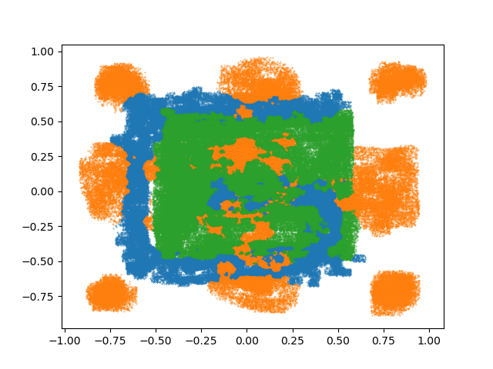
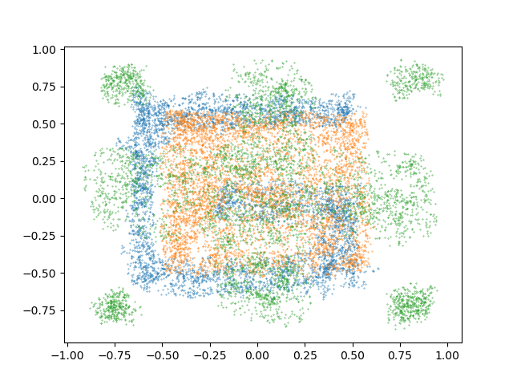
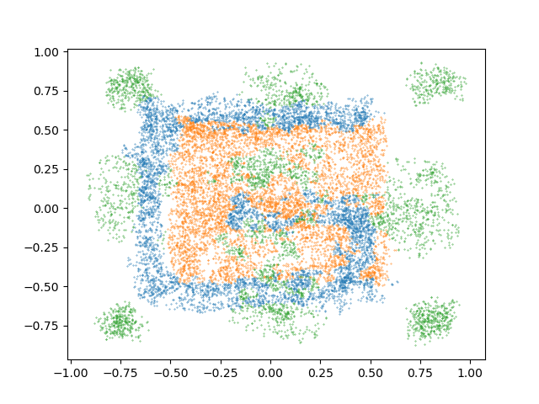
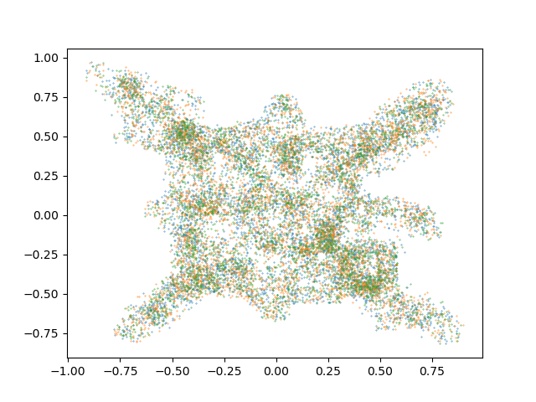
K-Nearest neighbor: RESULTS
train | Dev | eval
25.62% | 25.39% | 67.32%
Train ref and train hyp plots
Table 1: KNN error rates on different data
Dev ref and dev hyp plots
Eval hyp plots

Slide 6
Multilayer perceptron: Algorithm
Multi-layer Perceptron (MLP) is a class of feedforward artificial neural network.
Multi-layer Perceptron (MLP) is a supervised learning algorithm that learns a function $f\left(.\right)= R^{m}→R^{o}$by training on a dataset, where m is the number of dimensions for input and o is the number of dimensions for output.
MLP consists of one input layer, one output layer, and one or more non-linear layers, called hidden layers.
Hidden layers
Input layer
Output layer
…
…
…

Slide 7
Multilayer perceptron: TUNING
Parameters:
Hidden layer sizes: The ith elememnt represents the number of neurons in the ith hidden layer
Activation: activation function for the hidden layer
GridSearchCV is used to tune the model.
Our optimal activation function is rectified linear unit function, returns f(x) = max(0,x).
Optimal hidden layer size is (100, 100, 50)

Slide 8
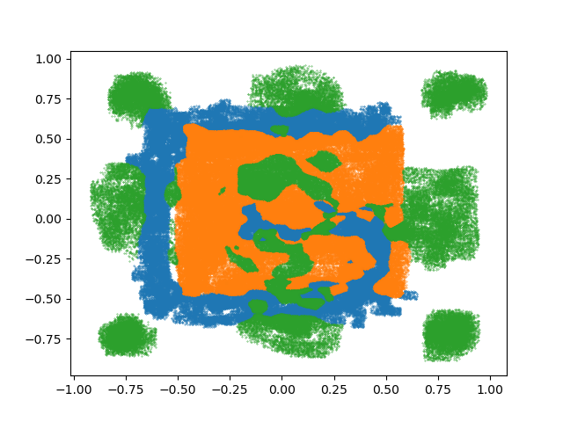
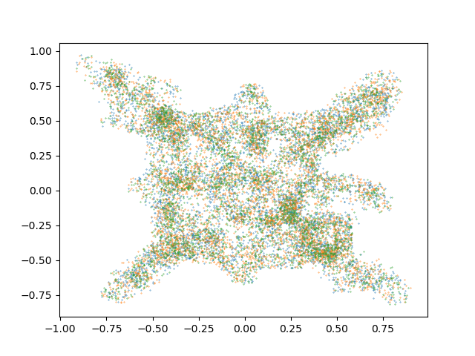
Multilayer perceptron: RESULTS
train | Dev | eval
26.29% | 26.35% | 67.07%
Train ref and train hyp plots
Table 1: MLP error rates on different data
Dev ref and dev hyp plots
Eval hyp plots

Slide 9
Analysis
 | train | Dev | eval
KNN | 25.62% | 25.39% | 67.32%
MLP | 26.29% | 26.35% | 67.07%
KNN and MLP give similar performance. Generally, KNN performs slightly better on our training data and development data, whereas MLP gives a slightly smaller error rates on the eval data
Because time is limited and Sklearn GridsearchCV requires long computing time, more parameters are not able to be tested (hidden layer sizes, learning rate)
Table 3: Error rates for each method

