Slide 1
The Little Big Data Showdown
ECE 8110 Pattern Recognition and Machine Learning
Temple University
Christian Ward

Slide 2
What Data Is This?
One set stationary, one set temporal
Dimension’s greater than three
Small test sets
Let’s go with SVM, GM and KNN as our algorithms

Slide 3
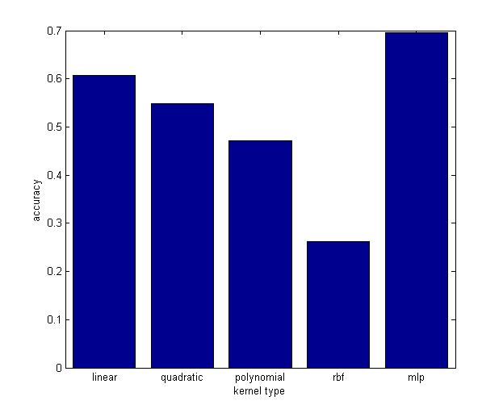
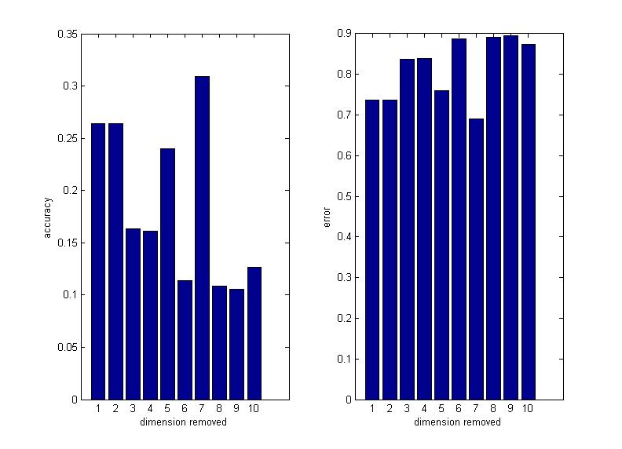
Stationary Data with SVMs

Slide 4
SVM Continued, Correlation Matrix
1.0000 -0.5147 -0.4311 0.0187 -0.1690 0.2420 -0.0503 0.2004 0.0185 -0.0950
-0.5147 1.0000 0.0723 -0.4291 -0.3513 -0.4408 0.2307 0.1541 0.0875 -0.1293
-0.4311 0.0723 1.0000 0.1364 -0.0116 -0.5351 -0.2828 -0.1291 0.1782 0.3096
0.0187 -0.4291 0.1364 1.0000 -0.0799 0.1217 -0.5577 -0.0558 0.2751 0.2015
-0.1690 -0.3513 -0.0116 -0.0799 1.0000 0.1156 0.0074 -0.4807 -0.5363 0.0527
0.2420 -0.4408 -0.5351 0.1217 0.1156 1.0000 0.0345 0.2274 -0.1463 -0.3007
-0.0503 0.2307 -0.2828 -0.5577 0.0074 0.0345 1.0000 -0.0646 -0.2255 -0.3072
0.2004 0.1541 -0.1291 -0.0558 -0.4807 0.2274 -0.0646 1.0000 0.1398 -0.3006
0.0185 0.0875 0.1782 0.2751 -0.5363 -0.1463 -0.2255 0.1398 1.0000 -0.0051
-0.0950 -0.1293 0.3096 0.2015 0.0527 -0.3007 -0.3072 -0.3006 -0.0051 1.0000

Slide 5
SVM Continued, Correlation Probability
1.0000 0.0000 0.0000 0.6681 0.0001 0.0000 0.2483 0.0000 0.6722 0.0291
0.0000 1.0000 0.0968 0.0000 0.0000 0.0000 0.0000 0.0004 0.0444 0.0029
0.0000 0.0968 1.0000 0.0017 0.7904 0.0000 0.0000 0.0030 0.0000 0.0000
0.6681 0.0000 0.0017 1.0000 0.0666 0.0051 0.0000 0.2007 0.0000 0.0000
0.0001 0.0000 0.7904 0.0666 1.0000 0.0078 0.8657 0.0000 0.0000 0.2270
0.0000 0.0000 0.0000 0.0051 0.0078 1.0000 0.4283 0.0000 0.0007 0.0000
0.2483 0.0000 0.0000 0.0000 0.8657 0.4283 1.0000 0.1383 0.0000 0.0000
0.0000 0.0004 0.0030 0.2007 0.0000 0.0000 0.1383 1.0000 0.0013 0.0000
0.6722 0.0444 0.0000 0.0000 0.0000 0.0007 0.0000 0.0013 1.0000 0.9068
0.0291 0.0029 0.0000 0.0000 0.2270 0.0000 0.0000 0.0000 0.9068 1.0000

Slide 6
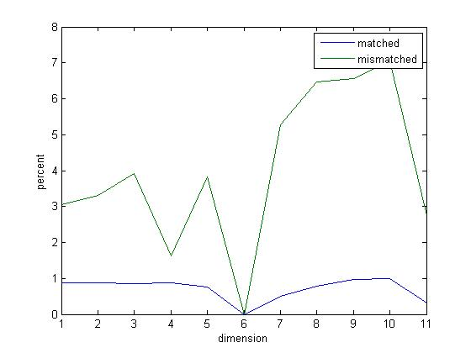
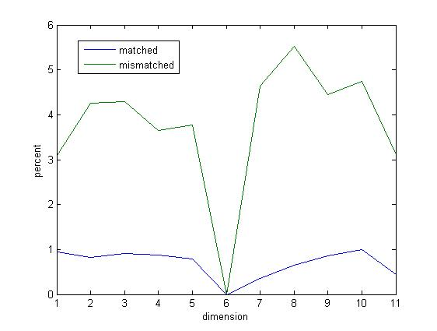
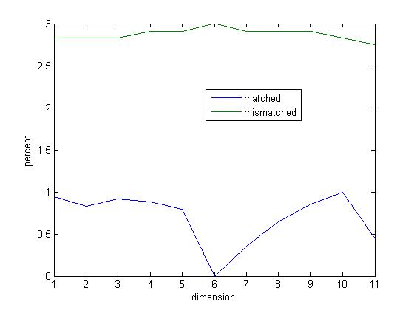
SVM, Accurate?
Below: Baseline accuracy with best kernel
Right Top: Training Scaled
Right Bottom: Training and Testing Scaled
Best effort 14% accuracy overall

Slide 7
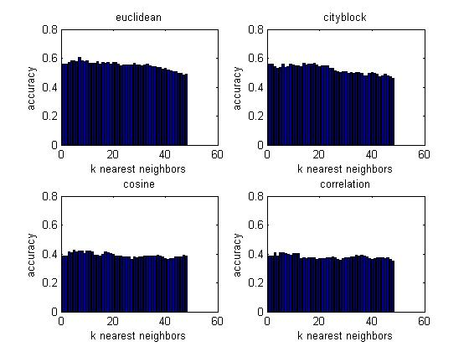
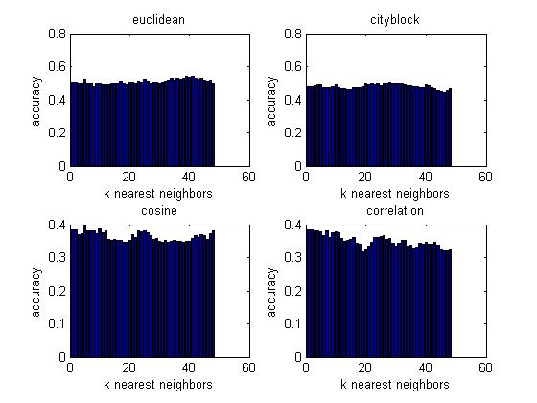
KNN, How Many Neighbors Is Too Many?
KNN scaled inputs: k=5 with 43% accuracy
KNN unscaled inputs: k=7 with 60% accuracy
This makes slight sense given the scaling from the SVM models and the covariance matrix.

Slide 8
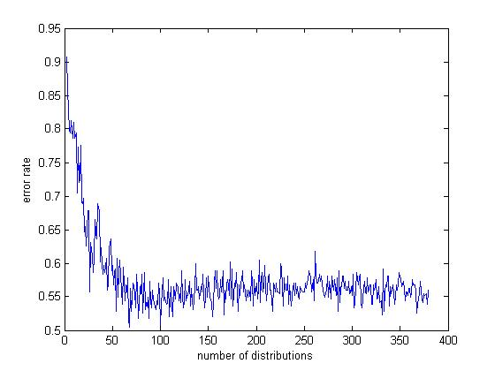
Gaussian Mixtures, Are Only Hope?
Distribution sizes from 1 to 379
Best error rate found around 54% near 60 clusters. Attempts to feed the algorithm with the means from KMEANS failed due to my inability to properly generate covariance matrix to meet the function’s needs.

Slide 9
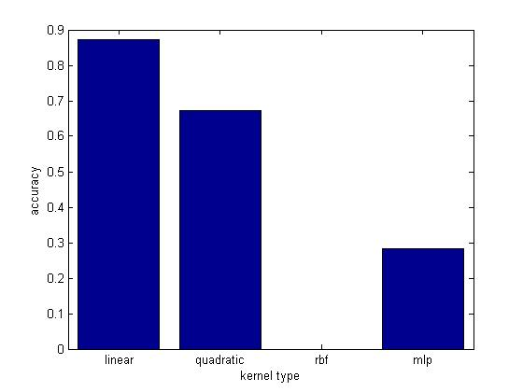
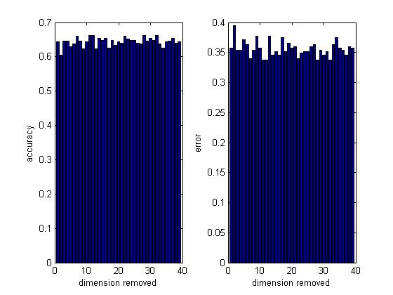
Data Set 2, Too Much Data

Slide 10
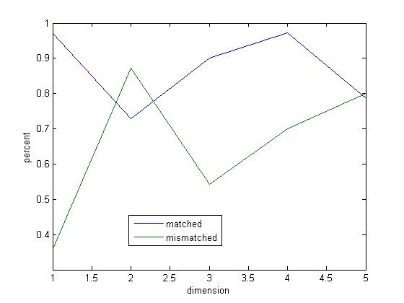
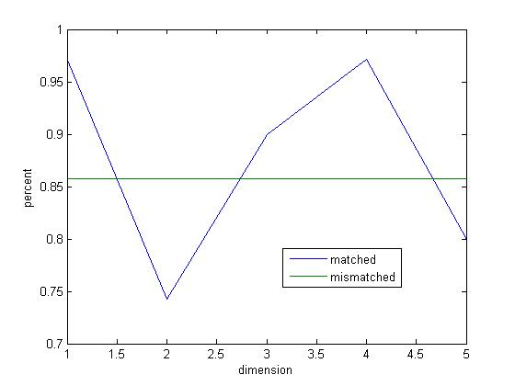
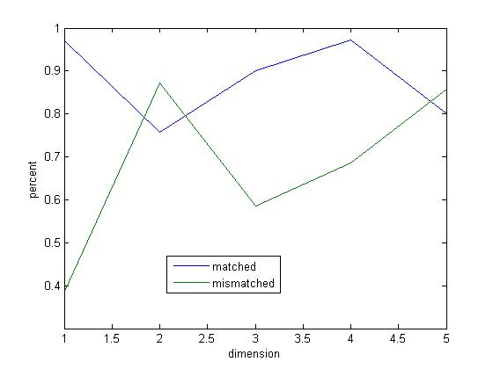
SVM, Results
Top Left: Baseline Results
Top Right: Scaled Training Results
Bottom: Scaled Training and Testing Data Results
Accuracy for each specific classifier is quite high, but there are excessive errors and overlaps outside the correct classes. This results in an overall accuracy of only 60 percent.

Slide 11
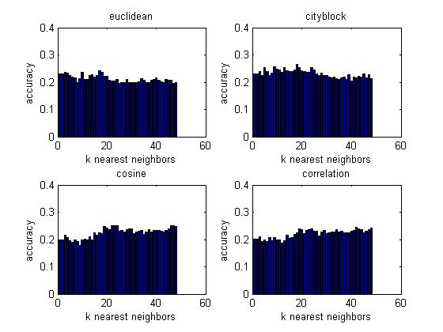
KNN, Too Few Neighbors?
This time the various metrics perform with the same results, which lends further credence to the difference between the two data sets.

Slide 12
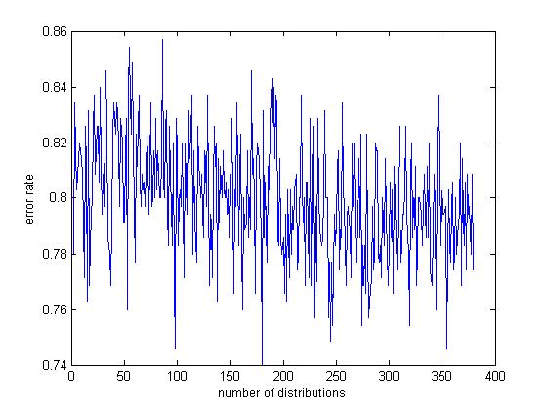
Gaussian Mixture Models on Temporal
The Gaussian approach fails quite hard given the temporal nature of the data and no trend develops as the number of clusters increases. This is not too surprising given that the 39x39 element covariance matrix shows quite a bit of

