Slide 1
Introduction to Machine Learning and Pattern Recognition
ECE8527: Final Project
Professor: Dr. Picone
Temple University
Brian Thibodeau

Slide 2
Overview
K-Nearest Neighbor
Standard and cross validated error
Principle Components Analysis (PCA)
Evaluation
Linear Discriminant Analysis
Linear Vs. Quadratic Discriminants
Predictors and PCA
Gaussian Mixture Model Assessment
Evaluation
Classification Tree
Leaf, Parents, and Levels
PCA
Evaluation
Algorithm Comparison

Slide 3
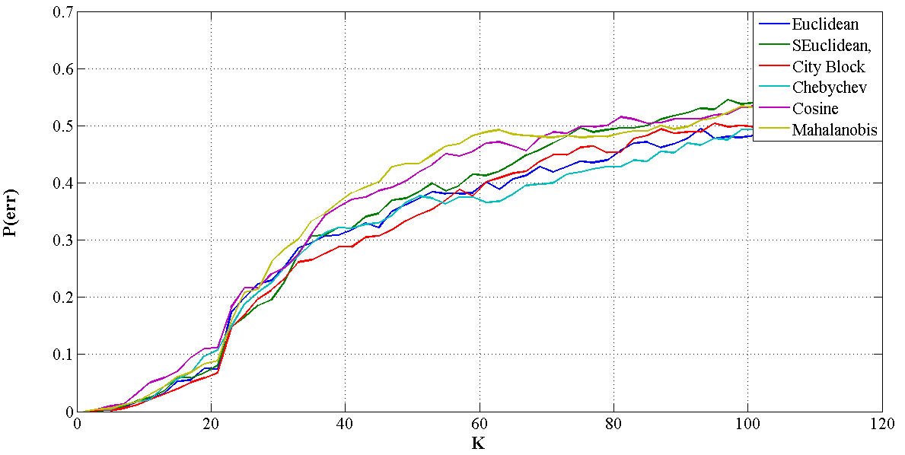
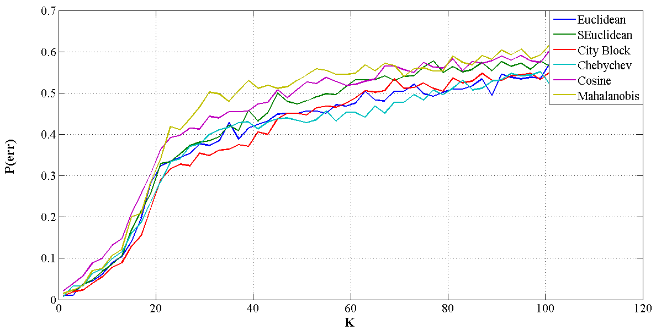
KNN Classification: Training/Cross Validation Error
Standard Error (Function of neighbors, k, and distance metric
Cross Validated Error
(Function of neighbors, k, and distance metric

Slide 4
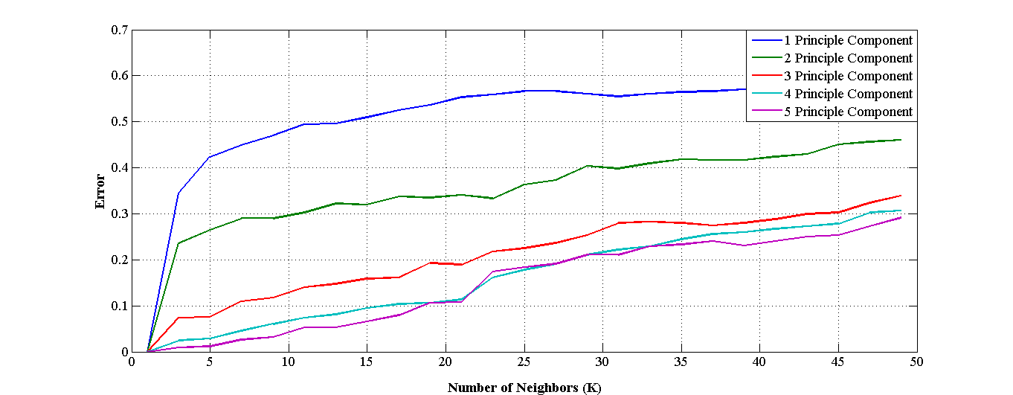
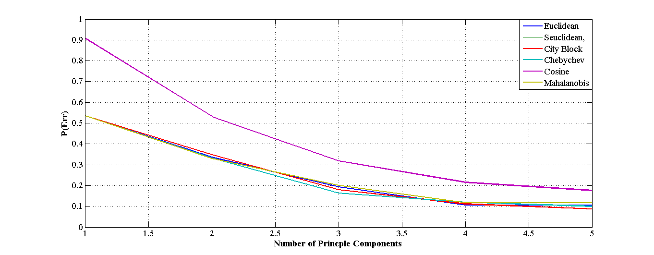
KNN Classification: PCA Analysis and Error
Standard Error (Function of neighbors, k, and 5 Largest Principle Components
Standard Error
(Function of 5 largest Principle Components and distance metric

Slide 5
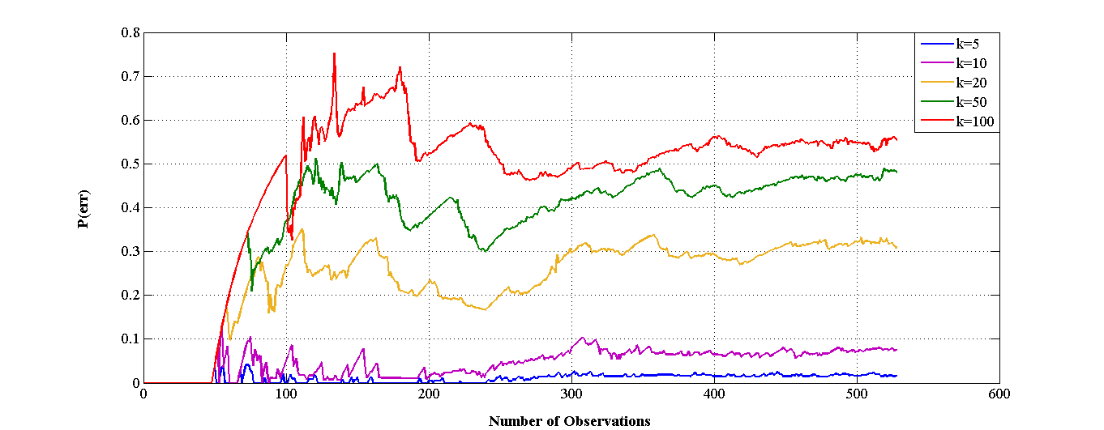
KNN Classification: Number of Observations and Error
Standard Error (Function of number of Observations and neighbors k
Number of Neighbors (K) | Distance Metric | Number of Principle Components (Largest) | Evaluation Error
5 | City Block | 10 | 0.4644

Slide 6
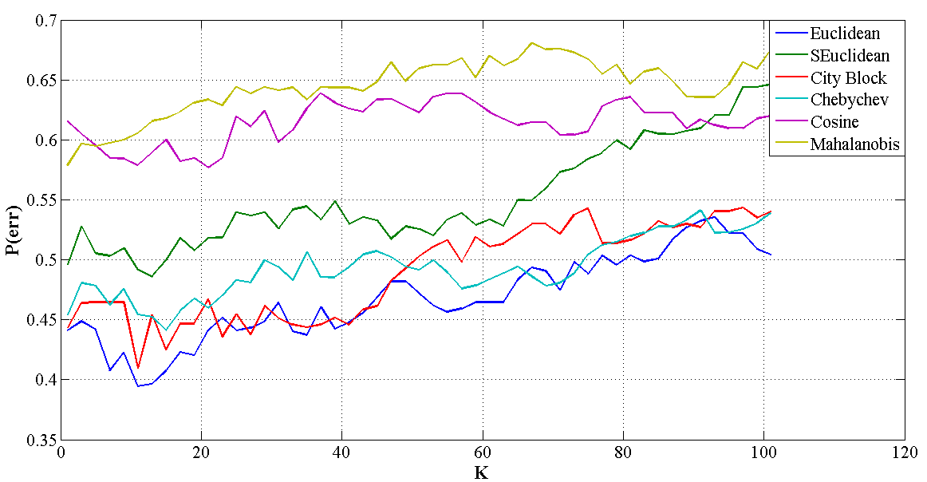
KNN Classification: Evaluation
Standard Error (Function of neighbors, k, and distance metric
Evaluation Error (Function of neighbors, k, and distance metric

Slide 7
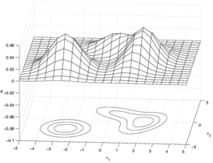
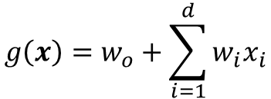
LDA Classification: Training/Cross-Validation Error
Linear Discriminant
Quadratic Discriminant
$$g\left(x\right)=w_{o}+\sum_{i=1}^{d}{w_{i}x_{i}}$$
$$g\left(x\right)=w_{o}+\sum_{i=1}^{d}{w_{i}x_{i}+\sum_{i=1}^{d}{\sum_{j=1}^{d}{w_{ij}x_{i}x_{j}}}}$$
LDA Error | QDA Error | Cross Validated LDA Error | Cross Validated QDA Error
0.3163 | 0.0114 | 0.3731 | 0.0625

Slide 8
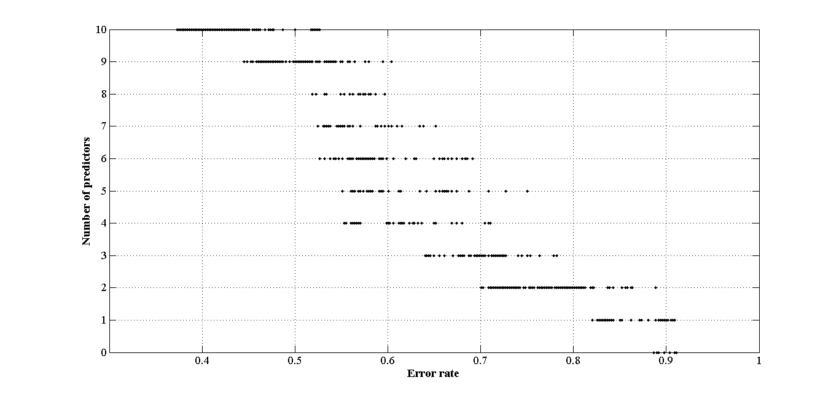
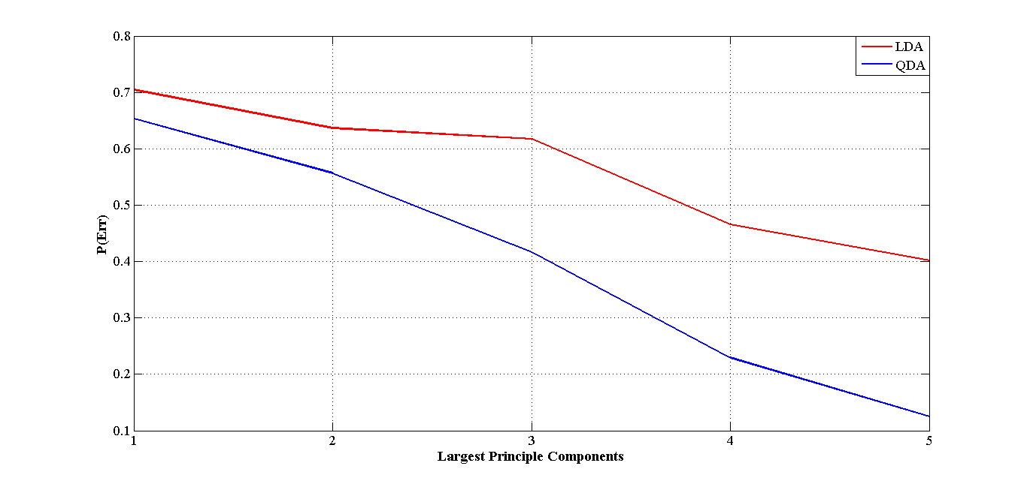
LDA Classification: Predictor and PCA Errors
Cross-Validated Error (Function of number of predictors (features))
Standard Error
(Function of 5 largest Principle Components)

Slide 9
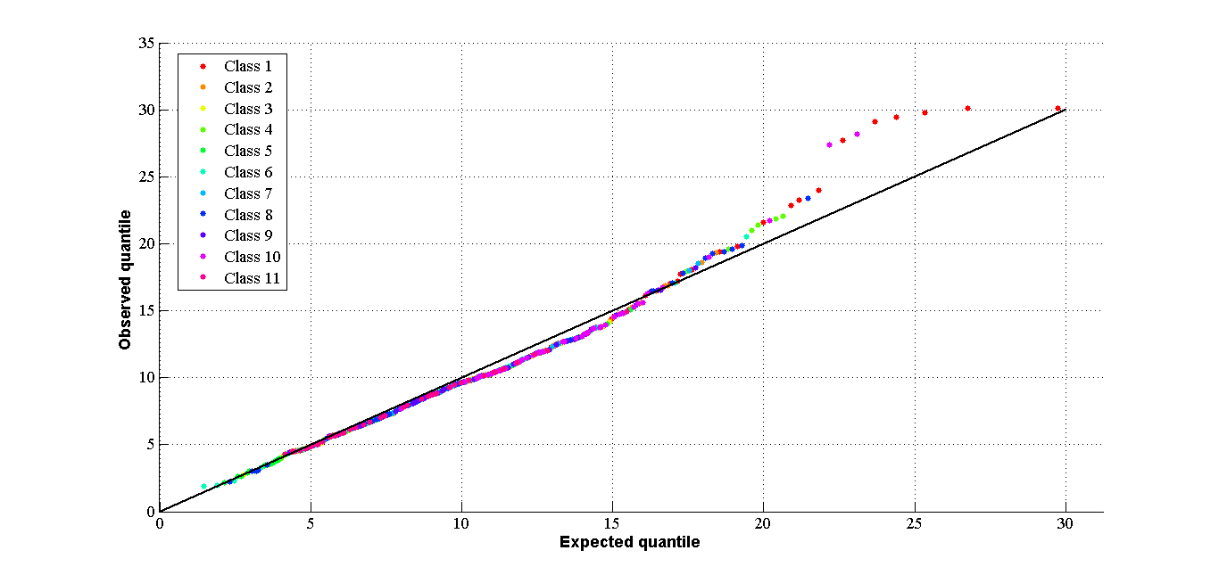
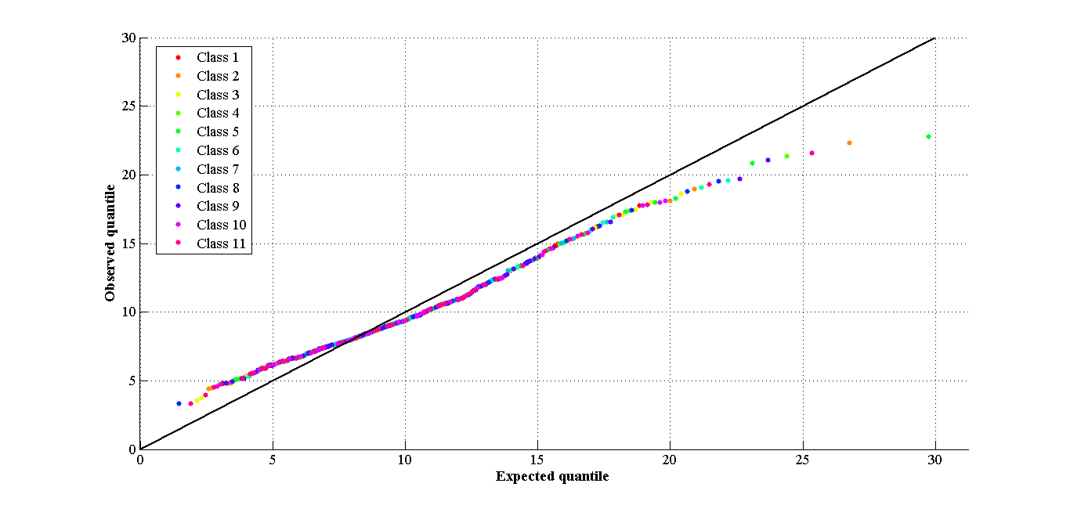
LDA Classification: Validity of GMM Estimations
Outliers on LDA Q-Q plot.
Outliers on QDA Q-Q plot.
Decreasing weight of outliers increased error rate
Removing Outliers increased error rate

Slide 10
LDA Classification: Evaluation Error and Comparison
Quadratic Discriminant
$$g\left(x\right)=w_{o}+\sum_{i=1}^{d}{w_{i}x_{i}+\sum_{i=1}^{d}{\sum_{j=1}^{d}{w_{ij}x_{i}x_{j}}}}$$
LDA Method | QDA Training Error | Cross Validated QDA Error | Evaluation Error
Quadratic | 0.0114 | 0.0625 | 0.5038

Slide 11
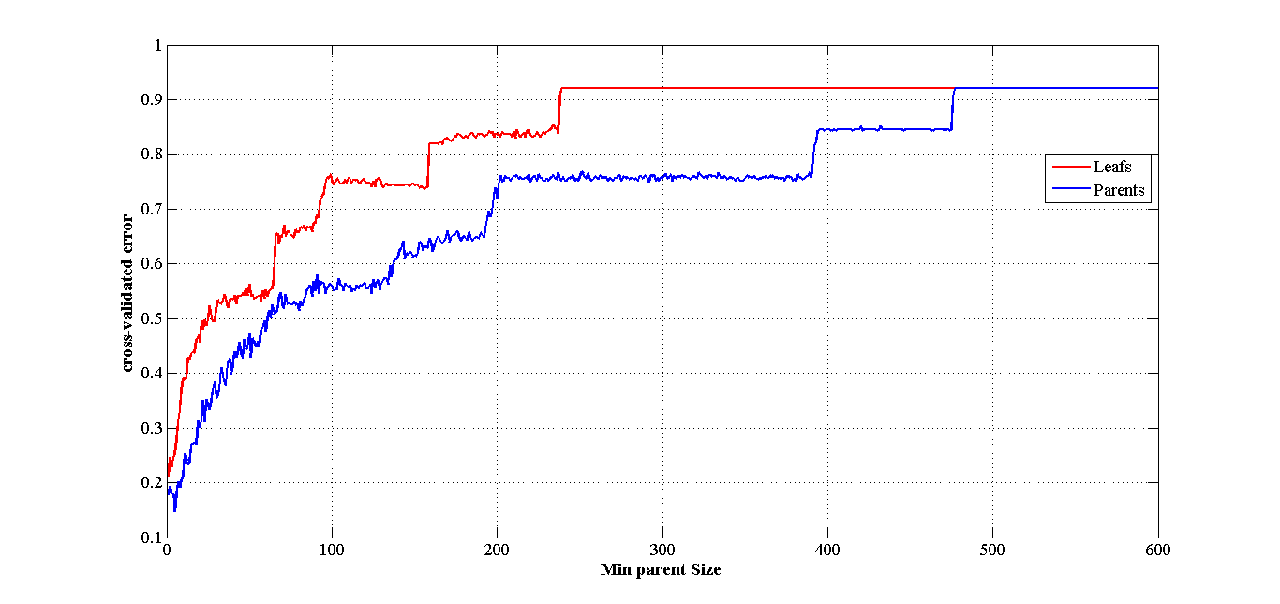
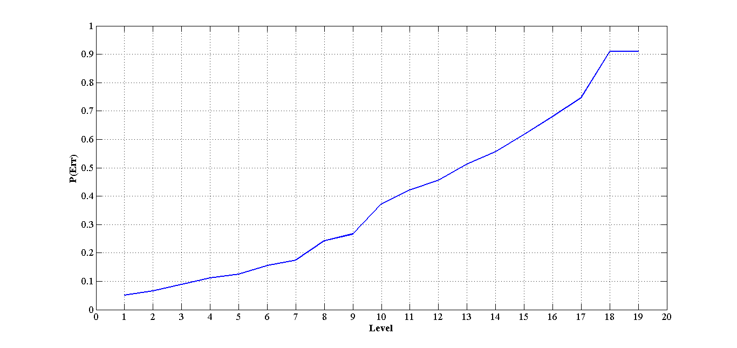
Classification Tree: Cross-Validated Error, Minimum Leafs/Parents and Levels
Cross-Validated Error
Function of Leafs (Red) and Parents (Blue)
Standard Error
(Function of 5 number of tree levels)

Slide 12
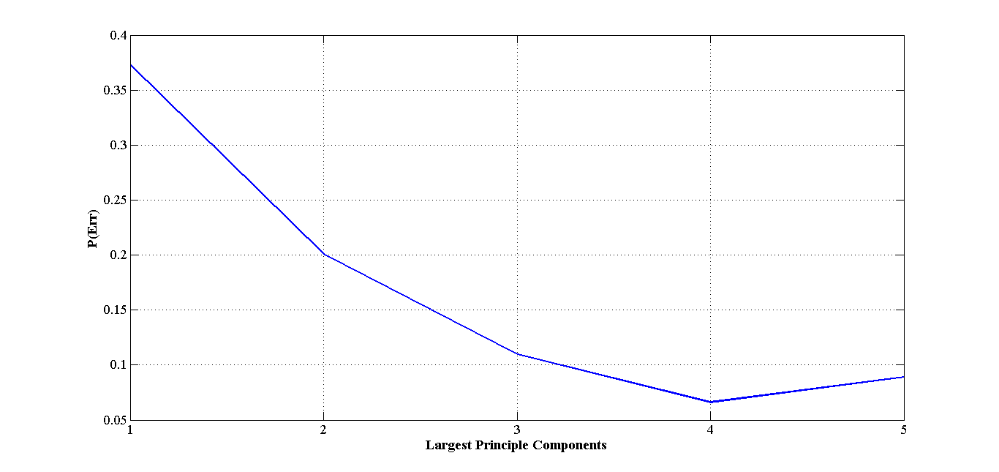
Classification Tree: Training Error and PCA
Training using 4 Largest Principle Components has a reduced error rate

Slide 13
Classification Tree: Evaluation Error and Comparison
Leafs | Parents | Levels | Largest Principle Components | Evaluation Error
1 | 5 | 1 | 4 | 0.7619
Leafs | Parents | Levels | Largest Principle Components | Evaluation Error
1 | 6 | 0 | 10 | 0.5199

Slide 14
Algorithm Comparison and Statistical Significance
K-Nearest Neighbor | Linear Discriminant Analysis | Classification Tree
0.4644 | 0.5038 | 0.5199

Slide 15
Challenges
Dimensionality of data
Hard to visualize
Dealing with outliers
Remove, decrease weight?
Learning Matlab’s Machine Learning Vocabulary
e.g. leafs/parents
Not training on the evaluation data
One shot, good luck
NOT ENOUGH DATA

