Slide 1
Final Project
Cedric Destin

Slide 2
Data Set 1
Used three algorithms
2 supervised
Linear Discriminant Analysis (LDA)
Classification and Regression Trees (CART)
1 unsupervised
K Means

Slide 3
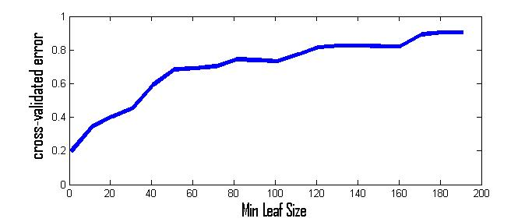
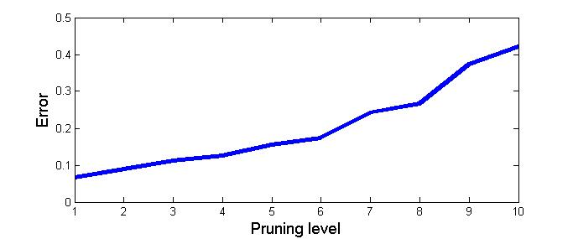
CART Training
ClassificationTree.fit
Cross-validate
cvLoss
Found best # of leaves

Slide 4
CART Training (Observation)
Two methods for tuning
Vary the number of leaves (Purity)
This is to reduce the entropy, where splitting at a node will yield better uncertainty
Prune the tree
Avoid generalization
Validation
(resubLoss)
Cross-validation (cvLoss)

Slide 5
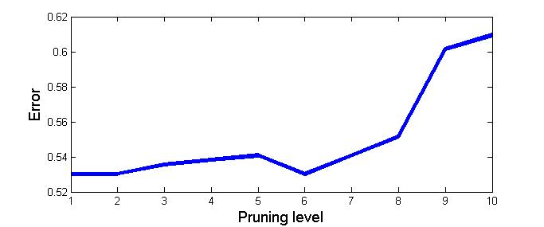
CART Training (Evaluation)
Number of leaves: 1
Pruning Level
Ideal = 6:13 levels
p(error)=0.5303

Slide 6
CART Conclusion
Used 6 pruning levels
Trained on 528 data points
Splitting criterion GDI
Measures how frequent an event occurs

Slide 7
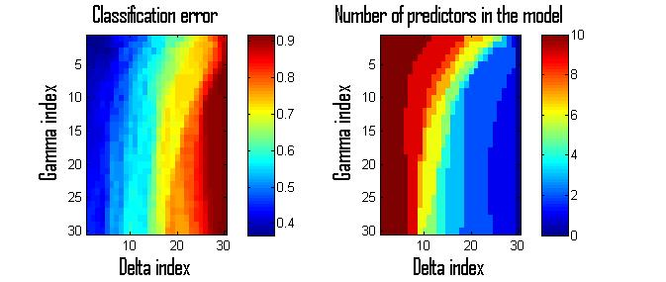
LDA Training
ClassificationDiscriminant
Cross-validate
cvLoss
Quadratic/ Linear
Varying the covariance
Gamma, Delta

Slide 8
LDA (Observation)
Tested if the covariance are Linear or Quadratic
Did not need to change Gamma or Delta
Uniform prior
Linear discriminant | Quadratic discriminant
0.3163 | 0.107

Slide 9
LDA Conclusion
Quadratic discriminant
Error=0.504
Linear discriminant
Error=0.5646

Slide 10
K-Means
How to train?
Unsupervised
Preparing the data
PCA
Procedure
Iterated 10 times
Initial cluster
Calculated 1st k iterations
Problem: data is unlabeled

Slide 11
Conclusion Data Set 1
Quadratic Discriminant AnalysisError=0.504
This seems to give better results that CART, I think that observing the classes in terms of their covariance made it perform slightly better
CART
Error=0.5303
CART required a little more tuning than QAD. I was kind of expecting it to perform slightly better, since it is trying to minizmie the uncertainty
K-Means
Error=???
This technic worked great, but I was not able to specify my centroid and label them at first.

Slide 12
Data Set: Playing Around with KNN
With basic training and no tuning
Error = 0.4406

Slide 13
Data Set 2
Temporal data
Technic: Hidden Markof Models
Training
hmmtrain
Initial transit and emit matrices calculated
Decoding
Used the estimate of the hmmtrain for the Viterbi Decoder

Slide 14
Conclusion Data Set 2
Hidden Markof Model
Error=???
This process worked until the Viterbi Decoder…

Slide 15
Question

