Slide 1


Optimized Image Processing Pipeline
Engineering Computation IV Final Project
Yingting Wu
Electrical and Computer Engineering Department

Slide 2


Introduction & Problem Statement
The Challenge
Our Objective
Rapid advancements in imaging technology have led to significantly higher resolutions. Processing these large datasets creates a massive computational bottleneck, extending beyond simple algorithm design to I/O and hardware limitations.
We aim to optimize the pipeline by integrating spatial and frequency-domain techniques. Balance spatial resolution preservation with computational cost to efficiently calculate global histogram statistics across large datasets.
Notes:
As imaging technology advances, image resolution continues to increase dramatically.
And that creates a real problem. It’s not just that the algorithms get heavier; the data movement, the I/O, even the hardware limitations all start becoming bottlenecks.
So the real question becomes: How can we analyze a massive while reducing computation and memory usage?
In this project, my goal is to build a pipeline that can handle these large images efficiently. We combine Gaussian smoothing, FFT for spectral analysis, and histogram-based statistics.
One of the hardest parts is computing global histogram statistics across all images. If we do that naively, the memory usage becomes impossible.
So the project focuses on reorganizing the workflow to balance accuracy, memory, and computation.

Slide 3










System Pipeline Overview
1. Spatial
2. Smooth
3. Spectral
4. Analysis
Window shifting
&
Grayscale Conversion
Gaussian Blurring to suppress noise
2D Fast Fourier Transform (FFT)
Log Scaling
&
Histogram Calculation
Notes:
This slide gives a quick overview of the full pipeline.
To handle memory limitations, the main idea is to compute the global histogram from small window streams rather than storing full spectral maps in memory.
I start by sliding a window across the image.
Instead of loading the entire image, I load only small RGB window chunks into memory and send those to the GPU.
On the GPU, the first step is converting each window to grayscale, which reduces the data from three channels down to one.
After that, I apply Gaussian blurring to smooth the window and reduce noise
Then, I move into the frequency domain using FFT to extract structural patterns from the window.
From there, I take the log-scaled magnitude spectrum and compute the histogram values. These histogram pieces are then accumulated and used to compute the global histogram for the entire dataset.

Slide 4



Implementation Details
Configuration & Specs
Data Flow Optimization
•
Hardware: Node nedc_012 (NVIDIA A40), 4 GPUs, 12 Threads.
chunk_size = batch_size * 4
•
•
CPU (Chunk Size): Reads large buffers (4×N) into system RAM. This prevents System Memory (RAM) exhaustion by avoiding full-image loading while ensuring a steady stream.
Windowing: 256×256 spatial window with a 128 stride.
•
Histogram Config:
bin =16, range = [0, 16.612394]
•
GPU (Batch Size): Processes smaller subsets (N) to balance VRAM constraints vs. kernel launch overhead.
Notes:
To run this pipeline efficiently, I used node nedc_012, which is equipped with an NVIDIA A40 and using four of them.
On the CPU side, I used 12 threads to continually read window values.
I used a 256×256 sliding window with a 128-pixel stride, which gives me 50%.
For the histogram, I used 16 bins within a fixed range. To determine that range, I randomly selected 20 images and computed their spectrum’s minimum and maximum values.
A key optimization in this pipeline is separating the CPU chunk size from the GPU batch size.
The CPU work with about 4N windows at a time—into RAM so we don’t load all windows at once.
The GPUs, on the other hand, work with smaller batches of size N, which keeps.

Slide 5
Spatial Domain Processing
Sliding Window Strategy
Grayscale Conversion
•
Windowing: 256×256 pixels.
Gray = 0.299R + 0.587G + 0.114B
•
Stride: 128 pixels (50% Overlap).
•
Benefit: Reduces dimensionality by 3 channels → 1. Method: Aligns with human luminance perception for structural analysis.
•
Benefit: Allows processing of large scale dataset without full-memory loading.
Notes:
To avoid loading large SVS files into memory, I extract the image in small local windows. Using this approach, we can process very large datasets while using only a small portion of memory at any time.
Because the frequency spectrum of these images doesn't depend on color, I convert each window to grayscale before continuing. This reduces the three RGB channels down to one while still preserving the structural information we need for spectral analysis.
I use the standard luminance-weighted formula:
This step greatly reduces data size and helps speed up the overall pipeline

Slide 6
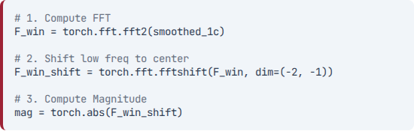


Gaussian Smoothing Strategy
Custom 7x7 Kernel (PyTorch)
•
Grid Generation: Created using torch.meshgrid over a 7x7 window centered at 0.
•
Formula: Standard Gaussian distribution where σ=1.0
def make_gaussian_kernel_7x7(device, sigma: float = 1.0):
size = 7
coords = torch.arange(size, device=device) - size // 2
yy, xx = torch.meshgrid(coords, coords, indexing="ij")
kernel = torch.exp(-(xx**2 + yy**2) / (2 * sigma**2))
kernel = kernel / kernel.sum()
return kernel.view(1, 1, size, size)
•
Normalization: kernel = kernel / kernel.sum(). This ensures the filter preserves global image brightness (energy = 1).
Notes:
The next step is Gaussian blurring, which I apply using a 7×7 custom kernel built in PyTorch. The kernel is centered at zero and normalized. Gaussian smoothing helps reduce high-frequency noise before running the FFT.
By smoothing the window first, the frequency spectrum becomes much more stable and easier to analyze.

Slide 7
Spectral Analysis: 2D FFT
Why 2D FFT?
Implementation (PyTorch)
Transforms the image from the spatial domain to the frequency domain, representing the image as a combination of sinusoidal components. This allows efficient analysis of structural patterns.
Notes:
Key Steps:
1. fft2: Computes the discrete Fourier transform.
2. fftshift: Centers the zero-frequency component (DC) for easier visualization.
3. abs: Extracts magnitude, discarding phase.
Then we transform each window into the frequency domain using a 2D FFT.
FFT decomposes the image into sinusoidal components, allowing us to observe patterns that are hard to see in the spatial domain.
In my implementation, PyTorch handles FFT operations directly on the GPU.

Slide 8

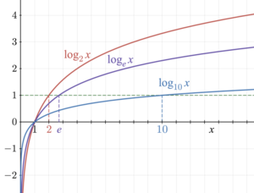
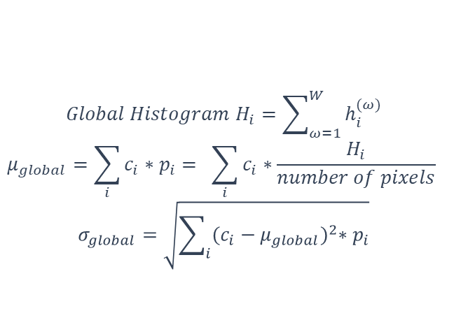
Analysis: Log Scaling & Global Stats
Logarithmic Scaling
Global Statistics
log(1+x)
•
Strategy: Aggregate local histograms directly.
•
Goal: Compress high dynamic range.
•
Key: Fixed bin centers across dataset.
•
Why "+1"? Prevents singularity at 0.
•
$$Global Histogram H_{i}=\sum_{ω=1}^{W}{h_{i}^{(ω)}}$$
$$μ_{global}=\sum_{i}{c_{i}∗p_{i}= \sum_{i}{c_{i}∗\frac{H_{i}}{number of pixels} }}$$
$$σ_{global}=\sqrt{\sum_{i}{{(c_{i}−μ_{global})}^{2}∗p_{i}}}$$
Benefit: Stabilizes numerical noise.
Notes:
After computing the magnitude spectrum, I apply log scaling to compress the values.
Before taking the log, I add 1 to every pixel. This avoids log-zero issues and also prevents extremely small values—like 0.0001 or 0.001—from blowing up after the log transformation.
Without adding 1, those tiny low-frequency values would expand into very large negative numbers, which means they would dominate the mean of histogram.
After the log transform, I compute histograms for each window and then aggregate them to produce the global mean and standard deviation across the entire dataset.

Slide 9
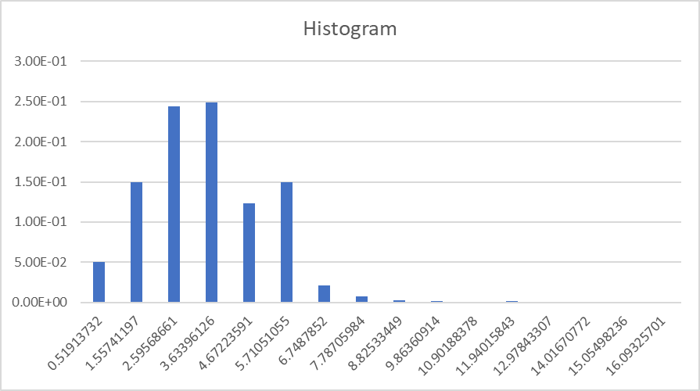
Experimental Results
Performance
•
Runtime: Average of 23.97 seconds per image.
Statistical Findings
•
Global Mean: 3.4859934625303106
•
Standard Deviation: 1.6502819934047135
The histogram resembles a bell curve, indicating spectral energy is concentrated around central values with few high-frequency outliers.
Numbers of GPU | Real time
1 | 154.094793 sec/image
2 | 71.256 sec/image
4 | 23.97061 sec/image
Notes:
Here are the results. I tested the pipeline on 100 images from the dataset.
The histogram shows a bell-shaped distribution, which means most of the spectral energy is concentrated around the center frequencies rather than the extremes.
The average runtime is about 23.97 seconds per image.
The global histogram statistics come out to a mean of 3.486 and a standard deviation of 1.650.
I also experimented with using different numbers of GPUs. As expected, when more GPUs are used, the overall processing time becomes faster

Slide 10
Conclusion
Summary
Impact
I successfully developed a scalable pipeline integrating FFT, Gaussian blurring, and fixed-range histograms. The CPU-GPU pre-fetching architecture effectively mitigates I/O latency.
These strategies significantly reduce memory usage while maintaining statistical precision, offering an effective solution for high-resolution databases like SVS pathology images, even in resource-constrained environments.
Notes:
In summary, I built an efficient pipeline that combines window extraction, Gaussian blurring, FFT, and histogram analysis to process very large datasets.
Through this project, I learned how important careful memory management is.
By batching the data, I was able to significantly reduce memory usage and keep the system stable. So I want to sincerely apologize for accidentally shutting down the system a couple of times during testing.

Slide 11
Questions?
Thank you for your attention

