Slide 1
GPU-Accelerated Multi-Threaded Pipeline
By Shahzad Khan
Temple University
College of Engineering
12/12/2025

Slide 2
Overview and Objectives
Goal: Iterate of a database of images and apply a 2D Gaussian filter, compute a 2D FFT, and compute a histogram of the data
Implement a pipeline that optimizes this process and get the fastest time
Tools: PyTorch, nedc_image_tools, os, fft

Slide 3
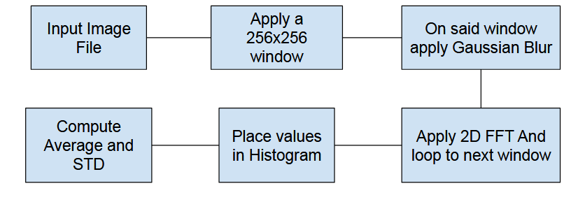
Pipeline
Read Image using nedc_image_tool
Apply 256x256 windowing
Apply 2d Gaussian Blur
Apply 2d FFT
Compute a 16 bin histogram
Average through all windows

Slide 4
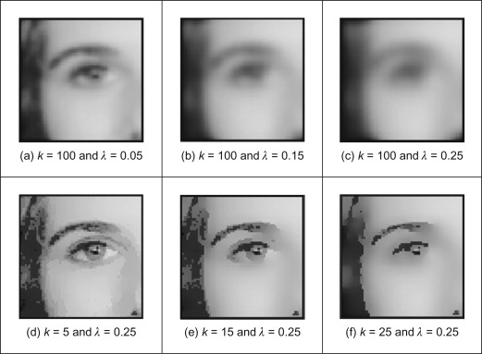

2D Gaussian Blur
Split into 2 1D Gaussian Blurs
1 Horizontal Blur 1 Vertical Blur
Used simple $σ=1.0$
From $O\left(n^{2}\right) to O\left(2n\right)$

Slide 5
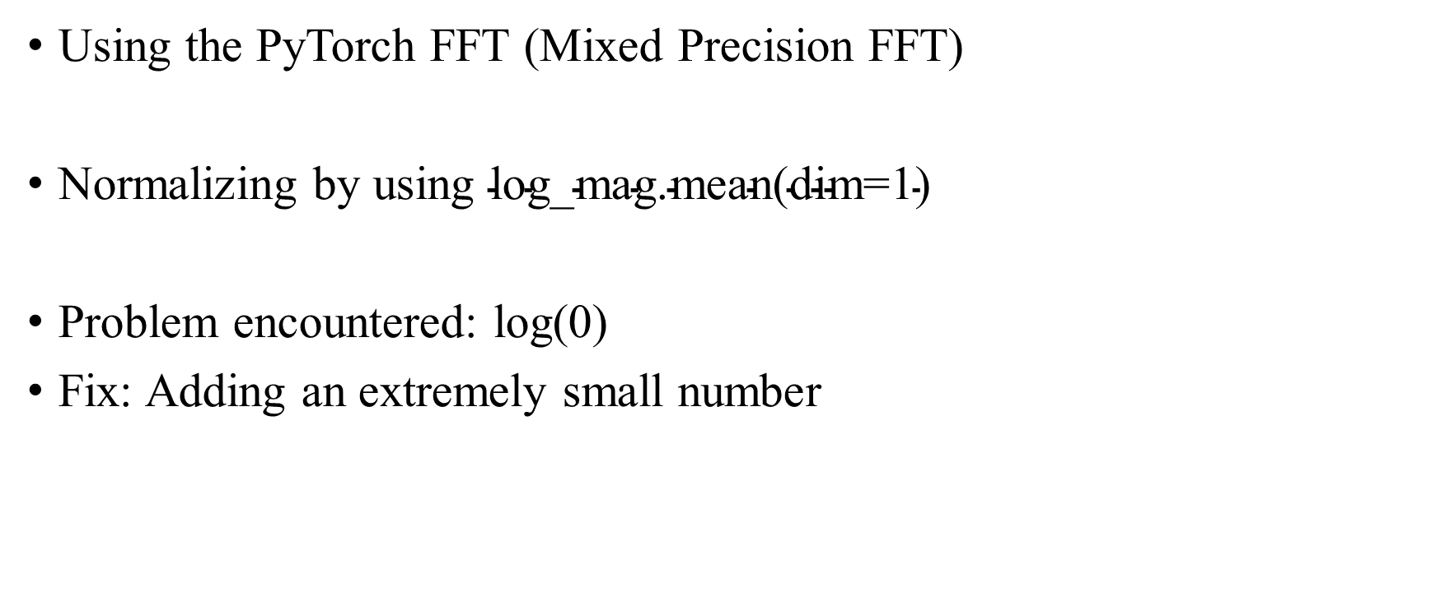
Compute 2d FFT
Using the PyTorch FFT (Mixed Precision FFT)
Normalizing by using $\text{log}\text{_}\text{mag}\text{.}\text{mean}\text{(}\text{dim}\text{=1)}$
Problem encountered: log(0)
Fix: Adding an extremely small number

Slide 6
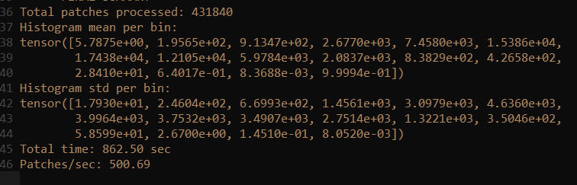
Histogram Results
FFT after log computations returns a 256x256 matrix
Compute a global min and max from each window
Figure 1: Hist mean and STD per bin 86.2 sec per image

Slide 7
Conclusion
Memory management:
Better management of intermediate buffers could allow even larger batch sizes per GPU.
Optimize batch sizes:
Larger batches (128–256 patches) could further reduce CPU-GPU transfer overhead.

