Slide 1
Final Project: GPU-Accelerated Processing of Large-Scale SVS Images
Temple University ECE 4822 Yi Hsuan Huang

Slide 2
Motivation & Problem
Motivation: Frequency-Based Analysis of Whole-Slide Images
Whole-slide images are extremely large
Direct pixel-wise comparison is impractical
CPU-only processing is too slow
Use GPU to accelerate heavy computation
Goal: accelerate preprocessing using GPU
Notes:
We cannot load them entirely into memory.
Extracting frequency-based features requires sliding window
so the goal of this project is to move as much computation as possible to the GPU.

Slide 3
Dataset &
Input Format
Input format: .svs files (WSIs)
File paths stored in files.list
Images streamed instead of fully loaded into memory
Total number of slides: 3505
Notes:
The dataset contains 3,505 de-identified whole-slide images in .svs format. All file paths are stored in a files.list.
Because these files are too large, I process them using streaming window extraction instead of full loading.

Slide 4
Overall Pipeline
.svs (WSI) → sliding windows
RGB → grayscale
Gaussian blur
2D FFT → magnitude → log
Histogram feature (16 bins)
Mean & standard deviation
Notes:
This figure shows the entire pipeline.
Windows are extracted on CPU, but all heavy numerical operations are on GPU:
grayscale conversion, Gaussian blur, FFT, logarithmic magnitude, and histogram.
Finally, mean and standard deviation are computed across all slides.

Slide 5
Window Extraction (CPU I/O)
Window size: 256 × 256
Stride (frame size): 128 × 128
Overlapping windows
Implemented by stream_windows
All I/O operations on CPU
Windows sent to GPU in batches (batch = 256)
Per slide, windows are streamed in mini-batches (batch size = 256).
Batch size refers to the number of windows processed simultaneously on the GPU, not the number of slides.
Notes:
Window extraction is performed entirely on the CPU.
The function stream_windows streams windows in batches. These batches are then transferred to the GPU for processing.
Instead of processing one window at a time, I use mini-batch processing, where 256 windows are stacked into a single tensor and transferred to the GPU at once. This significantly reduces CPU–GPU data transfer overhead and improves GPU utilization, leading to much faster computation.

Slide 6
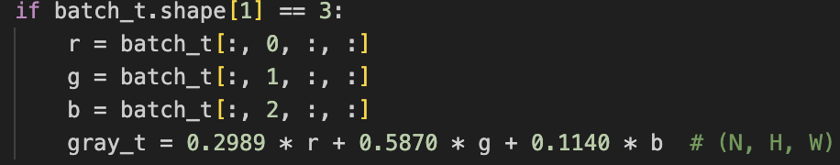

GPU Preprocessing: Grayscale + Gaussian
RGB → grayscale on GPU
Standard luminance conversion
$$Gray = 0.2989R + 0.5870G + 0.1140B$$
7×7 Gaussian kernel (σ = 1.5) using $conv2d$
Implemented by conv2d on GPU
Notes:
One major optimization is moving the
RGB-to-grayscale conversion onto the GPU.
Previously, each window was converted on the CPU before being copied to the GPU, which caused unnecessary CPU load and extra transfer overhead.
On the GPU, the conversion becomes a simple tensor operation applied to the entire batch at once.
The formula 0.2989 R + 0.5870 G + 0.1140 B is the standard luminance-based grayscale conversion.
After grayscale, I apply a 7×7 Gaussian blur using PyTorch’s conv2d

Slide 7

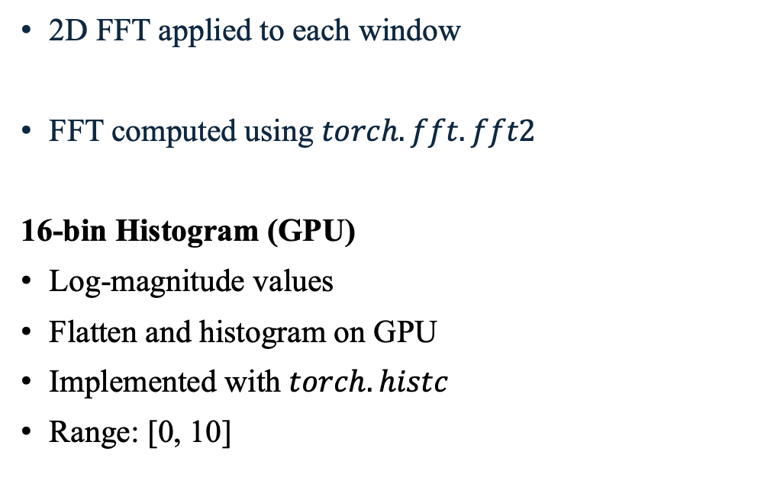
2D FFT &
Log-Magnitude &
GPU Histogram
2D FFT applied to each window
FFT computed using $torch.fft.fft2$
16-bin Histogram (GPU)
Log-magnitude values
Flatten and histogram on GPU
Implemented with $torch.histc$
Range: [0, 10]
Notes:
The log-magnitude results are flattened and passed to torch.histc to compute a 16-bin histogram.
Performing the histogram on the GPU avoids transferring intermediate results back to the CPU.

Slide 8
Performance Improvements
GPU Optimization
The core algorithm (Gaussian + FFT + histogram) is unchanged.
Three Key Optimizations
Grayscale moved to GPU
Batch size increased: 128 → 256
Disabled debug printing
Result:
Average runtime per slide ≈ 45 seconds
Notes:
I applied three key optimizations.
First, grayscale conversion was moved to the GPU.
Second, increasing the batch size from 128 to 256 improved GPU utilization.
Third, I disabled unnecessary debug printing to avoid I/O overhead.
After these optimizations, the average processing time per slide was about 45 seconds.."

Slide 9
Moving Grayscale Conversion from CPU to GPU
Before (Initial Implementation):
Grayscale conversion was performed on the CPU.
Each window was converted one by one before being sent to the GPU.
This introduced extra CPU workload and CPU–GPU data transfer overhead.
After (Final Implementation):
RGB windows are directly transferred to the GPU.
Grayscale conversion is performed on the GPU using tensor operations.
All windows in a batch are processed in parallel.
Effect:
Reduced CPU computation
Reduced data transfer overhead

Slide 10
Batch Size Optimization
Before:
Batch size = 8, 64, 128
GPU utilization was not fully saturated.
After:
Batch size = 256
More windows are processed simultaneously on the GPU.
FFT and convolution are executed in larger batched operations.
Effect:
Better GPU parallelism
Faster average processing time per slide

Slide 11
Disabling Debug Printing
Before:
Debug information was printed every 2000 windows.
Frequent console I/O caused performance slowdown during long runs.
After:
Debug printing is disabled during the full experiment.
Effect:
Reduced I/O interruption
More accurate wall-clock timing

Slide 12
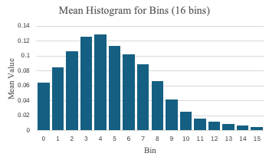
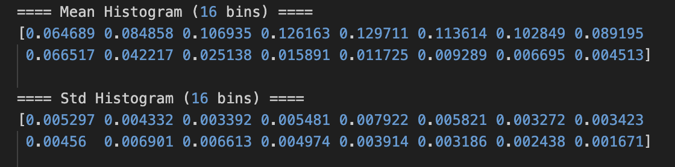
Dataset (Mean & Std)
Figure1 Mean Spectral Histogram across 3,505 Whole Slide Images
Spectral Centroid (Expected Value): Bin 4.77
Figure2 Mean and Std of the 16-Bin Histogram
Notes:
Here I summarize the statistical results over all 3,505 slides.
The bar chart on the shows the mean histogram across all slides.
You can see that most log-magnitude values fall within the lower bins, roughly between bin 2 and bin 6.
This means the frequency content of the blurred windows is concentrated in the low-to-mid range.
Below that, I also computed the standard deviation for the same 16 bins.
The standard deviations are very small, less than 0.02 across all bins
which indicates that the histogram distribution is quite stable across different slides.
This stability is important, because it shows that the feature extraction pipeline is consistent and robust.
Finally, the entire GPU-accelerated pipeline achieves an average runtime of about 45 seconds per slide, which is a significant improvement without modifying the core FFT-based algorithm.
這一頁我總結所有 3505 張 slide 的統計結果。
右邊的長條圖顯示的是所有 slide 的「平均直方圖」。
可以看到大部分的 log-magnitude 值集中在 bin 2 到 bin 6 之間，
代表經過 Gaussian 模糊後的頻率能量主要集中在低到中頻段。
下面的數字則是 16 個 bins 的「標準差」。
標準差非常小，表示不同 slide 的直方圖分布其實相當一致。
這代表整個特徵抽取流程是穩定且具有一致性的。
最後，使用 GPU 加速後，整體流程平均每張 slide 大約 45 秒，
而且完全沒有更動核心 FFT-based 演算法，屬於純粹的效率提升

Slide 13
Performance
Version | Grayscale Location | Batch Size | Notes
Initial Version | CPU | 128 | CPU gray + smaller batch
Optimized Version | GPU | 256 | GPU gray + larger batch
Performance improvement mainly comes from better GPU utilization.
Moving grayscale conversion to the GPU and increasing the batch size reduce overhead significantly.
Final Performance:
Average runtime ≈ 45.139 seconds per slide
This means the GPU pipeline is approximately conservative 11.58 times faster than the CPU-based version.
Version | CPU or GPU | 10 Slides | Average/ slide
Initial Version | CPU | 5230.147 s | 523.0147 s
Optimized Version | GPU | 463.312 s | 46.3312 s
the CPU baseline was limited to only 2000 windows, while my GPU version processed the full resolution
Notes:
This table summarizes the performance difference between the initial version and the optimized version of the pipeline.
In the initial version, the grayscale conversion was performed on the CPU.
For 10 slides, the total processing time was 5230 seconds, which results in an average of 523 seconds per slide
In the optimized version, the grayscale operation was moved to the GPU.
The same 10 slides now take 463 seconds in total, which is only 46.3 seconds per slide.
This means the GPU pipeline is approximately 11 times faster than the CPU-based version, even though the core algorithm remains exactly the same.

Slide 14
Conclusion
Heavy computation fully on GPU
Bottleneck: I/O and window extraction on CPU
Batched FFT and convolution
Achieved 11.58x speedup(45s/slide) compared to CPU-only approach
Future: multi-gpu scaling
Notes:
In conclusion,
The acceleration comes entirely from moving preprocessing steps onto the GPU and increasing parallelism.
The final pipeline is efficient and scalable for large WSI datasets. In the future, the workflow could be extended to multiple GPUs.
"In this project, I have demonstrated the effectiveness of using GPU for accelerating the processing of whole-slide images.
By fully offloading computationally intensive tasks, such as grayscale conversion, Gaussian smoothing, and 2D FFT, to the GPU, we achieve a significant speedup.
This approach allows us to handle larger datasets and process images much faster compared to traditional CPU-only methods.
However, there are still limitations, particularly with I/O latency, which impacts overall performance.
In conclusion, this GPU-accelerated pipeline greatly reduces processing time while maintaining consistency in spectral features.
Moving forward, one of the key areas for improvement is exploring multi-GPU scaling to further boost performance, especially for larger datasets.

Slide 15
Thank you

