Slide 1

Ece 4822 final image processing with a GPU
Massimo Graham

Slide 2
Overview of the task
Load and read .svs file
Loop over image using 256x256 pixel window
Apply 2D gaussian filter
Place magnitudes into log magnitude spectrum histogram
Convert frequencies to magnitudes
Compute 2d fft

Slide 3

IMplementation
Cpu Tasks
  Loading and reading images
  Batching the data
  Transferring data to GPU
  Printing results
Gpu tasks
  Gaussian filter
  2d FFT
  Log magnitude spectrum calculations
  Histogram binning

Slide 4
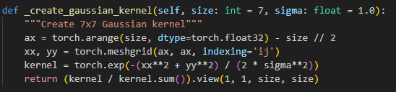
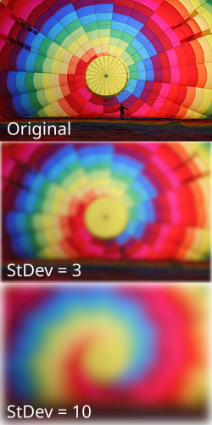

Gaussian BLur
Reduces detail
  Acts as a low pass filter
Convolution allows for separation of rgb channels so they are all filtered equally

Slide 5
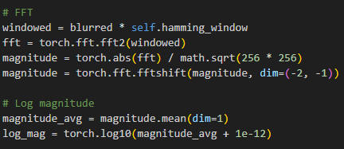
2d fft
Break down each window into its representative frequency
Convert to log mag

Slide 6
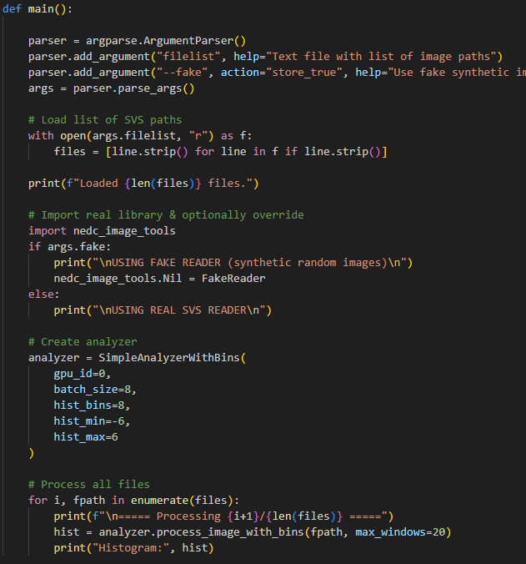
Testing
Created synthetic images
Ran the analyzer on them
  Results with majority of the data in low frequency spectrum

Slide 7
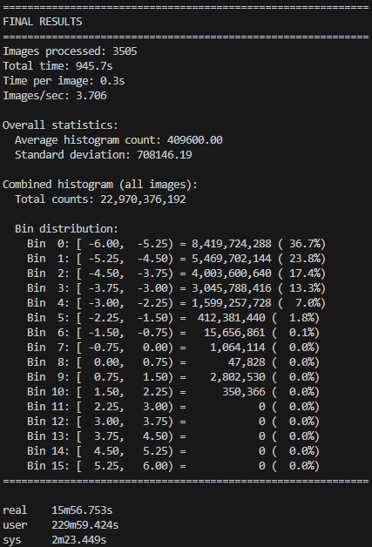
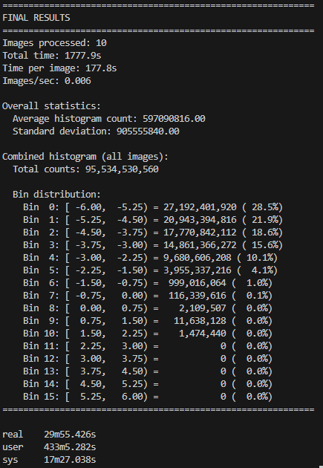
Results
More windows fells into the low frequency spectrum
  To be expected after applying blur
High standard deviation

Slide 8
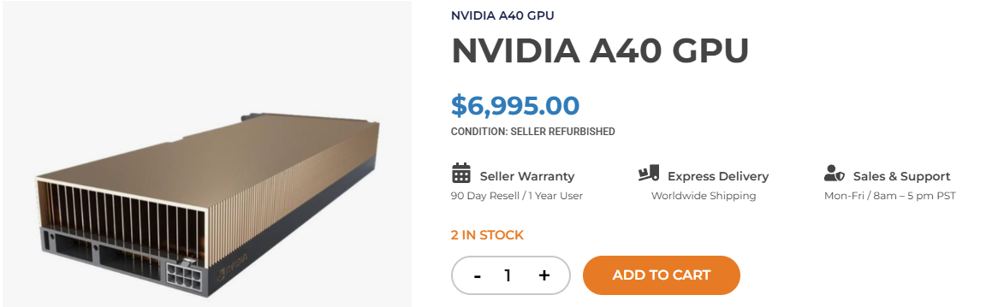
Conclusion
Started with python – way to slow
  ~12 hours for 100 images
Gpu code was fairly complicated but the speedup is very impressive

