Slide 1
ENGR Computation IV Project
Korey M. Frazer
Electrical and Computer Engineering Department
Temple University

Slide 2
Objectives, Constraints, and Notes
The objective of this project is to filter the data located on the images (SVS files) by constantly feeding small amounts of information from the files into NEDC_012 to calculate a log-mag histogram.
Using the time command, take the real time it takes for the code to complete
Reading files from the /svs directory is a potential bottleneck since the data would have to be read from somewhere else
Used PyTorch instead of CUDA

Slide 3

PyTorch
PyTorch is an open-source deep learning framework and tensor computation library.
Uses tensors (multi-dimensional arrays) and accelerates operations using CUDA.
Since it can run CUDA, most code written using PyTorch can be sent to GPUs without much difficulty.

Slide 4
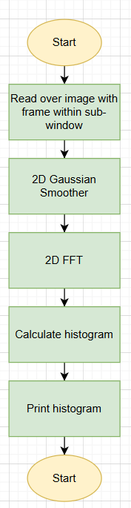
Order of Functions
1) Read over the image with a 128x128 frame size in a 256x256 window size
2) Apply 2D Gaussian Smoother to the image
3) Compute 2D FFT to find the magnitudes
4) Compute histogram on log-mag spectrum
5) Print the histogram

Slide 5
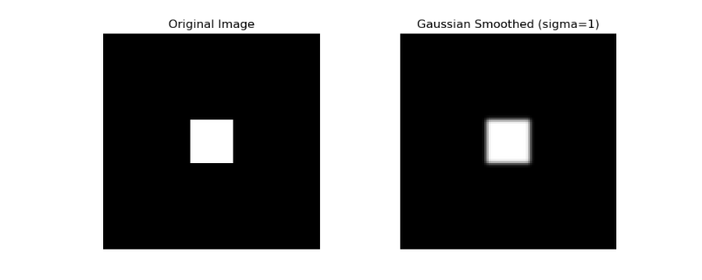
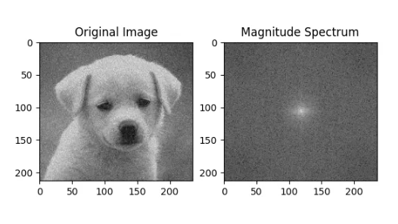

2D Gaussian Blur and 2D FFT
2D Gaussian Blur:
Image must be blurred to read the shifting magnitude from black to white
The value of sigma ($σ$) matters greatly, value used is 1.2
2D FFT:
Takes a spatial image, converts to the frequency domain and shows where the most power is located.
Light spot in the middle represents the DC component or the point where the lowest frequency resides
Smooth surfaces have lower frequencies, sharper images have higher frequencies

Slide 6

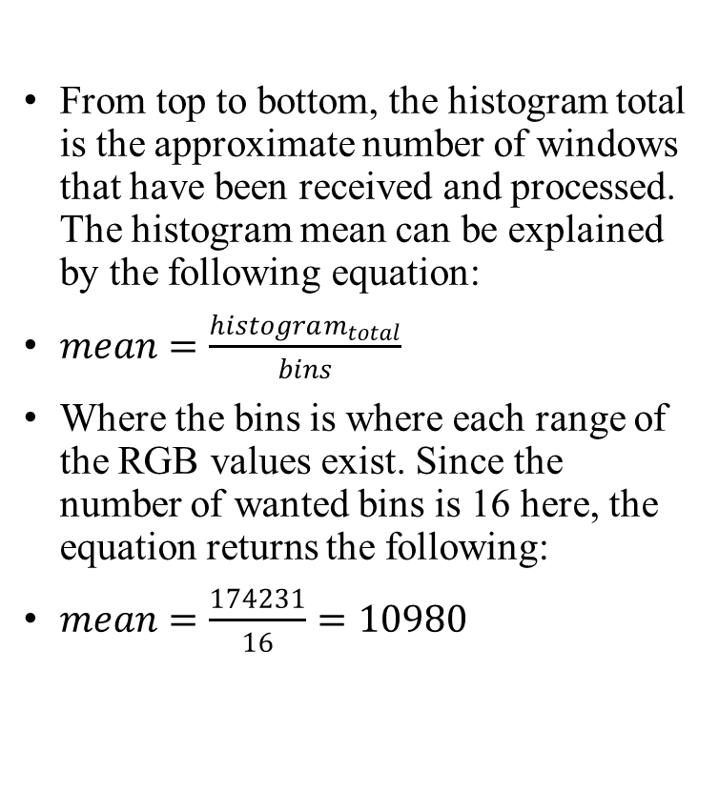
Histogram
From top to bottom, the histogram total is the approximate number of windows that have been received and processed. The histogram mean can be explained by the following equation:
$mean=\frac{histogram_{total}}{bins}$
Where the bins is where each range of the RGB values exist. Since the number of wanted bins is 16 here, the equation returns the following:
$mean=\frac{174231}{16}=10980$

Slide 7
Results
With one GPU and five images, the average time between them was 102 seconds per image.
Speedup can be achieved with more I/O optimization.

Slide 8
Discussion and Future Ideas
Understood the value of using Python over C/CUDA code when it comes to complex issues, raw CUDA code has its bottlenecks if it’s not carefully created.
More I/O optimization is needed for another time, I imagine grabbing data in batches would speed things up since the CPU and GPUs would be busy with the information already given.
Compare the speed that CuPy can get versus PyTorch to see which can operate this project faster.

Slide 9
Thank you for your time!
Any questions?

