Slide 1
Medical Image Processing
Ken Chong
Electrical Engineering, Temple University

Slide 2
Image Processing Pipeline

Slide 3
Memory Optimization

Slide 4
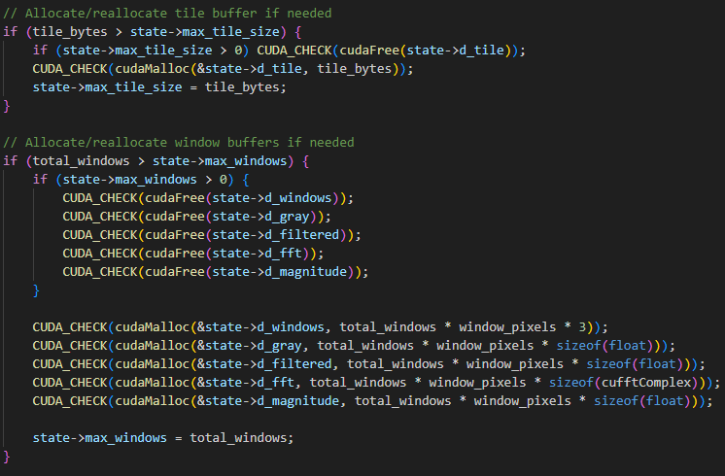

Slide 5
Shared Memory Optimization

Slide 6
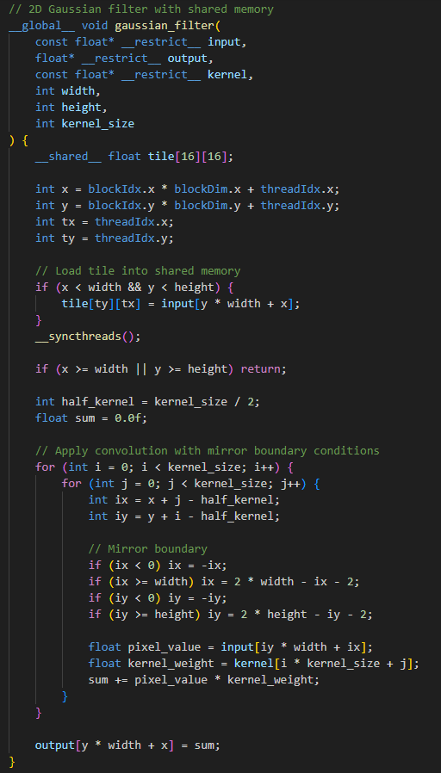
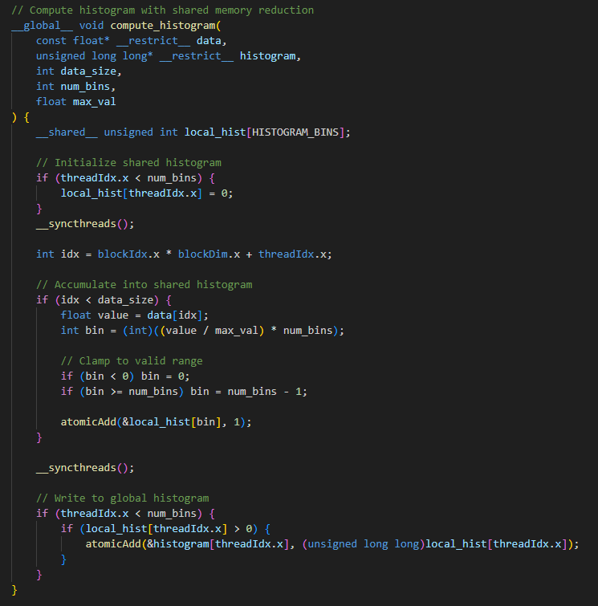

Slide 7
Multiple GPUs

Slide 8
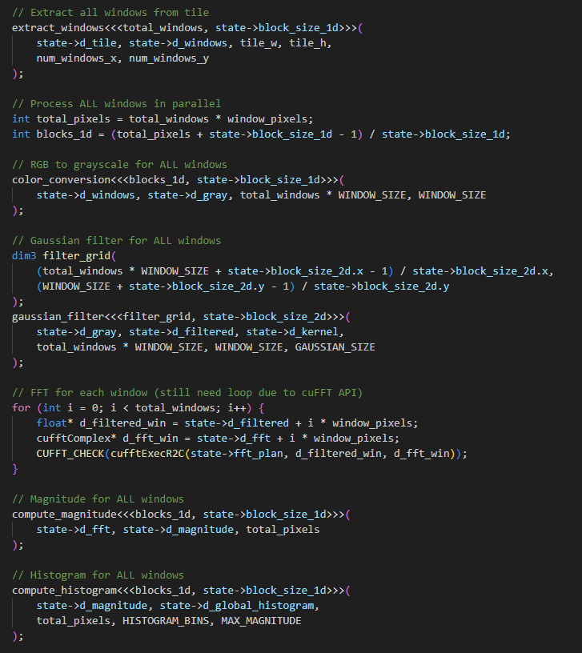
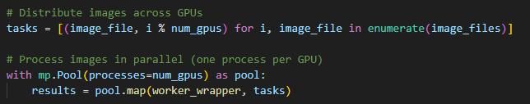

Slide 9
Performance Results

