Slide 1



High-Performance GPU Computing for Medical Image Spectral Analysis
Md Abdullah Al Mamun​
MS Student, Electrical Engineering​
Neural Engineering Data Consortium​
Temple University​

Slide 2
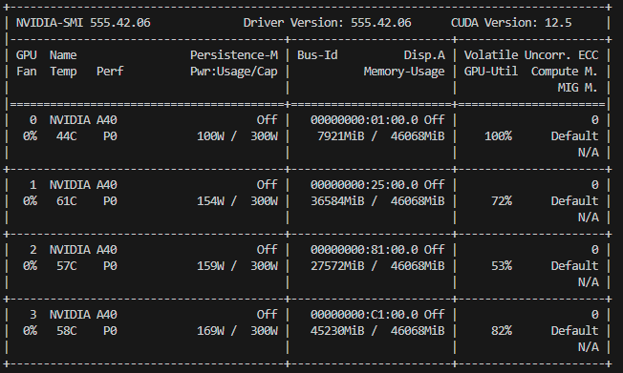
Problem Definition & Constraints
Objective:
  Compute log-magnitude spectral distributions for 3,505 high-res SVS slides (~30TB uncompressed pixel data).
Hardware:
  4x GPUs available (nedc_012).
  NVIDIA A40
  GPU-Memory: ~45Gi (each)
  CPU-Memory: 251Gi
  CPU Cores: 96
Metric:
  Wall-clock time (Total Throughput).
Core Challenge:
  The math (Convolution and FFT) is fast; moving terabytes of
  data from disk to GPU memory is the
  bottleneck.

Slide 3
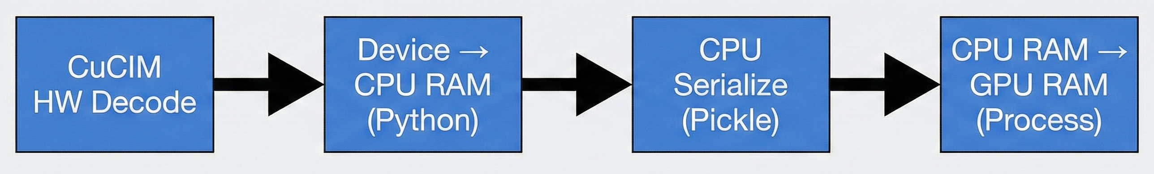
Architecture A (Baseline) – "Producer-Consumer"
Design:
  Standard Producer-Consumer with nedc_image_tools.
Prefetching:
  While the GPU is crunching the FFTs for Batch N the I/O async is used to pre-load the data
  The GPU less likely stops compute to wait for I/O.
The Hidden Flaw:
  CuCIM reads the file (Hardware Decode).
  Data is moved FROM Device TO CPU RAM (Host) to be handled by Python.
  CPU serializes (pickles) the tensor.
  Data is moved FROM CPU RAM BACK TO GPU RAM for processing.
Result:
  We saturate the PCIe bus moving the same data twice.
Cost:
  Massive CPU overhead managing memory copies.

Slide 4
Architecture A Performance
Time data:
  1 GPU: 141,678s (~39 hrs)
  2 GPUs: 78,562s (~22 hrs)
  4 GPUs: 59,512s (~16.5 hrs)
Analysis:
  Scaling from 2 → 4 GPUs only yielded a 1.3x speedup.
Failure Point:
  Python Serialization (Pickling). The CPU spent more time packing data into Queues than reading from disk. The GPUs were idling, waiting for data.
Throughput:
  Capped at 0.06 files/sec.
Configuration | Total Time (s) | Avg Time / Image (s) | Throughput (files/sec) | Speed-up vs 1 GPU | Speed-up vs 2 GPUs
1 GPU | 141,677.998 | 40.422 | 0.025 | 1.00× (baseline) | —
2 GPUs | 78,561.901 | 22.414 | 0.045 | 1.81× | 1.00× (baseline)
4 GPUs | 59,512.124 | 16.979 | 0.059 | 2.38× | 1.32×

Slide 5
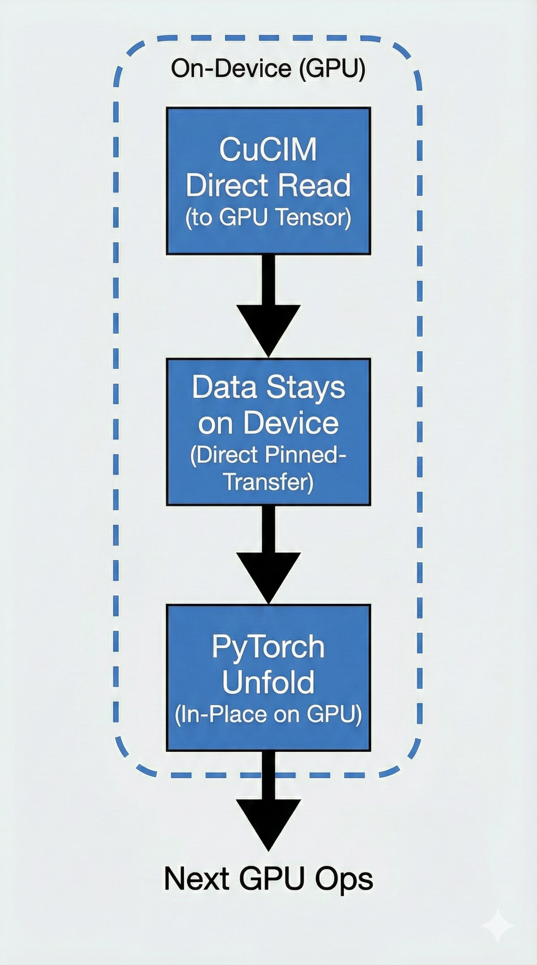
Architecture B (Optimized) – "Zero-Copy" Pipeline
Design Shift:
  Eliminate Python loop overhead and CPU-GPU serialization.
  Tensor-Native processing.
The Fix:
  CuCIM reads the file directly into GPU tensors.
  Data stays on the device (or uses direct transfer).
  CuPy is used to convert CuCIM objects into CuPy array
  PyTorch unfold processes the data in-place on the GPU.
Prefetching:
  While the GPU is crunching the FFTs for Batch N (Zero-Copy), the I/O thread is loading Batch N+1 into the buffer.
  The GPU never stops compute to wait for I/O.
Efficiency:
  Eliminates the redundant Device -> Host -> Device round trip.
Key Stat:
  CPU usage dropped significantly; GPU utilization spiked because it wasn't waiting for the bus

Slide 6
Architecture B (Optimized) Performance
Time data:
  1 GPU: 100,540.925s (~27.9 hrs)
  2 GPUs: 55,095.679s (~15.3 hrs)
  4 GPUs: 32,809.7208s (~9.1 hrs)
Analysis:
  Scaling from 2 → 4 GPUs yielded a 1.7x speedup.
Throughput:
  Capped at 0.107 files/sec.
GPUs | Total Time (s) | Avg Time / Image (s) | Throughput (files/sec) | Speed-up vs 1 GPU | Speed-up vs 2 GPUs
1 GPU | 100,540.925 | 28.677 | 0.035 | 1.00× (baseline) | —
2 GPUs | 55,095.679 | 15.720 | 0.064 | 1.825× | 1.00× (baseline)
4 GPUs | 32,809.721 | 9.360 | 0.107 | 3.066× | 1.680×

Slide 7
Architecture B+: Next Level Optimization – Latency Hiding
Tuning Block Size:
  Reading small strips (256px) = High overhead per read.
  Reading large blocks (1024px) = Maximized sequential throughput.
Time data:
  1 GPU: 85,056.208s (~23.6 hrs)
  2 GPUs: 40,282.754s (~11.2 hrs)
  4 GPUs: 18,894.64s (~5.25 hrs)
GPUs | Total Time (s) | Avg Time / Image (s) | Throughput (files/sec) | Speed-up vs 1 GPU | Speed-up vs 2 GPUs
1 GPU | 85,056.208 | 24.2671 | 0.04121 | 1.000× (baseline) | —
2 GPUs | 40,282.754 | 11.4929 | 0.08701 | 2.111× | 1.000× (baseline)
4 GPUs | 18,894.640 | 5.3908 | 0.18550 | 4.502× | 2.132×

Slide 8
The Benchmark Showdown
GPUs | Approach A (Producer–Consumer) | Avg/Image | Approach B (Optimized) | Avg/Image | Approach B+ (Highly Optimized) | Avg/Image
1 GPU | ~39.35 hrs | 40.42 s/image | ~27.9 hrs | 28.68 s/image | ~23.6 hrs | 24.27 s/image
2 GPUs | ~21.82 hrs | 22.41 s/image | ~15.3 hrs | 15.72 s/image | ~11.2 hrs | 11.49 s/image
4 GPUs | ~16.53 hrs | 16.98 s/image | ~9.1 hrs | 9.36 s/image | ~5.25 hrs | 5.39 s/image

Slide 9
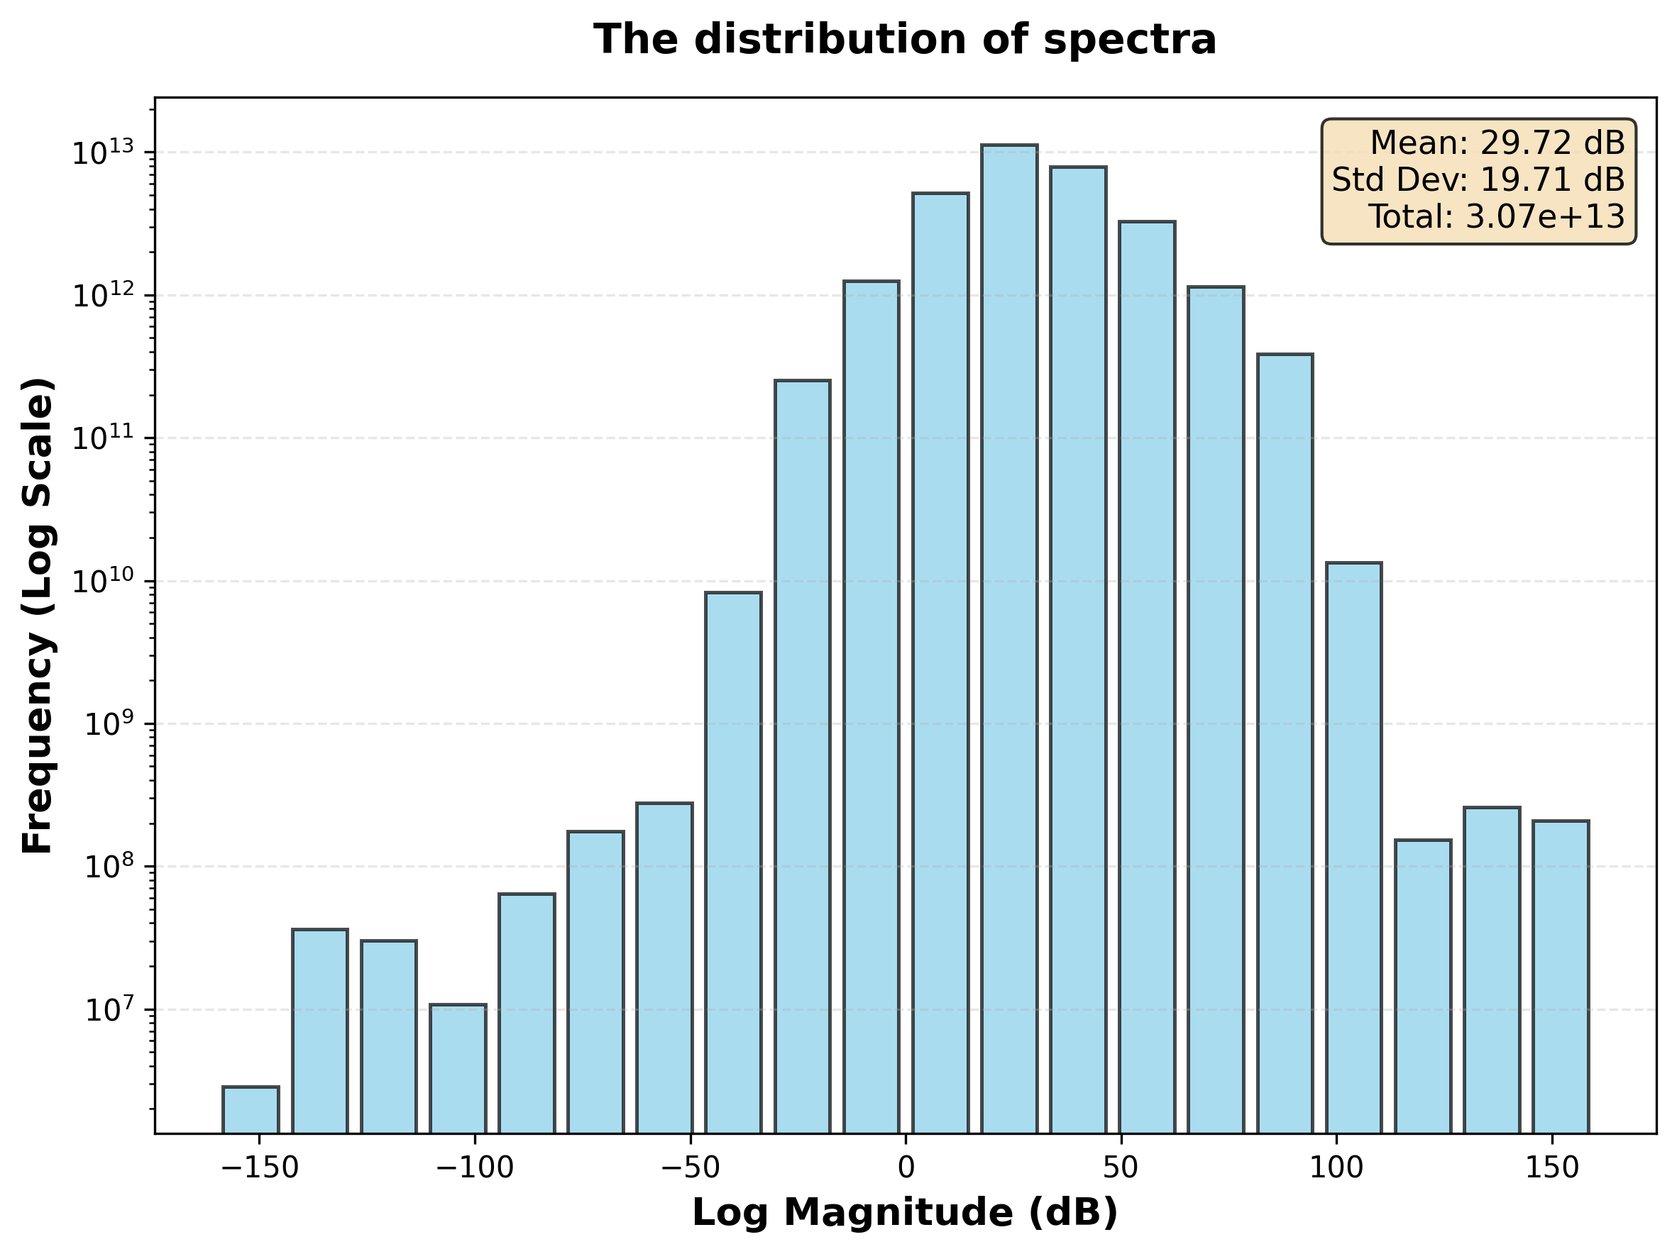
Histogram and statistics
Baseline:
Mean: 29.72
Std: 19.71
Optimized:
Mean: 29.57
Std: 20.06
Statistical Comparison
Mean (dB)
Std Dev (dB)
Total Count
29.72 vs 29.57
19.71 vs 20.06
~3.07×10¹³
0.5% diff
1.8% diff
pixels
✓ Both approaches produce nearly identical statistics

Slide 10
Acknowledgements
Computational Resources:
Neural Engineering Data Consortium (NEDC) Lab (nedc_012)
nedc_image_tools (reading WSI data efficiently)
Course Support:
Dr. Joseph Picone,
ECE 4822: Engineering Computation IV (ECE 8110 Graduate Level),
Temple University
Data Source:
The Temple University Hospital Digital Pathology Corpus (Houser et al., 2018)

