Slide 1
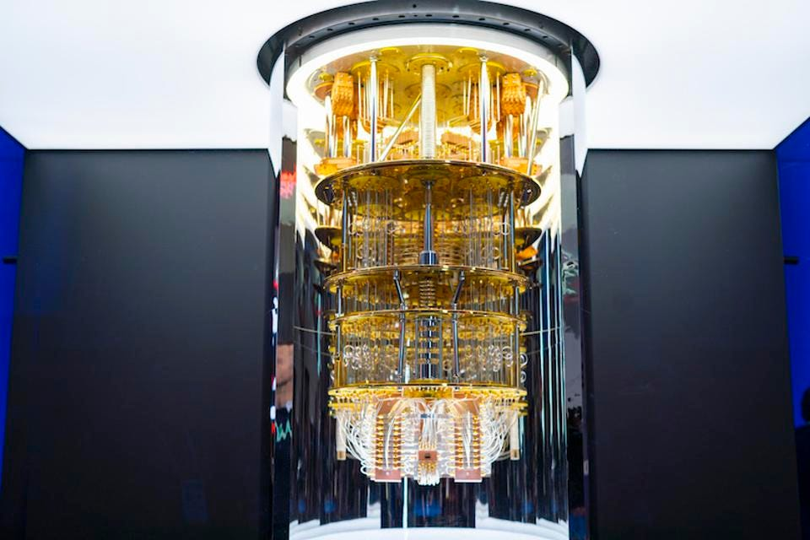
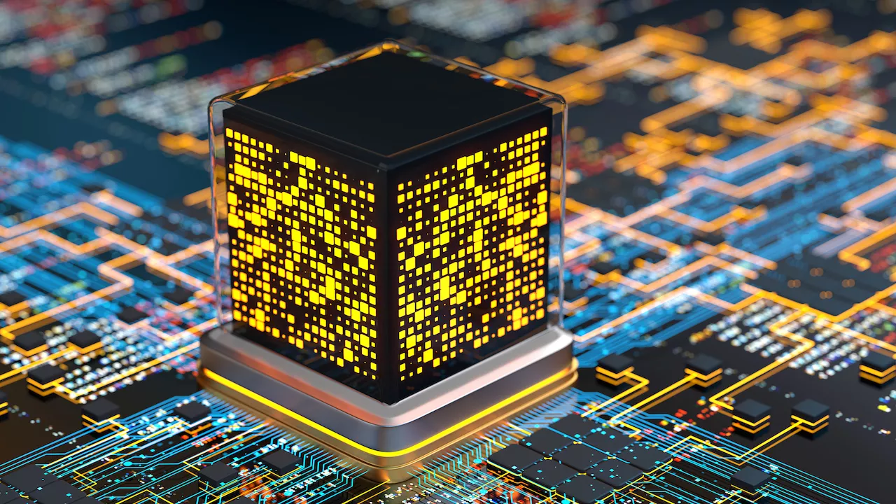
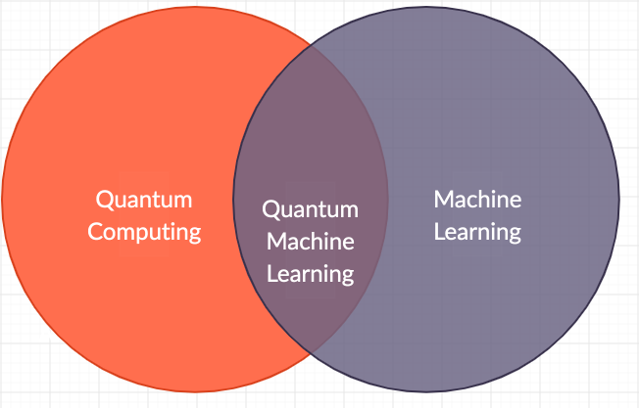
Lecture 41: Introduction to Quantum Computing
Books:
Quantum Computing: A Gentle Introduction
Lectures:
Quantum Machine Learning (IEEE SPMB)
Topics:
Quantum Computing For The Very Curious
Quantum Machine Learning (IEEE SPMB)
Quantum Computing (IBM)

Slide 2
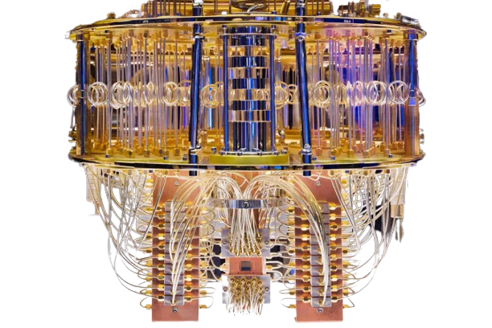
Quantum Computing
Presented By –
Biswadeep Mukhopadhyay
Roll No.: CTS/20/602
Department of Computer Science
5th Semester, 3rd Year

Slide 3
“ When you change the way you look at things,
the things you look at change ”
Max Planck
Father of Quantum Physics

Slide 4
Contents
Sl No. | Topic | Slide No.
1 | Introduction | 4
2 | QUBIT | 5 - 6
3 | Evolution of Quantum Computing | 7
4 | Quantum Superposition | 8
5 | Quantum Entanglement | 9
6 | How does a Quantum Computer Works ? | 10 - 11
7 | Why Quantum Computing ? | 12
8 | Types of Quantum Computing | 13 - 17
9 | Drawbacks | 18
10 | Tech-Giants’ Utilizing Quantum Computing | 19
11 | Conclusion | 20

Slide 5
Introduction
Quantum computing is an area of computer science that uses the principles of quantum theory. Quantum theory explains the behavior of energy and material on the atomic and subatomic levels.
Quantum computing uses subatomic particles, such as electrons or photons. Quantum bits, or qubits, allow these particles to exist in more than one state (i.e., 1 and 0) at the same time.

Slide 6
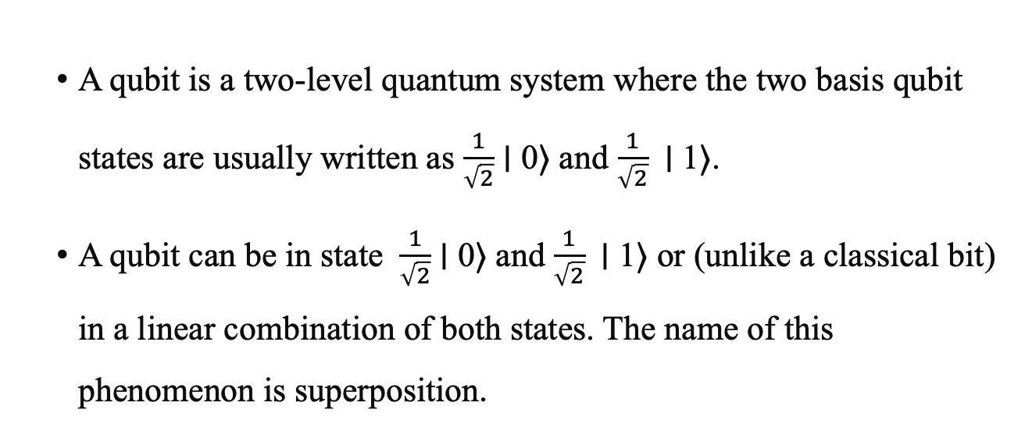
QUBIT
  A qubit is a two-level quantum system where the two basis qubit states are usually written as $\frac{1}{\sqrt{2}}$ ∣ 0⟩ and $\frac{1}{\sqrt{2}}$ ∣ 1⟩.
  A qubit can be in state $\frac{1}{\sqrt{2}}$ ∣ 0⟩ and $\frac{1}{\sqrt{2}}$ ∣ 1⟩ or (unlike a classical bit) in a linear combination of both states. The name of this phenomenon is superposition.

Slide 7
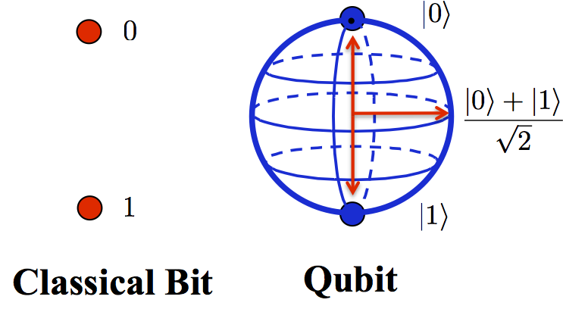
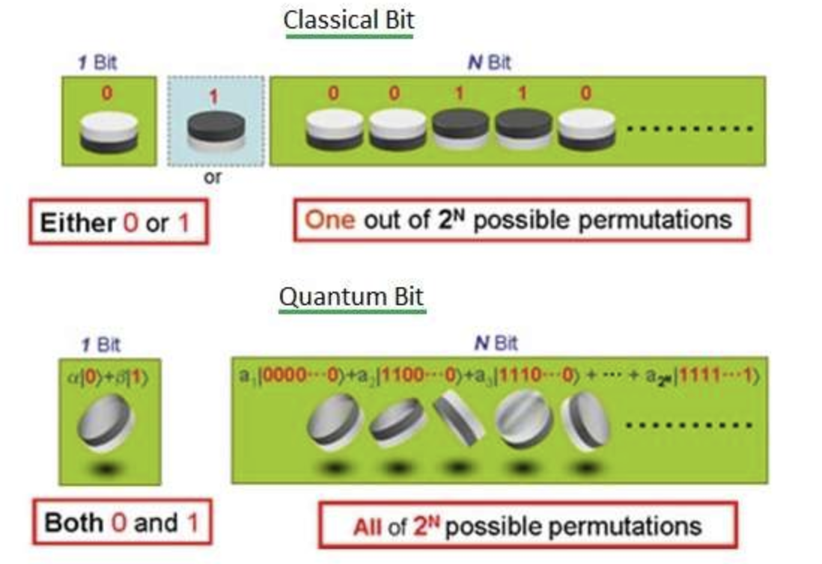

Graphical Representation of QUBIT

Slide 8
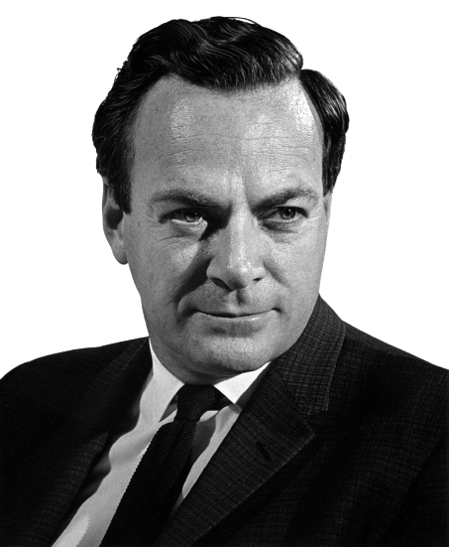
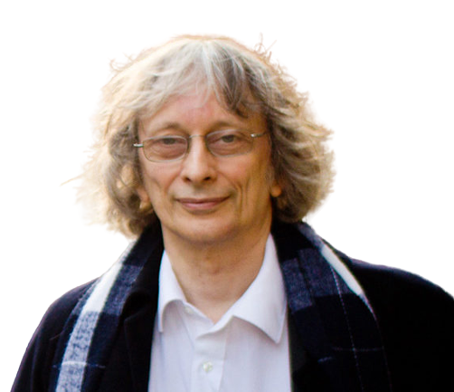
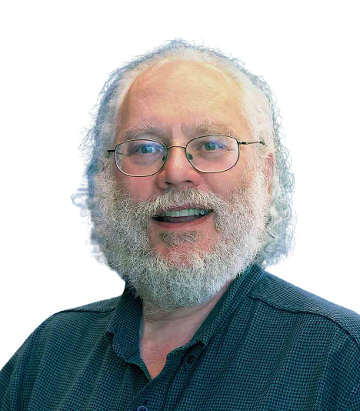
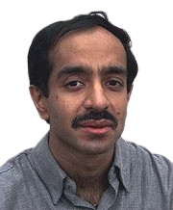
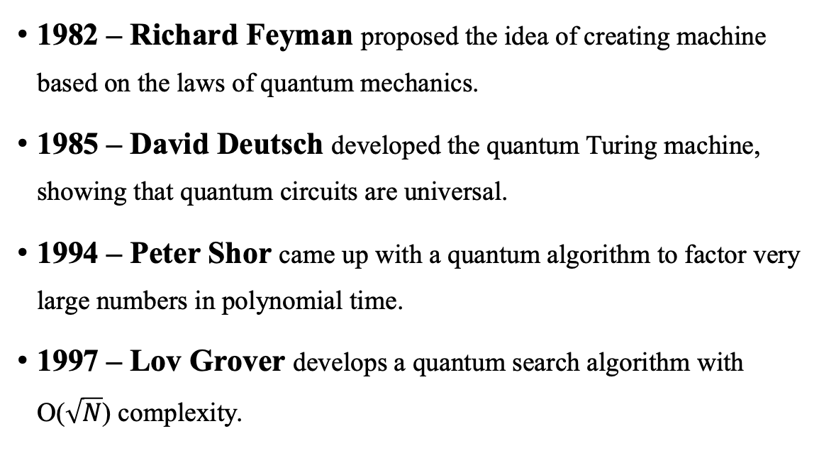
Evolution of Quantum Computer
1982 – Richard Feyman proposed the idea of creating machine based on the laws of quantum mechanics.
1985 – David Deutsch developed the quantum Turing machine, showing that quantum circuits are universal.
1994 – Peter Shor came up with a quantum algorithm to factor very large numbers in polynomial time.
1997 – Lov Grover develops a quantum search algorithm with O($\sqrt{N}$) complexity.

Slide 9
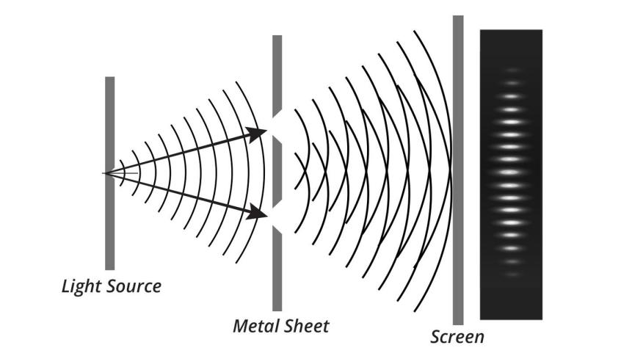
Quantum Superposition
The quantum system is capable of being in several different states at the same time.
Example – Young’s Double Slit Experiment

Slide 10
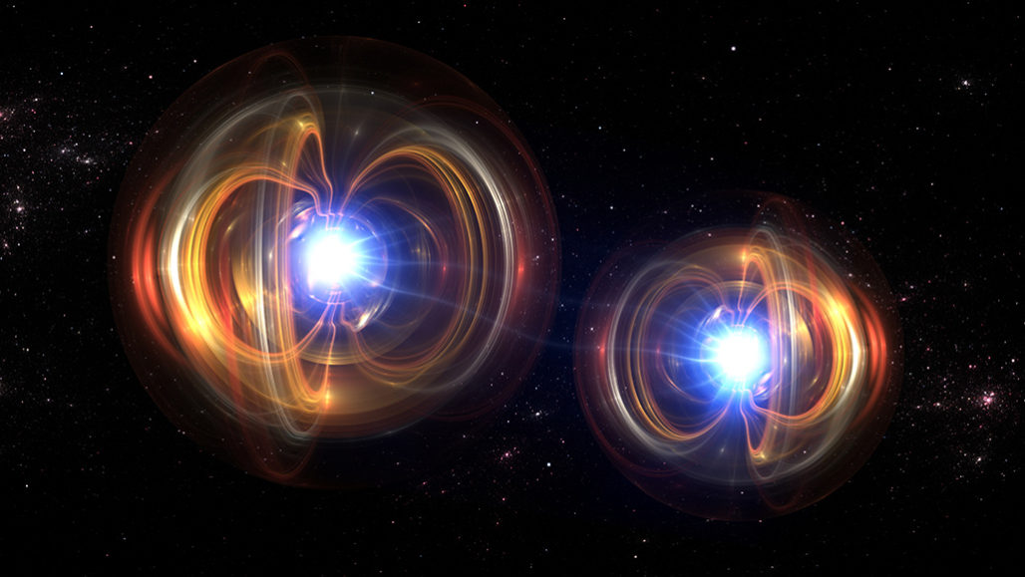
Quantum Entanglement
It is an extremely strong correlation that exists between quantum particles
Two or more quantum particles can be inextricably linked in perfect unis-on, even when placed at opposite ends of the universe.
This seemingly impossible connection inspired Einstein to describe entanglement as “Spooky action at a distance”.

Slide 11
How a Quantum Computer works ?
Let’s say you invite five colleagues to your wedding, and you need to plan their seating arrangements. The total number of ways to do so is 5! = 120.
Now, a conventional computing system tends to evaluate each of the 120 possibilities, compare them, and then decide on the final optimization.
However, a quantum computer undertakes the following steps for optimizing seat allocation:

Slide 12
How a Quantum Computer works ?
Considers qubits and creates quantum superposition for all possible quantum states.
The encoder applies phases to each quantum state and configures the qubits. For the possible sitting ways that fall in phase, the amplitudes add up, while for the out-of-phase ways, the amplitudes cancel out.
The quantum computer then uses interference to reinforce or amplify some answers and cancel or diminish the others. As a result, a single solution for optimized seat allocation is finally reached.

Slide 13
Why Quantum Computing ?
Quantum computers take up a fraction of the space of classical computers.
Level of power that can find solutions to problems out of the reach of today's computers.
By decreasing the size of transistors we are gradually approaching to the atom stage, beyond which we can’t move down except applying the quantum mechanics which in-turn give rise to quantum computing.
"A quantum computer can create superposition with multiple probabilities that we cannot achieve today, let alone examine the features of those probabilities. With this type of application, the quantum computer will be much more efficient than a classical computer,” asserts García Ripoll.

Slide 14
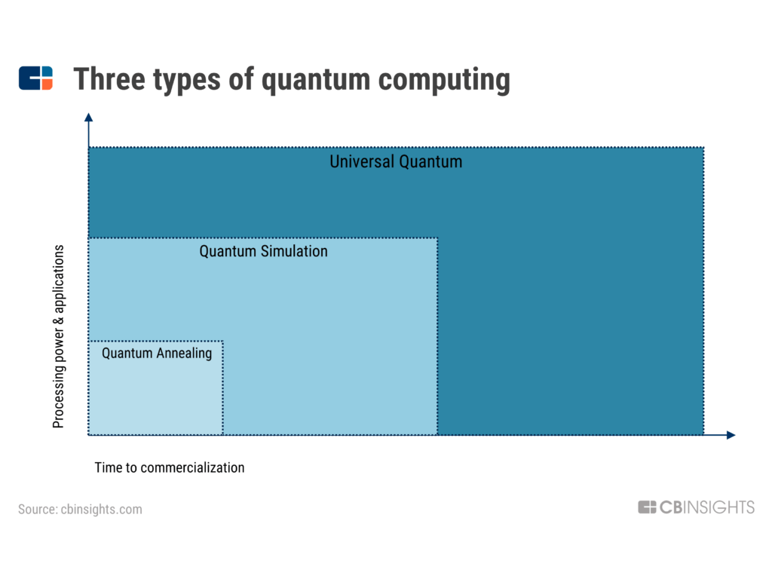
Types of Quantum Computing

Slide 15
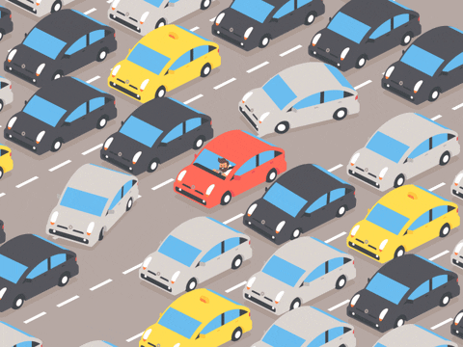
1. Quantum Annealing
Quantum annealing is best for solving optimization problems.
Quantum annealing is the least powerful and most narrowly applied form of quantum computing.
For example, Volkswagen (VW) recently conducted a quantum experiment to optimize traffic flows in the overcrowded city of Beijing, China. The experiment was run in partnership with Google and D-Wave Systems. The algorithm could successfully reduce traffic by choosing the ideal path for each vehicle, according to VW. Classical computers would take thousands of years to compute the optimum solution to such a problem. Quantum computers, theoretically, can do it in a few hours or less, as the number of qubits per quantum computer increases.

Slide 16
2. Quantum Simulation
Quantum simulations explore specific problems in quantum physics that are beyond the capacity of classical systems. Simulating complex quantum phenomena could be one of the most important applications of quantum computing.
Quantum simulation promises to have applications in the study of many problems in, e.g., condensed-matter physics, high-energy physics, atomic physics, quantum chemistry and cosmology.

Slide 17
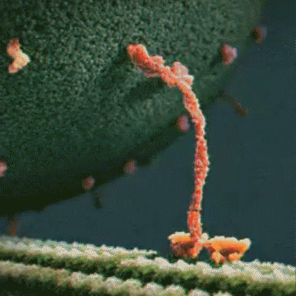
2. Quantum Simulation
In particular, quantum simulators could be used to simulate protein folding — one of biochemistry’s toughest problems. Misfolded proteins can cause diseases like Alzheimer’s and Parkinson’s, and researchers testing new treatments must learn which drugs cause reactions for each protein through the use of random computer modeling. Quantum computers can help compute the vast number of possible protein folding sequences for making more effective medications. In the future, quantum simulations will enable rapid designer drug testing by accounting for every possible protein-to-drug combination.

Slide 18
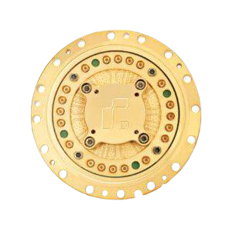
2. Universal Quantum
Universal quantum computers are the most powerful and most generally applicable, but also the hardest to build.
A truly universal quantum computer would likely make use of over 100,000 qubits.
The basic idea behind the universal quantum computer is that you could direct the machine at any massively complex computation and get a quick solution.
In the distant future, universal quantum computers could revolutionize the field of artificial intelligence. Quantum AI could enable machine learning that is faster than that of classical computers.
Rigetti’s 128 qubit quantum chip

Slide 19
Drawbacks (In Today’s World)
Algorithm creation
The low temperature needed
Not open for public
Internet Security

Slide 20
Tech – Giants’ Utilizing Quantum Computing
IBM
D-Wave Systems
Google
Microsoft Corporation
Rigetti Computing
IonQ

Slide 21
Conclusion
Quantum computers have the potential to revolutionize computation by making certain types of classically intractable problems solvable.
While no quantum computer is yet sophisticated enough to carry out calculations that a classical computer can't, great progress is under way.
Quantum simulators are making strides in fields varying from molecular energetics to many-body physics.

Slide 22
Thank You…

