Slide 1
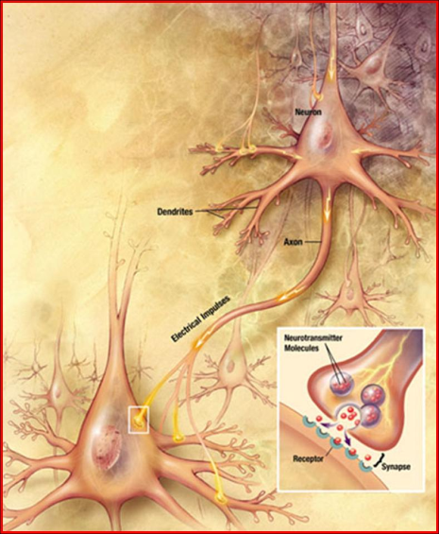
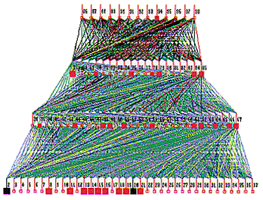
Lecture 39: Applications – Introduction to
Neural Networks and Deep Learning
Books:
Hands-On Machine Learning
Lectures:
Neural Networks in 5 Minutes
Introduction to Machine Learning
Machine Learning on a GPU
Deep Learning with GPUs
Deep Learning in Human Language Technology
Topics:
A Basic Neural Network Architecture
What is Deep Learning?
Under the Hood of Forward Propagation

Slide 2
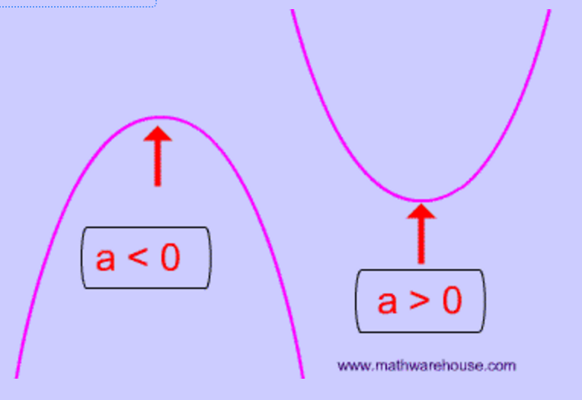
What Is A Function?
Equation of a line: y = mx + b
Equation of a parabola: y = ax² + bx + c
How do we estimate the equation of a line from two points?
  m = slope = (y₂-y₁) / (x₂-x₁)
  b = y intercept:
  y₁ = m(x₁) + b
  b = y₁ – m(x₁)
  check:
  b = y₂ – m(x₂)
How do we estimate the equation of a line from three points or more (hint: mean square error or regression?

Slide 3
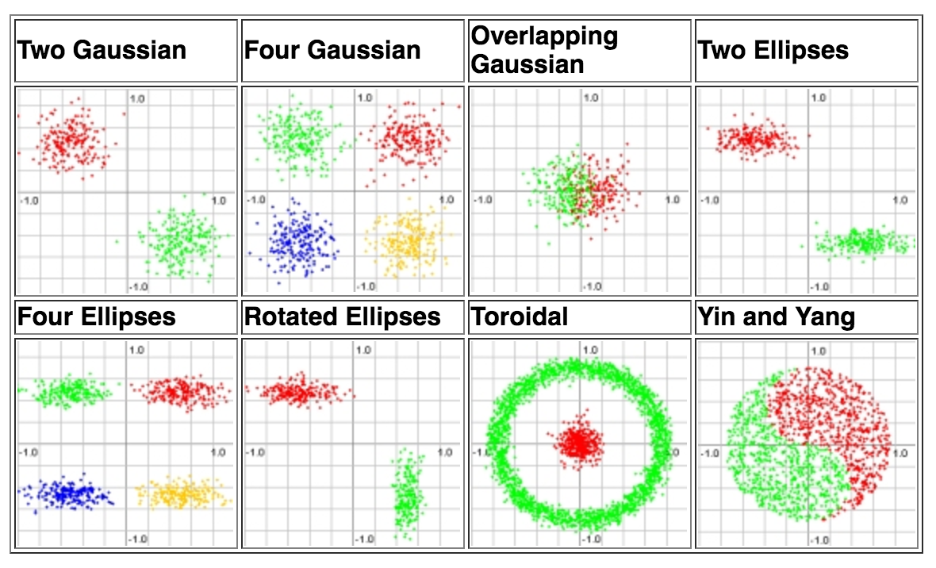
What Is A Functional Mapping?
Emulating human performance can be a complicated process involving highly nonlinear functions.
Example: Equal Loudness Curves
Your perception of loudness varies with frequency.
Perceived loudness also changes depending on the intensity.
Classifying data can be easy:
But generalization can be difficult:

Slide 4
How Do We Minimize An Objective Function?
Most modern learning algorithms use a variant of gradient descent in which we iteratively search for a maximum (or minimum) in a function:
The algorithmic details vary from implementation to implementation, but most approaches are based on derivatives (slopes).

Slide 5
Ideal Search Spaces Are Convex
If the search space for a solution is convex, gradient descent or hill-climbing will find an optimal solution.
This is one reason solutions that minimize the mean square error are popular.
However, real world problems involve optimization in very high dimensional spaces that are extremely complex.
To simplify things, we often try to “regularize” the problem:

Slide 6
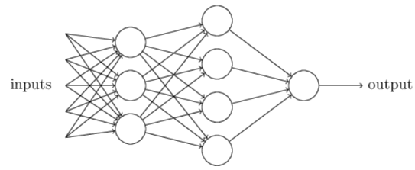
Neural Networks
Artificial neural networks (ANNs) are algorithms modeled after how the human brain operates.
ANNs today perform a number of functions including feature extraction, signal modeling and language or domain modeling.
Neural networks are comprised of nodes, which combine the inputs from the data with a set of coefficients or weights and determine whether the signal will progress further through the network.

Slide 7
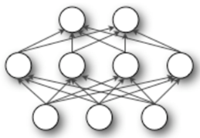
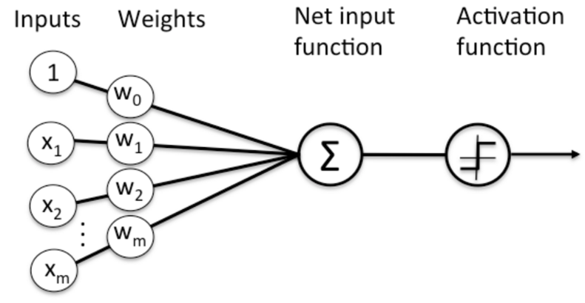
Nodes in Neural Networks
The products between the inputs $x_{n}$ and the weight $ω_{n}$ are summed in the node and the result is passed to the node’s activation function, which determines whether the node will fire.
Perceptrons are the most fundamental and simplest models of neurons.
Node Diagram

Slide 8
Perceptrons
Perceptrons are very simple. They take several binary inputs and generate a single binary output.
Given a set of inputs $x_{1}, x_{2}, x_{3}$, and a set of corresponding weights $ω_{1},ω_{2}$, $ω_{3},$the neuron’s output is given by:
$$output=\left\{\begin{aligned}0 if \sum_{j}{ω_{j}x_{j}≤threshold} \\ 1 if \sum_{j}{ω_{j}x_{j}>threshold}\end{aligned}\right.$$
To simplify, $x$ and $ω$ can be seen as vectors and the threshold is presented as a bias b, where $bias≡−threshold$
$$x_{1}$$
$$ω_{1}$$
$$output=\left\{\begin{aligned}0 if ω∙x+b ≤0 \\ 1 if ω∙x+b >0\end{aligned}\right.$$
$$ω_{2}$$
$$x_{2}$$
$$output$$
$$ω_{3}$$
$$x_{3}$$

Slide 9
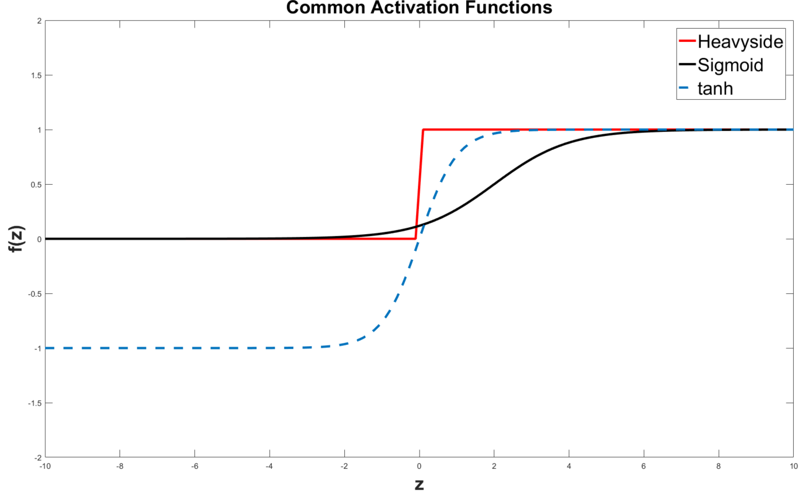
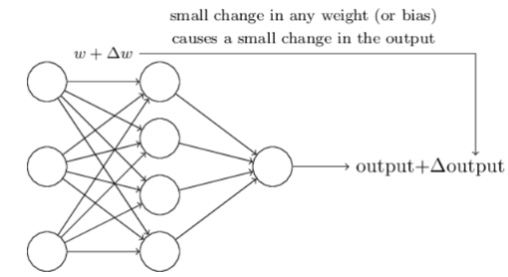
Sigmoid Neurons
Learning algorithms involve the adjustment of the weights and bias
If the neuron model used is the perceptron, a small change in a weight or bias can cause output to completely flip (being a binary model), and the flip can cause a change in the behavior of the entire network
A new type of artificial neuron, a sigmoid neuron, is commonly used to overcome this issue
In this case, the output is given by $σ\left(z\right)≡ \frac{1}{1+e^{z}}$, where $z=ω∙x+b$
This means, the activation function is a logistic function. Other common activation function is the tanh function, given by $tanh\left(z\right)=\frac{{e^{z}−e}^{−z}}{e^{z}+e^{−z}}$

Slide 10
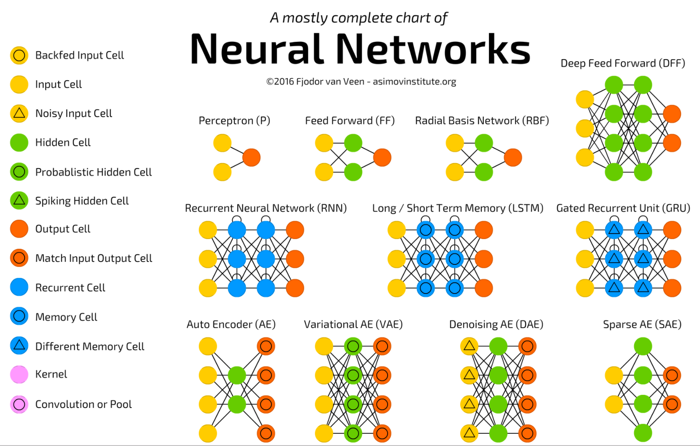
There Are Many Types Of Neural Networks

Slide 11
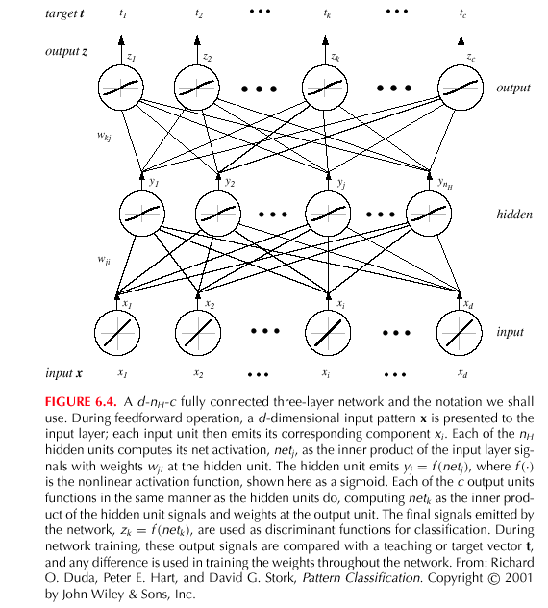
Networks of Nodes

Slide 12
So, 1. what exactly is deep learning ?
And, 2. why is it generally better than other methods on image, speech and certain other types of data?

Slide 13
So, 1. what exactly is deep learning ?
And, 2. why is it generally better than other methods on image, speech and certain other types of data?
The short answers
1. ‘Deep Learning’ means using a neural network
with several layers of nodes between input and output
2. the series of layers between input & output do
feature identification and processing in a series of stages,
just as our brains seem to.

Slide 14
hmmm… OK, but:
3. multilayer neural networks have been around for
25 years. What’s actually new?

Slide 15
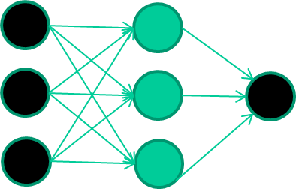
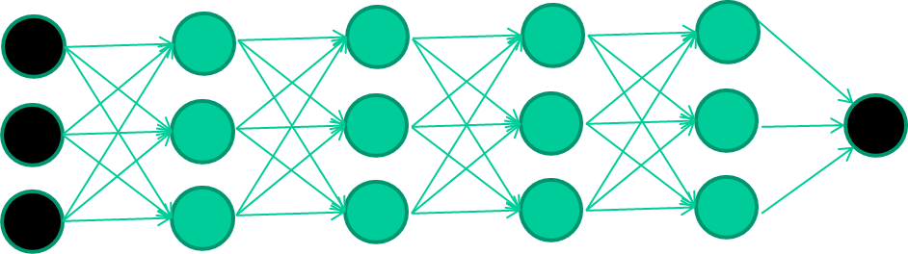
hmmm… OK, but:
3. multilayer neural networks have been around for
25 years. What’s actually new?
we have always had good algorithms for learning the
weights in networks with 1 hidden layer
but these algorithms are not good at learning the weights for
networks with more hidden layers
what’s new is: algorithms for training many-later networks

Slide 16
longer answers
reminder/quick-explanation of how neural network weights are learned;
the idea of unsupervised feature learning (why ‘intermediate features’ are important for difficult classification tasks, and how NNs seem to naturally learn them)
The ‘breakthrough’ – the simple trick for training Deep neural networks

Slide 17
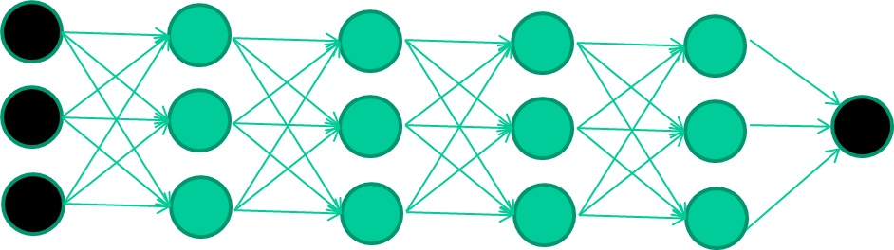
So: multiple layers make sense
Many-layer neural network architectures should be capable of learning the true underlying features and ‘feature logic’, and therefore generalise very well …

Slide 18
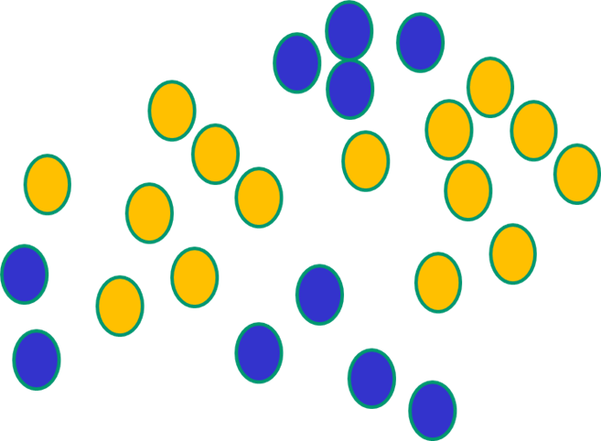

But, until very recently, our weight-learning algorithms simply did not work on multi-layer architectures

Slide 19
Along came deep learning …

Slide 20
The new way to train multi-layer NNs…

Slide 21
The new way to train multi-layer NNs…
Train this layer first

Slide 22
The new way to train multi-layer NNs…
Train this layer first
then this layer

Slide 23
The new way to train multi-layer NNs…
Train this layer first
then this layer
then this layer

Slide 24
The new way to train multi-layer NNs…
Train this layer first
then this layer
then this layer
then this layer

Slide 25
The new way to train multi-layer NNs…
Train this layer first
then this layer
then this layer
then this layer
finally this layer

Slide 26
The new way to train multi-layer NNs…
EACH of the (non-output) layers is trained to be an auto-encoder
Basically, it is forced to learn good features that describe what comes from the previous layer

Slide 27
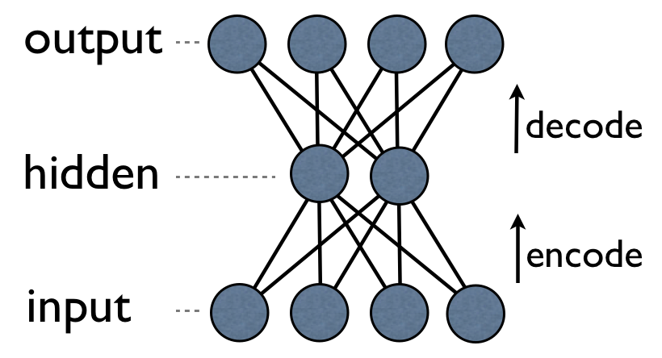
an auto-encoder is trained, with an absolutely standard weight-adjustment algorithm to reproduce the input

Slide 28
an auto-encoder is trained, with an absolutely standard weight-adjustment algorithm to reproduce the input
By making this happen with (many) fewer units than the inputs, this forces the ‘hidden layer’ units to become good feature detectors

Slide 29
intermediate layers are each trained to be auto encoders (or similar)

Slide 30
Final layer trained to predict class based on outputs from previous layers

Slide 31
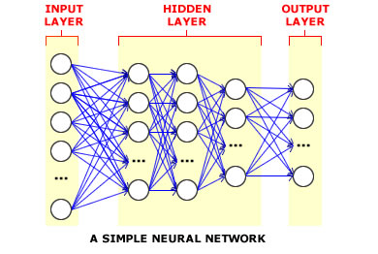
And that’s that
That’s the basic idea
There are many many types of deep learning,
different kinds of autoencoder, variations on architectures and training algorithms, etc…
Very fast growing area …

Slide 32
Summary
A neural network attempts to emulate properties observed in the human brain: a simple computational element is used that emulates the basic properties of a neuron. By combining large numbers of these nodes in various topologies, we can solve complex engineering and scientific problems.
Nodes can use a variety of activation functions ranging from simply hard limiters to soft mappings such as a sigmoid function.
The ability to learn complex mappings from data can be a powerful way to predict and classify data, and can lead to a better understanding of underlying dependencies.
This type of learning, however, requires iterative algorithms that are computationally expensive.
Gradient descent is a popular way to find good solutions.
There are many types of neural networks in use today. The best choice of a network is very application dependent.
State of the art systems today leverage a process known as transfer learning where users start from pretrained networks trained on large amounts of data.

