Slide 1
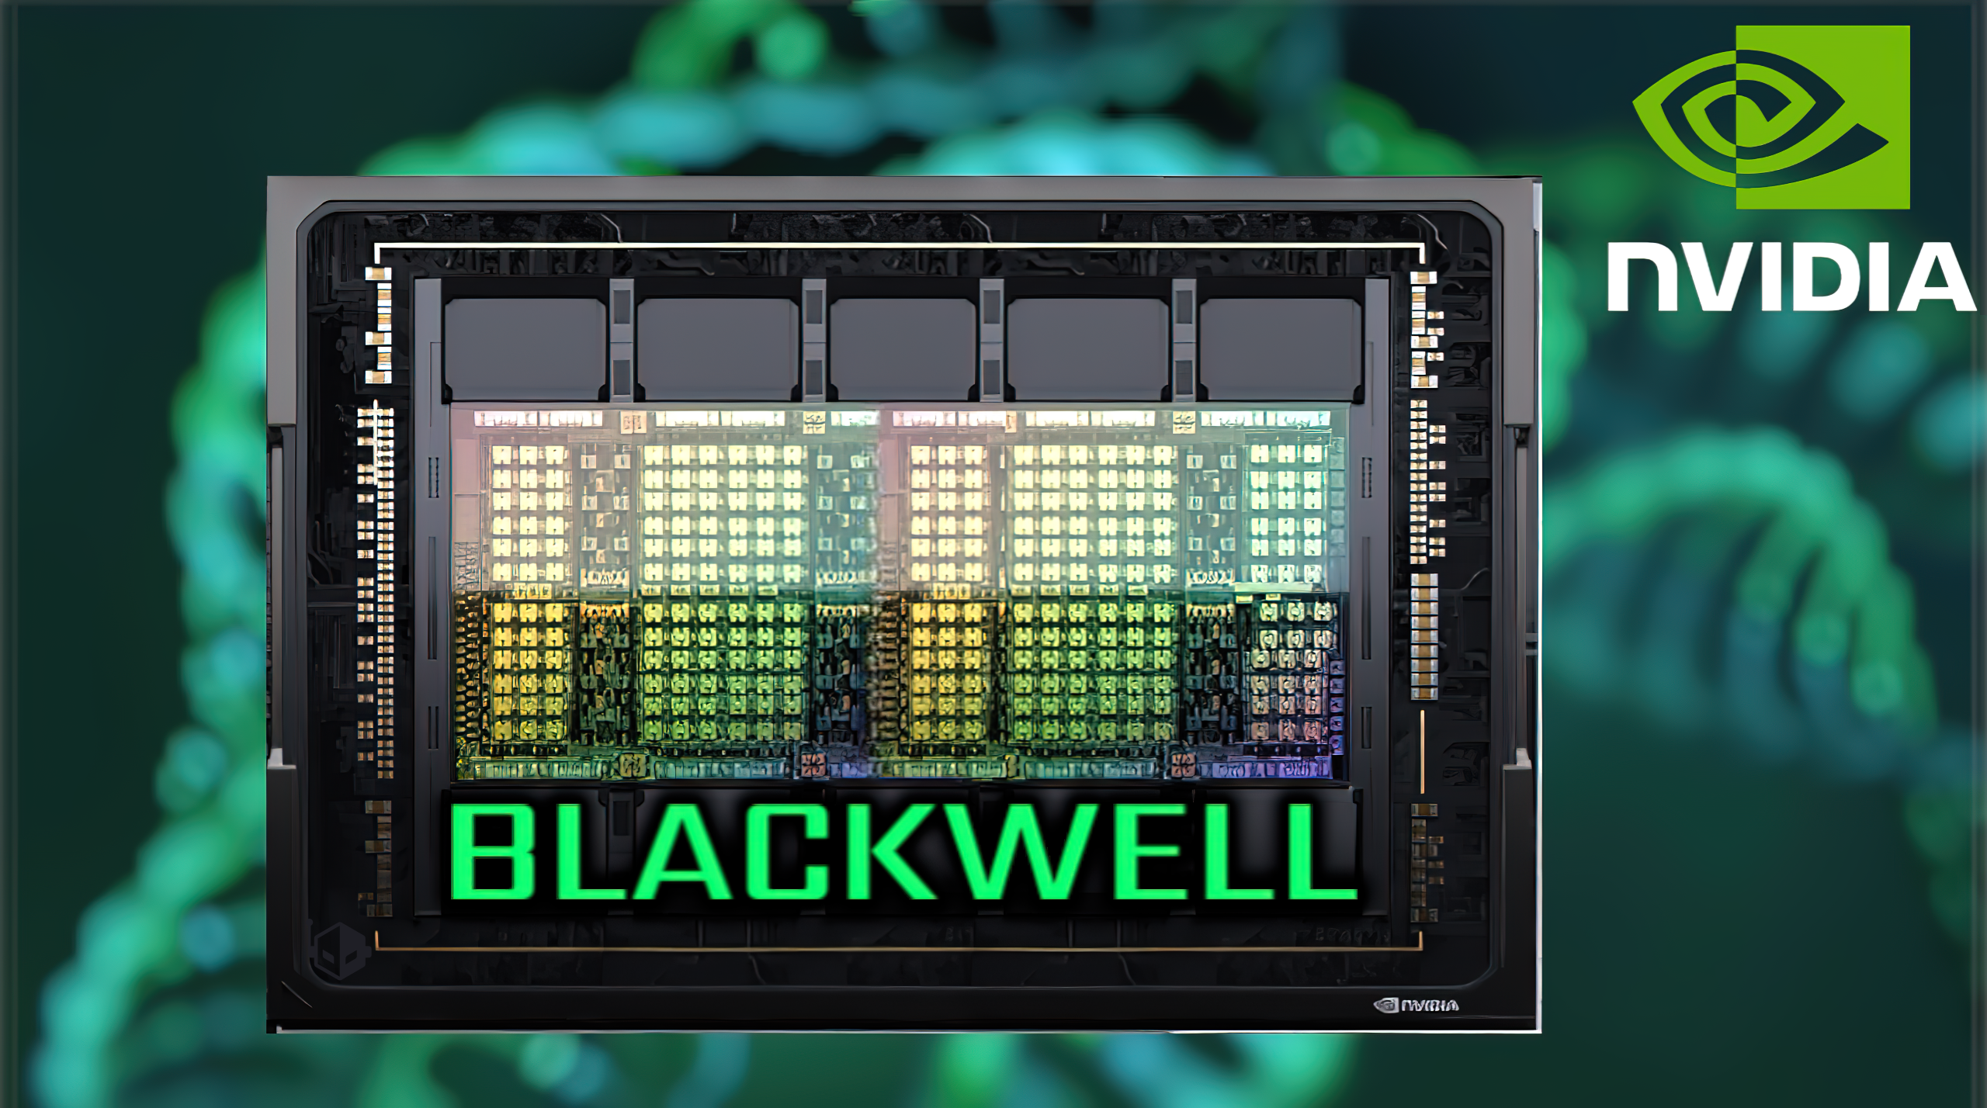
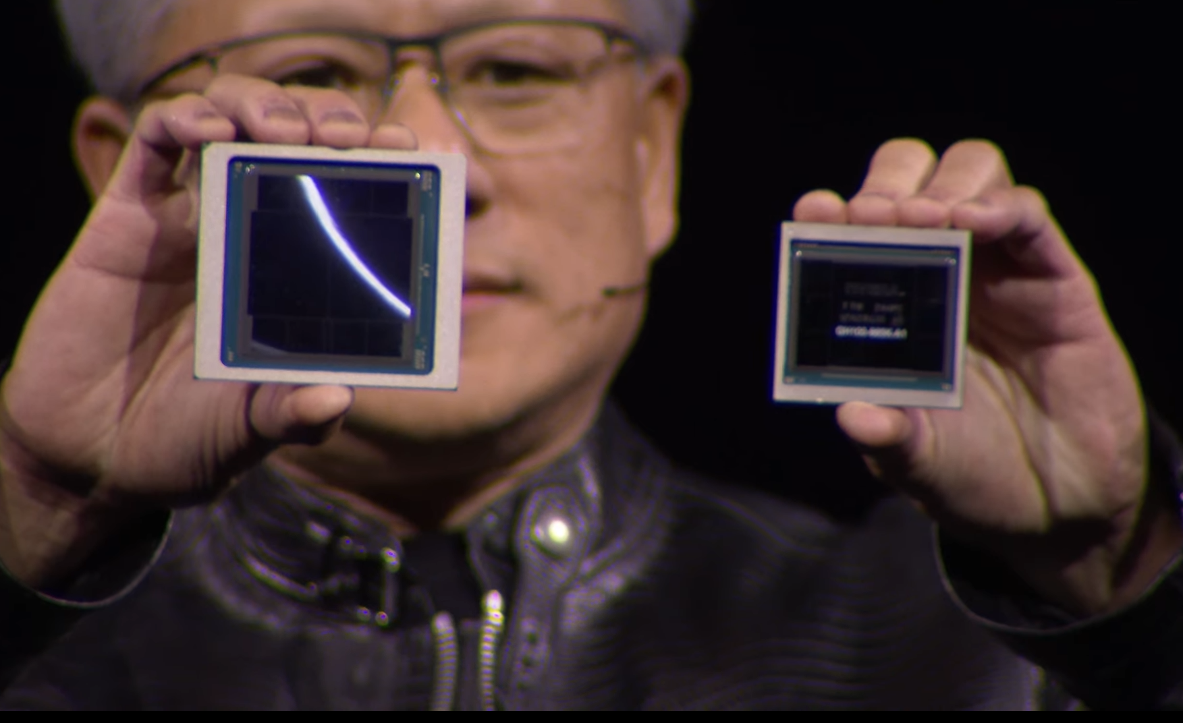
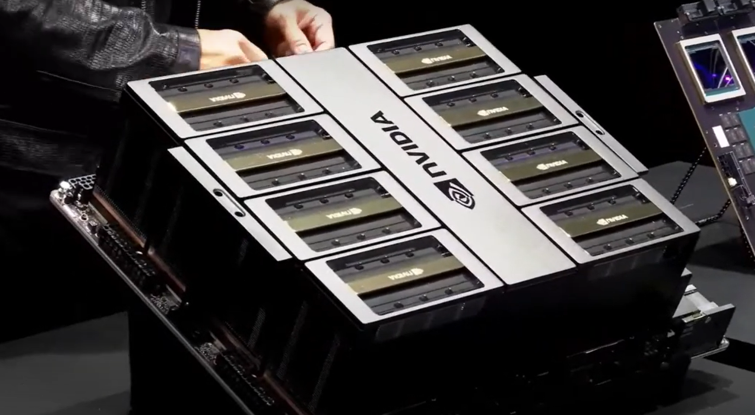
Lecture 38: The NVIDIA Blackwell GPU
Books:
Graphics Processor Architectures
Lectures:
NVIDIA H100 (Hopper) Design
NVIDIA H100 Quick Tour (Marketing)
NVIDIA B100 Quick Tour (Marketing)
NVIDIA Blackwell Deep Dive
Inside xAI Colussus
NVIDIA Data Center Tour (Older)
Topics:
NVIDIA Hopper Architecture
NVIDIA Blackwell Architecture
NVIDIA Blackwell Technical Overview
Blackwell vs. Hopper Comparison

