Slide 1
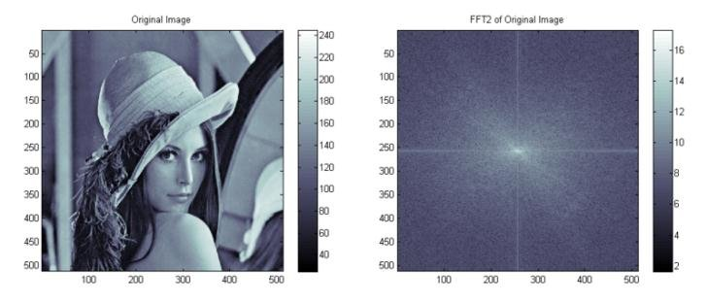
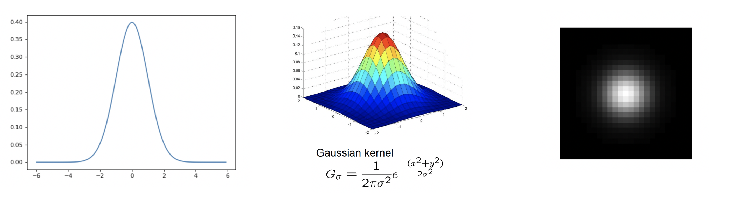
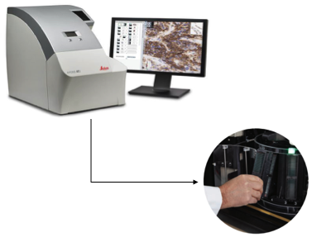
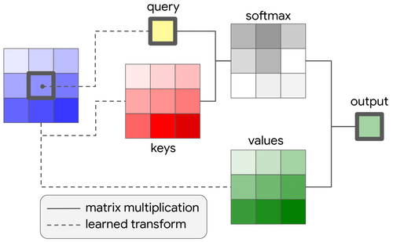
Lecture 37: Final Exam – A Deep Dive Into Image Processing
Books:
DSP Guide
Lectures:
Processing Whole Slide Images
2D Fourier Transforms
Gaussian Filters
Topics:
OpenSlide
2D FFT in Numpy
Gaussian Filter

