Slide 1
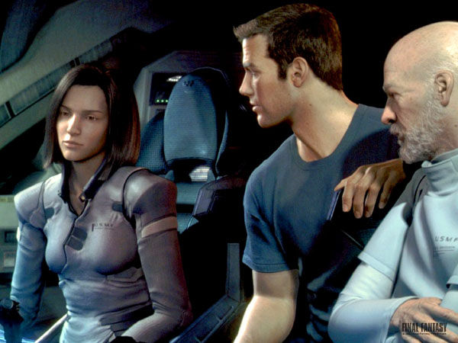


Lecture 35: Applications – Ray Tracing in Computer Graphics
Books:
Ray Tracing in One Weekend
Computer Graphics: Principles and Practice
Lectures:
Ray Tracing in C++
GPU Ray Tracing
Shading and Materials
Topics:
Introduction to Real-Time Ray Tracing
GPU Ray Tracing
Dynamic Parallelism and Recursion

Slide 2
Rendering – Raytracing
CSE 3541/5541
Matt Boggus

Slide 3
Overview
Ray tracing basic concepts
PPM image file format
Ray generation and collision
Lighting and shading
Recursive ray generation

Slide 4
Ray tracing algorithm
Image plane
Eye
Loop over all pixels
  Shoot ray through each pixel
  Determine the color of the object at the point of intersection
Notes:
Figures modified from Rick Parent’s 681 slides:
http://web.cse.ohio-state.edu/~parent.1/classes/681/WI11/schedule.html

Slide 5
Recursive rays
Image plane
Eye
Notes:
Figures modified from Rick Parent’s 681 slides:
http://web.cse.ohio-state.edu/~parent.1/classes/681/WI11/schedule.html

Slide 6
Image output

Slide 7
Generating the initial rays

Slide 8
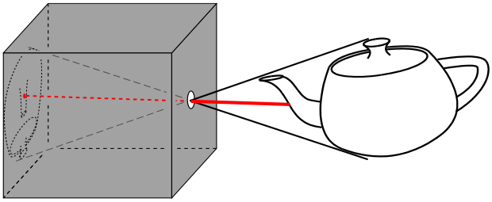
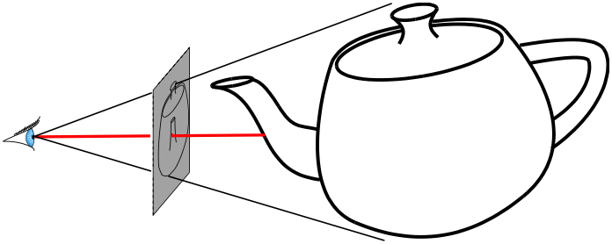
Pin-hole camera model
pin-hole camera
simplified pin-hole camera
Notes:
Figures modified from Rick Parent’s 681 slides:
http://web.cse.ohio-state.edu/~parent.1/classes/681/WI11/schedule.html

Slide 9
Pin-hole camera model
pin-hole camera
Camera’s forward and up vectors
simplified pin-hole camera
Notes:
Figures modified from Rick Parent’s 681 slides:
http://web.cse.ohio-state.edu/~parent.1/classes/681/WI11/schedule.html

Slide 10
Defining the image frame
Width ; number of columns
Height ; number of rows

Slide 11
Defining the image frame
camera
r(t)
p [ a point in the image plane ]
t=0
p [center of image frame] = camera.position + camera.forward * distanceToImageFrame
4 adjacent pixels: p + dx * camera.right ; p – dx * camera.right ;
p + dy * camera.up ; p – dy * camera.up

Slide 12
Ray construction – perspective and orthographic projects
Boardwork examples

Slide 13
Ray intersection testing in Unity
Physics.Raycast
Video tutorial
Raycast rendering algorithm:
Foreach ray r corresponding to one pixel[x,y] in image frame
if(r hit nothing)
pixel[x,y] = background color
else(r hit object o)
pixel[x,y] = color of object o at point of intersection with r

Slide 14
Lighting and Shading calculations

Slide 15
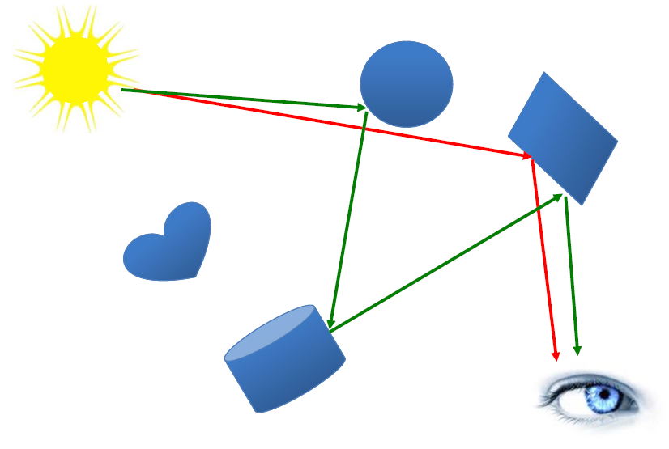
Physics of light
Red lines – single bounce ; local illumination
Green lines – multiple bounce ; global illumination

Slide 16
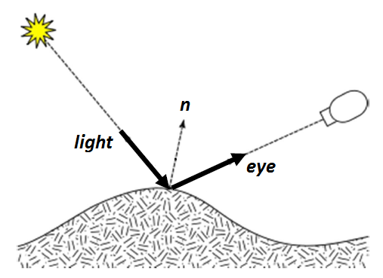
Vectors for light modeling

Slide 17
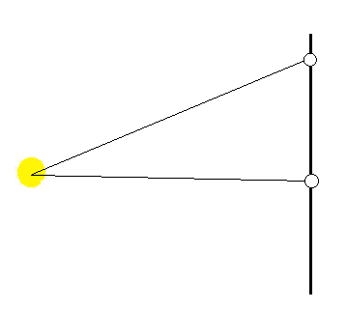
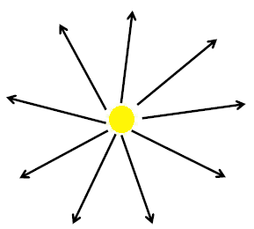
Point light
Emit light in all directions
Vector from point to light

Slide 18
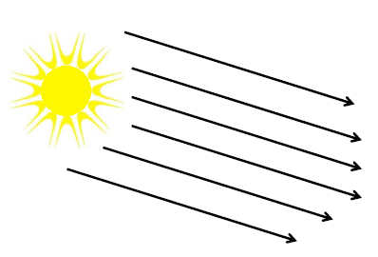
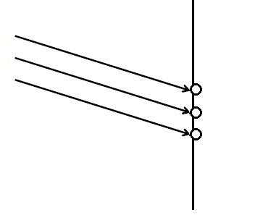
Directional light
Light vector always the same

Slide 19
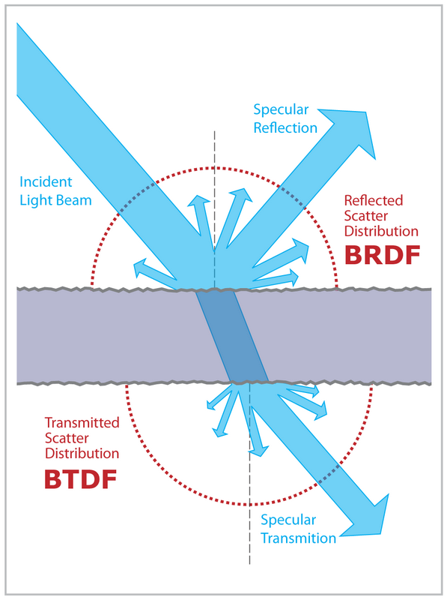
Light scattering on a surface
Figure from http://en.wikipedia.org/wiki/Bidirectional_scattering_distribution_function

Slide 20
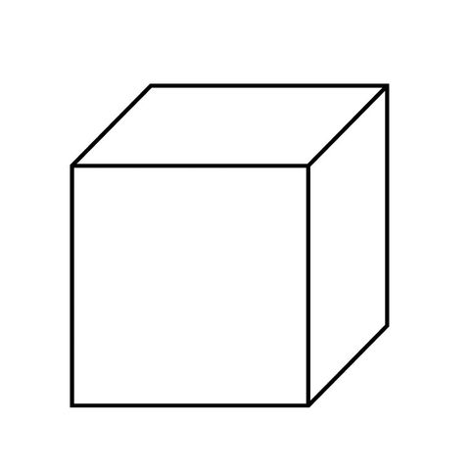
Normals of points on a cube face

Slide 21
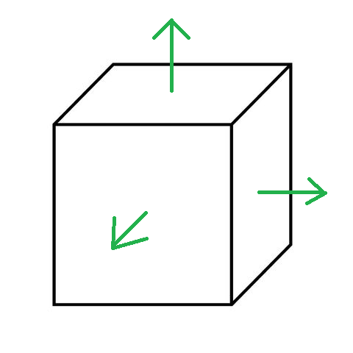
Normals of points on a cube face
Remember: the transform component has vectors for forward, up, and right

Slide 22
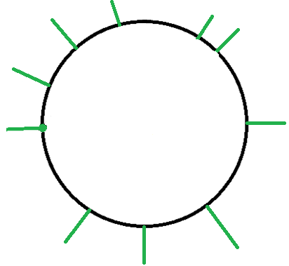
Normals of points on a sphere

Slide 23
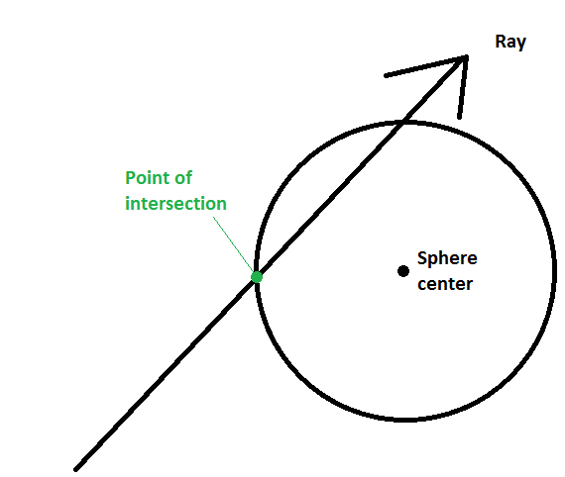
Normal of a point on a sphere

Slide 24
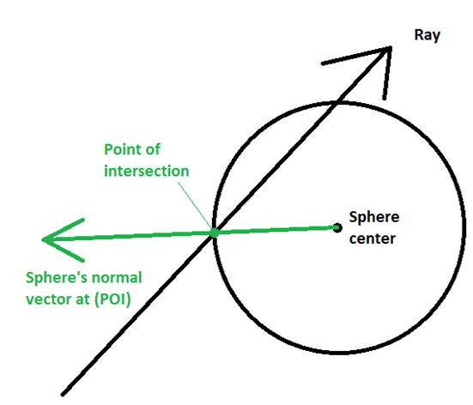
Normal of a point on a sphere

Slide 25
Defining light and material properties
(Red, Green, Blue) values
  For a light source, intensity
  For the material of an object, reflectivity
  Color = intensity * material
Examples:
  (1,1,1) white light, (1,1,1) white object ; object appears white
  (1,0,0) red light, (1,1,1) white object ; object appears red
  (1,1,1) white light, (1,0,0) red object ; object appears red
  (1,1,0) yellow light, (0,1,1) cyan object ; object appears green

Slide 26
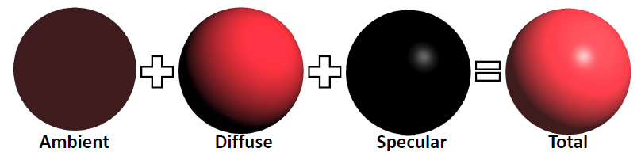
Phong illumination model

Slide 27

Ambient illumination
Approximation for global illumination
L_{ambient} = I_{ambient} * K_{ambient}
[Light = Intensity * Material]
Often I_{ambient} just a constant
Notable exceptions:
  Ambient occlusion
  Radiant flux

Slide 28
Diffuse illumination
Diffuse reflection assumes that the light is equally reflected in every direction.
In other words, if the light source and the object has fixed positions in the world space, the camera motion doesn’t affect the appearance of the object.
The reflection only depends on the incoming direction. It is independent of the outgoing (viewing) direction.

Slide 29
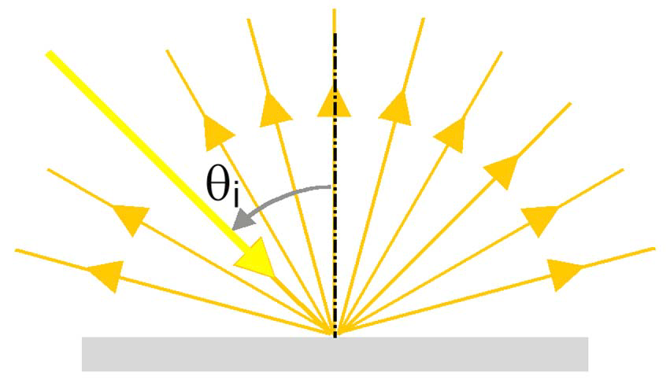
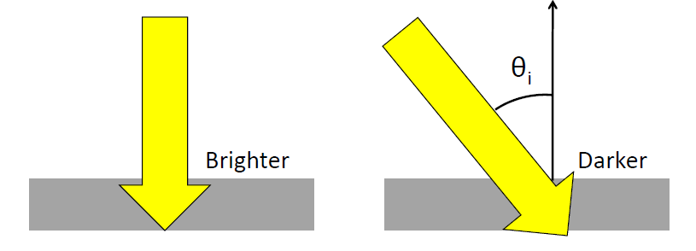
Diffuse illumination
L_{diffuse} = I_{diffuse} * K_{diffuse} * cos θ_{i}

Slide 30
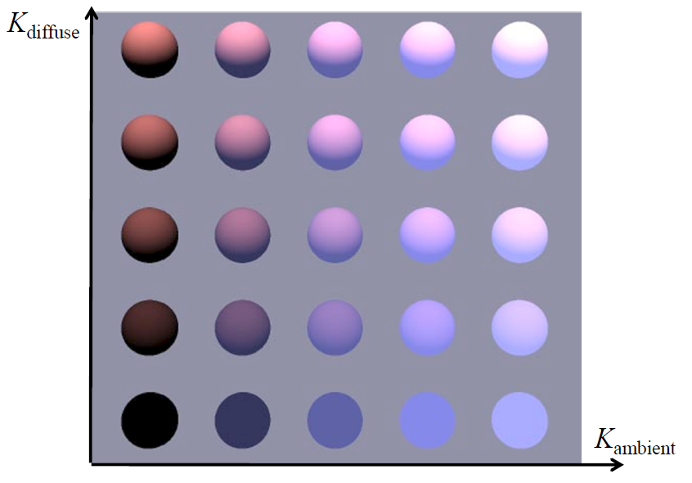
Ambient and Diffuse illumination example

Slide 31
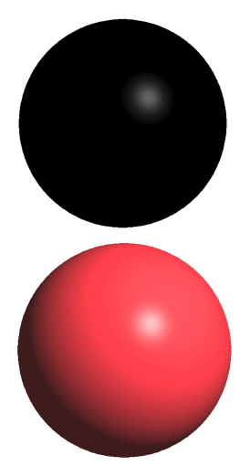
Specular illumination
Some materials, such as plastic and metal, can have shiny highlight spots.
This is due to a glossy mirror-like reflection.
Materials have different shininess/glossiness.

Slide 32
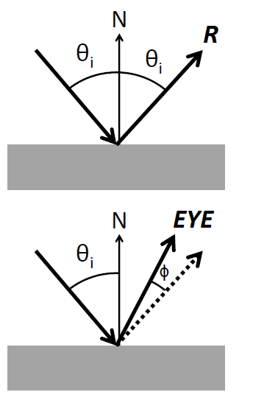
Specular reflection
R = 2(L⋅N)N- L
L_{specular} =
I_{specular} * K_{specular} * cos^{n} φ
n is shininess coefficient
φ is the angle between EYE and R

Slide 33
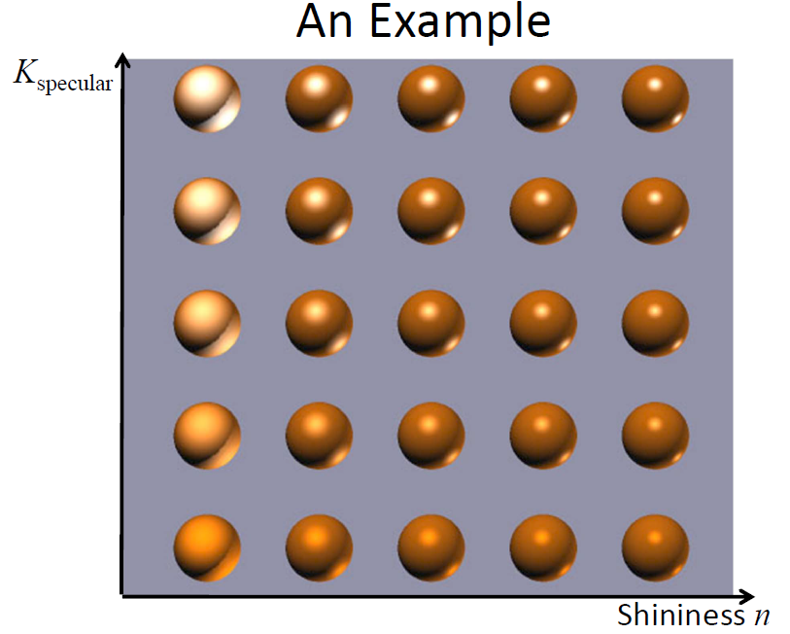
Specular illumination example

Slide 34
Algorithm to ‘color’ a ray
Color shade(R)
{
intersect objects – get closest intersection
c = ambient
For each light source
Add in diffuse and specular components to c
Return c
}

Slide 35
Recursively generated rays

Slide 36
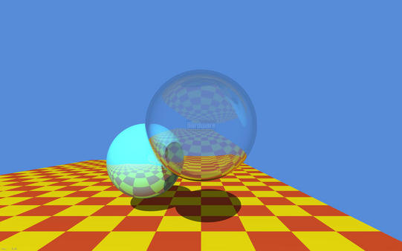
Shadows, reflections, and refractions

Slide 37
Shadows
Determine when light ray is blocked from reaching object
Ray-object intersection calculation
For each pixel
for each object
for each light source
for each object

Slide 38
Shadow algorithm (expands the code iterating over light sources)
For each light source i
  If face is backface with respect to light source (determined using normal)
    Set IN-SHADOW to TRUE
  else
    Set IN-SHADOW to FALSE
    Construct ray from point to light source
    For each object
      Test ray-object intersection (between point and l.s.)
      If intersection found
        Set IN-SHADOW to TRUE for this light source
        Break out of object loop
  If (NOT IN-SHADOW) add in effect of light source i
  accumulate diffuse light
  accumulate specular light

Slide 39
Reflection
Image plane
Eye

Slide 40
Reflection algorithm (expands previous ‘coloring’ algorithm)
Color shade(ray,recursionDepth)
{
  intersect objects to get point, normal, object
  If (intersection) {
    c = ambient color
    Compute reflective ray, R, based on ray and normal
    For each light source
      Compute and add in diffuse and specular components to c
    If ( (recursionDepth < maxRecursion) && (object is shiny) )
      c += object.shininess * shade(R,recursionDepth+1)
  }
  Else c = backgroundColor;
  Return c
}

Slide 41
Transparency & Refraction
Ray changes direction in transition between materials
Material properties give ratio of in/out angles
Details in the additional slides

Slide 42
Additional slides

Slide 43
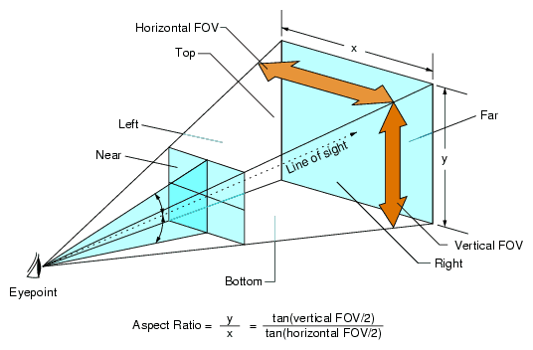
Various parameters for field of view
Notes:
Image source https://pcgamingwiki.com/wiki/Glossary:Field_of_view_(FOV)#/media/File:Fov_diagram.png

Slide 44
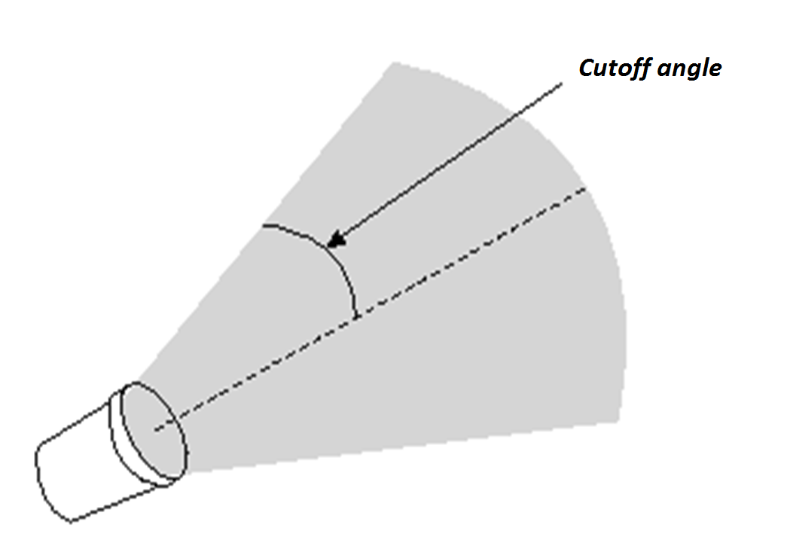
Spotlight

Slide 45
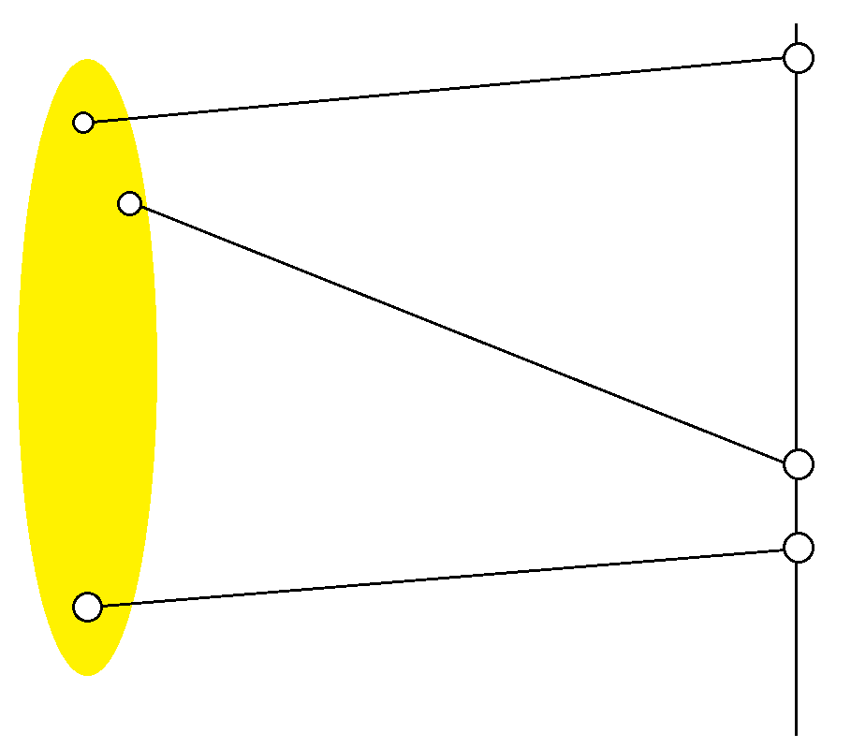
Area light
Requires sampling – pick point on the light then generate the vector from point on the surface to point on the light

Slide 46
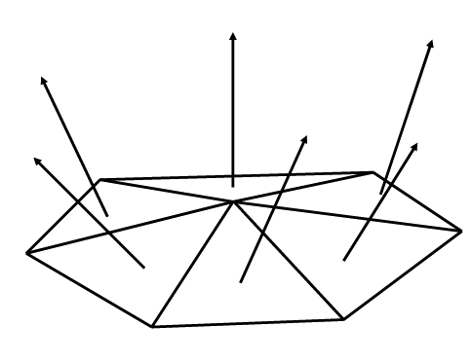
Normal of polygon(s)

Slide 47
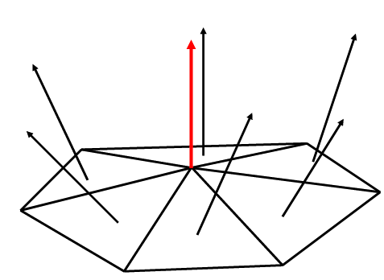
Normal of vertex
Average the normals of the polygons it is used in

Slide 48
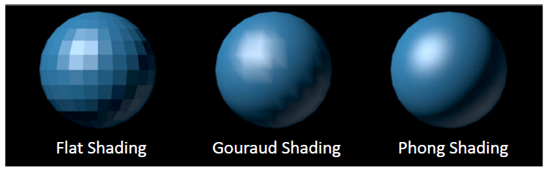
Shading model comparison
Flat shading – one normal per polygon
Gouraud shading – one normal per vertex ; compute color of a point on the polygon by:
computing color at each vertex and linearly interpolate colors inside the polygon
Phong shading – one normal per vertex ; compute color of a point on the polygon by:
linearly interpolate the normal vector, then perform lighting calculation

Slide 49
Optimizations

Slide 50
Sampling and Aliasing
Problem: Representing pixel by a single ray.
Notes:
Using higher resolution won’t solve problem.
No matter how small pixels are, objects can be smaller.

Slide 51
Efficiency
1280 x 1024 = 1,310,720 ≈ 10⁶ pixels.
10⁶ initial rays.
10⁶ reflection rays.
Potentially 10⁶ refraction rays.
3 x 10⁶ shadow rays (3 lights.)
Next level:
Potentially 4 x 10⁶ refraction/reflection rays.
1,000,000 polygons.
10⁷ x 10⁶ = 10¹³ ray-polygon intersection calculations.
Notes:
No anti-aliasing.

Slide 52
Intersection Data Structures
Coarse test to see if a ray could *possibly* intersect object
  OR
Divide space up
– sort objects into spatial buckets
– trace ray from bucket to bucket

Slide 53
Bounding Boxes

Slide 54
Spatial Subdivision

Slide 55
Additional / Cut Slides

Slide 56
Refractive Ray Tracing
Same idea as Reflective ray tracing – spawn a secondary ray
The direction of the spawned ray is in the direction of the incoming ray altered a little bit
The alteration is based on the material that the ray is leaving (e.g. air) and the material that the ray is entering (e.g., glass)
Once this direction is computed, then the shade routine is called recursively, just as with reflective rays.

Slide 57
Refractive Ray Tracing
dir
n
θ₁
Medium c₁
Medium c₂
Τ₂
θ₂
Snell’s Law

Slide 58
Refractive Ray Direction
dir
cos(θ₁) = -dir·n
θ₁
n
sin(θ₁) = sqrt(1- cos²(θ₁))
sin(θ₂) = n₁*sin(θ₁)/n₂
θ₂
cos(θ₂) = sqrt(1 - sin²(θ₂))
cos(θ₂) = sqrt(1 - (n₁*sin(θ₁)/n₂)²)
cos(θ₂) = sqrt(1 - (n₁/n₂)²* (1- cos²(θ₁)))
cos(θ₂) = sqrt(1 - (n₁/n₂)²* (1- (dir·n)²)
NOTE: if radical is negative, no refraction!

Slide 59
Refractive Ray Direction
n
Go cos(θ₂) in the -n direction
Go sin(θ₂) in the orthogonal direction
(while still in the plane of dir and n)
θ₁
dir
This direction (scaled by sin(θ₁)) is: dir - (dir·n)n
And scaled by sin(θ₂) is: (n₁/n₂)(dir-(dir·n)n)
T = (n₁/n₂)dir - (n₁/n₂)(dir·n)n - cos(θ₂)n

Slide 60
Recursive Ray Tracing
Color shade(ray,recursionDepth)
{
  intersect objects…
  compute R …
  Process each light source …
If (recursionDepth < maxRecursion) {
      If (object is shiny) c += shininess * shade(R, recursionDepth+1)
      If (object is transmittive) {
  Compute refractive ray, T, based on ray, normal, and Snell constants
      c = (1-transmittive)*c + transmittive * shade(T, recursionDepth+1)
      }
  }
  Return c
}

Slide 61
Refractive Intersection Normal

Slide 62
Recursive Ray Tracing
ray
n
R1
T1
R2
T2
T3
R3

Slide 63
Reflectivity varies with incident angle
NOTE: refraction is really wavelength dependent (where rainbows come from).
Fresnel equations
Schlick approximation:
R0 is reflectance at normal incidence:

Slide 64
Introduction to Real-time Ray Tracing Part 2
Going fast: Parallelizing Your Ray Tracer
Chris Wyman
Principal Research Scientist
NVIDIA

Slide 65
Some Preliminaries
Ideas needed before GPU ray tracing

Slide 66
You Just Got the Basics

Slide 67
You Just Got the Basics
But additional features expected for GPU rendering

Slide 68
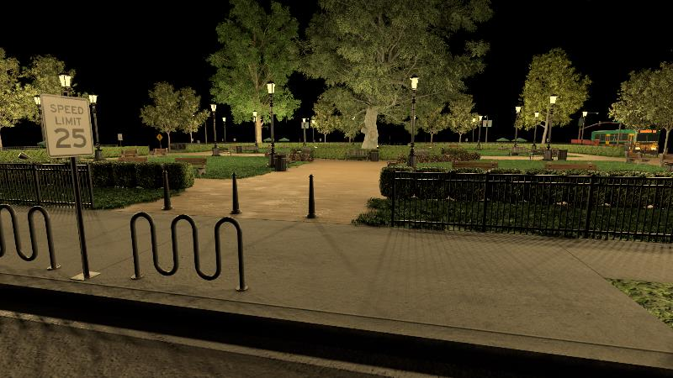
You Just Got the Basics
But additional features expected for GPU rendering
  Typically, increased complexity; not just a few primitives

Slide 69
You Just Got the Basics
But additional features expected for GPU rendering
  Typically, increased complexity; not just a few primitives
  Render triangle meshes
  Just collections of triangles approximating 3D shapes
  Easy enough; intersect each triangle in turn

Slide 70
You Just Got the Basics
But additional features expected for GPU rendering
  Typically, increased complexity; not just a few primitives
  Render triangle meshes
  Just collections of triangles approximating 3D shapes
  Easy enough; intersect each triangle in turn
  Mesh files usually contain material information
  Often small-scale detail stored in textures

Slide 71
How to Handle Materials And Textures?

Slide 72
How to Handle Materials And Textures?
Ray-primitive intersection
  Not just binary: Did we hit? Yes / No
  Also need to store attributes at the hit point, e.g.:
    Positions
    Normal
    Color

Slide 73
How to Handle Materials And Textures?
Ray-primitive intersection
  Not just binary: Did we hit? Yes / No
  Also need to store attributes at the hit point, e.g.:
    Positions
    Normal
    Color
    Texture coordinates
    Material parameters
    Et cetera

Slide 74
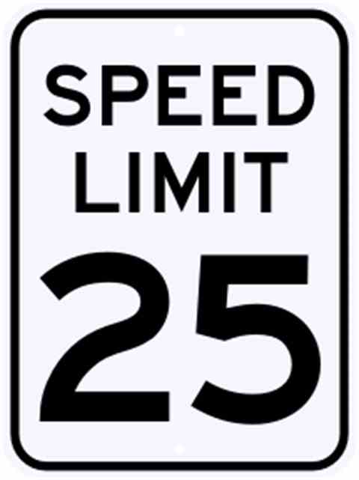
How to Handle Materials And Textures?
Ray-primitive intersection
  Not just binary: Did we hit? Yes / No
  Also need to store attributes at the hit point, e.g.:
    Positions
    Normal
    Color
    Texture coordinates
    Material parameters
    Et cetera
Our texture:

Slide 75
How to Handle Materials And Textures?
Ray-primitive intersection
  Not just binary: Did we hit? Yes / No
  Also need to store attributes at the hit point, e.g.:
    Positions
    Normal
    Color
    Texture coordinates
    Material parameters
    Et cetera
Triangle vertices have:
texture coordinates
(0,0)
(1,0)
(0,1)

Slide 76
How to Handle Materials And Textures?
Ray-primitive intersection
  Not just binary: Did we hit? Yes / No
  Also need to store attributes at the hit point, e.g.:
    Positions
    Normal
    Color
    Texture coordinates
    Material parameters
    Et cetera
Triangle vertices have:
texture coordinates
(0,0)
(1,0)
Coordinate here:
Interpolates coordinates at vertices
(0,1)

Slide 77
How to Handle Materials And Textures?
Ray-primitive intersection
  Not just binary: Did we hit? Yes / No
  Also need to store attributes at the hit point, e.g.:
    Positions
    Normal
    Color
    Texture coordinates
    Material parameters
    Et cetera
Triangle vertices have:
texture coordinates
(0,0)
(1,0)
Coordinate here:
Interpolates coordinates at vertices
Same interpolation as position,
normal, color, etc.
Use coord to index in the image array
(0,1)

Slide 78
How to Handle Materials And Textures?
Ray-primitive intersection
  Not just binary: Did we hit? Yes / No
  Also need to store attributes at the hit point, e.g.:
    Positions
    Normal
    Color
    Texture coordinates
    Material parameters
    Et cetera
  All attribute interpolation work the same way

Slide 79
Basics of Optimization
Before jumping to GPU, take some baby steps

Slide 80
Before Diving into Parallelization…
Need to talk about some performance basics

Slide 81
Before Diving into Parallelization…
Need to talk about some performance basics
  Why is tracing rays slow at all?

Slide 82
Before Diving into Parallelization…
Need to talk about some performance basics
  Why is tracing rays slow at all?
Consider basic ray tracing algorithm:
  Take a ray through your scene

Slide 83
Before Diving into Parallelization…
Need to talk about some performance basics
  Why is tracing rays slow at all?
Consider basic ray tracing algorithm:
  Take a ray through your scene
  Test triangle to find intersection

Slide 84
Before Diving into Parallelization…
Need to talk about some performance basics
  Why is tracing rays slow at all?
Consider basic ray tracing algorithm:
  Take a ray through your scene
  Test triangle to find intersection
    Repeat

Slide 85
Before Diving into Parallelization…
Need to talk about some performance basics
  Why is tracing rays slow at all?
Consider basic ray tracing algorithm:
  Take a ray through your scene
  Test triangle to find intersection
    Repeat

Slide 86
Before Diving into Parallelization…
Need to talk about some performance basics
  Why is tracing rays slow at all?
Consider basic ray tracing algorithm:
  Take a ray through your scene
  Test triangle to find intersection
    Repeat

Slide 87
Before Diving into Parallelization…
Need to talk about some performance basics
  Why is tracing rays slow at all?
Consider basic ray tracing algorithm:
  Take a ray through your scene
  Test triangle to find intersection
    Repeat

Slide 88
Before Diving into Parallelization…
Need to talk about some performance basics
  Why is tracing rays slow at all?
Consider basic ray tracing algorithm:
  Take a ray through your scene
  Test triangle to find intersection
    Repeat
  How do you know when you’re done?

Slide 89
Before Diving into Parallelization…
Need to talk about some performance basics
  Why is tracing rays slow at all?
Consider basic ray tracing algorithm:
  Take a ray through your scene
  Test triangle to find intersection
    Repeat
  How do you know when you’re done?
    When you’ve tested every triangle?

Slide 90

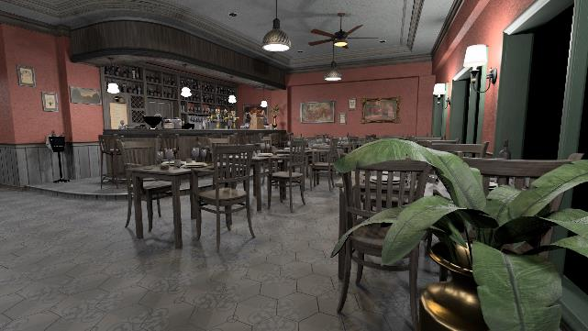
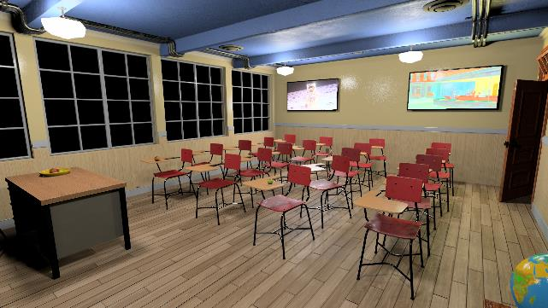
Before Diving into Parallelization…
Need to talk about some performance basics
  Why is tracing rays slow at all?
Consider basic ray tracing algorithm:
  Take a ray through your scene
  Test triangle to find intersection
    Repeat
  How do you know when you’re done?
    When you’ve tested every triangle?
    Very expensive…
    Every ray could test, 1 million (or more) triangles

Slide 91
What’s Our Computation Budget?

Slide 92
What’s Our Computation Budget?
Let’s be easy on ourselves:
  Target just 1920 x 1080 at 60 fps

Slide 93
What’s Our Computation Budget?
Let’s be easy on ourselves:
  Target just 1920 x 1080 at 60 fps
  We need 125 million pixels per second!

Slide 94
What’s Our Computation Budget?
Let’s be easy on ourselves:
  Target just 1920 x 1080 at 60 fps
  We need 125 million pixels per second!
With a ~10 TFLOP state-of-the-art GPU
  If tracing one ray per pixel…
  About 80,000 flops per ray

Slide 95
What’s Our Computation Budget?
Let’s be easy on ourselves:
  Target just 1920 x 1080 at 60 fps
  We need 125 million pixels per second!
With a ~10 TFLOP state-of-the-art GPU
  If tracing one ray per pixel…
  About 80,000 flops per ray
An optimized triangle intersection: ~10 flops
  Can afford at most 8,000 intersections per ray

Slide 96
What’s Our Computation Budget?
Let’s be easy on ourselves:
  Target just 1920 x 1080 at 60 fps
  We need 125 million pixels per second!
With a ~10 TFLOP state-of-the-art GPU
  If tracing one ray per pixel…
  About 80,000 flops per ray
An optimized triangle intersection: ~10 flops
  Can afford at most 8,000 intersections per ray
Conclusion: Don’t test every triangle!

Slide 97
Key Principal To Optimization:
Make the common case fast

Slide 98
Key Principal To Optimization:
Make the common case fast
Common case in ray tracing?
  Ray does not intersect a triangle

Slide 99
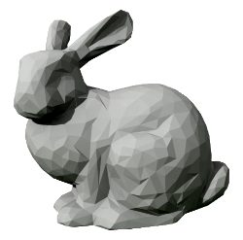
Key Principal To Optimization:
Make the common case fast
Common case in ray tracing?
  Ray does not intersect a triangle
  For any mesh, ray typically misses mesh

Slide 100
Key Principal To Optimization:
Make the common case fast
Common case in ray tracing?
  Ray does not intersect a triangle
  For any mesh, ray typically misses mesh
Perhaps:
  First intersect a mesh bounding box

Slide 101
Key Principal To Optimization:
Make the common case fast
Common case in ray tracing?
  Ray does not intersect a triangle
  For any mesh, ray typically misses mesh
Perhaps:
  First intersect a mesh bounding box
  Most rays avoid testing thousands of triangles
  But, extra box test when hit bunny

Slide 102
Key Principal To Optimization:
What if you have thousands of bunnies?

Slide 103

Key Principal To Optimization:
What if you have thousands of bunnies?

Slide 104
Key Principal To Optimization:
What if you have thousands of bunnies?
  Common case: Ray misses most bunnies

Slide 105
Key Principal To Optimization:
What if you have thousands of bunnies?
  Common case: Ray misses most bunnies
  Can skip testing this half…

Slide 106
Key Principal To Optimization:
What if you have thousands of bunnies?
  Common case: Ray misses most bunnies
  Can skip testing this half… and this quarter… with a few more boxes

Slide 107
Key Principal To Optimization:
Build a tree of bounding boxes
  Known as a “bounding volume hierarchy” or BVH

Slide 108
Key Principal To Optimization:
Build a tree of bounding boxes
  Known as a “bounding volume hierarchy” or BVH
When using a principled tree build
  Reduces number of required intersections
  From O(N) to O(log N)

Slide 109
Key Principal To Optimization:
Build a tree of bounding boxes
  Known as a “bounding volume hierarchy” or BVH
When using a principled tree build
  Reduces number of required intersections
  From O(N) to O(log N)
With a binary tree, 1 million ray-triangle tests becomes:
  Around 20 ray-box tests
  A few ray-triangle tests in leaf nodes

Slide 110
Key Principal To Optimization:
Production ray tracers always use some acceleration structure

Slide 111
Key Principal To Optimization:
Production ray tracers always use some acceleration structure
But, which structure? How do you best build it?
  Literally decades of research

Slide 112
Key Principal To Optimization:
Production ray tracers always use some acceleration structure
But, which structure? How do you best build it?
  Literally decades of research
  Continuing to today (e.g., “Wide BVH Traversal with a Short Stack,” Vaidyanathan et al. 2019)

Slide 113
Key Principal To Optimization:
Production ray tracers always use some acceleration structure
But, which structure? How do you best build it?
  Literally decades of research
  Continuing to today (e.g., “Wide BVH Traversal with a Short Stack,” Vaidyanathan et al. 2019)
When starting real-time ray tracing, best bet:
  Use someone else’s code
  Quality of your BVH easily affects performance by 2x, 3x, or >10x
    Varies per scene!
  Luckily most APIs will build structure

Slide 114
Going Parallel
Coding for massively parallel GPUs

Slide 115
Ray tracing: Embarrassingly Parallel
Defined: Little to no effort needed to separate into parallel tasks

Slide 116
Ray tracing: Embarrassingly Parallel
Defined: Little to no effort needed to separate into parallel tasks
Rendering often a prototypical example of embarrassingly parallel
  One obvious way: assign one CPU or GPU core per pixel

Slide 117
Ray tracing: Embarrassingly Parallel
On CPU, call fork() or spawn() to create multiple threads
  Each thread works on separate pixels
  Wait for all threads to complete
  Some threads take longer → may need load balancing

Slide 118
Ray tracing: Embarrassingly Parallel
GPU programming model hides thread spawning and load-balancing
  Code appears serial, but you have access to current pixel index

Slide 119
Ray tracing: Embarrassingly Parallel
GPU programming model hides thread spawning and load-balancing
  Code appears serial, but you have access to current pixel index
// Simple DirectX-like ray tracing shader
RWTexture<float4> rayColors;
[shader(“raygeneration”)]
void SimpleRayTracer() {
uint2 curPixel = DispatchRaysIndex().xy;
RayDesc ray = { GetRayOrigin(curPixel), 0.0f, GetRayDir(curPixel), 1e+38f };
RayPayload payload = { float3(0, 0, 0) };
TraceRay( ..., ray, payload );
rayColors[curPixel] = float4( payload.rayColor, 1.0f );
}

Slide 120
Ray tracing: Embarrassingly Parallel
GPU programming model hides thread spawning and load-balancing
  Code appears serial, but you have access to current pixel index
// Simple DirectX-like ray tracing shader
RWTexture<float4> rayColors;
[shader(“raygeneration”)]
void SimpleRayTracer() {
uint2 curPixel = DispatchRaysIndex().xy;
RayDesc ray = { GetRayOrigin(curPixel), 0.0f, GetRayDir(curPixel), 1e+38f };
RayPayload payload = { float3(0, 0, 0) };
TraceRay( ..., ray, payload );
rayColors[curPixel] = float4( payload.rayColor, 1.0f );
}
Identify the current pixel

Slide 121
Ray tracing: Embarrassingly Parallel
GPU programming model hides thread spawning and load-balancing
  Code appears serial, but you have access to current pixel index
// Simple DirectX-like ray tracing shader
RWTexture<float4> rayColors;
[shader(“raygeneration”)]
void SimpleRayTracer() {
uint2 curPixel = DispatchRaysIndex().xy;
RayDesc ray = { GetRayOrigin(curPixel), 0.0f, GetRayDir(curPixel), 1e+38f };
RayPayload payload = { float3(0, 0, 0) };
TraceRay( ..., ray, payload );
rayColors[curPixel] = float4( payload.rayColor, 1.0f );
}
Setup the ray

Slide 122
Ray tracing: Embarrassingly Parallel
GPU programming model hides thread spawning and load-balancing
  Code appears serial, but you have access to current pixel index
// Simple DirectX-like ray tracing shader
RWTexture<float4> rayColors;
[shader(“raygeneration”)]
void SimpleRayTracer() {
uint2 curPixel = DispatchRaysIndex().xy;
RayDesc ray = { GetRayOrigin(curPixel), 0.0f, GetRayDir(curPixel), 1e+38f };
RayPayload payload = { float3(0, 0, 0) };
TraceRay( ..., ray, payload );
rayColors[curPixel] = float4( payload.rayColor, 1.0f );
}
Initialize ray return values

Slide 123
Ray tracing: Embarrassingly Parallel
GPU programming model hides thread spawning and load-balancing
  Code appears serial, but you have access to current pixel index
// Simple DirectX-like ray tracing shader
RWTexture<float4> rayColors;
[shader(“raygeneration”)]
void SimpleRayTracer() {
uint2 curPixel = DispatchRaysIndex().xy;
RayDesc ray = { GetRayOrigin(curPixel), 0.0f, GetRayDir(curPixel), 1e+38f };
RayPayload payload = { float3(0, 0, 0) };
TraceRay( ..., ray, payload );
rayColors[curPixel] = float4( payload.rayColor, 1.0f );
}
Trace your ray

Slide 124
Ray tracing: Embarrassingly Parallel
GPU programming model hides thread spawning and load-balancing
  Code appears serial, but you have access to current pixel index
// Simple DirectX-like ray tracing shader
RWTexture<float4> rayColors;
[shader(“raygeneration”)]
void SimpleRayTracer() {
uint2 curPixel = DispatchRaysIndex().xy;
RayDesc ray = { GetRayOrigin(curPixel), 0.0f, GetRayDir(curPixel), 1e+38f };
RayPayload payload = { float3(0, 0, 0) };
TraceRay( ..., ray, payload );
rayColors[curPixel] = float4( payload.rayColor, 1.0f );
}
Output your results

Slide 125
Doing It Yourself V.S. Existing APIs
Embarrassingly parallel ≠ easy to parallelize

Slide 126
Doing It Yourself V.S. Existing APIs
Embarrassingly parallel ≠ easy to parallelize
  Not the same as getting best performance

Slide 127
Doing It Yourself V.S. Existing APIs
Embarrassingly parallel ≠ easy to parallelize
  Not the same as getting best performance
Many performance considerations:
  # intersections, data structures, coherence, caching, load-balancing, SIMD

Slide 128
Doing It Yourself V.S. Existing APIs
Embarrassingly parallel ≠ easy to parallelize
  Not the same as getting best performance
Many performance considerations:
  # intersections, data structures, coherence, caching, load-balancing, SIMD
APIs can leverage best-known methods behind your back

Slide 129
Doing It Yourself V.S. Existing APIs
Embarrassingly parallel ≠ easy to parallelize
  Not the same as getting best performance
Many performance considerations:
  # intersections, data structures, coherence, caching, load-balancing, SIMD
APIs can leverage best-known methods behind your back
APIs allow you to shoot yourself in the foot without knowing it

Slide 130
Doing It Yourself V.S. Existing APIs
Embarrassingly parallel ≠ easy to parallelize
  Not the same as getting best performance
Many performance considerations:
  # intersections, data structures, coherence, caching, load-balancing, SIMD
APIs can leverage best-known methods behind your back
APIs allow you to shoot yourself in the foot without knowing it
APIs come at many levels (e.g., use of CUDA without ray tracing API)

Slide 131
Some Ray Tracing APIs
Hardware vendor specific:
  OptiX, Embree, FireRays
Cross-vendor APIs:
  DirectX Raytracing, Vulkan RT
Game engine APIs:
  Unity, Unreal
Different:
  Audiences, learning curves, flexibility, performance, built-in optimizations

Slide 132
Today: Using DirectX For Sample Code
Why?
  DirectX widely used API for interactive graphics
  Similar to Vulkan model
  Abstracts some bits tricky for novices’ ray tracers
  Tutorial frameworks for easy experimentation

Slide 133
DirectX Ray Tracing Resources
Some DirectX Ray Tracing tutorials:
  Tutorial framework that hides the C++ API ( http://intro-to-dxr.cwyman.org )
    Easy to get started, not targeted at optimal performance
    Used for my sample code today
    Builds on Falcor for abstraction
  Lower-level tutorial covering DirectX API
    From the “Introduction to DirectX Ray Tracing” Ray Tracing Gems article
  A simple getting started blog post
  Microsoft’s DXR samples
    A DirectX Raytracing functional specification

Slide 134
We’ll Focus on GPU Shader Code
Why?
  Focus on tracing rays, identifying where to trace rays
  Where interesting rendering algorithms mostly live

Slide 135
We’ll Focus on GPU Shader Code
Why?
  Focus on tracing rays, identifying where to trace rays
  Where interesting rendering algorithms mostly live
The CPU has vital infrastructure…
  But it’s largely reusable stuff like asset loaders
  Not interesting (to me) to re-write

Slide 136
We’ll Focus on GPU Shader Code
Why?
  Focus on tracing rays, identifying where to trace rays
  Where interesting rendering algorithms mostly live
The CPU has vital infrastructure…
  But it’s largely reusable stuff like asset loaders
  Not interesting (to me) to re-write
For parallel GPU ray tracer, CPU code is mostly glue:
  Pass configuration and data to GPU
  Launch GPU processes

Slide 137
Structure of GPU Shaders
Specifically DirectX HLSL, but many similarities elsewhere

Slide 138
Five Types of Ray Tracing Shaders
Ray tracing pipeline split into five shaders:
  A ray generation shader define how to start tracing rays

Slide 139
Five Types of Ray Tracing Shaders
Ray tracing pipeline split into five shaders:
  A ray generation shader define how to start tracing rays
  Intersection shader(s) define how rays intersect geometry

Slide 140
Five Types of Ray Tracing Shaders
Ray tracing pipeline split into five shaders:
  A ray generation shader define how to start tracing rays
  Intersection shader(s) define how rays intersect geometry
  Miss shader(s) shading for when rays miss geometry

Slide 141
Five Types of Ray Tracing Shaders
Ray tracing pipeline split into five shaders:
  A ray generation shader define how to start tracing rays
  Intersection shader(s) define how rays intersect geometry
  Miss shader(s) shading for when rays miss geometry
  Closest-hit shader(s) shading at the intersection point

Slide 142
Five Types of Ray Tracing Shaders
Ray tracing pipeline split into five shaders:
  A ray generation shader define how to start tracing rays
  Intersection shader(s) define how rays intersect geometry
  Miss shader(s) shading for when rays miss geometry
  Closest-hit shader(s) shading at the intersection point
  Any-hit shader(s) run once per hit** (e.g., for transparency)

Slide 143
Five Types of Ray Tracing Shaders
Ray tracing pipeline split into five shaders:
  A ray generation shader define how to start tracing rays
  Intersection shader(s) define how rays intersect geometry
  Miss shader(s) shading for when rays miss geometry
  Closest-hit shader(s) shading at the intersection point
  Any-hit shader(s) run once per hit** (e.g., for transparency)
← Controls other shaders
← Defines object shapes (one shader per type)
← Controls per-ray behavior (often many types)

Slide 144
How Do these Fit Together? [Eye Chart Version]
Traversal Loop
No (additional) potential hits
Ray Shading
Closest-Hit
Shader
TraceRay()
Called
Acceleration
Traversal
Intersection
Shader
Yes
Have
Hit?
Yes
Return From TraceRay()
Is
Opaque?
Any-Hit
Shader
Accept hit
No
No
No intersection
Miss Shader
Update
Closest
Hit Data
Closest
Hit?
Ignore hit
(transparent)
Not closest
This is closest hit

Slide 145
How Do these Fit Together? [LOGICAL Version]
Loop during ray tracing, testing hits until there’s no more; then shade
Traversal Loop
Ray Shading
Closest-Hit
Shader
TraceRay()
Called
Acceleration
Traversal
Return From TraceRay()
Miss Shader
Any-Hit
Shader
Intersection
Shader

Slide 146
How Do these Fit Together? [LOGICAL Version]
Loop during ray tracing, testing hits until there’s no more; then shade
Traversal Loop
Ray Shading
Closest-Hit
Shader
TraceRay()
Called
Acceleration
Traversal
Return From TraceRay()
Miss Shader
Any-Hit
Shader
Intersection
Shader
Some important details here; learn later for advanced functionality

Slide 147
Really SIMPLE GPU Ray Tracer
RWTexture<float4> gOutTex;
struct RayPayload { float3 color; };
[shader(“miss”)]
void MyMiss(inout RayPayload payload) {
payload.color = float3( 0, 0, 1 );
}
[shader(“closesthit”)]
void MyClosestHit(inout RayPayload data,
BuiltinTriangleIntersectAttribs attribs) {
data.color = float3( 1, 0, 0 );
}
[shader(“raygeneration”)]
void MyRayGen() {
uint2 curPixel = DispatchRaysIndex().xy;
float3 pixelRayDir = normalize( getRayDirFromPixelID( curPixel ) );
RayDesc ray = { gCamera.posW, 0.0f, pixelRayDir, 1e+38f };
RayPayload payload = { float3(0, 0, 0) };
TraceRay( gRtScene, RAY_FLAG_NONE, 0xFF, 0, 1, 0, ray, payload );
outTex[curPixel] = float4( payload.color, 1.0f );
}
Remember:
  Ray generation shader starts work

Slide 148
Really SIMPLE GPU Ray Tracer
RWTexture<float4> gOutTex;
struct RayPayload { float3 color; };
[shader(“miss”)]
void MyMiss(inout RayPayload payload) {
payload.color = float3( 0, 0, 1 );
}
[shader(“closesthit”)]
void MyClosestHit(inout RayPayload data,
BuiltinTriangleIntersectAttribs attribs) {
data.color = float3( 1, 0, 0 );
}
[shader(“raygeneration”)]
void MyRayGen() {
uint2 curPixel = DispatchRaysIndex().xy;
float3 pixelRayDir = normalize( getRayDirFromPixelID( curPixel ) );
RayDesc ray = { gCamera.posW, 0.0f, pixelRayDir, 1e+38f };
RayPayload payload = { float3(0, 0, 0) };
TraceRay( gRtScene, RAY_FLAG_NONE, 0xFF, 0, 1, 0, ray, payload );
outTex[curPixel] = float4( payload.color, 1.0f );
}
Remember:
  Ray generation shader starts work
Output image buffer
  Communicates results with CPU

Slide 149
Really SIMPLE GPU Ray Tracer
RWTexture<float4> gOutTex;
struct RayPayload { float3 color; };
[shader(“miss”)]
void MyMiss(inout RayPayload payload) {
payload.color = float3( 0, 0, 1 );
}
[shader(“closesthit”)]
void MyClosestHit(inout RayPayload data,
BuiltinTriangleIntersectAttribs attribs) {
data.color = float3( 1, 0, 0 );
}
[shader(“raygeneration”)]
void MyRayGen() {
uint2 curPixel = DispatchRaysIndex().xy;
float3 pixelRayDir = normalize( getRayDirFromPixelID( curPixel ) );
RayDesc ray = { gCamera.posW, 0.0f, pixelRayDir, 1e+38f };
RayPayload payload = { float3(0, 0, 0) };
TraceRay( gRtScene, RAY_FLAG_NONE, 0xFF, 0, 1, 0, ray, payload );
outTex[curPixel] = float4( payload.color, 1.0f );
}
Remember:
  Ray generation shader starts work
Information about scene
  Passed as input from the CPU

Slide 150
Really SIMPLE GPU Ray Tracer
RWTexture<float4> gOutTex;
struct RayPayload { float3 color; };
[shader(“miss”)]
void MyMiss(inout RayPayload payload) {
payload.color = float3( 0, 0, 1 );
}
[shader(“closesthit”)]
void MyClosestHit(inout RayPayload data,
BuiltinTriangleIntersectAttribs attribs) {
data.color = float3( 1, 0, 0 );
}
[shader(“raygeneration”)]
void MyRayGen() {
uint2 curPixel = DispatchRaysIndex().xy;
float3 pixelRayDir = normalize( getRayDirFromPixelID( curPixel ) );
RayDesc ray = { gCamera.posW, 0.0f, pixelRayDir, 1e+38f };
RayPayload payload = { float3(0, 0, 0) };
TraceRay( gRtScene, RAY_FLAG_NONE, 0xFF, 0, 1, 0, ray, payload );
outTex[curPixel] = float4( payload.color, 1.0f );
}
Remember:
  Ray generation shader starts work
Each ray returns some value
  Return payload is user-defined
  Often, like this one, just a color
Before tracing, initialize payload

Slide 151

Really SIMPLE GPU Ray Tracer
RWTexture<float4> gOutTex;
struct RayPayload { float3 color; };
[shader(“miss”)]
void MyMiss(inout RayPayload payload) {
payload.color = float3( 0, 0, 1 );
}
[shader(“closesthit”)]
void MyClosestHit(inout RayPayload data,
BuiltinTriangleIntersectAttribs attribs) {
data.color = float3( 1, 0, 0 );
}
[shader(“raygeneration”)]
void MyRayGen() {
uint2 curPixel = DispatchRaysIndex().xy;
float3 pixelRayDir = normalize( getRayDirFromPixelID( curPixel ) );
RayDesc ray = { gCamera.posW, 0.0f, pixelRayDir, 1e+38f };
RayPayload payload = { float3(0, 0, 0) };
TraceRay( gRtScene, RAY_FLAG_NONE, 0xFF, 0, 1, 0, ray, payload );
outTex[curPixel] = float4( payload.color, 1.0f );
}
Remember:
  Ray generation shader starts work
You write a function here
  Computes per-pixel ray direction
  Based on location on screen

Slide 152
Really SIMPLE GPU Ray Tracer
RWTexture<float4> gOutTex;
struct RayPayload { float3 color; };
[shader(“miss”)]
void MyMiss(inout RayPayload payload) {
payload.color = float3( 0, 0, 1 );
}
[shader(“closesthit”)]
void MyClosestHit(inout RayPayload data,
BuiltinTriangleIntersectAttribs attribs) {
data.color = float3( 1, 0, 0 );
}
[shader(“raygeneration”)]
void MyRayGen() {
uint2 curPixel = DispatchRaysIndex().xy;
float3 pixelRayDir = normalize( getRayDirFromPixelID( curPixel ) );
RayDesc ray = { gCamera.posW, 0.0f, pixelRayDir, 1e+38f };
RayPayload payload = { float3(0, 0, 0) };
TraceRay( gRtScene, RAY_FLAG_NONE, 0xFF, 0, 1, 0, ray, payload );
outTex[curPixel] = float4( payload.color, 1.0f );
}
Remember:
  Ray generation shader starts work
You write a function here
  Computes per-pixel ray direction
  Based on location on screen
Setup the ray to trace

Slide 153
Really SIMPLE GPU Ray Tracer
RWTexture<float4> gOutTex;
struct RayPayload { float3 color; };
[shader(“miss”)]
void MyMiss(inout RayPayload payload) {
payload.color = float3( 0, 0, 1 );
}
[shader(“closesthit”)]
void MyClosestHit(inout RayPayload data,
BuiltinTriangleIntersectAttribs attribs) {
data.color = float3( 1, 0, 0 );
}
[shader(“raygeneration”)]
void MyRayGen() {
uint2 curPixel = DispatchRaysIndex().xy;
float3 pixelRayDir = normalize( getRayDirFromPixelID( curPixel ) );
RayDesc ray = { gCamera.posW, 0.0f, pixelRayDir, 1e+38f };
RayPayload payload = { float3(0, 0, 0) };
TraceRay( gRtScene, RAY_FLAG_NONE, 0xFF, 0, 1, 0, ray, payload );
outTex[curPixel] = float4( payload.color, 1.0f );
}
Remember:
  Ray generation shader starts work
You write a function here
  Computes per-pixel ray direction
  Based on location on screen
Setup the ray to trace
  Min and max distances to search

Slide 154
Really SIMPLE GPU Ray Tracer
RWTexture<float4> gOutTex;
struct RayPayload { float3 color; };
[shader(“miss”)]
void MyMiss(inout RayPayload payload) {
payload.color = float3( 0, 0, 1 );
}
[shader(“closesthit”)]
void MyClosestHit(inout RayPayload data,
BuiltinTriangleIntersectAttribs attribs) {
data.color = float3( 1, 0, 0 );
}
[shader(“raygeneration”)]
void MyRayGen() {
uint2 curPixel = DispatchRaysIndex().xy;
float3 pixelRayDir = normalize( getRayDirFromPixelID( curPixel ) );
RayDesc ray = { gCamera.posW, 0.0f, pixelRayDir, 1e+38f };
RayPayload payload = { float3(0, 0, 0) };
TraceRay( gRtScene, RAY_FLAG_NONE, 0xFF, 0, 1, 0, ray, payload );
outTex[curPixel] = float4( payload.color, 1.0f );
}
Remember:
  Ray generation shader starts work
Trace your ray here

Slide 155
Really SIMPLE GPU Ray Tracer
RWTexture<float4> gOutTex;
struct RayPayload { float3 color; };
[shader(“miss”)]
void MyMiss(inout RayPayload payload) {
payload.color = float3( 0, 0, 1 );
}
[shader(“closesthit”)]
void MyClosestHit(inout RayPayload data,
BuiltinTriangleIntersectAttribs attribs) {
data.color = float3( 1, 0, 0 );
}
[shader(“raygeneration”)]
void MyRayGen() {
uint2 curPixel = DispatchRaysIndex().xy;
float3 pixelRayDir = normalize( getRayDirFromPixelID( curPixel ) );
RayDesc ray = { gCamera.posW, 0.0f, pixelRayDir, 1e+38f };
RayPayload payload = { float3(0, 0, 0) };
TraceRay( gRtScene, RAY_FLAG_NONE, 0xFF, 0, 1, 0, ray, payload );
outTex[curPixel] = float4( payload.color, 1.0f );
}
Remember:
  Ray generation shader starts work
Trace your ray here
  Scene BVH

Slide 156
Really SIMPLE GPU Ray Tracer
RWTexture<float4> gOutTex;
struct RayPayload { float3 color; };
[shader(“miss”)]
void MyMiss(inout RayPayload payload) {
payload.color = float3( 0, 0, 1 );
}
[shader(“closesthit”)]
void MyClosestHit(inout RayPayload data,
BuiltinTriangleIntersectAttribs attribs) {
data.color = float3( 1, 0, 0 );
}
[shader(“raygeneration”)]
void MyRayGen() {
uint2 curPixel = DispatchRaysIndex().xy;
float3 pixelRayDir = normalize( getRayDirFromPixelID( curPixel ) );
RayDesc ray = { gCamera.posW, 0.0f, pixelRayDir, 1e+38f };
RayPayload payload = { float3(0, 0, 0) };
TraceRay( gRtScene, RAY_FLAG_NONE, 0xFF, 0, 1, 0, ray, payload );
outTex[curPixel] = float4( payload.color, 1.0f );
}
Remember:
  Ray generation shader starts work
Trace your ray here
  Scene BVH
  No special ray behaviors

Slide 157
Really SIMPLE GPU Ray Tracer
RWTexture<float4> gOutTex;
struct RayPayload { float3 color; };
[shader(“miss”)]
void MyMiss(inout RayPayload payload) {
payload.color = float3( 0, 0, 1 );
}
[shader(“closesthit”)]
void MyClosestHit(inout RayPayload data,
BuiltinTriangleIntersectAttribs attribs) {
data.color = float3( 1, 0, 0 );
}
[shader(“raygeneration”)]
void MyRayGen() {
uint2 curPixel = DispatchRaysIndex().xy;
float3 pixelRayDir = normalize( getRayDirFromPixelID( curPixel ) );
RayDesc ray = { gCamera.posW, 0.0f, pixelRayDir, 1e+38f };
RayPayload payload = { float3(0, 0, 0) };
TraceRay( gRtScene, RAY_FLAG_NONE, 0xFF, 0, 1, 0, ray, payload );
outTex[curPixel] = float4( payload.color, 1.0f );
}
Remember:
  Ray generation shader starts work
Trace your ray here
  Scene BVH
  No special ray behaviors
  What geometry should we test?
    Bitmask; 0xFF → test all geometry

Slide 158
Really SIMPLE GPU Ray Tracer
RWTexture<float4> gOutTex;
struct RayPayload { float3 color; };
[shader(“miss”)]
void MyMiss(inout RayPayload payload) {
payload.color = float3( 0, 0, 1 );
}
[shader(“closesthit”)]
void MyClosestHit(inout RayPayload data,
BuiltinTriangleIntersectAttribs attribs) {
data.color = float3( 1, 0, 0 );
}
[shader(“raygeneration”)]
void MyRayGen() {
uint2 curPixel = DispatchRaysIndex().xy;
float3 pixelRayDir = normalize( getRayDirFromPixelID( curPixel ) );
RayDesc ray = { gCamera.posW, 0.0f, pixelRayDir, 1e+38f };
RayPayload payload = { float3(0, 0, 0) };
TraceRay( gRtScene, RAY_FLAG_NONE, 0xFF, 0, 1, 0, ray, payload );
outTex[curPixel] = float4( payload.color, 1.0f );
}
Remember:
  Ray generation shader starts work
Trace your ray here
  Scene BVH
  No special ray behaviors
  What geometry should we test?
    Bitmask; 0xFF → test all geometry
  Ray and payload from earlier

Slide 159
Really SIMPLE GPU Ray Tracer
RWTexture<float4> gOutTex;
struct RayPayload { float3 color; };
[shader(“miss”)]
void MyMiss(inout RayPayload payload) {
payload.color = float3( 0, 0, 1 );
}
[shader(“closesthit”)]
void MyClosestHit(inout RayPayload data,
BuiltinTriangleIntersectAttribs attribs) {
data.color = float3( 1, 0, 0 );
}
[shader(“raygeneration”)]
void MyRayGen() {
uint2 curPixel = DispatchRaysIndex().xy;
float3 pixelRayDir = normalize( getRayDirFromPixelID( curPixel ) );
RayDesc ray = { gCamera.posW, 0.0f, pixelRayDir, 1e+38f };
RayPayload payload = { float3(0, 0, 0) };
TraceRay( gRtScene, RAY_FLAG_NONE, 0xFF, 0, 1, 0, ray, payload );
outTex[curPixel] = float4( payload.color, 1.0f );
}
Remember:
  Ray generation shader starts work
Which miss shader to use?
  There’s a list of miss shaders
  Specify index of the one to use

Slide 160
Really SIMPLE GPU Ray Tracer
RWTexture<float4> gOutTex;
struct RayPayload { float3 color; };
[shader(“miss”)]
void MyMiss(inout RayPayload payload) {
payload.color = float3( 0, 0, 1 );
}
[shader(“closesthit”)]
void MyClosestHit(inout RayPayload data,
BuiltinTriangleIntersectAttribs attribs) {
data.color = float3( 1, 0, 0 );
}
[shader(“raygeneration”)]
void MyRayGen() {
uint2 curPixel = DispatchRaysIndex().xy;
float3 pixelRayDir = normalize( getRayDirFromPixelID( curPixel ) );
RayDesc ray = { gCamera.posW, 0.0f, pixelRayDir, 1e+38f };
RayPayload payload = { float3(0, 0, 0) };
TraceRay( gRtScene, RAY_FLAG_NONE, 0xFF, 0, 1, 0, ray, payload );
outTex[curPixel] = float4( payload.color, 1.0f );
}
Remember:
  Ray generation shader starts work
Which miss shader to use?
  There’s a list of miss shaders
  Specify index of the one to use
In my tutorials, MyMiss is index 0
  Why? First miss shader I loaded

Slide 161
Really SIMPLE GPU Ray Tracer
RWTexture<float4> gOutTex;
struct RayPayload { float3 color; };
[shader(“miss”)]
void MyMiss(inout RayPayload payload) {
payload.color = float3( 0, 0, 1 );
}
[shader(“closesthit”)]
void MyClosestHit(inout RayPayload data,
BuiltinTriangleIntersectAttribs attribs) {
data.color = float3( 1, 0, 0 );
}
[shader(“raygeneration”)]
void MyRayGen() {
uint2 curPixel = DispatchRaysIndex().xy;
float3 pixelRayDir = normalize( getRayDirFromPixelID( curPixel ) );
RayDesc ray = { gCamera.posW, 0.0f, pixelRayDir, 1e+38f };
RayPayload payload = { float3(0, 0, 0) };
TraceRay( gRtScene, RAY_FLAG_NONE, 0xFF, 0, 1, 0, ray, payload );
outTex[curPixel] = float4( payload.color, 1.0f );
}
Remember:
  Ray generation shader starts work
Which hit group to use?
  May have 1 any-hit shader
  May have 1 closest-hit shader
  May have 1 intersection shader

Slide 162
Really SIMPLE GPU Ray Tracer
RWTexture<float4> gOutTex;
struct RayPayload { float3 color; };
[shader(“miss”)]
void MyMiss(inout RayPayload payload) {
payload.color = float3( 0, 0, 1 );
}
[shader(“closesthit”)]
void MyClosestHit(inout RayPayload data,
BuiltinTriangleIntersectAttribs attribs) {
data.color = float3( 1, 0, 0 );
}
[shader(“raygeneration”)]
void MyRayGen() {
uint2 curPixel = DispatchRaysIndex().xy;
float3 pixelRayDir = normalize( getRayDirFromPixelID( curPixel ) );
RayDesc ray = { gCamera.posW, 0.0f, pixelRayDir, 1e+38f };
RayPayload payload = { float3(0, 0, 0) };
TraceRay( gRtScene, RAY_FLAG_NONE, 0xFF, 0, 1, 0, ray, payload );
outTex[curPixel] = float4( payload.color, 1.0f );
}
Remember:
  Ray generation shader starts work
Which hit group to use?
  May have 1 any-hit shader
  May have 1 closest-hit shader
  May have 1 intersection shader
Here, has just one shader
  It’s index 0 → specified first on load

Slide 163
Really SIMPLE GPU Ray Tracer
RWTexture<float4> gOutTex;
struct RayPayload { float3 color; };
[shader(“miss”)]
void MyMiss(inout RayPayload payload) {
payload.color = float3( 0, 0, 1 );
}
[shader(“closesthit”)]
void MyClosestHit(inout RayPayload data,
BuiltinTriangleIntersectAttribs attribs) {
data.color = float3( 1, 0, 0 );
}
[shader(“raygeneration”)]
void MyRayGen() {
uint2 curPixel = DispatchRaysIndex().xy;
float3 pixelRayDir = normalize( getRayDirFromPixelID( curPixel ) );
RayDesc ray = { gCamera.posW, 0.0f, pixelRayDir, 1e+38f };
RayPayload payload = { float3(0, 0, 0) };
TraceRay( gRtScene, RAY_FLAG_NONE, 0xFF, 0, 1, 0, ray, payload );
outTex[curPixel] = float4( payload.color, 1.0f );
}
How to read at high level:
  For each pixel determine ray

Slide 164
Really SIMPLE GPU Ray Tracer
RWTexture<float4> gOutTex;
struct RayPayload { float3 color; };
[shader(“miss”)]
void MyMiss(inout RayPayload payload) {
payload.color = float3( 0, 0, 1 );
}
[shader(“closesthit”)]
void MyClosestHit(inout RayPayload data,
BuiltinTriangleIntersectAttribs attribs) {
data.color = float3( 1, 0, 0 );
}
[shader(“raygeneration”)]
void MyRayGen() {
uint2 curPixel = DispatchRaysIndex().xy;
float3 pixelRayDir = normalize( getRayDirFromPixelID( curPixel ) );
RayDesc ray = { gCamera.posW, 0.0f, pixelRayDir, 1e+38f };
RayPayload payload = { float3(0, 0, 0) };
TraceRay( gRtScene, RAY_FLAG_NONE, 0xFF, 0, 1, 0, ray, payload );
outTex[curPixel] = float4( payload.color, 1.0f );
}
How to read at high level:
  For each pixel determine ray
  Shoot the ray

Slide 165
Really SIMPLE GPU Ray Tracer
RWTexture<float4> gOutTex;
struct RayPayload { float3 color; };
[shader(“miss”)]
void MyMiss(inout RayPayload payload) {
payload.color = float3( 0, 0, 1 );
}
[shader(“closesthit”)]
void MyClosestHit(inout RayPayload data,
BuiltinTriangleIntersectAttribs attribs) {
data.color = float3( 1, 0, 0 );
}
[shader(“raygeneration”)]
void MyRayGen() {
uint2 curPixel = DispatchRaysIndex().xy;
float3 pixelRayDir = normalize( getRayDirFromPixelID( curPixel ) );
RayDesc ray = { gCamera.posW, 0.0f, pixelRayDir, 1e+38f };
RayPayload payload = { float3(0, 0, 0) };
TraceRay( gRtScene, RAY_FLAG_NONE, 0xFF, 0, 1, 0, ray, payload );
outTex[curPixel] = float4( payload.color, 1.0f );
}
How to read at high level:
  For each pixel determine ray
  Shoot the ray
  If it misses? Return blue

Slide 166
Really SIMPLE GPU Ray Tracer
RWTexture<float4> gOutTex;
struct RayPayload { float3 color; };
[shader(“miss”)]
void MyMiss(inout RayPayload payload) {
payload.color = float3( 0, 0, 1 );
}
[shader(“closesthit”)]
void MyClosestHit(inout RayPayload data,
BuiltinTriangleIntersectAttribs attribs) {
data.color = float3( 1, 0, 0 );
}
[shader(“raygeneration”)]
void MyRayGen() {
uint2 curPixel = DispatchRaysIndex().xy;
float3 pixelRayDir = normalize( getRayDirFromPixelID( curPixel ) );
RayDesc ray = { gCamera.posW, 0.0f, pixelRayDir, 1e+38f };
RayPayload payload = { float3(0, 0, 0) };
TraceRay( gRtScene, RAY_FLAG_NONE, 0xFF, 0, 1, 0, ray, payload );
outTex[curPixel] = float4( payload.color, 1.0f );
}
How to read at high level:
  For each pixel determine ray
  Shoot the ray
  If it misses? Return blue
  If it hits? Return red

Slide 167
Really SIMPLE GPU Ray Tracer
RWTexture<float4> gOutTex;
struct RayPayload { float3 color; };
[shader(“miss”)]
void MyMiss(inout RayPayload payload) {
payload.color = float3( 0, 0, 1 );
}
[shader(“closesthit”)]
void MyClosestHit(inout RayPayload data,
BuiltinTriangleIntersectAttribs attribs) {
data.color = float3( 1, 0, 0 );
}
[shader(“raygeneration”)]
void MyRayGen() {
uint2 curPixel = DispatchRaysIndex().xy;
float3 pixelRayDir = normalize( getRayDirFromPixelID( curPixel ) );
RayDesc ray = { gCamera.posW, 0.0f, pixelRayDir, 1e+38f };
RayPayload payload = { float3(0, 0, 0) };
TraceRay( gRtScene, RAY_FLAG_NONE, 0xFF, 0, 1, 0, ray, payload );
outTex[curPixel] = float4( payload.color, 1.0f );
}
How to read at high level:
  For each pixel determine ray
  Shoot the ray
  If it misses? Return blue
  If it hits? Return red
  Output our result

Slide 168
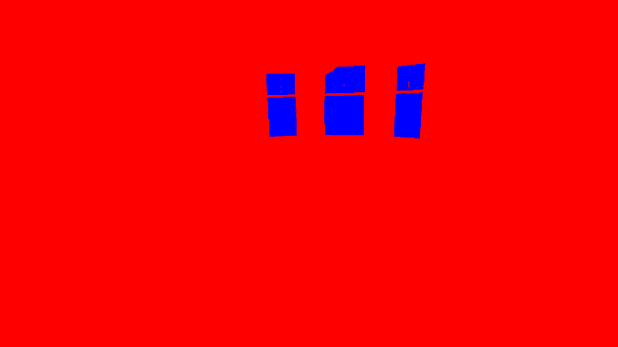
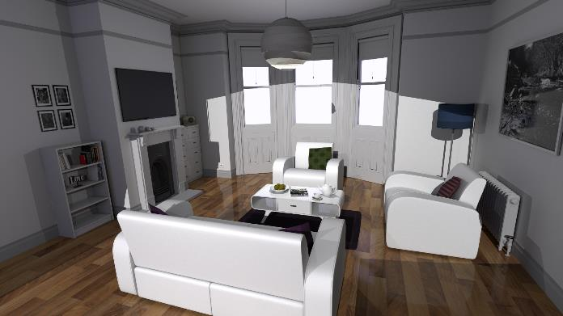
Really SIMPLE GPU Ray Tracer
RWTexture<float4> gOutTex;
struct RayPayload { float3 color; };
[shader(“miss”)]
void MyMiss(inout RayPayload payload) {
payload.color = float3( 0, 0, 1 );
}
[shader(“closesthit”)]
void MyClosestHit(inout RayPayload data,
BuiltinTriangleIntersectAttribs attribs) {
data.color = float3( 1, 0, 0 );
}
[shader(“raygeneration”)]
void MyRayGen() {
uint2 curPixel = DispatchRaysIndex().xy;
float3 pixelRayDir = normalize( getRayDirFromPixelID( curPixel ) );
RayDesc ray = { gCamera.posW, 0.0f, pixelRayDir, 1e+38f };
RayPayload payload = { float3(0, 0, 0) };
TraceRay( gRtScene, RAY_FLAG_NONE, 0xFF, 0, 1, 0, ray, payload );
outTex[curPixel] = float4( payload.color, 1.0f );
}
This code renders this
For this scene

Slide 169
What about a Real Example?

Slide 170
What about a Real Example?
Examples from my DXR tutors: http://intro-to-dxr.cwyman.org
  Click on “code walkthrough”
  Not quite equivalent to any of those, but close

Slide 171
What about a Real Example?
How about adding shadows?

Slide 172
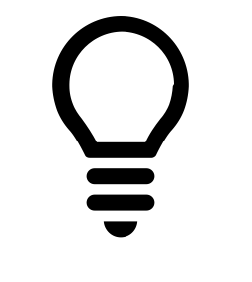

What about a Real Example?
How about adding shadows?
  For each pixel, determine if light visible
  Shoot a ray towards light
×

Slide 173
How does this work?
Trace a ray from the camera

Slide 174
How does this work?
Trace a ray from the camera
  At the shading point (i.e., the closest hit)
  Trace another ray towards the light
?

Slide 175
How does this work?
Trace a ray from the camera
  At the shading point (i.e., the closest hit)
  Trace another ray towards the light
  If it hits, shade the pixel as in shadow
  If it misses, illuminate the pixel by the light
?

Slide 176
A Reusable Shadow Ray
...
struct ShadowPayload {
float visibility; // 0.0 means ‘shadowed’, 1.0 means ‘lit’
};
[shader(“miss”)]
void ShadowMiss(inout ShadowPayload pay) {
pay.visibility = 1.0f;
}
[shader(“anyhit”)]
void ShadowAnyHit(inout ShadowPayload pay, BuiltinIntersectAttribs attribs) {
if (alphaTestFails(attribs))
IgnoreHit();
}
float shootShadowRay(float3 orig, float3 dir, float minT, float maxT) {
RayDesc ray = { orig, minT, dir, maxT };
ShadowPayload pay = { 0.0f };
uint flags = RAY_FLAG_ACCEPT_FIRST_HIT_AND_END_SEARCH |
RAY_FLAG_SKIP_CLOSEST_HIT_SHADER;
TraceRay( gRtScene, flags, 0xFF, 0, 1, 0, ray, pay );
return pay.visibility;
}
...
Encapsulate a shadow ray
  Create shootShadowRay()
  Can call while shading

Slide 177
A Reusable Shadow Ray
...
struct ShadowPayload {
float visibility; // 0.0 means ‘shadowed’, 1.0 means ‘lit’
};
[shader(“miss”)]
void ShadowMiss(inout ShadowPayload pay) {
pay.visibility = 1.0f;
}
[shader(“anyhit”)]
void ShadowAnyHit(inout ShadowPayload pay, BuiltinIntersectAttribs attribs) {
if (alphaTestFails(attribs))
IgnoreHit();
}
float shootShadowRay(float3 orig, float3 dir, float minT, float maxT) {
RayDesc ray = { orig, minT, dir, maxT };
ShadowPayload pay = { 0.0f };
uint flags = RAY_FLAG_ACCEPT_FIRST_HIT_AND_END_SEARCH |
RAY_FLAG_SKIP_CLOSEST_HIT_SHADER;
TraceRay( gRtScene, flags, 0xFF, 0, 1, 0, ray, pay );
return pay.visibility;
}
...
Encapsulate a shadow ray
  Create a ray
    From some origin
    In some direction
    Check occlusions in [t_{min}…t_{max}]

Slide 178
A Reusable Shadow Ray
...
struct ShadowPayload {
float visibility; // 0.0 means ‘shadowed’, 1.0 means ‘lit’
};
[shader(“miss”)]
void ShadowMiss(inout ShadowPayload pay) {
pay.visibility = 1.0f;
}
[shader(“anyhit”)]
void ShadowAnyHit(inout ShadowPayload pay, BuiltinIntersectAttribs attribs) {
if (alphaTestFails(attribs))
IgnoreHit();
}
float shootShadowRay(float3 orig, float3 dir, float minT, float maxT) {
RayDesc ray = { orig, minT, dir, maxT };
ShadowPayload pay = { 0.0f };
uint flags = RAY_FLAG_ACCEPT_FIRST_HIT_AND_END_SEARCH |
RAY_FLAG_SKIP_CLOSEST_HIT_SHADER;
TraceRay( gRtScene, flags, 0xFF, 0, 1, 0, ray, pay );
return pay.visibility;
}
...
Encapsulate a shadow ray
  Create a ray
    From some origin
    In some direction
    Check occlusions in [t_{min}…t_{max}]
  Assume shadows are occluded

Slide 179
A Reusable Shadow Ray
...
struct ShadowPayload {
float visibility; // 0.0 means ‘shadowed’, 1.0 means ‘lit’
};
[shader(“miss”)]
void ShadowMiss(inout ShadowPayload pay) {
pay.visibility = 1.0f;
}
[shader(“anyhit”)]
void ShadowAnyHit(inout ShadowPayload pay, BuiltinIntersectAttribs attribs) {
if (alphaTestFails(attribs))
IgnoreHit();
}
float shootShadowRay(float3 orig, float3 dir, float minT, float maxT) {
RayDesc ray = { orig, minT, dir, maxT };
ShadowPayload pay = { 0.0f };
uint flags = RAY_FLAG_ACCEPT_FIRST_HIT_AND_END_SEARCH |
RAY_FLAG_SKIP_CLOSEST_HIT_SHADER;
TraceRay( gRtScene, flags, 0xFF, 0, 1, 0, ray, pay );
return pay.visibility;
}
...
Encapsulate a shadow ray
  Create a ray
    From some origin
    In some direction
    Check occlusions in [t_{min}…t_{max}]
  Assume shadows are occluded
  Trace the ray
  Return 1 if lit, 0 otherwise

Slide 180
A Reusable Shadow Ray
...
struct ShadowPayload {
float visibility; // 0.0 means ‘shadowed’, 1.0 means ‘lit’
};
[shader(“miss”)]
void ShadowMiss(inout ShadowPayload pay) {
pay.visibility = 1.0f;
}
[shader(“anyhit”)]
void ShadowAnyHit(inout ShadowPayload pay, BuiltinIntersectAttribs attribs) {
if (alphaTestFails(attribs))
IgnoreHit();
}
float shootShadowRay(float3 orig, float3 dir, float minT, float maxT) {
RayDesc ray = { orig, minT, dir, maxT };
ShadowPayload pay = { 0.0f };
uint flags = RAY_FLAG_ACCEPT_FIRST_HIT_AND_END_SEARCH |
RAY_FLAG_SKIP_CLOSEST_HIT_SHADER;
TraceRay( gRtScene, flags, 0xFF, 0, 1, 0, ray, pay );
return pay.visibility;
}
...
Encapsulate a shadow ray
  Create a ray
    From some origin
    In some direction
    Check occlusions in [t_{min}…t_{max}]
  Assume shadows are occluded
  Trace the ray
  Return 1 if lit, 0 otherwise
Some shadow ray optimizations
  No shading; skip closest hit
  End at any occlusion
    Need if not where

Slide 181
A Reusable Shadow Ray
...
struct ShadowPayload {
float visibility; // 0.0 means ‘shadowed’, 1.0 means ‘lit’
};
[shader(“miss”)]
void ShadowMiss(inout ShadowPayload pay) {
pay.visibility = 1.0f;
}
[shader(“anyhit”)]
void ShadowAnyHit(inout ShadowPayload pay, BuiltinIntersectAttribs attribs) {
if (alphaTestFails(attribs))
IgnoreHit();
}
float shootShadowRay(float3 orig, float3 dir, float minT, float maxT) {
RayDesc ray = { orig, minT, dir, maxT };
ShadowPayload pay = { 0.0f };
uint flags = RAY_FLAG_ACCEPT_FIRST_HIT_AND_END_SEARCH |
RAY_FLAG_SKIP_CLOSEST_HIT_SHADER;
TraceRay( gRtScene, flags, 0xFF, 0, 1, 0, ray, pay );
return pay.visibility;
}
...
Miss shader:
  We missed…
  Set visibility to 1.0

Slide 182
A Reusable Shadow Ray
...
struct ShadowPayload {
float visibility; // 0.0 means ‘shadowed’, 1.0 means ‘lit’
};
[shader(“miss”)]
void ShadowMiss(inout ShadowPayload pay) {
pay.visibility = 1.0f;
}
[shader(“anyhit”)]
void ShadowAnyHit(inout ShadowPayload pay, BuiltinIntersectAttribs attribs) {
if (alphaTestFails(attribs))
IgnoreHit();
}
float shootShadowRay(float3 orig, float3 dir, float minT, float maxT) {
RayDesc ray = { orig, minT, dir, maxT };
ShadowPayload pay = { 0.0f };
uint flags = RAY_FLAG_ACCEPT_FIRST_HIT_AND_END_SEARCH |
RAY_FLAG_SKIP_CLOSEST_HIT_SHADER;
TraceRay( gRtScene, flags, 0xFF, 0, 1, 0, ray, pay );
return pay.visibility;
}
...
Miss shader:
  We missed…
  Set visibility to 1.0
Any hit shader:
  Asks is occluder transparent?
  If so, ignore this hit

Slide 183
A Reusable Shadow Ray
...
struct ShadowPayload {
float visibility; // 0.0 means ‘shadowed’, 1.0 means ‘lit’
};
[shader(“miss”)]
void ShadowMiss(inout ShadowPayload pay) {
pay.visibility = 1.0f;
}
[shader(“anyhit”)]
void ShadowAnyHit(inout ShadowPayload pay, BuiltinIntersectAttribs attribs) {
if (alphaTestFails(attribs))
IgnoreHit();
}
float shootShadowRay(float3 orig, float3 dir, float minT, float maxT) {
RayDesc ray = { orig, minT, dir, maxT };
ShadowPayload pay = { 0.0f };
uint flags = RAY_FLAG_ACCEPT_FIRST_HIT_AND_END_SEARCH |
RAY_FLAG_SKIP_CLOSEST_HIT_SHADER;
TraceRay( gRtScene, flags, 0xFF, 0, 1, 0, ray, pay );
return pay.visibility;
}
...
Gives reusable shadow rays
  Useful in many contexts

Slide 184
A Reusable Shadow Ray
Gives reusable shadow rays
  Useful in many contexts
Like where?
  Maybe: want to shade this point
?

Slide 185
Shading a Diffuse SURFACE
To shade, we need:
  Position at hit point
  Normal at hit point
  Material at hit point
float3 DiffuseShade( float3 hitPos, float3 hitNorm, float3 difColor ) {
// Get information about the light; access your framework’s scene structs
float distToLight = length( gLight.position – hitPos );
float3 dirToLight = normalize( gLight.position – hitPos );
// Shoot shadow ray with our encapsulated shadow tracing function
float isLit = shootShadowRay(hitPos, dirToLight, 1.0e-4f, distToLight );
// Compute our NdotL term; shoot our shadow ray in selected direction
float NdotL = saturate( dot( hitNorm, dirToLight ) ); // In range [0..1]
// Return shaded color
return isLit
? (NdotL * gLight.intensity * (difColor / M_PI) )
: float3(0, 0, 0);
}

Slide 186
Shading a Diffuse SURFACE
To shade, we need:
  Position at hit point
  Normal at hit point
  Material at hit point
Grab light information
  Direction to light
  How far away is it?
float3 DiffuseShade( float3 hitPos, float3 hitNorm, float3 difColor ) {
// Get information about the light; access your framework’s scene structs
float distToLight = length( gLight.position – hitPos );
float3 dirToLight = normalize( gLight.position – hitPos );
// Shoot shadow ray with our encapsulated shadow tracing function
float isLit = shootShadowRay(hitPos, dirToLight, 1.0e-4f, distToLight );
// Compute our NdotL term; shoot our shadow ray in selected direction
float NdotL = saturate( dot( hitNorm, dirToLight ) ); // In range [0..1]
// Return shaded color
return isLit
? (NdotL * gLight.intensity * (difColor / M_PI) )
: float3(0, 0, 0);
}

Slide 187
Shading a Diffuse SURFACE
To shade, we need:
  Position at hit point
  Normal at hit point
  Material at hit point
Grab light information
  Direction to light
  How far away is it?
Trace our shadow ray
float3 DiffuseShade( float3 hitPos, float3 hitNorm, float3 difColor ) {
// Get information about the light; access your framework’s scene structs
float distToLight = length( gLight.position – hitPos );
float3 dirToLight = normalize( gLight.position – hitPos );
// Shoot shadow ray with our encapsulated shadow tracing function
float isLit = shootShadowRay(hitPos, dirToLight, 1.0e-4f, distToLight );
// Compute our NdotL term; shoot our shadow ray in selected direction
float NdotL = saturate( dot( hitNorm, dirToLight ) ); // In range [0..1]
// Return shaded color
return isLit
? (NdotL * gLight.intensity * (difColor / M_PI) )
: float3(0, 0, 0);
}

Slide 188
Shading a Diffuse SURFACE
To shade, we need:
  Position at hit point
  Normal at hit point
  Material at hit point
Grab light information
  Direction to light
  How far away is it?
Trace our shadow ray
Compute diffuse shading
float3 DiffuseShade( float3 hitPos, float3 hitNorm, float3 difColor ) {
// Get information about the light; access your framework’s scene structs
float distToLight = length( gLight.position – hitPos );
float3 dirToLight = normalize( gLight.position – hitPos );
// Shoot shadow ray with our encapsulated shadow tracing function
float isLit = shootShadowRay(hitPos, dirToLight, 1.0e-4f, distToLight );
// Compute our NdotL term; shoot our shadow ray in selected direction
float NdotL = saturate( dot( hitNorm, dirToLight ) ); // In range [0..1]
// Return shaded color
return isLit
? (NdotL * gLight.intensity * (difColor / M_PI) )
: float3(0, 0, 0);
}

Slide 189
Shading a Diffuse SURFACE
To shade, we need:
  Position at hit point
  Normal at hit point
  Material at hit point
Grab light information
  Direction to light
  How far away is it?
Trace our shadow ray
Compute diffuse shading
Want more complex material?
  Insert different code here
float3 DiffuseShade( float3 hitPos, float3 hitNorm, float3 difColor ) {
// Get information about the light; access your framework’s scene structs
float distToLight = length( gLight.position – hitPos );
float3 dirToLight = normalize( gLight.position – hitPos );
// Shoot shadow ray with our encapsulated shadow tracing function
float isLit = shootShadowRay(hitPos, dirToLight, 1.0e-4f, distToLight );
// Compute our NdotL term; shoot our shadow ray in selected direction
float NdotL = saturate( dot( hitNorm, dirToLight ) ); // In range [0..1]
// Return shaded color
return isLit
? (NdotL * gLight.intensity * (difColor / M_PI) )
: float3(0, 0, 0);
}

Slide 190
USE A Shade function
Where to use DiffuseShade()?

Slide 191
USE A Shade function
struct IndirectPayload {
float3 color; // will store ray color
};
[shader(“miss”)]
void IndirectMiss(inout IndirectPayload pay) {
pay.color = GetBackgroundColor( WorldRayDirection() );
}
[shader(“anyhit”)]
void IndirectAnyHit(inout IndirectPayload pay, BuiltinIntersectAttribs attribs) {
if (alphaTestFails(attribs))
IgnoreHit();
}
[shader(“closesthit”)]
void IndirectClosestHit(inout IndirectPayload pay,
BuiltinTriangleIntersectAttribs attribs) {
ShadingData hit = getHitShadingData( attribs );
pay.color = DiffuseShade( hit.pos, hit.norm, hit.difColor );
}
float3 shootColorRay(float3 orig, float3 dir, float minT ) {
RayDesc ray = { orig, minT, dir, 1.0e+38 };
IndirectPayload pay = { float3( 0.0f ) };
TraceRay( gRtScene, RAY_FLAG_NONE, 0xFF, 1, 2, 1, ray, pay );
return pay.color;
}
Where to use DiffuseShade()?
Encapsulate tracing a color ray

Slide 192
USE A Shade function
struct IndirectPayload {
float3 color; // will store ray color
};
[shader(“miss”)]
void IndirectMiss(inout IndirectPayload pay) {
pay.color = GetBackgroundColor( WorldRayDirection() );
}
[shader(“anyhit”)]
void IndirectAnyHit(inout IndirectPayload pay, BuiltinIntersectAttribs attribs) {
if (alphaTestFails(attribs))
IgnoreHit();
}
[shader(“closesthit”)]
void IndirectClosestHit(inout IndirectPayload pay,
BuiltinTriangleIntersectAttribs attribs) {
ShadingData hit = getHitShadingData( attribs );
pay.color = DiffuseShade( hit.pos, hit.norm, hit.difColor );
}
float3 shootColorRay(float3 orig, float3 dir, float minT ) {
RayDesc ray = { orig, minT, dir, 1.0e+38 };
IndirectPayload pay = { float3( 0.0f ) };
TraceRay( gRtScene, RAY_FLAG_NONE, 0xFF, 1, 2, 1, ray, pay );
return pay.color;
}
Where to use DiffuseShade()?
Encapsulate tracing a color ray
  Setup a ray
  Initialize return color to black

Slide 193
USE A Shade function
struct IndirectPayload {
float3 color; // will store ray color
};
[shader(“miss”)]
void IndirectMiss(inout IndirectPayload pay) {
pay.color = GetBackgroundColor( WorldRayDirection() );
}
[shader(“anyhit”)]
void IndirectAnyHit(inout IndirectPayload pay, BuiltinIntersectAttribs attribs) {
if (alphaTestFails(attribs))
IgnoreHit();
}
[shader(“closesthit”)]
void IndirectClosestHit(inout IndirectPayload pay,
BuiltinTriangleIntersectAttribs attribs) {
ShadingData hit = getHitShadingData( attribs );
pay.color = DiffuseShade( hit.pos, hit.norm, hit.difColor );
}
float3 shootColorRay(float3 orig, float3 dir, float minT ) {
RayDesc ray = { orig, minT, dir, 1.0e+38 };
IndirectPayload pay = { float3( 0.0f ) };
TraceRay( gRtScene, RAY_FLAG_NONE, 0xFF, 1, 2, 1, ray, pay );
return pay.color;
}
Where to use DiffuseShade()?
Encapsulate tracing a color ray
  Setup a ray
  Initialize return color to black
  Trace ray, then return its color

Slide 194
USE A Shade function
struct IndirectPayload {
float3 color; // will store ray color
};
[shader(“miss”)]
void IndirectMiss(inout IndirectPayload pay) {
pay.color = GetBackgroundColor( WorldRayDirection() );
}
[shader(“anyhit”)]
void IndirectAnyHit(inout IndirectPayload pay, BuiltinIntersectAttribs attribs) {
if (alphaTestFails(attribs))
IgnoreHit();
}
[shader(“closesthit”)]
void IndirectClosestHit(inout IndirectPayload pay,
BuiltinTriangleIntersectAttribs attribs) {
ShadingData hit = getHitShadingData( attribs );
pay.color = DiffuseShade( hit.pos, hit.norm, hit.difColor );
}
float3 shootColorRay(float3 orig, float3 dir, float minT ) {
RayDesc ray = { orig, minT, dir, 1.0e+38 };
IndirectPayload pay = { float3( 0.0f ) };
TraceRay( gRtScene, RAY_FLAG_NONE, 0xFF, 1, 2, 1, ray, pay );
return pay.color;
}
Where to use DiffuseShade()?
Encapsulate tracing a color ray
  Setup a ray
  Initialize return color to black
  Trace ray, then return its color
  For every hit, check transparency

Slide 195
USE A Shade function
struct IndirectPayload {
float3 color; // will store ray color
};
[shader(“miss”)]
void IndirectMiss(inout IndirectPayload pay) {
pay.color = GetBackgroundColor( WorldRayDirection() );
}
[shader(“anyhit”)]
void IndirectAnyHit(inout IndirectPayload pay, BuiltinIntersectAttribs attribs) {
if (alphaTestFails(attribs))
IgnoreHit();
}
[shader(“closesthit”)]
void IndirectClosestHit(inout IndirectPayload pay,
BuiltinTriangleIntersectAttribs attribs) {
ShadingData hit = getHitShadingData( attribs );
pay.color = DiffuseShade( hit.pos, hit.norm, hit.difColor );
}
float3 shootColorRay(float3 orig, float3 dir, float minT ) {
RayDesc ray = { orig, minT, dir, 1.0e+38 };
IndirectPayload pay = { float3( 0.0f ) };
TraceRay( gRtScene, RAY_FLAG_NONE, 0xFF, 1, 2, 1, ray, pay );
return pay.color;
}
Where to use DiffuseShade()?
Encapsulate tracing a color ray
  Setup a ray
  Initialize return color to black
  Trace ray, then return its color
  For every hit, check transparency
  On miss, return background

Slide 196
USE A Shade function
struct IndirectPayload {
float3 color; // will store ray color
};
[shader(“miss”)]
void IndirectMiss(inout IndirectPayload pay) {
pay.color = GetBackgroundColor( WorldRayDirection() );
}
[shader(“anyhit”)]
void IndirectAnyHit(inout IndirectPayload pay, BuiltinIntersectAttribs attribs) {
if (alphaTestFails(attribs))
IgnoreHit();
}
[shader(“closesthit”)]
void IndirectClosestHit(inout IndirectPayload pay,
BuiltinTriangleIntersectAttribs attribs) {
ShadingData hit = getHitShadingData( attribs );
pay.color = DiffuseShade( hit.pos, hit.norm, hit.difColor );
}
float3 shootColorRay(float3 orig, float3 dir, float minT ) {
RayDesc ray = { orig, minT, dir, 1.0e+38 };
IndirectPayload pay = { float3( 0.0f ) };
TraceRay( gRtScene, RAY_FLAG_NONE, 0xFF, 1, 2, 1, ray, pay );
return pay.color;
}
Where to use DiffuseShade()?
Encapsulate tracing a color ray
  Setup a ray
  Initialize return color to black
  Trace ray, then return its color
  For every hit, check transparency
  On miss, return background
  On closest hit, shade

Slide 197
Putting it Together…

Slide 198
Putting it Together…
Go back to ray gen shader
  Similar to simple one we started with
[shader(“raygeneration”)]
void BasicRayTracer() {
uint2 curPixel = DispatchRaysIndex().xy;
float3 pixelRayDir = normalize( getRayDirFromPixelID( curPixel ) );
float3 pixelColor = shootColorRay( gCamera.posW, pixelRayDir, 0.0f );
outTex[curPixel] = float4( pixelColor, 1.0f );
}

Slide 199
Putting it Together…
Go back to ray gen shader
  Similar to simple one we started with
  Get current pixel, it’s ray direction
[shader(“raygeneration”)]
void BasicRayTracer() {
uint2 curPixel = DispatchRaysIndex().xy;
float3 pixelRayDir = normalize( getRayDirFromPixelID( curPixel ) );
float3 pixelColor = shootColorRay( gCamera.posW, pixelRayDir, 0.0f );
outTex[curPixel] = float4( pixelColor, 1.0f );
}

Slide 200
Putting it Together…
Go back to ray gen shader
  Similar to simple one we started with
  Get current pixel, it’s ray direction
  Shoot a color ray in that direction
[shader(“raygeneration”)]
void BasicRayTracer() {
uint2 curPixel = DispatchRaysIndex().xy;
float3 pixelRayDir = normalize( getRayDirFromPixelID( curPixel ) );
float3 pixelColor = shootColorRay( gCamera.posW, pixelRayDir, 0.0f );
outTex[curPixel] = float4( pixelColor, 1.0f );
}

Slide 201
Putting it Together…
Go back to ray gen shader
  Similar to simple one we started with
  Get current pixel, it’s ray direction
  Shoot a color ray in that direction
  Output the final result
[shader(“raygeneration”)]
void BasicRayTracer() {
uint2 curPixel = DispatchRaysIndex().xy;
float3 pixelRayDir = normalize( getRayDirFromPixelID( curPixel ) );
float3 pixelColor = shootColorRay( gCamera.posW, pixelRayDir, 0.0f );
outTex[curPixel] = float4( pixelColor, 1.0f );
}

Slide 202
Demo?
Full code, binaries, and walk through:
  http://intro-to-dxr.cwyman.org

Slide 203
Going Further
More complex materials, multi-bounce lighting, etc.

Slide 204
Going Further
struct IndirectPayload {
float3 color; // will store ray color
};
[shader(“miss”)]
void IndirectMiss(inout IndirectPayload pay) {
pay.color = GetBackgroundColor( WorldRayDirection() );
}
[shader(“anyhit”)]
void IndirectAnyHit(inout IndirectPayload pay, BuiltinIntersectAttribs attribs) {
if (alphaTestFails(attribs))
IgnoreHit();
}
[shader(“closesthit”)]
void IndirectClosestHit(inout IndirectPayload pay,
BuiltinTriangleIntersectAttribs attribs) {
ShadingData hit = getHitShadingData( attribs );
pay.color = DiffuseShade( hit.pos, hit.norm, hit.difColor );
}
float3 shootColorRay(float3 orig, float3 dir, float minT ) {
RayDesc ray = { orig, minT, dir, 1.0e+38 };
IndirectPayload pay = { float3( 0.0f ) };
TraceRay( gRtScene, RAY_FLAG_NONE, 0xFF, 1, 2, 1, ray, pay );
return pay.color;
}
Take code for color ray & tweak

Slide 205
Going Further
struct IndirectPayload {
float3 color; // will store ray color
};
[shader(“miss”)]
void IndirectMiss(inout IndirectPayload pay) {
pay.color = GetBackgroundColor( WorldRayDirection() );
}
[shader(“anyhit”)]
void IndirectAnyHit(inout IndirectPayload pay, BuiltinIntersectAttribs attribs) {
if (alphaTestFails(attribs))
IgnoreHit();
}
[shader(“closesthit”)]
void IndirectClosestHit(inout IndirectPayload pay,
BuiltinTriangleIntersectAttribs attribs) {
ShadingData hit = getHitShadingData( attribs );
pay.color = DiffuseShade( hit.pos, hit.norm, hit.difColor );
}
float3 shootColorRay(float3 orig, float3 dir, float minT ) {
RayDesc ray = { orig, minT, dir, 1.0e+38 };
IndirectPayload pay = { float3( 0.0f ) };
TraceRay( gRtScene, RAY_FLAG_NONE, 0xFF, 1, 2, 1, ray, pay );
return pay.color;
}
Take code for color ray & tweak
  Mostly here:

Slide 206
Going Further
[shader(“closesthit”)]
void IndirectClosestHit(inout IndirectPayload pay,
BuiltinTriangleIntersectAttribs attribs) {
ShadingData hit = getHitShadingData( attribs );
float3 directLight = DiffuseShade( hit.pos, hit.norm, hit.difColor );
float3 bounceDir = selectRandomDirection();
float3 indirectColor = shootColorRay( hit.pos, bouncDir );
float3 indirectLight = DiffuseIndirect( bounceDir, indirectColor );
pay.color = directLight + indirectLight;
}
Want global illumination?

Slide 207
Going Further
[shader(“closesthit”)]
void IndirectClosestHit(inout IndirectPayload pay,
BuiltinTriangleIntersectAttribs attribs) {
ShadingData hit = getHitShadingData( attribs );
float3 directLight = DiffuseShade( hit.pos, hit.norm, hit.difColor );
float3 bounceDir = selectRandomDirection();
float3 indirectColor = shootColorRay( hit.pos, bouncDir );
float3 indirectLight = DiffuseIndirect( bounceDir, indirectColor );
pay.color = directLight + indirectLight;
}
Want global illumination?
  Add a random outgoing ray
  Recursive call: shootColorRay()
  Account for BRDF
  Add contributions together
A basic path tracer

Slide 208
Going Further
[shader(“closesthit”)]
void IndirectClosestHit(inout IndirectPayload pay,
BuiltinTriangleIntersectAttribs attribs) {
ShadingData hit = getHitShadingData( attribs );
float3 directLight = DiffuseShade( hit.pos, hit.norm, hit.difColor );
float3 bounceDir = selectRandomDirection();
float3 indirectColor = shootColorRay( hit.pos, bouncDir );
float3 indirectLight = DiffuseIndirect( bounceDir, indirectColor );
pay.color = directLight + indirectLight;
}
Want global illumination?
  Add a random outgoing ray
  Recursive call: shootColorRay()
  Account for BRDF
  Add contributions together
A basic path tracer
  Usually encapsulate BRDF
  Direct light done with BRDF::evaluate()

Slide 209
Going Further
[shader(“closesthit”)]
void IndirectClosestHit(inout IndirectPayload pay,
BuiltinTriangleIntersectAttribs attribs) {
ShadingData hit = getHitShadingData( attribs );
float3 directLight = DiffuseShade( hit.pos, hit.norm, hit.difColor );
float3 bounceDir = selectRandomDirection();
float3 indirectColor = shootColorRay( hit.pos, bouncDir );
float3 indirectLight = DiffuseIndirect( bounceDir, indirectColor );
pay.color = directLight + indirectLight;
}
Want global illumination?
  Add a random outgoing ray
  Recursive call: shootColorRay()
  Account for BRDF
  Add contributions together
A basic path tracer
  Usually encapsulate BRDF
  Direct light done with BRDF::evaluate()
  Indirect done with BRDF::scatter()
    Also sometimes called sample()

Slide 210
Going Further
[shader(“closesthit”)]
void IndirectClosestHit(inout IndirectPayload pay,
BuiltinTriangleIntersectAttribs attribs) {
ShadingData hit = getHitShadingData( attribs );
float3 directLight = DiffuseShade( hit.pos, hit.norm, hit.difColor );
float3 bounceDir = selectRandomDirection();
float3 indirectColor = shootColorRay( hit.pos, bouncDir );
float3 indirectLight = DiffuseIndirect( bounceDir, indirectColor );
pay.color = directLight + indirectLight;
}
Want global illumination?
  Add a random outgoing ray
  Recursive call: shootColorRay()
  Account for BRDF
  Add contributions together
A basic path tracer
  Usually encapsulate BRDF
  Direct light done with BRDF::evaluate()
  Indirect done with BRDF::scatter()
    Also sometimes called sample()
Makes it easy to plug in new materials

Slide 211
Many lights?

Slide 212
Many lights?
Don’t just evaluate BRDF for one light
float3 DiffuseShade( float3 hitPos, float3 hitNorm, float3 difColor ) {
// Get information about the light; access your framework’s scene structs
float distToLight = length( gLight.position – hitPos );
float3 dirToLight = normalize( gLight.position – hitPos );
// Shoot shadow ray with our encapsulated shadow tracing function
float isLit = shootShadowRay(hitPos, dirToLight, 1.0e-4f, distToLight );
// Compute our NdotL term; shoot our shadow ray in selected direction
float NdotL = saturate( dot( hitNorm, dirToLight ) ); // In range [0..1]
// Return shaded color
return isLit
? (NdotL * gLight.intensity * (difColor / M_PI) )
: float3(0, 0, 0);
}

Slide 213
Many lights?
Don’t just evaluate BRDF for one light
  Loop per light
float3 DiffuseShade( float3 hitPos, float3 hitNorm, float3 difColor ) {
// Get information about the light; access your framework’s scene structs
float distToLight = length( gLight.position – hitPos );
float3 dirToLight = normalize( gLight.position – hitPos );
// Shoot shadow ray with our encapsulated shadow tracing function
float isLit = shootShadowRay(hitPos, dirToLight, 1.0e-4f, distToLight );
// Compute our NdotL term; shoot our shadow ray in selected direction
float NdotL = saturate( dot( hitNorm, dirToLight ) ); // In range [0..1]
// Return shaded color
return isLit
? (NdotL * gLight.intensity * (difColor / M_PI) )
: float3(0, 0, 0);
}

Slide 214
Many lights?
Don’t just evaluate BRDF for one light
  Loop per light
Thousands of lights? Becomes expensive
float3 DiffuseShade( float3 hitPos, float3 hitNorm, float3 difColor ) {
// Get information about the light; access your framework’s scene structs
float distToLight = length( gLight.position – hitPos );
float3 dirToLight = normalize( gLight.position – hitPos );
// Shoot shadow ray with our encapsulated shadow tracing function
float isLit = shootShadowRay(hitPos, dirToLight, 1.0e-4f, distToLight );
// Compute our NdotL term; shoot our shadow ray in selected direction
float NdotL = saturate( dot( hitNorm, dirToLight ) ); // In range [0..1]
// Return shaded color
return isLit
? (NdotL * gLight.intensity * (difColor / M_PI) )
: float3(0, 0, 0);
}

Slide 215
Many lights?
Don’t just evaluate BRDF for one light
  Loop per light
Thousands of lights? Becomes expensive
What if: emissive triangles, spheres, bunnies?

Slide 216
Many lights?
Don’t just evaluate BRDF for one light
  Loop per light
Thousands of lights? Becomes expensive
What if: emissive triangles, spheres, bunnies?
Need to sample your lights
  Pick a random location on some light
  Evaluate direct lighting from that point

Slide 217
Naïve Light Sampling:
Lots of point lights (e.g., N points):
  Randomly pick number in [1…N], use that light for shading

Slide 218
Naïve Light Sampling:
Lots of point lights (e.g., N points):
  Randomly pick number in [1…N], use that light for shading
One surface light:
  Pick a point uniformly over the surface
  E.g., on a quad, pick both (u, v) randomly in [0…1]

Slide 219
Naïve Light Sampling:
Lots of point lights (e.g., N points):
  Randomly pick number in [1…N], use that light for shading
One surface light:
  Pick a point uniformly over the surface
  E.g., on a quad, pick both (u, v) randomly in [0…1]
For many emissive surfaces (e.g., N surfaces):
  First pick number in [1…N], then pick random point on surface

Slide 220
Naïve Light Sampling:
Lots of point lights (e.g., N points):
  Randomly pick number in [1…N], use that light for shading
One surface light:
  Pick a point uniformly over the surface
  E.g., on a quad, pick both (u, v) randomly in [0…1]
For many emissive surfaces (e.g., N surfaces):
  First pick number in [1…N], then pick random point on surface
  Alternatively weight choice of light based on area

Slide 221
Up Next
Morgan McGuire
With more on materials, sampling, and how to think about GPU ray tracing performance

Slide 222
Questions?
E-mail: cwyman@nvidia.com
Twitter: @_cwyman_
Code: http://intro-to-dxr.cwyman.org

