Slide 1

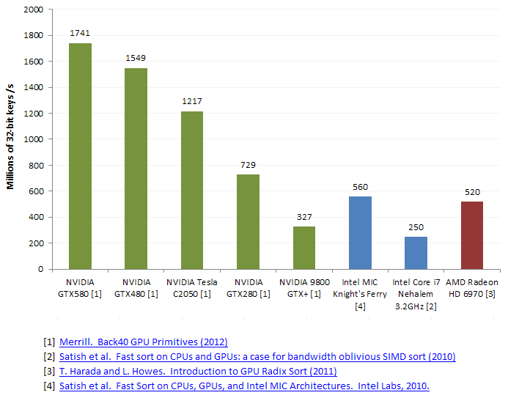
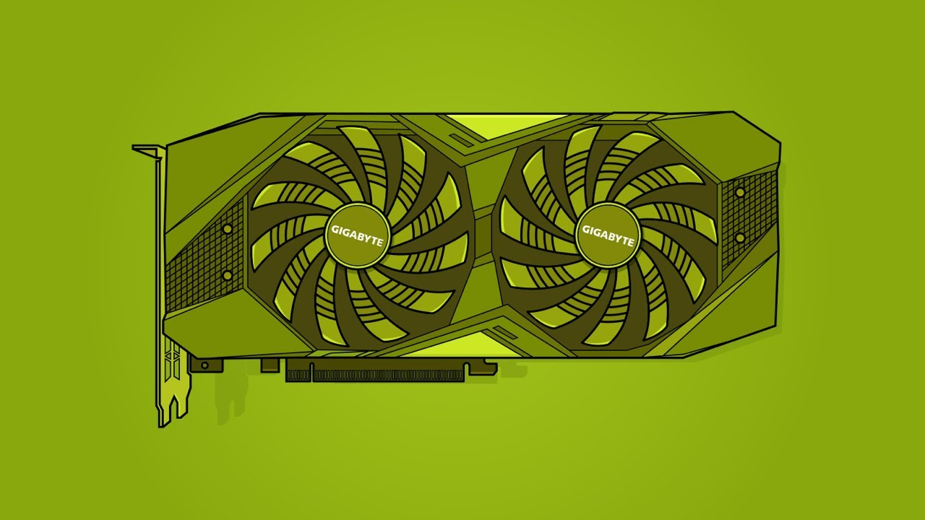
Lecture 32: Advanced GPU Programming – The Thrust Library
Books:
Programming on Parallel Machines
Lectures:
GPU Programming With Thrust and CUDA
Thrust Library Intro
Topics:
Thrust (NVIDIA Developer)
Nvidia Thrust Documentation
Thrust Github
Parallel Processing
Matrix Multiplication
Selecting Devices

