Slide 1
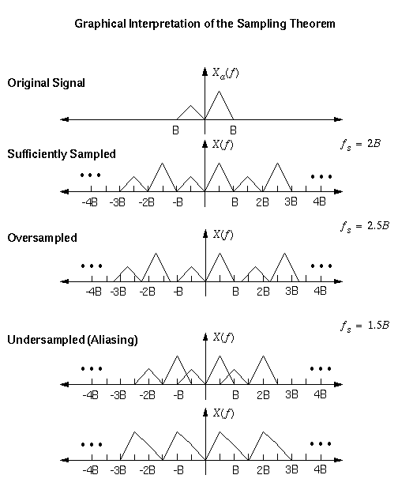
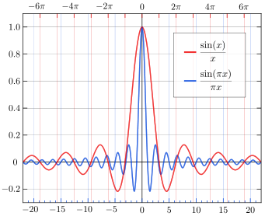
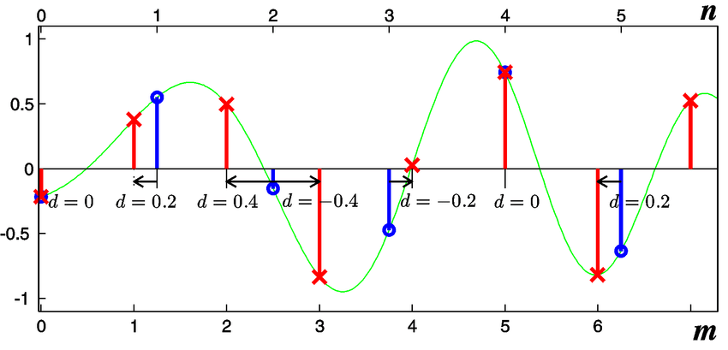
Lecture 31: Final Exam – Image Processing
Books:
DSP Guide
Lectures:
Resampling Theory
Topics:
Final Exam: Digital Resampling
The Sampling Theorem
Changing the Sample Frequency
Multidimensional DSP

