Slide 1
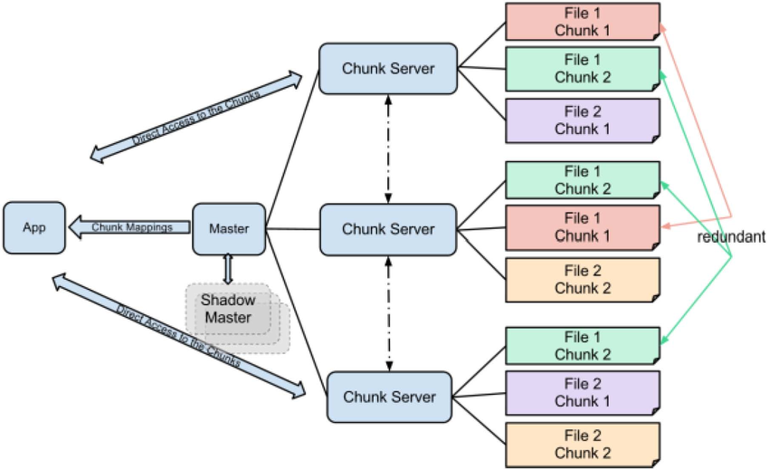

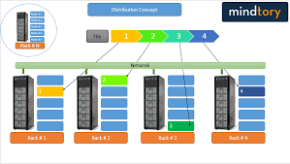
Lecture 30: Hadoop – A Distributed File System
Books:
Hadoop: The Definitive Guide
Lectures:
What is Hadoop?
Hadoop in 5 Minutes
Topics:
Comparison of Distributed File Systems
High Performance Storage System
LANs, SANs, NetApps
What is Apache Hadoop?
Hadoop Introduction
Hadoop: A Distributed Framework
Hadoop for Big Data
Apache Hadoop Tutorial

