Slide 1
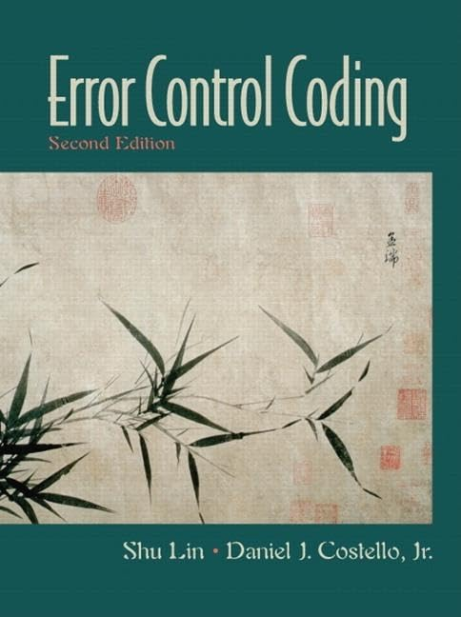
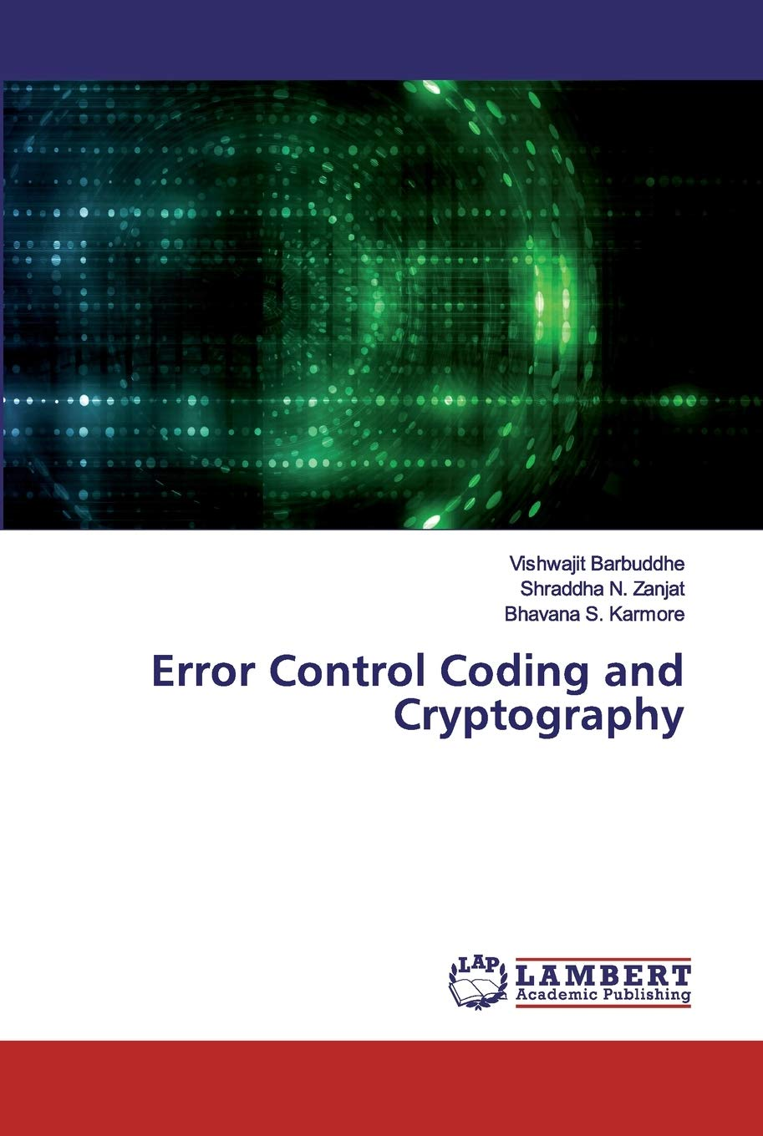
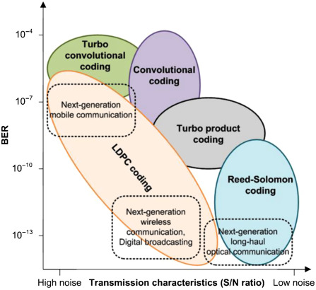
Lecture 28: Error Correction Coding
Books:
Fundamentals of Error Control Coding
Error Control Coding and Cryptography
Error Control Coding
Lectures:
Essential Coding Theory (MIT)
Essential Coding Theory (Harvard)
Error Control in Data Links
Coding Theory
Topics:
Information Theory
Noisy Communication Channel
Error Correction and Detection
Low Density Parity Check Coding

Slide 2

Chapter 10
Error Detection
and Correction
Copyright © The McGraw-Hill Companies, Inc. Permission required for reproduction or display.

Slide 3

Note
Data can be corrupted
during transmission.
Some applications require that
errors be detected and corrected.

Slide 4
10-1 INTRODUCTION
Let us first discuss some issues related, directly or indirectly, to error detection and correction.
Topics discussed in this section:
Types of Errors
Redundancy
Detection Versus Correction
Forward Error Correction Versus Retransmission
Coding
Modular Arithmetic

Slide 5
Note
In a single-bit error, only 1 bit in the data unit has changed.

Slide 6
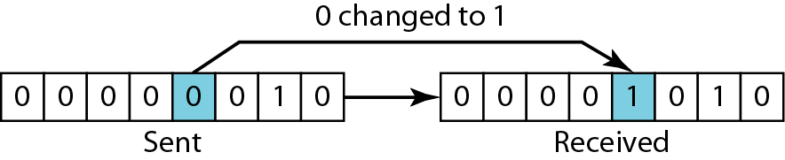
Figure 10.1 Single-bit error

Slide 7
Note
A burst error means that 2 or more bits in the data unit have changed.

Slide 8
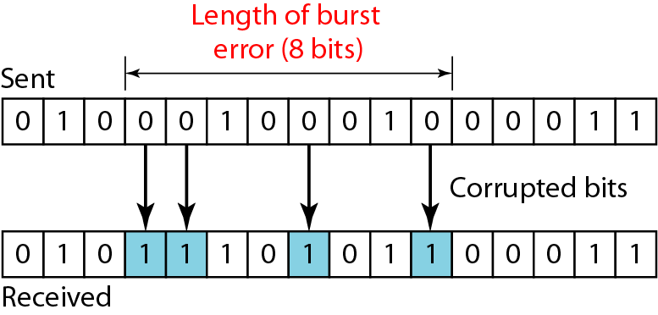
Figure 10.2 Burst error of length 8

Slide 9
Note
To detect or correct errors, we need to send extra (redundant) bits with data.

Slide 10
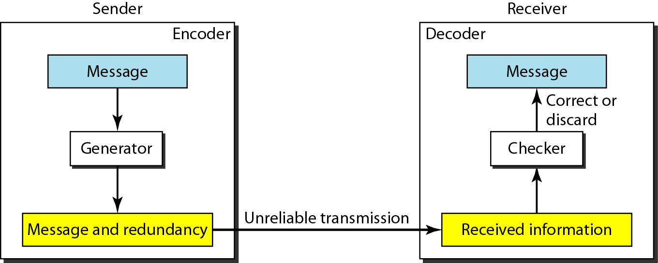
Figure 10.3 The structure of encoder and decoder

Slide 11
Note
In modulo-N arithmetic, we use only the integers in the range 0 to N −1, inclusive.

Slide 12
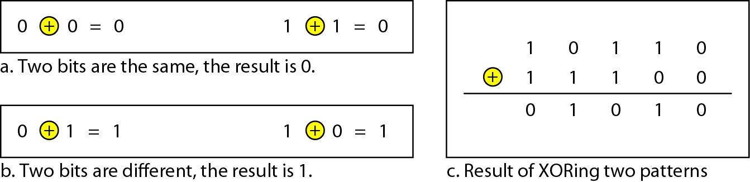
Figure 10.4 XORing of two single bits or two words

Slide 13
10-2 BLOCK CODING
In block coding, we divide our message into blocks, each of k bits, called datawords. We add r redundant bits to each block to make the length n = k + r. The resulting n-bit blocks are called codewords.
Topics discussed in this section:
Error Detection
Error Correction
Hamming Distance
Minimum Hamming Distance

Slide 14
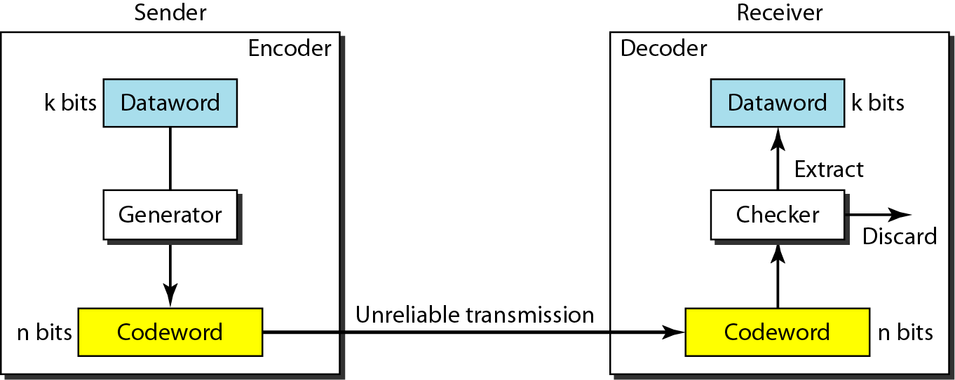
Figure 10.6 Process of error detection in block coding

Slide 15
Example 10.2
Let us assume that k = 2 and n = 3. Table 10.1 shows the list of datawords and codewords (even parity). It is only good for detecting one bit error.
Table 10.1 A code for error detection (Example 10.2)

Slide 16
Note
An error-detecting code can detect
only the types of errors for which it is designed; other types of errors may remain undetected.

Slide 17
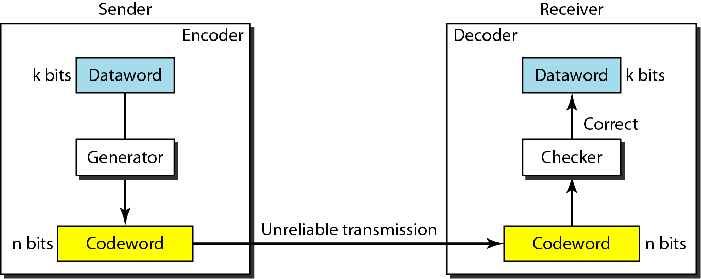
Figure 10.7 Structure of encoder and decoder in error correction

Slide 18
Note
The Hamming distance between two words is the number of differences between corresponding bits.

Slide 19
Example 10.4
Let us find the Hamming distance between two pairs of words.
1. The Hamming distance d(000, 011) is 2 because
2. The Hamming distance d(10101, 11110) is 3 because

Slide 20
Note
The minimum Hamming distance is the smallest Hamming distance between
all possible pairs in a set of words.

Slide 21
Example 10.5
Find the minimum Hamming distance of the coding scheme in Table 10.1.
Solution
We first find all Hamming distances.
The d_{min} in this case is 2.

Slide 22
Note
To guarantee the detection of up to s errors in all cases, the minimum
Hamming distance in a block
code must be d_{min} = s + 1.
Why?
More than s-bit error is possible to detect,
but not guaranteed.

Slide 23
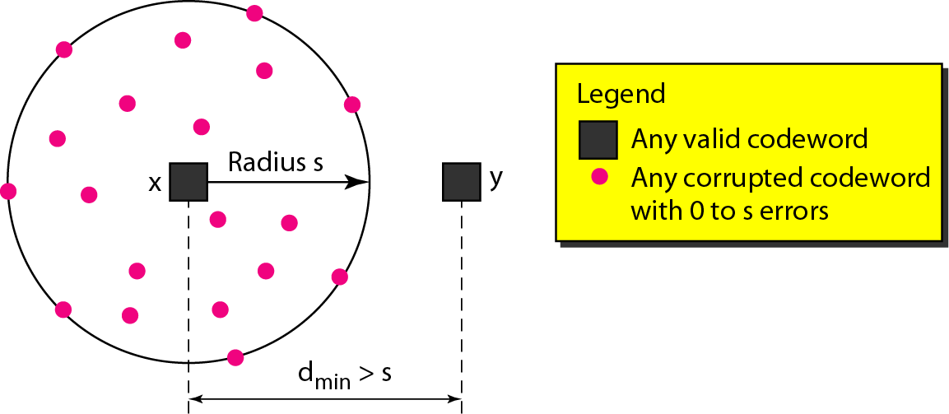
Figure 10.8 Geometric concept for finding d_{min} in error detection

Slide 24
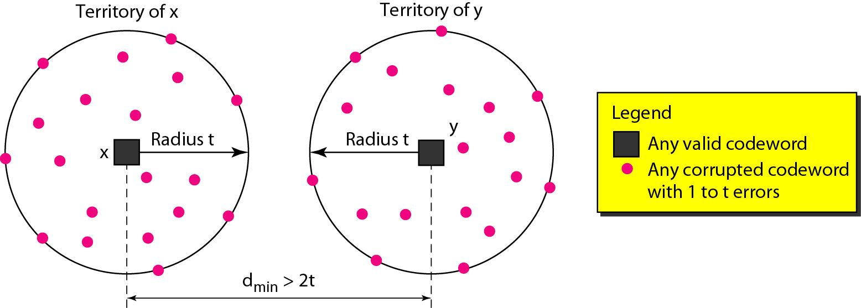
Figure 10.9 Geometric concept for finding d_{min} in error correction

Slide 25
Note
To guarantee correction of up to t errors in all cases, the minimum Hamming distance in a block code
must be d_{min} = 2t + 1.

Slide 26
Example 10.9
A code scheme has a Hamming distance d_{min} = 4. What is the error detection and correction capability of this scheme?
Solution
This code guarantees the detection of up to three errors
(s = 3), but it can correct up to one error. In other words,
if this code is used for error correction, part of its capability is wasted. Error correction codes should have an odd minimum distance (3, 5, 7, . . . ).

Slide 27
10-3 LINEAR BLOCK CODES
Almost all block codes used today belong to a subset called linear block codes. A linear block code is a code in which the XOR (addition modulo-2) of two valid codewords creates another valid codeword.
Topics discussed in this section:
Minimum Distance for Linear Block Codes
Some Linear Block Codes

Slide 28
Note
In a linear block code, the exclusive OR (XOR) of any two valid codewords creates another valid codeword.

Slide 29
Example 10.10
Let us see if the two codes we defined in Table 10.1 belong to the class of linear block codes.
The scheme in Table 10.1 is a linear block code because the result of XORing any codeword with any other codeword is a valid codeword. For example, the XORing of the second and third codewords creates the fourth one.

Slide 30
Example 10.11
Note
In a linear block code, the minimum Hamming distance is the number of 1s in the nonzero valid codeword with the smallest number of 1s.
In our first code (Table 10.1), the numbers of 1s in the nonzero codewords are 2, 2, and 2. So the minimum Hamming distance is d_{min} = 2.

Slide 31
Note
A simple parity-check code is a
single-bit error-detecting
code in which
n = k + 1 with d_{min} = 2.

Slide 32
Table 10.3 Simple parity-check code C(5, 4)

Slide 33
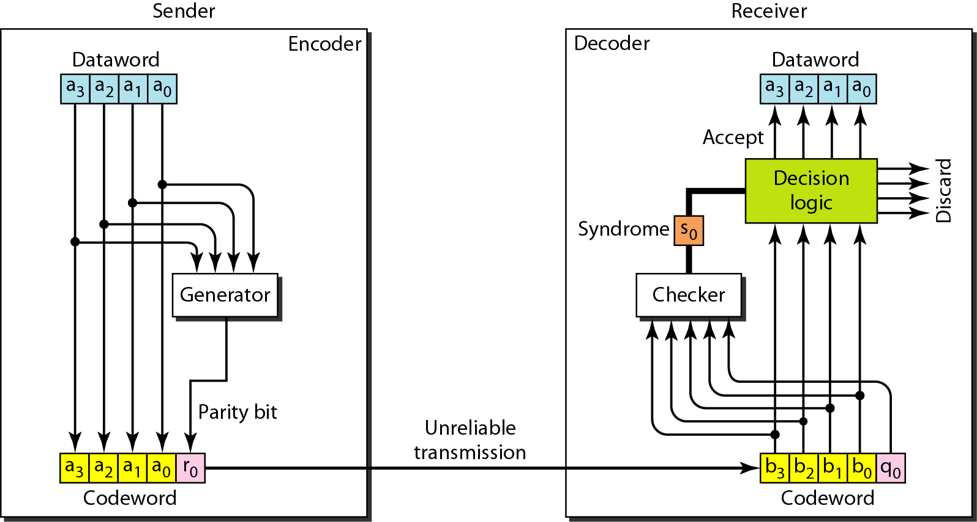
Figure 10.10 Encoder and decoder for simple parity-check code

Slide 34
Parity-check code
r0 = a3 + a2 + a1 + a1 (modulo-2)
Syndrome (calculated by the receiver)
s0 = b3 + b2 + b1 + b0 + q0 (modulo-2)

Slide 35
Note
A simple parity-check code can detect an odd number of errors.

Slide 36
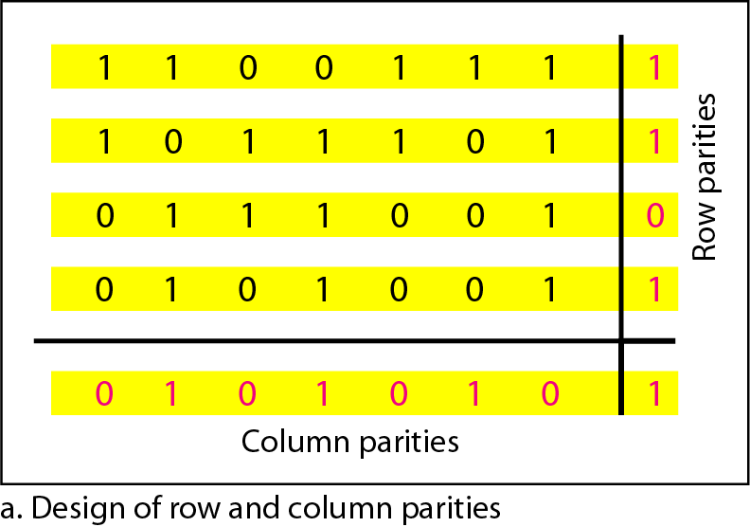
Figure 10.11 Two-dimensional parity-check code

Slide 37
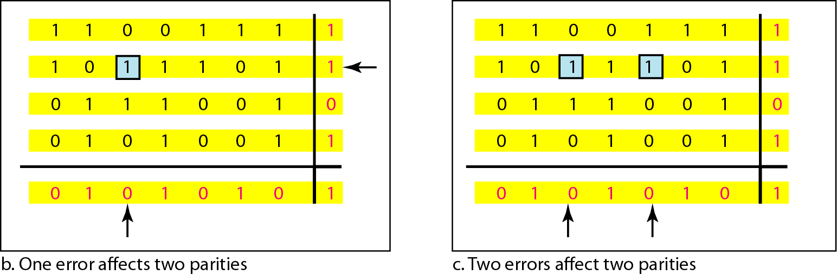
Figure 10.11 Two-dimensional parity-check code

Slide 38
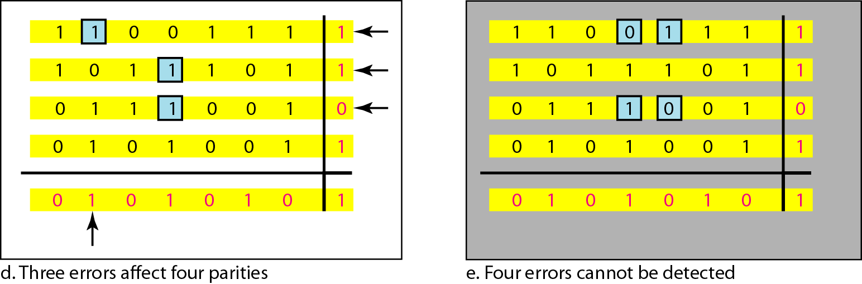
Figure 10.11 Two-dimensional parity-check code
Two-dimensional parity-check can
detect up to 3-bit errors

Slide 39
Table 10.4 Hamming code C(7, 4) C(n,k) d_{min}=3

Slide 40
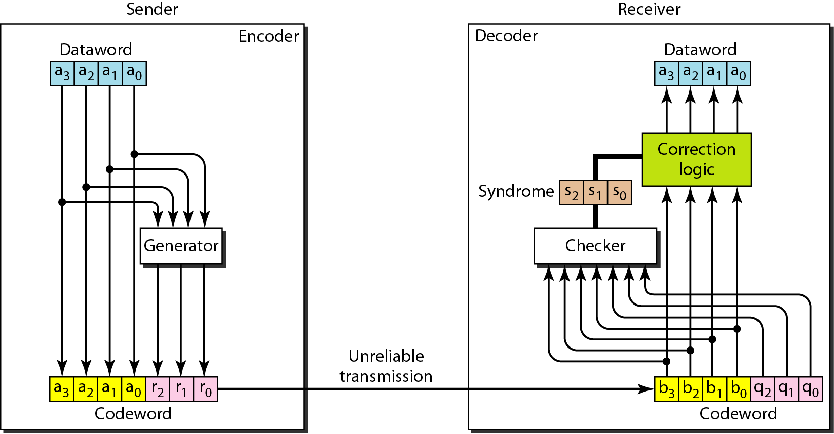
Figure 10.12 The structure of the encoder and decoder for a Hamming code

Slide 41
Hamming Code
Parity checks are created as follow (using modulo-2)
  r0 = a2 + a1 + a0
  r1 = a3 + a2 + a1
  r2 = a1 + a0 + a3

Slide 42
Hamming Code
The checker in the decoder creates a 3-bit syndrome (s2s1s0).
In which each bit is the parity check for 4 out of the 7 bits in the received codeword:
s0 = b2 + b1 + b0 + q0
s1 = b3 + b2 + b1 + q1
s2 = b1 + b0 + b3 + q2
The equations used by the checker are the same as those used by the generator with the parity-check bits added to the right-hand side of the equation.

Slide 43
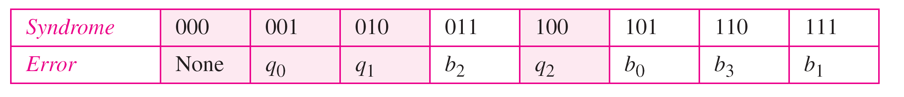
Table 10.5 Logical decision made by the correction logic analyzer
Hamming code C(7, 4) can :
detect up to 2-bit error (d_{min} -1)
can correct up to 1 bit error (d_{min}-1)/2

Slide 44
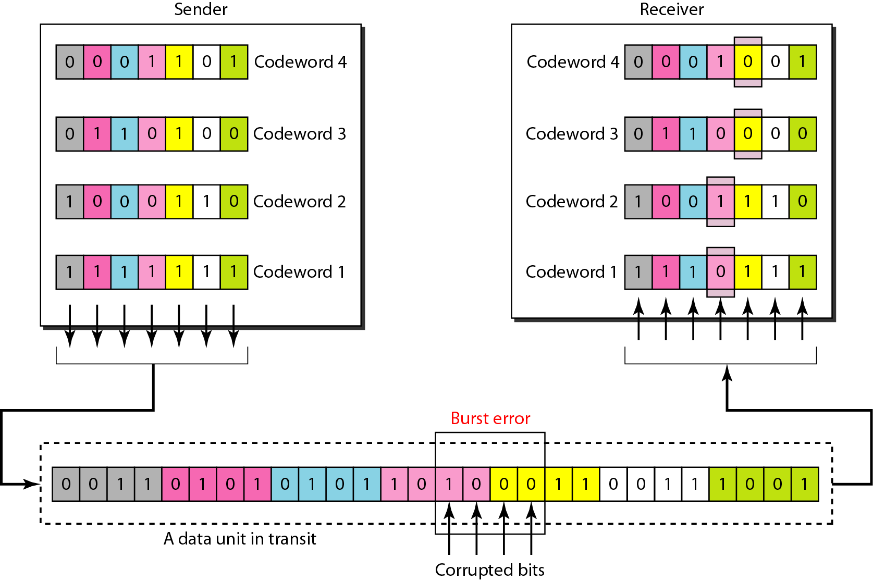
Figure 10.13 Burst error correction using Hamming code
Split burst error between multiple codewords

Slide 45
10-4 CYCLIC CODES
Cyclic codes are special linear block codes with one extra property. In a cyclic code, if a codeword is cyclically shifted (rotated), the result is another codeword.
Topics discussed in this section:
Cyclic Redundancy Check
Hardware Implementation
Polynomials
Cyclic Code Analysis
Advantages of Cyclic Codes
Other Cyclic Codes

Slide 46
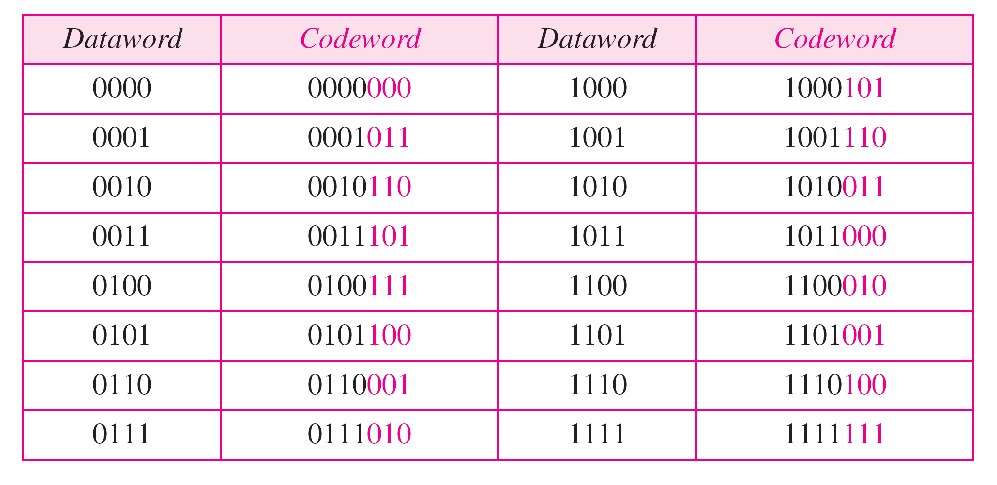
Table 10.6 A CRC code with C(7, 4)

Slide 47
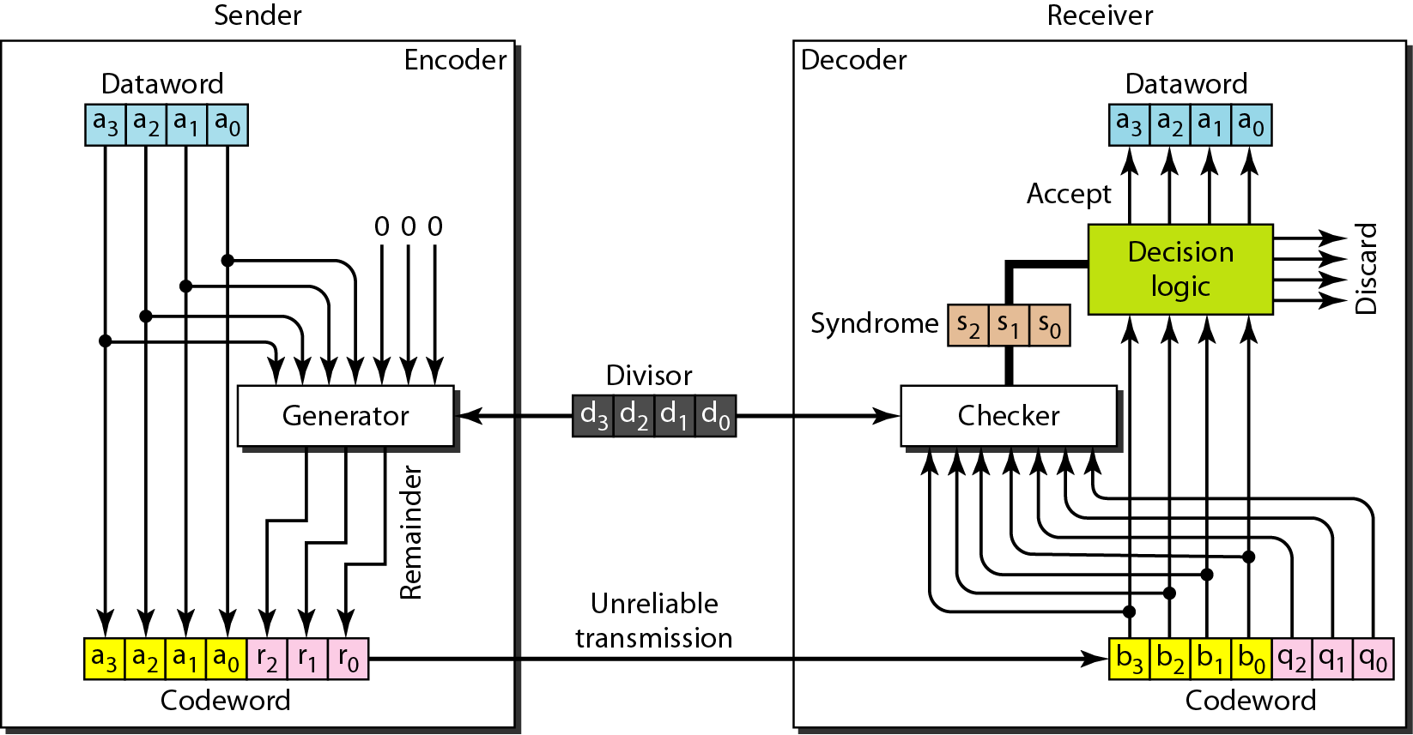
Figure 10.14 CRC encoder and decoder

Slide 48
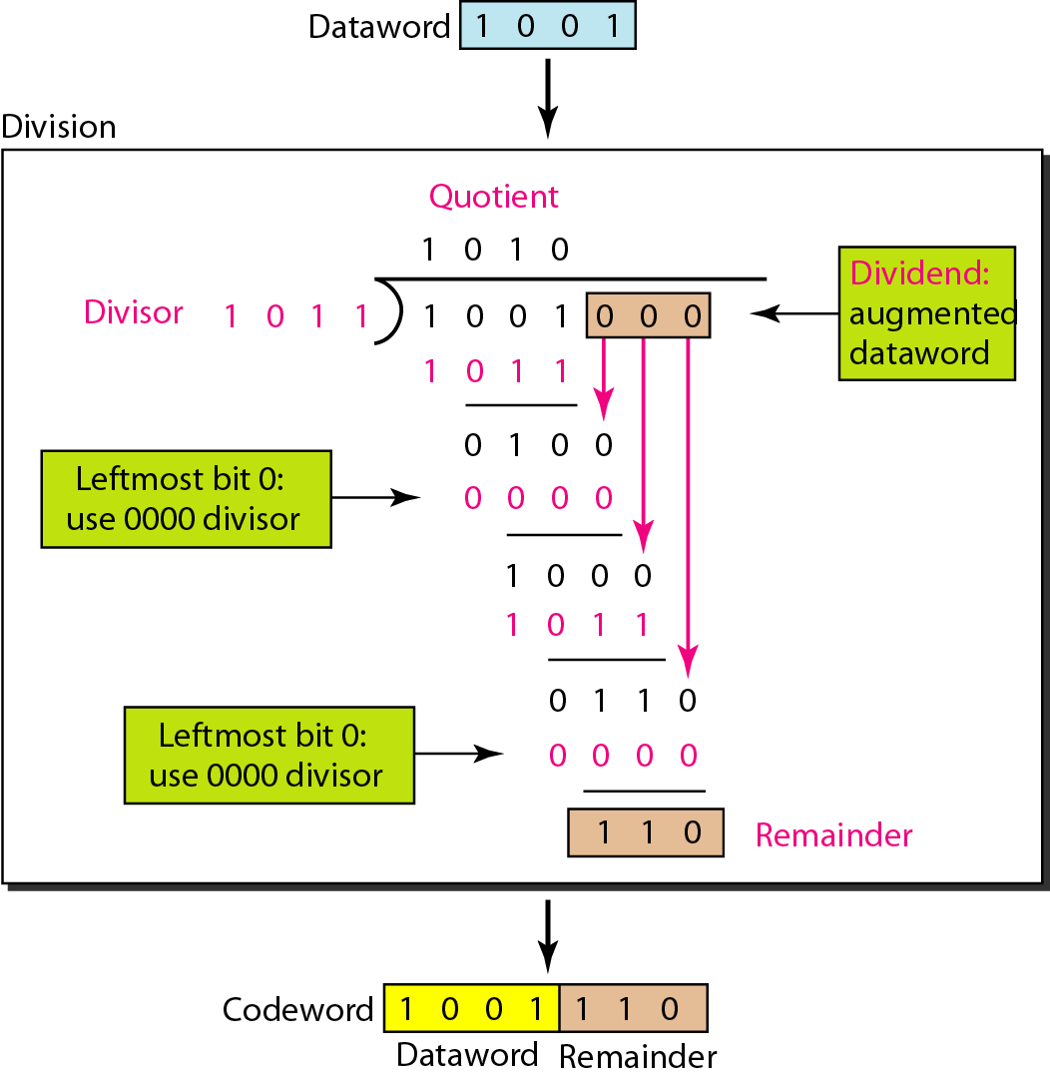
Figure 10.15 Division in CRC encoder

Slide 49
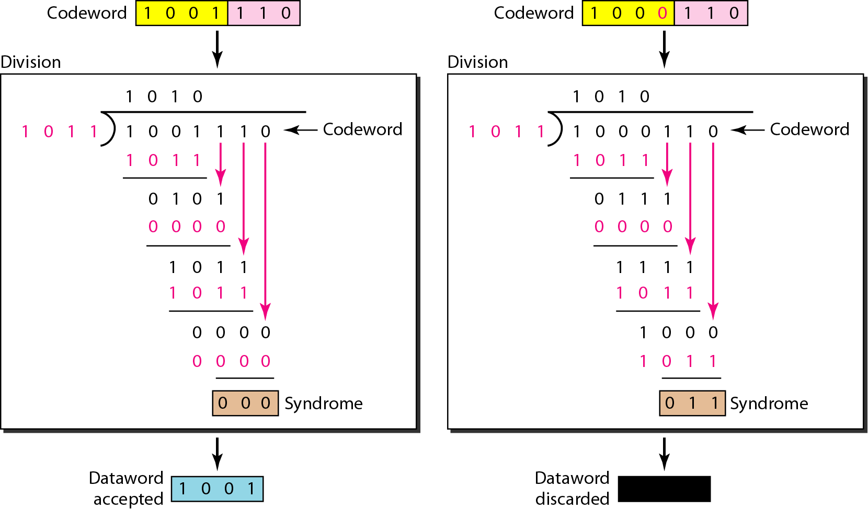
Figure 10.16 Division in the CRC decoder for two cases

Slide 50
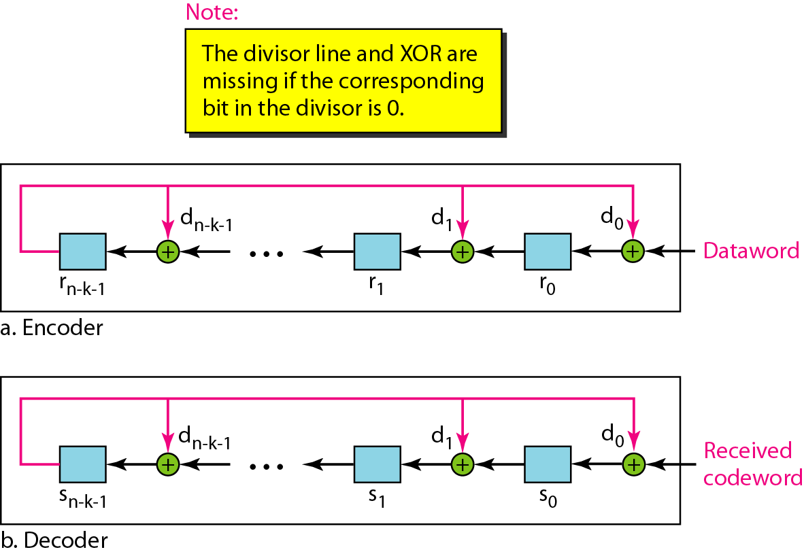
Figure 10.20 General design of encoder and decoder of a CRC code

Slide 51
Note
The divisor in a cyclic code is normally called the generator polynomial
or simply the generator.

Slide 52
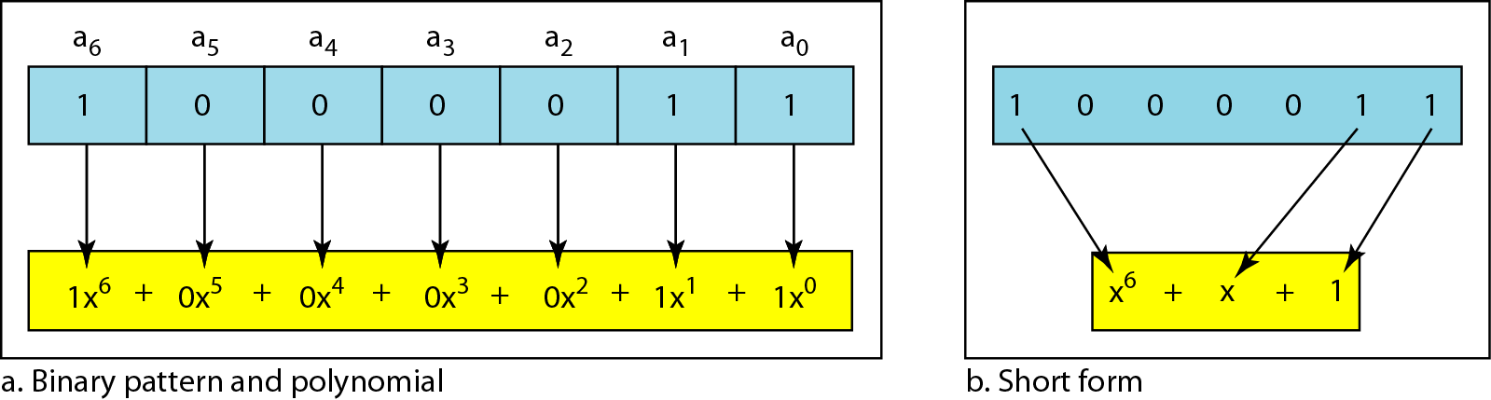
Figure 10.21 A polynomial to represent a binary word

Slide 53
Table 10.7 Standard polynomials

Slide 54
10-5 CHECKSUM
The last error detection method we discuss here is called the checksum. The checksum is used in the Internet by several protocols although not at the data link layer. However, we briefly discuss it here to complete our discussion on error checking
Topics discussed in this section:
Idea
One’s Complement
Internet Checksum

Slide 55
Example 10.18
Suppose our data is a list of five 4-bit numbers that we want to send to a destination. In addition to sending these numbers, we send the sum of the numbers. For example, if the set of numbers is (7, 11, 12, 0, 6), we send (7, 11, 12, 0, 6, 36), where 36 is the sum of the original numbers. The receiver adds the five numbers and compares the result with the sum. If the two are the same, the receiver assumes no error, accepts the five numbers, and discards the sum. Otherwise, there is an error somewhere and the data are not accepted.

Slide 56
Example 10.19
We can make the job of the receiver easier if we send the negative (complement) of the sum, called the checksum. In this case, we send (7, 11, 12, 0, 6, −36). The receiver can add all the numbers received (including the checksum). If the result is 0, it assumes no error; otherwise, there is an error.

Slide 57
Example 10.20
How can we represent the number 21 in one’s complement arithmetic using only four bits?
Solution
The number 21 in binary is 10101 (it needs five bits). We can wrap the leftmost bit and add it to the four rightmost bits. We have (0101 + 1) = 0110 or 6.

Slide 58
Example 10.21
How can we represent the number −6 in one’s complement arithmetic using only four bits?
Solution
In one’s complement arithmetic, the negative or complement of a number is found by inverting all bits. Positive 6 is 0110; negative 6 is 1001. If we consider only unsigned numbers, this is 9. In other words, the complement of 6 is 9.

Slide 59
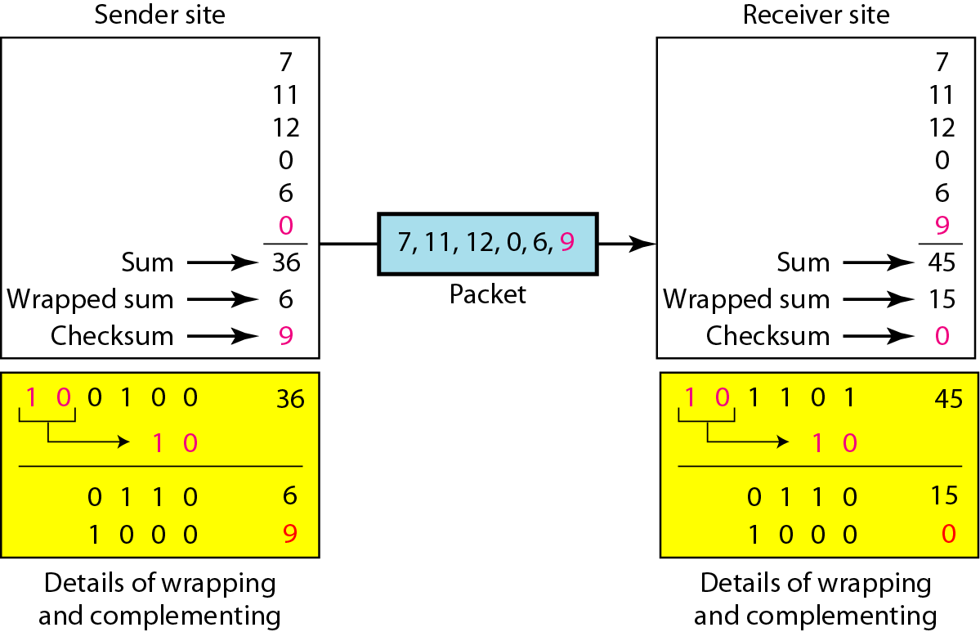
Figure 10.24 Example 10.22
1
1
1
0

Slide 60
Note
Sender site:
1. The message is divided into 16-bit words.
2. The value of the checksum word is set to 0.
3. All words including the checksum are
added using one’s complement addition.
4. The sum is complemented and becomes the
checksum.
5. The checksum is sent with the data.

Slide 61
Note
Receiver site:
1. The message (including checksum) is
divided into 16-bit words.
2. All words are added using one’s
complement addition.
3. The sum is complemented and becomes the
new checksum.
4. If the value of checksum is 0, the message
is accepted; otherwise, it is rejected.

Slide 62
Internet Checksum Example
Note
  When adding numbers, a carryout from the most significant bit needs to be added to the result
Example: add two 16-bit integers
1 1 1 1 0 0 1 1 0 0 1 1 0 0 1 1 0
1 1 1 0 1 0 1 0 1 0 1 0 1 0 1 0 1
1 1 0 1 1 1 0 1 1 1 0 1 1 1 0 1 1
1 1 0 1 1 1 0 1 1 1 0 1 1 1 1 0 0
1 0 1 0 0 0 1 0 0 0 1 0 0 0 0 1 1
wraparound
sum
checksum
Notes:
Kurose and Ross forgot to say anything about wrapping the carry and adding it to low order bit

