Slide 1

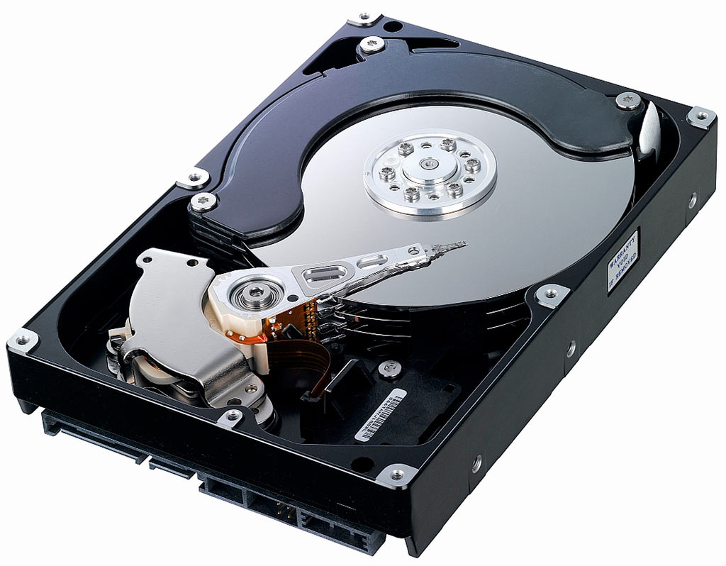
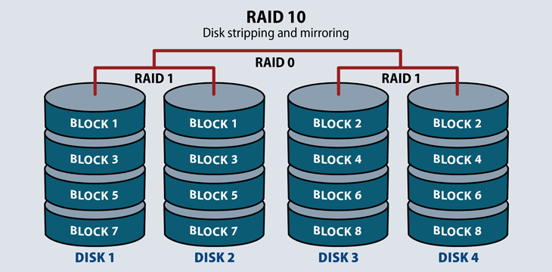
Lecture 29: Disks, File Systems and I/O
Books:
The OS Classics
Raidbook: A Storage System Technology
Storage Systems
Lectures:
YouTube: Unix File System
YouTube: RAID Basics
YouTube: du and df
Topics:
What disk subsystem should I buy?
The Unix File System
The Inode Index
Redundant Array of Inexpensive Disks
What is RAID?
How much disk space is usable?

