Slide 1
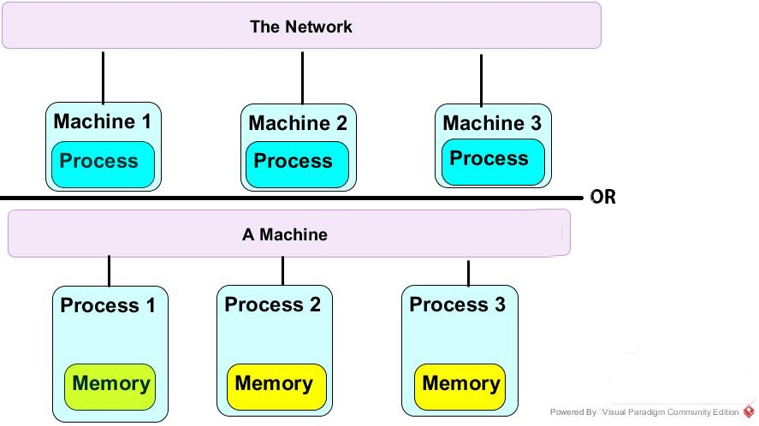
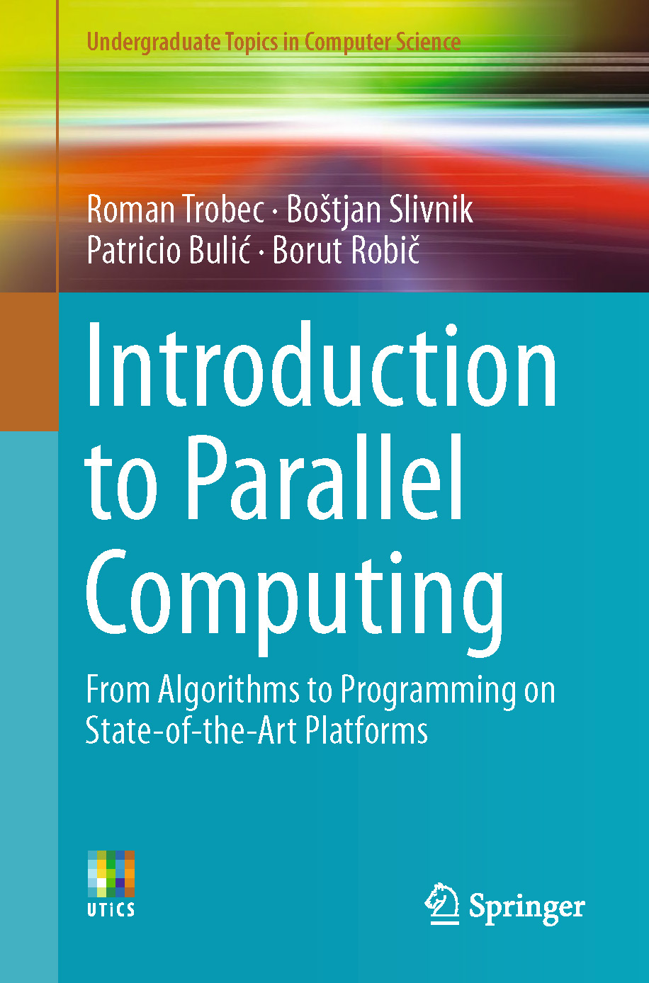
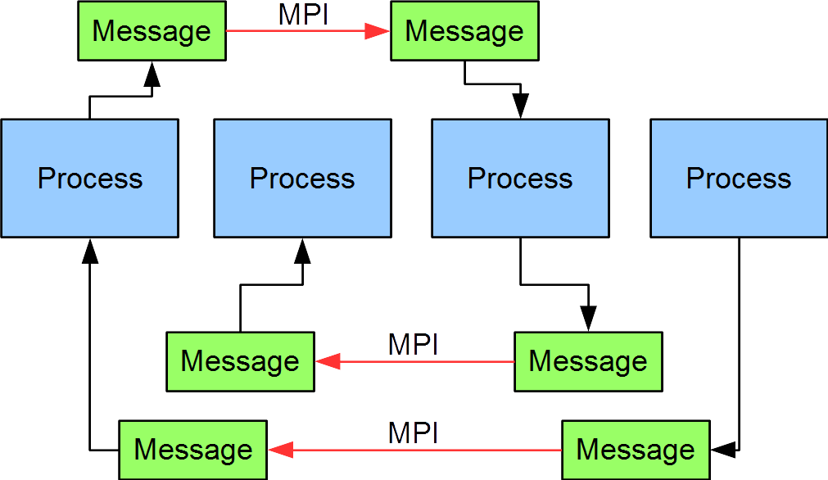
Lecture 26: Parallel Programming – Message Passing
Books:
Introduction to Parallel Computing
Lectures:
MPI Quick Look
Message Passing Interface - Part I
Introduction to MPI - Part 2
Topics:
Message Passing Interface
The MPI Standard (v1.0 and v2.0)
MPI v4.X and v5.0
Open MPI
MPI Intro

