Slide 1
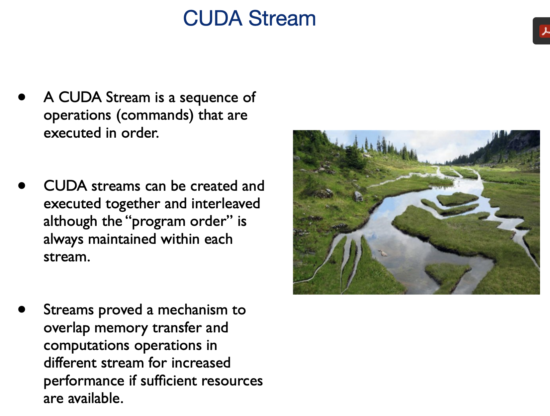
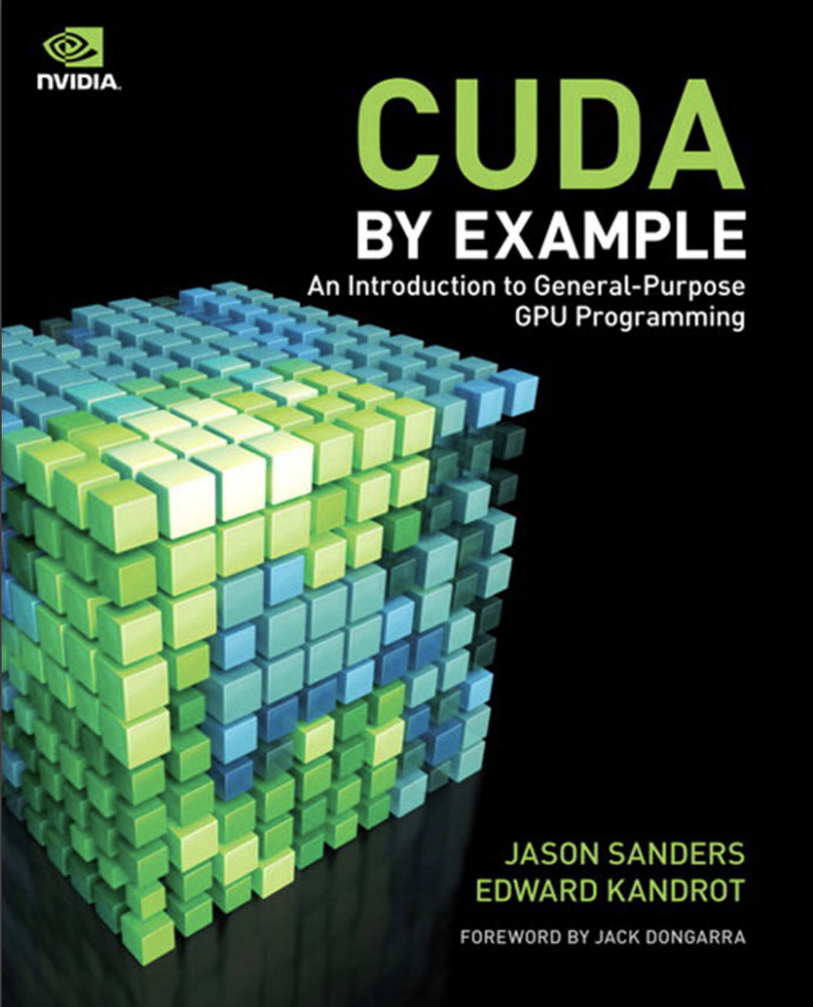
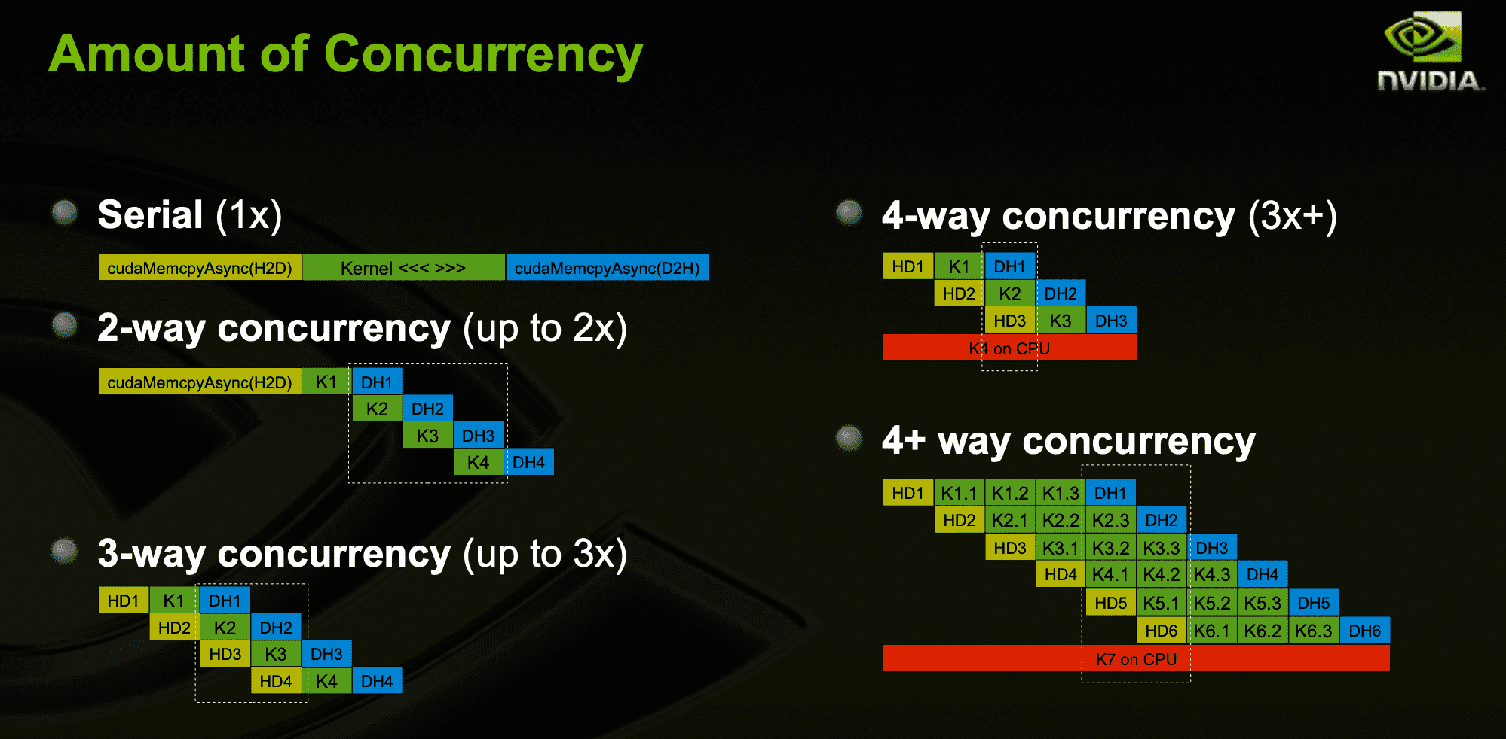
Lecture 25: Advanced GPU Programming – CUDA BLAS
Books:
Encyclopedia of Parallel Computing
An Updated BLAS
Lectures:
Linear Algebra with BLAS and LAPACK
Linear Algebra on a GPU
Topics:
Basic Linear Algebra Subprograms
cuBLAS
NVBLAS
Introduction to cuBLAS

