Slide 1
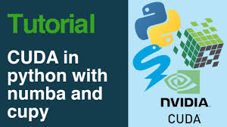
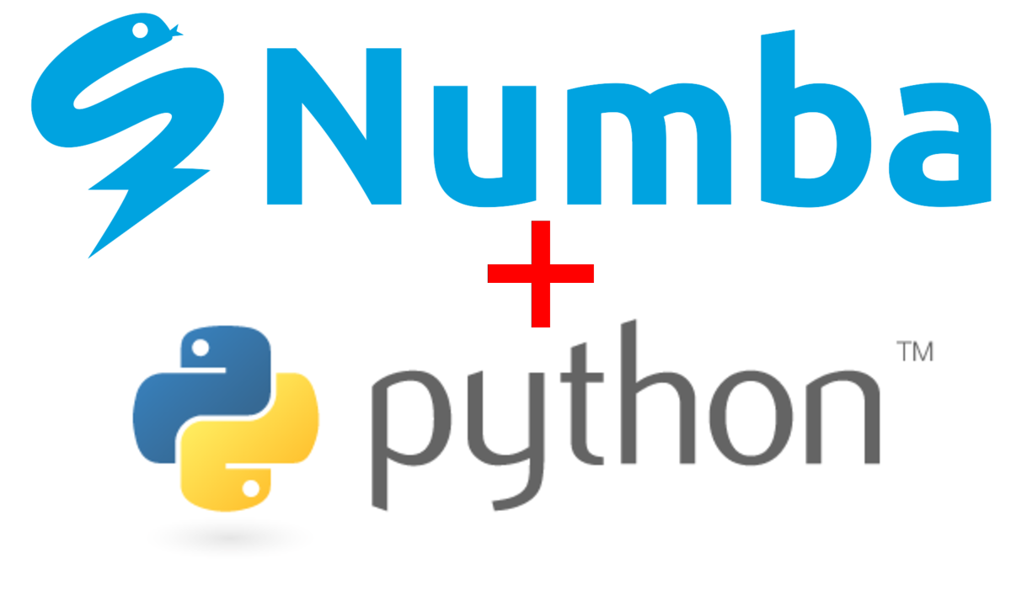
Lecture 22: Python Programming – Creating Efficient Functions in Numba
Books:
High Performance Python
Advanced Python Programming
Lectures:
Numba for CUDA GPUs
Introduction to Numba
Topics:
Compiling Python Code
Creating Universal Functions
Compiling Python Classes
Creating C Callback Functions

