Slide 1
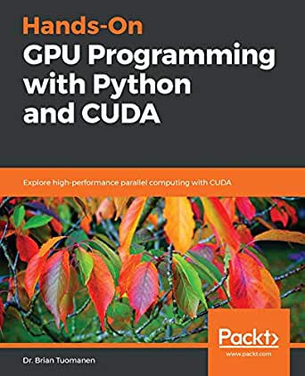
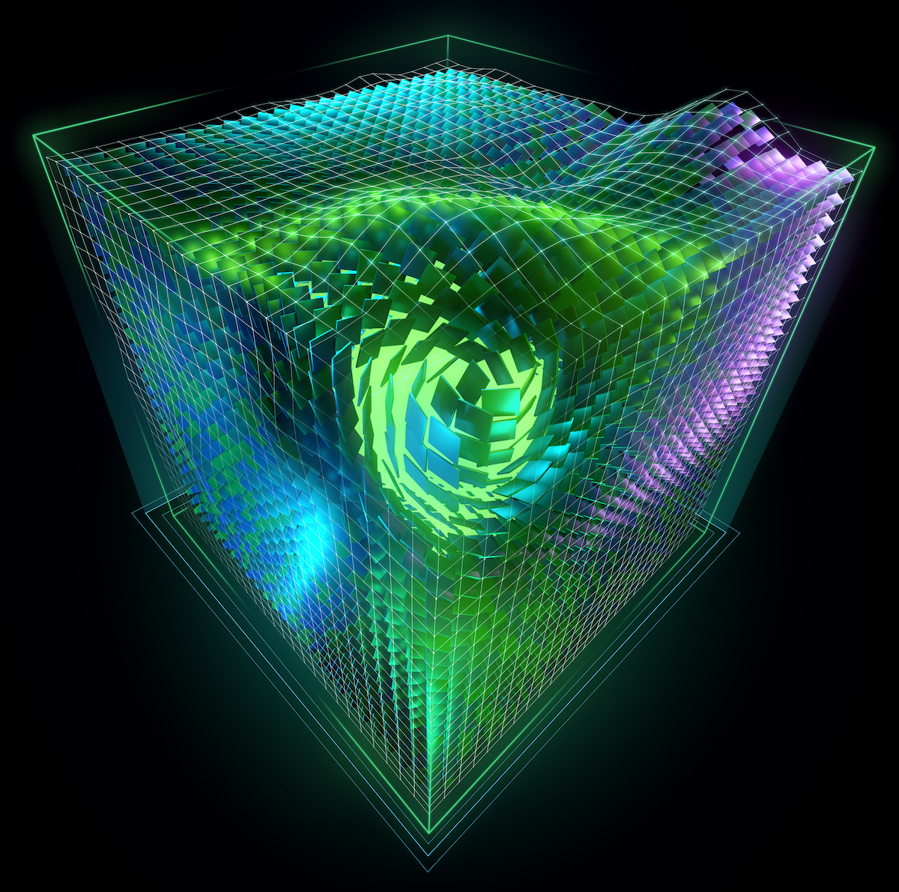
Lecture 21: Python Programming – Interfaces to CUDA
Books:
Hands-On GPU Programming with Python and CUDA
Getting Started with GPU Computing in Anaconda
Lectures:
Numba Makes Python Code Run Fast
Speed Up Your Algorithms
CUDA Python
PyCUDA: Even Simpler GPU Programming
Introduction to CUDA Programming
Topics:
A ~5 minute Guide to Numba
Numba: High-Performance Python with CUDA
Your First CUDA Python Program
Programming GPUs with Python
CUDA Programming

