Slide 1
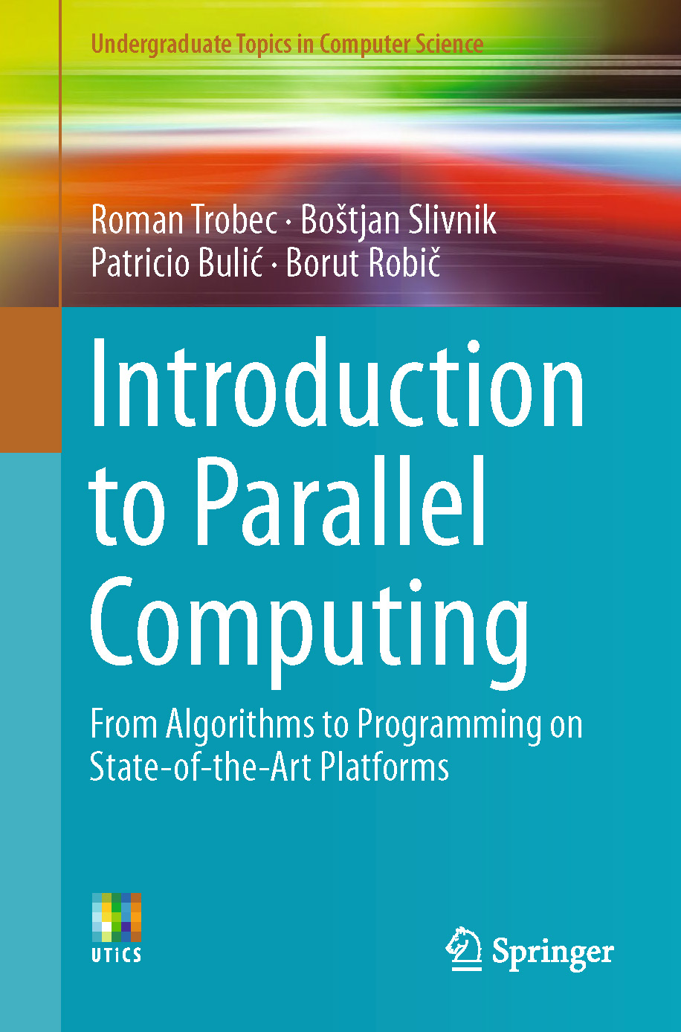
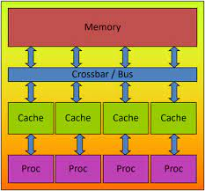
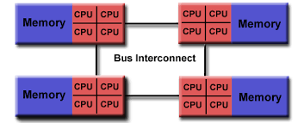
Lecture 20: Parallel Computing –
Shared Memory and Multithreading in OPenMP
Books:
Introduction to Parallel Computing
Lectures:
OpenMP Shared Memory
Multithreading OpenMP
Hands On Introduction
Topics:
OpenMP API Specification
OpenMP Web Site
Easy Multithreading in OpenMP
OpenMP by Example

