Slide 1
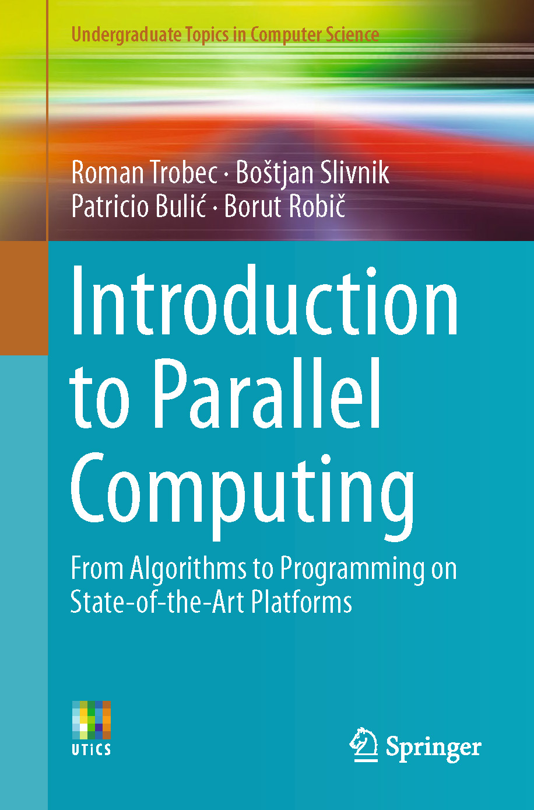
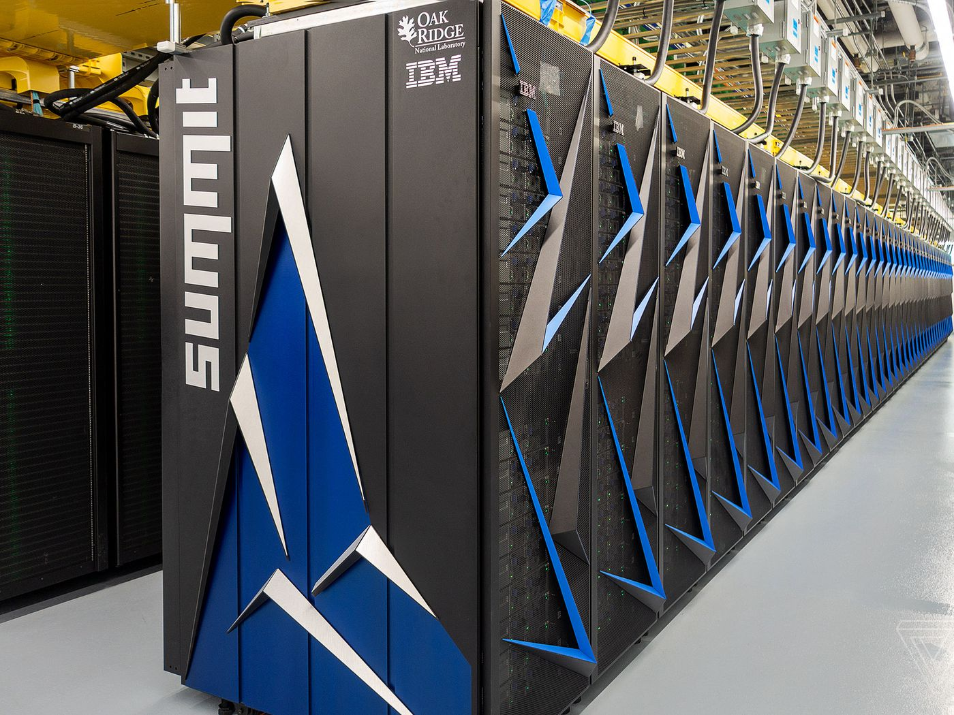
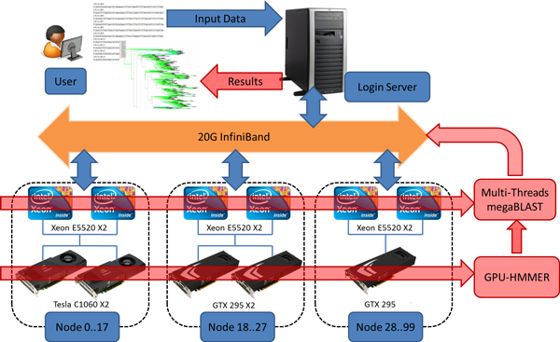
Lecture 18: Parallel Computing – Foundations
Books:
Introduction to Parallel Computing
Lectures:
Coursera
Slideplayer
Topics:
Parallel Computing Overview
Types of Parallel Computing
Classification of Parallel Computers

