Slide 1
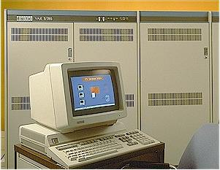
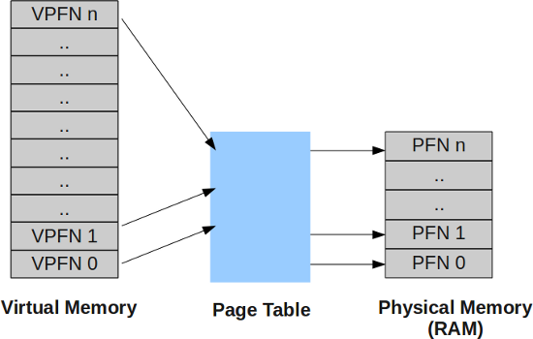
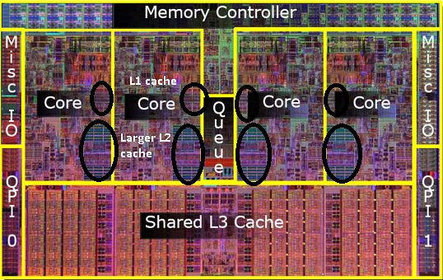
Lecture 16: Basic CPU Programming –
Cache, Multithreading and Hyperthreading
Books:
CUDA By Example
Lectures:
Multithreading
Hyperthreading
Topics:
CPU Cache
Multithreading
Hyperthreading
Hyperthreading Technology
Digital Equipment Corporation and the VAX

