Slide 1
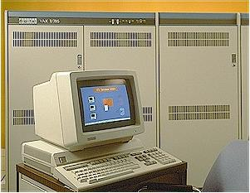
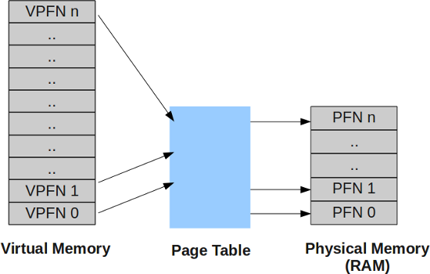
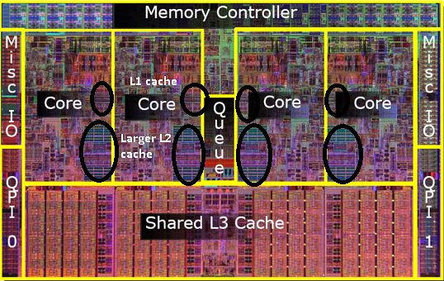
Lecture 15: Basic CPU Programming – Virtual Memory
Books:
CUDA By Example
Lectures:
Python Parallel Programming Solutions
Topics:
Virtual Memory
Memory Paging
Memory-Mapped File Systems
Digital Equipment Corporation and the VAX

