Slide 1
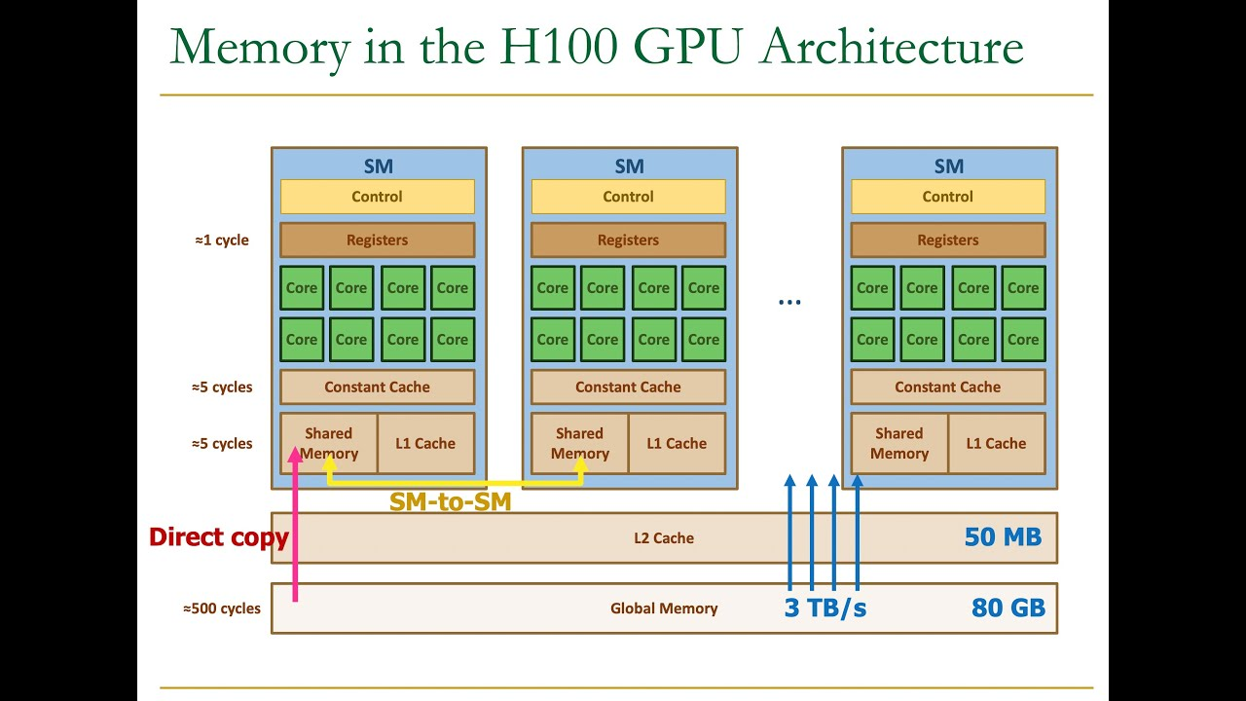
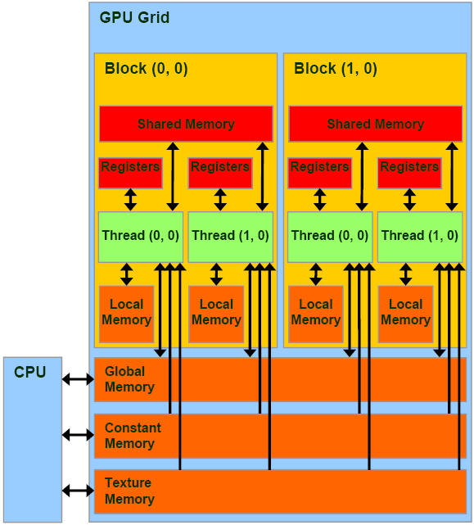
Lecture 14: Basic GPU Programming –
GPU Memory
Books:
CUDA Programming
CUDA C++ Programming Guide
Lectures:
Texture Memory
Topics:
GPU Memory
Constant Memory
Texture Objects
CUDA C++ Programming Guide
Intro to GPUs
Virtual Memory
Memory Paging
CPU Cache

