Slide 1
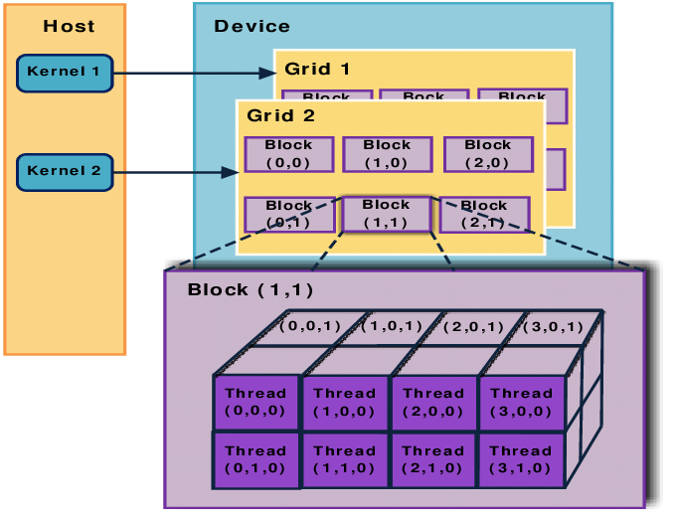
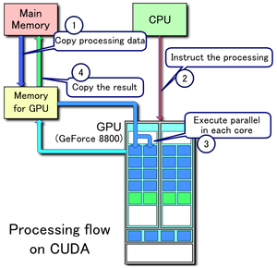
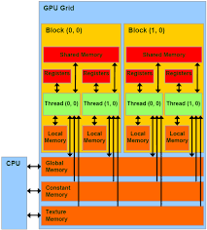
Lecture 13: Basic GPU Programming – Cooperating Threads
Books:
CUDA By Example
Professional CUDA C Programming
Nvidia Archive
Lectures:
Python Parallel Programming Solutions
CUDA In Your Python
CUDA C/C++ Basics
Topics:
CUDA C Basics
GPU Libraries and Programming Environments
Examples

