Slide 1
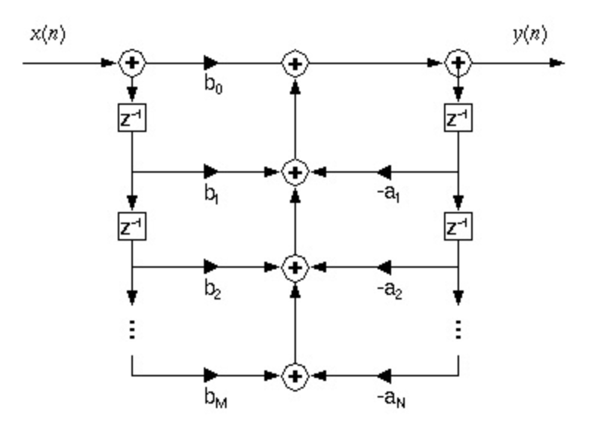
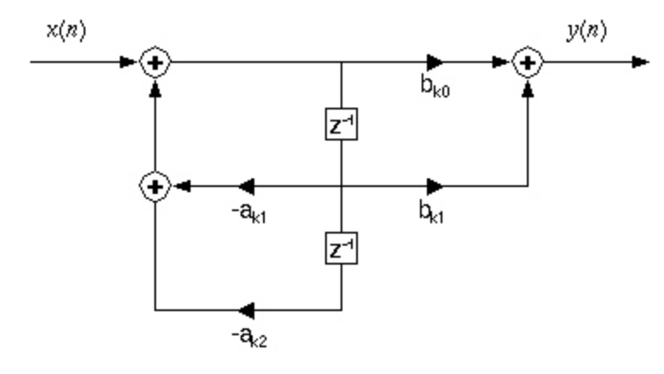
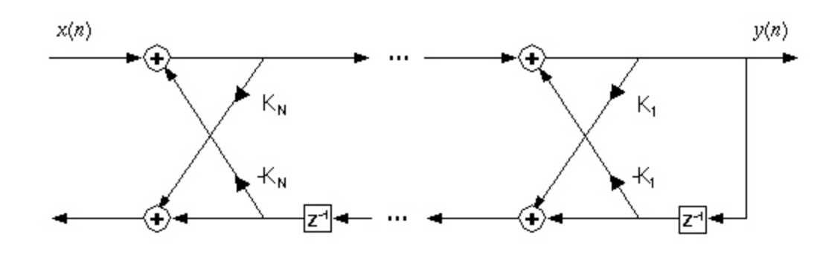
Lecture 10: DSP Review – Linear System Theory
Topics:
Discrete Time Systems
Transfer Functions
Difference Equations
Linear Systems Theory

