Slide 1
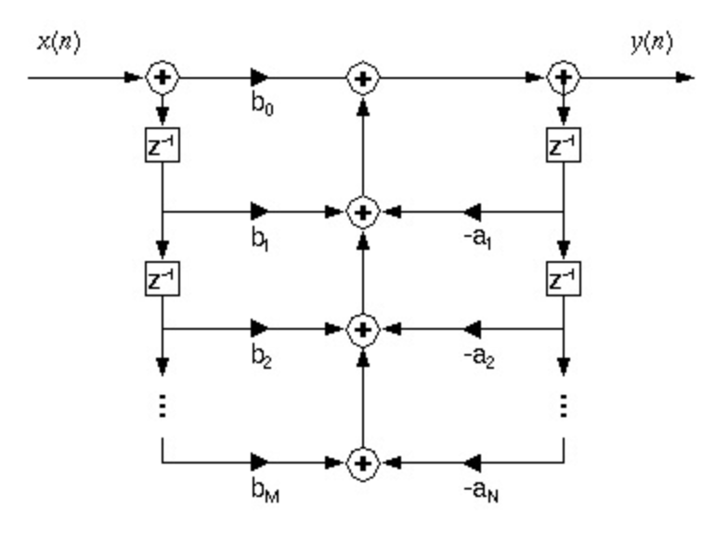
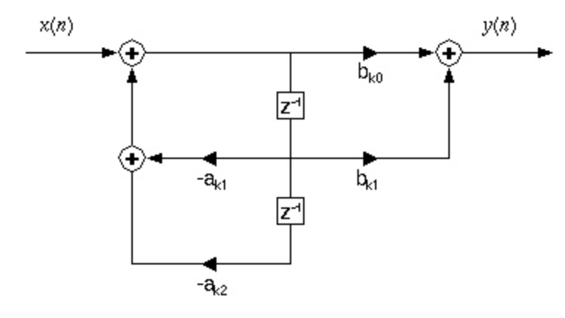
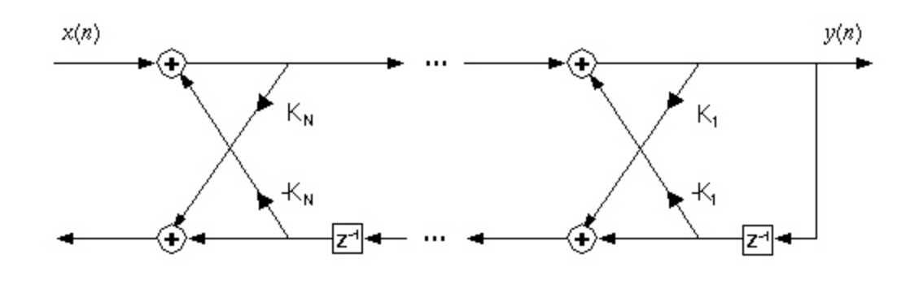
Lecture 09: DSP Review – Real-Time Systems
Topics:
A/D Converters
Memory Management
Circular Buffers
Framing and Windowing
Latency
Performance Considerations

