Slide 1
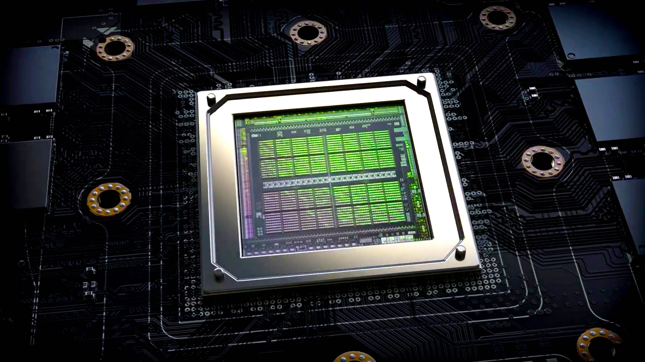
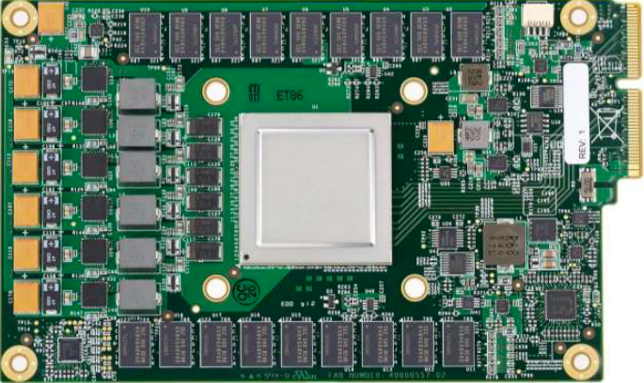
Lecture 07: Basic GPU Programming – GPU Architectures
Topics:
Nvidia Ampere: Architecture Overview
Nvidia Hopper: Architecture Overview
Nvidia Blackwell: Architecture Overview
Nvidia Ampere: White Paper
Google Coral TPU Overview
Graphic Processing Units
SIMD Processors and GPUs
Fused Multiply Add Operations

Slide 2
GPU Architecture and Its Application
陈越琦(121160005)
Yueqichen.0x0@gmail.com

Slide 3
Overview
What is a GPU
Difference between GPU and CPU
Graphics pipeline
History of the GPU
GPU architecture
Deep learning with GPUs (optional)

Slide 4
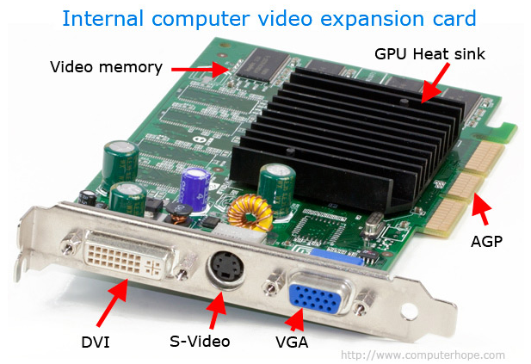
What is a GPU
Graphics Processing Unit is a specialized electronic circuit designed to rapidly manipulate and alter memory to accelerate the creation of images in a frame buffer intended for output to display.[1]
Typically placed on a video card, which contains its own memory and display interfaces(HDMI, DVI, VGA, etc)
Primitive GPUs were developed in the 1980s, although the first “complete” GPUs began in the mid 1990s

Slide 5
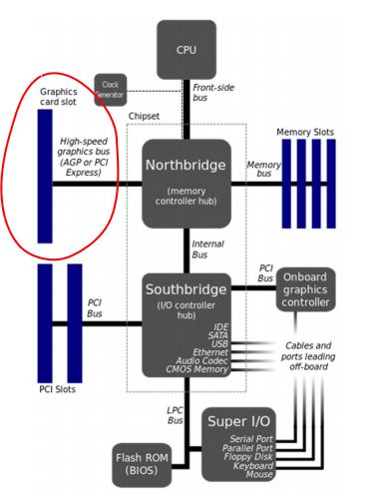
Video card connected to motherboard through PCI-Express or AGP(Accelerated Graphics Port)
Northbridge chip enables data transfer between the CPU and GPU
Graphics memory on the video card contains the pixel RGB data for each frame[4]

Slide 6
Difference between GPU and CPU
Throughput more important than latency
  High throughput needed for the huge amount of computations required for graphics
  Nor concerned about latency because human visual system operates on a much longer time scale
Extremely parallel
  Different pixels and elements of the image can be operated on independently
  Hundreds of cores executing at the same time to take advantage of this fundamental parallelism

Slide 7
Inputs and Outputs
Inputs to GPU(from the CPU/memory):
  vertices(3D coordinates) of objects
  Texture data
  Lighting data
Outputs from GPU
  Frame buffer
    placed in a specific section of graphics memory
    contains RGB values for each pixel on the screen
    data is sent directed to display

Slide 8
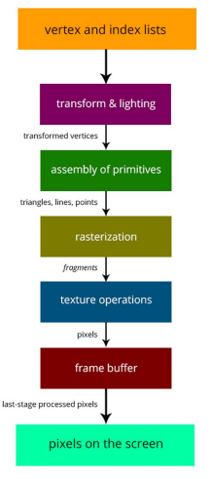
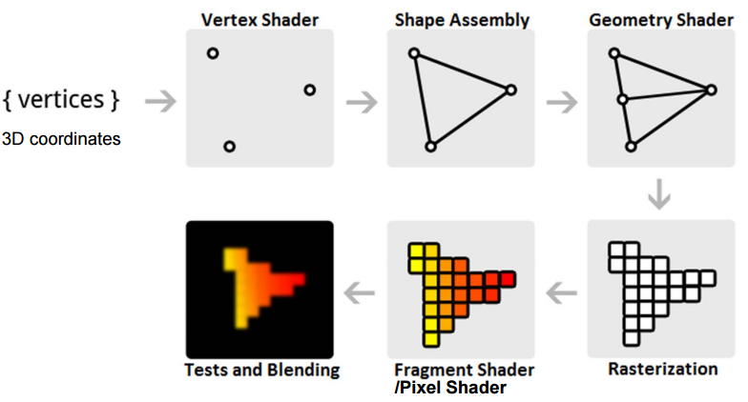
The Graphics Pipeline

Slide 9
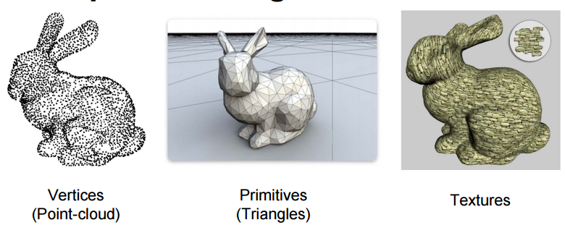
Renderings

Slide 10
Transformation
Camera transformation, Projection transformation
These transformations simply modify vertices, so they are done by vertex shaders
Transform computations are heavy on matrix multiplication
Each vertex can be transformed independently
  data parallelism

Slide 11
Fixed-Function to Programmable
Earlier GPUs were fix-function hardware pipelines
In new GPUs, portions of the pipeline are completedly programmable
  Vertex shaders = programs running on vertex processors
  fragment shaders = programs running on fragment processors
  However, some stages are still fixed function(e.g. rasterizaiton)

Slide 12
History of the GPU
1996: 3DFX Voodoo graphics card implements texture mapping, z-buffering, and rasterization, but no vertex processing
1999: GPUs implement the full graphics pipeline in fixed-function hardware(Nvidia GeForce 256, ATI Radeon 7500)
2000: Programmable shader pipelines(Nvidia GeForce 3)
2010: General Purpose GPUs for non-graphical compute-intensive applications, Nvidia CUDA parallel programming API
2014: Unprecedented computer power Nvidia Geforce GTX Titan Z – 8.2 TFLOPS AMD Radeon R9 295X2(dual GPU card) – 11.5 TFLOPS

Slide 13
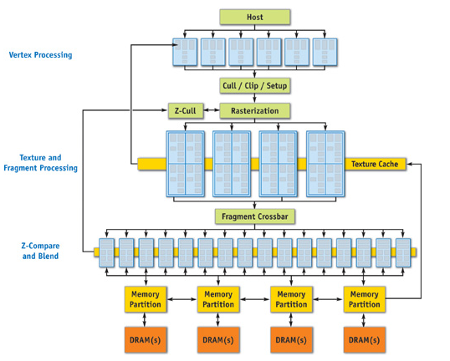
GPU Architecture
Nvidia GeForce 6 series(2004)[3]

Slide 14
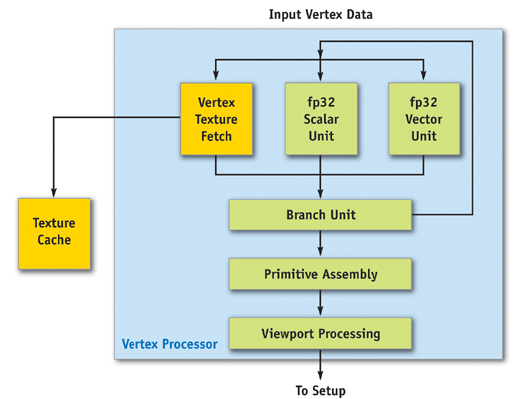
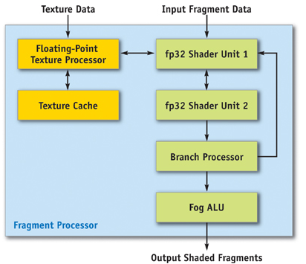
Shader processors
Vertex Shader core[3]
Fragment/Pixel Shader core[3]

Slide 15
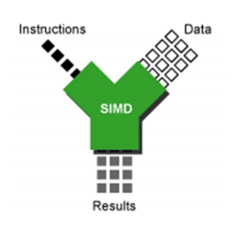
SIMD
Shader processors are generally SIMD
A single instruction executed on every vertex or pixel

Slide 16
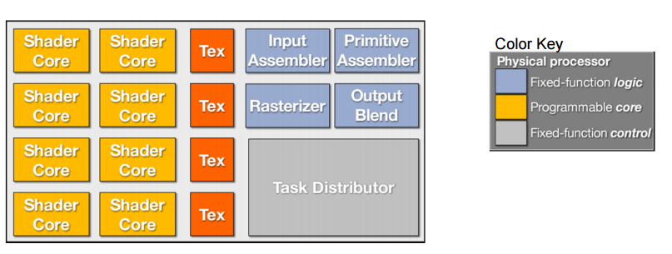
Optimizations
Combining different types of shader cores into a single unified shader core
Dynamic task scheduling to balance the load on all cores
Basic blocks in a modern GPU[4]

Slide 17
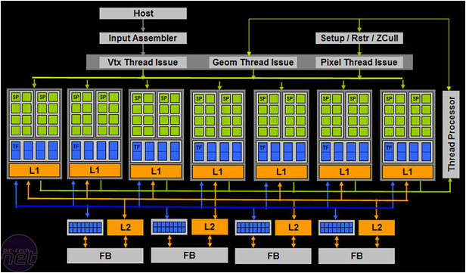
Unified Architecture example
Nvidia GeForce 8(2006)[5]

Slide 18
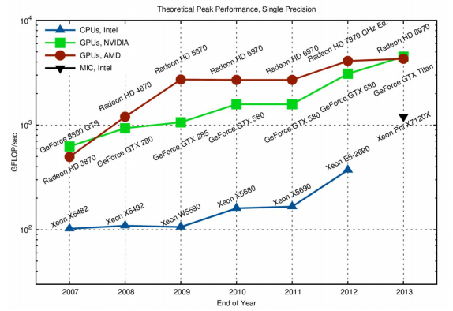
GPU Compute Performance

Slide 19
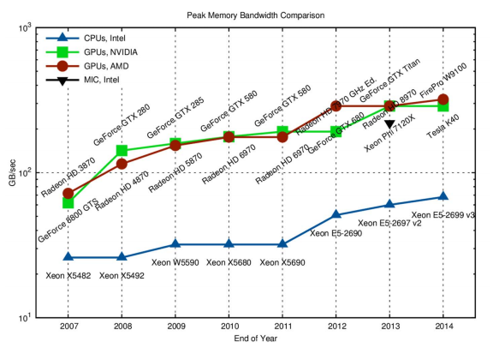
GPU Memory Bandwidth

Slide 20
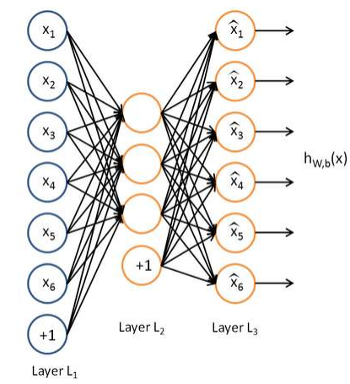
What is deep learning
Systems that learn to recognize objects that are important, without us telling the system explicitly what that object is ahead of time.[6]
  don’t have to figure out the features ahead of time
  use same neural net approach for many different problems
  fault tolerant
  scales well

Slide 21
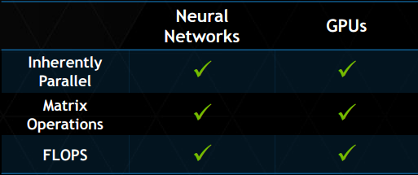
Why are GPUs good for deep learning
GPUs deliver –
- same or better prediction accuracy
- faster results
- smaller space
- lower power[6]

Slide 22
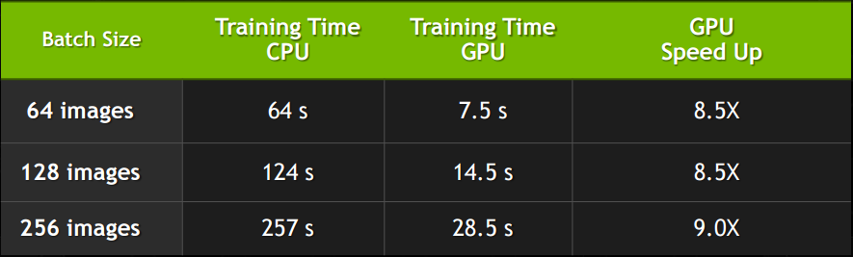
GPU Acceleration

Slide 23
References
[1] Wikipedia: Graphics Processing Unit. Retrieved February 2016
  https://en.wikipedia.org/wiki/Graphics_processing_unit
[2] Crow, Thomas. Evolution of the Graphical Processing Unit. 2004 paper
  http://citeseerx.ist.psu.edu/viewdoc/download?doi=10.1.1.142.368&rep=rep1&type=pdf
[3] Chapter 30. The GeForce 6 series GPU Architecture
  http://http.developer.nvidia.com/GPUGems2/gpugems2_chapter30.html

Slide 24
References
[4] GPU Architecture and Function
  http://meseec.ce.rit.edu/551-projects/spring2015/3-1.pdf
[5] G92: Nvidia GeForce 8800 GT
  http://www.bit-tech.net/hardware/graphics/2007/11/02/nvidia_geforce_8800_gt/2
[6] Deep learning with GPUs
  http://www.nvidia.com/content/events/geoInt2015/LBrown_DL.pdf
[7] GPU for Deep Learning Algorithm
  https://www.cs.rochester.edu/u/yli/files/report-gpu.pdf

