Slide 1
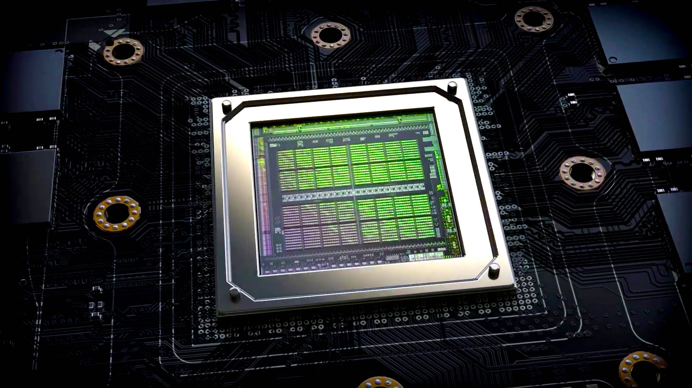
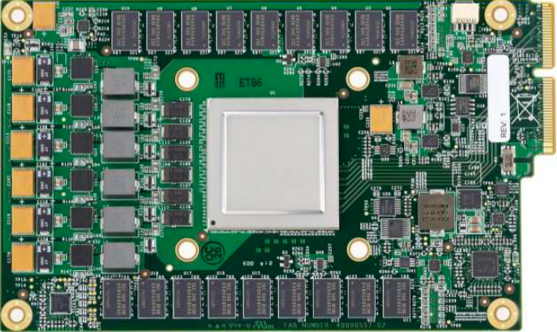
Lecture 05: Basic GPU Programming – The GPU Economy
Topics:
The GPU Marketplace, Nvidia Stock
What is a GPU? High-Level Overview
Nvidia, AMD, Intel, Google, Ampere, Radeon, Gen9
Nvidia Blackwell, Nvidia Ampere, Google Coral TPU
Comparisons: Ranking, Medium, vs FPGA,
IEEE, WCCFTech, Graphics Cards
Blogs: Dettmers, Giles, Arora

