Slide 1
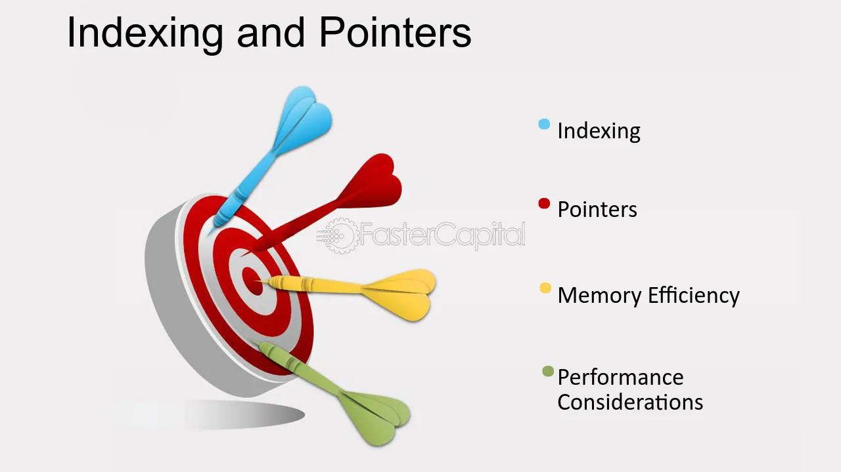
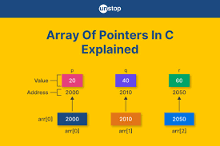
Lecture 05: C/C++ Programming –
Pointers, Array Indexing and Compiler Optimizations
Topics:
Pointers and Arrays
Compiler Optimization, C++ Optimization
Memory Management in Linux

